Slide 1
Learn Spark “join” strategies from source code Part5 (DRAFT)
BroadcastNestedLoop
Nikolay
Join us in telegram t.me/apache_spark
December 2020

Slide 2
Example
val df1 = spark.range(1,200000).select($"id".as("id1"))
val df2 = spark.range(0,100).select($"id".as("id2"))
df2.hint("broadcast").join( df1, $"id1".gt($"id2" )).collect()

Slide 3
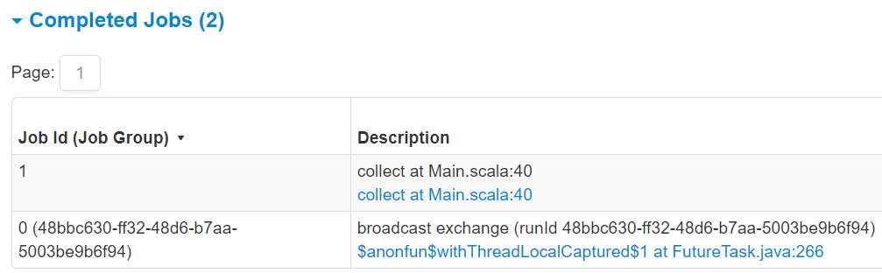

Slide 4
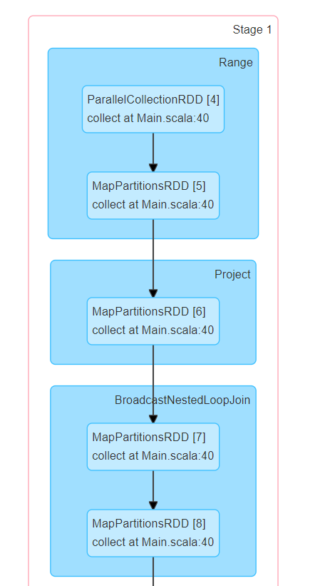

Slide 5
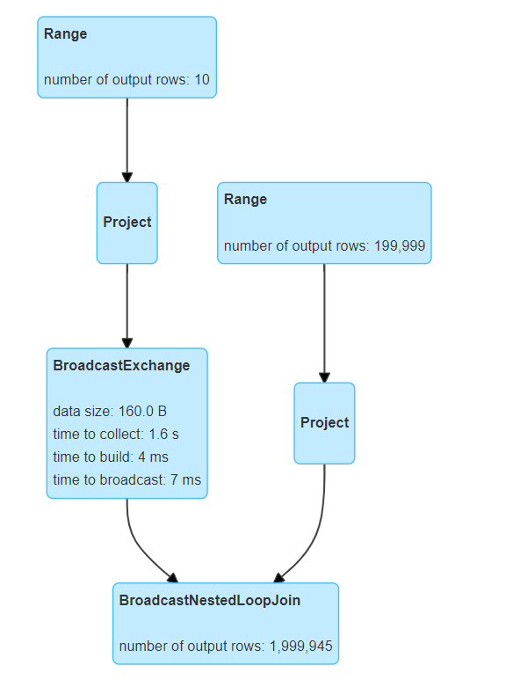

Slide 6
The idea of BNL
JOB 1
JOB 0
1
1
2
3
1
1
3
5
buildIterator
Iterator1
collect
1
1
2
3
Array
1
1
2
3
Build broadcast relation
broadcastedRelation
broadcast

Slide 7
== Analyzed Logical Plan ==
id2: bigint, id1: bigint
Join Inner, (id1#2L > id2#6L)
:- ResolvedHint (strategy=broadcast)
: +- Project [id#4L AS id2#6L]
: +- Range (0, 10, step=1, splits=Some(8))
+- Project [id#0L AS id1#2L]
+- Range (1, 200000, step=1, splits=Some(8))
== Optimized Logical Plan ==
Join Inner, (id1#2L > id2#6L), leftHint=(strategy=broadcast)
:- Project [id#4L AS id2#6L]
: +- Range (0, 10, step=1, splits=Some(8))
+- Project [id#0L AS id1#2L]
+- Range (1, 200000, step=1, splits=Some(8))
== Physical Plan ==
BroadcastNestedLoopJoin BuildLeft, Inner, (id1#2L > id2#6L)
:- BroadcastExchange IdentityBroadcastMode, [id=#19]
: +- Project [id#4L AS id2#6L]
: +- Range (0, 10, step=1, splits=8)
+- Project [id#0L AS id1#2L]
+- Range (1, 200000, step=1, splits=8)

Slide 8
case class Join(
left: LogicalPlan,
right: LogicalPlan,
joinType: JoinType,
condition: Option[Expression],
hint: JoinHint)
case class BroadcastNestedLoopJoinExec(
left: SparkPlan,
right: SparkPlan,
buildSide: BuildSide,
joinType: JoinType,
condition: Option[Expression])
Spark Planner

Slide 9
BroadcastNestedLoopJoinExec
protected override def doExecute(): RDD[InternalRow] = {
val broadcastedRelation = broadcast.executeBroadcast[Array[InternalRow]]()
val resultRdd = (joinType, buildSide) match {
case (_: InnerLike, _) =>
innerJoin(broadcastedRelation)
case (LeftOuter, BuildRight) | (RightOuter, BuildLeft) =>
outerJoin(broadcastedRelation)
case (LeftSemi, BuildRight) =>
leftExistenceJoin(broadcastedRelation, exists = true)
case (LeftAnti, BuildRight) =>
leftExistenceJoin(broadcastedRelation, exists = false)

Slide 10
private val (streamed, broadcast) = buildSide match {
case BuildRight => (left, right)
case BuildLeft => (right, left)
}
// This join could be very slow or OOM
val buildSide = getSmallerSide(left, right)
Seq(joins.BroadcastNestedLoopJoinExec(
planLater(left), planLater(right), buildSide, joinType, nonEquiCond))
case class BroadcastNestedLoopJoinExec(
left: SparkPlan,
right: SparkPlan,
buildSide: BuildSide,
joinType: JoinType,
condition: Option[Expression])

Slide 11
SparkPlan
Returns the result of this query as a broadcast variable by delegating to
`doExecuteBroadcast ` after preparations. Concrete implementations of SparkPlan should override `doExecuteBroadcast`. final def executeBroadcast[T](): broadcast.Broadcast[T] = executeQuery { if (isCanonicalizedPlan) { throw new IllegalStateException("A canonicalized plan is not supposed to be executed.") } doExecuteBroadcast() }

Slide 12
BroadcastExchangeExec
override protected[sql] def doExecuteBroadcast[T](): broadcast.Broadcast[T] = { try { relationFuture.get(timeout, TimeUnit.SECONDS).asInstanceOf[broadcast.Broadcast[T]] } catch { case ex: TimeoutException => logError(s"Could not execute broadcast in $timeout secs.", ex) if (!relationFuture.isDone) { sparkContext.cancelJobGroup(runId.toString) relationFuture.cancel(true) } throw new SparkException(s"Could not execute broadcast in $timeout secs. " + s"You can increase the timeout for broadcasts via ${SQLConf.BROADCAST_TIMEOUT.key} or " + s"disable broadcast join by setting ${SQLConf.AUTO_BROADCASTJOIN_THRESHOLD.key} to -1", ex) } }

Slide 13
override lazy val relationFuture: Future[broadcast.Broadcast[Any]] = { SQLExecution.withThreadLocalCaptured[broadcast.Broadcast[Any]]( sqlContext.sparkSession, BroadcastExchangeExec.executionContext) { try { // Setup a job group here so later it may get cancelled by groupId if necessary. sparkContext.setJobGroup(runId.toString, s"broadcast exchange (runId $runId)", interruptOnCancel = true) val beforeCollect = System.nanoTime() // Use executeCollect/executeCollectIterator to avoid conversion to Scala types val (numRows, input) = child.executeCollectIterator() if (numRows >= MAX_BROADCAST_TABLE_ROWS) { throw new SparkException( s"Cannot broadcast the table over $MAX_BROADCAST_TABLE_ROWS rows: $numRows rows") } val beforeBuild = System.nanoTime() longMetric("collectTime") += NANOSECONDS.toMillis(beforeBuild - beforeCollect)

Slide 14
// Construct the relation.
val relation = mode.transform(input, Some(numRows))
val dataSize = relation match {
case map: HashedRelation =>
map.estimatedSize
case arr: Array[InternalRow] =>
arr.map(_.asInstanceOf[UnsafeRow].getSizeInBytes.toLong).sum
case _ =>
throw new SparkException("[BUG] BroadcastMode.transform returned unexpected " +
s"type: ${relation.getClass.getName}")
}
longMetric("dataSize") += dataSize
if (dataSize >= MAX_BROADCAST_TABLE_BYTES) {
throw new SparkException(
s"Cannot broadcast the table that is larger than 8GB: ${dataSize >> 30} GB")
}

Slide 15
val beforeBroadcast = System.nanoTime()
longMetric("buildTime") += NANOSECONDS.toMillis(beforeBroadcast - beforeBuild)
// Broadcast the relation
val broadcasted = sparkContext.broadcast(relation)
longMetric("broadcastTime") += NANOSECONDS.toMillis(
System.nanoTime() - beforeBroadcast)
val executionId = sparkContext.getLocalProperty(SQLExecution.EXECUTION_ID_KEY)
SQLMetrics.postDriverMetricUpdates(sparkContext, executionId, metrics.values.toSeq)
promise.trySuccess(broadcasted)
broadcasted

Slide 16
BroadcastNestedLoopJoinExec
protected override def doExecute(): RDD[InternalRow] = {
val broadcastedRelation = broadcast.executeBroadcast[Array[InternalRow]]()
val resultRdd = (joinType, buildSide) match {
case (_: InnerLike, _) =>
innerJoin(broadcastedRelation)
case (LeftOuter, BuildRight) | (RightOuter, BuildLeft) =>
outerJoin(broadcastedRelation)
case (LeftSemi, BuildRight) =>
leftExistenceJoin(broadcastedRelation, exists = true)
case (LeftAnti, BuildRight) =>
leftExistenceJoin(broadcastedRelation, exists = false)

Slide 17
/**
* The implementation for InnerJoin.
*/
private def innerJoin(relation: Broadcast[Array[InternalRow]]): RDD[InternalRow] = {
streamed.execute().mapPartitionsInternal { streamedIter =>
val buildRows = relation.value
val joinedRow = new JoinedRow
streamedIter.flatMap { streamedRow =>
val joinedRows = buildRows.iterator.map(r => joinedRow(streamedRow, r))
if (condition.isDefined) {
joinedRows.filter(boundCondition)
} else {
joinedRows
}
}
}
}

Slide 18
private def leftExistenceJoin(
relation: Broadcast[Array[InternalRow]],
exists: Boolean): RDD[InternalRow] = {
assert(buildSide == BuildRight)
streamed.execute().mapPartitionsInternal { streamedIter =>
val buildRows = relation.value
val joinedRow = new JoinedRow
if (condition.isDefined) {
streamedIter.filter(l =>
buildRows.exists(r => boundCondition(joinedRow(l, r))) == exists
)
} else if (buildRows.nonEmpty == exists) {
streamedIter
} else {
Iterator.empty
}
}

Slide 19
Summary
Job0 and Job1
BroadcastNestedLoop
innerJoin ( flatMap , map, filter)
leftExistenceJoin( filter)

