Slide 1
Apache Spark Custom Stream Sources V2
Nikolay
Join us in telegram t.me/apache_spark
May 2021

Slide 2
Agenda
SimpleTableProvider, DataSourceRegister
Table, SupportsRead
ScanBuilder
MicroBatchStream
PartitionReader

Slide 3
Lets implement simple stream source
which emits random integers
spark
.readStream
.format("streams2.ConstStreamSource")
.load
.writeStream
.outputMode("append")
.format("console")
.trigger(ProcessingTimeTrigger(10000))
.start("c:\\tmp\\output")
.awaitTermination()

Slide 4
-------------------------------------------
Batch: 1
-------------------------------------------
+-----+---+
|value| ts|
+-----+---+
| 1| 1|
| 2| 2|
+-----+---+
Batch: 4
-------------------------------------------
+-----+---+
|value| ts|
+-----+---+
| 1| 1|
| 2| 2|
+-----+---+

Slide 5
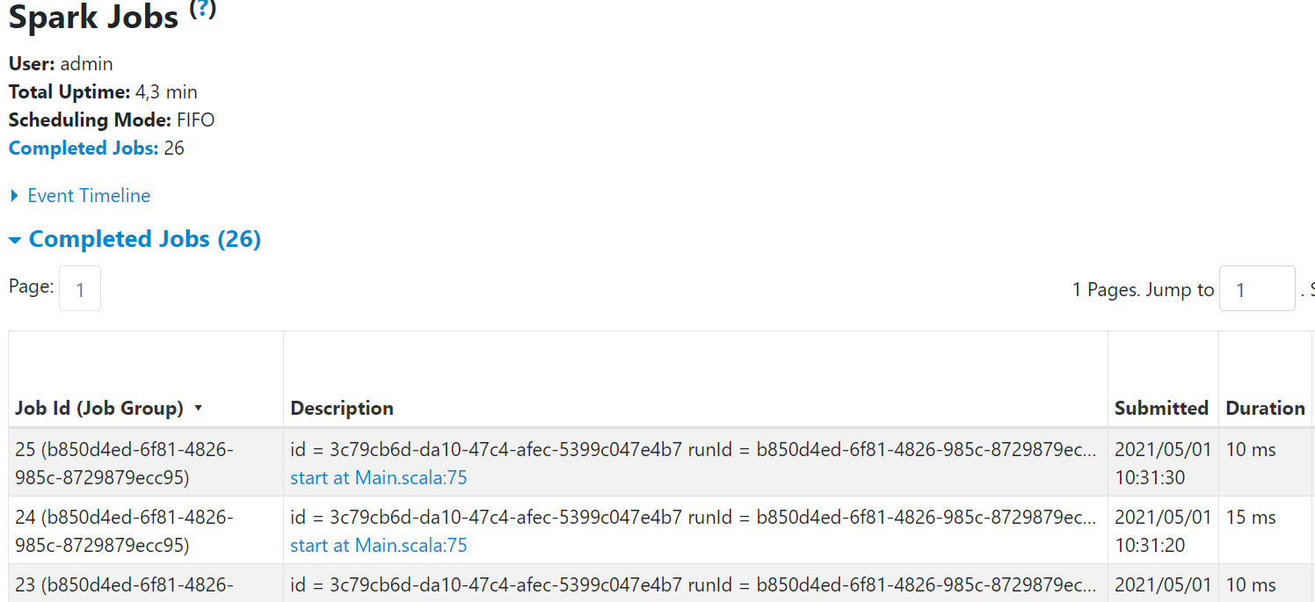
Тут нужно стэк трэйс показать!!!!!!!!!!!!!!

Slide 6
ConstDataSource
class ConstDataSource extends SimpleTableProvider {
override def getTable(options: CaseInsensitiveStringMap): Table = {
new ConstStreamTable()
}
}

Slide 7
/ A simple version of `TableProvider` which doesn't support specified table schema/partitioning
// and treats table properties case-insensitively. This is private and only used in builtin sources.
trait SimpleTableProvider extends TableProvider {
def getTable(options: CaseInsensitiveStringMap): Table
private[this] var loadedTable: Table = _
private def getOrLoadTable(options: CaseInsensitiveStringMap): Table = {
if (loadedTable == null) loadedTable = getTable(options)
loadedTable
}
override def inferSchema(options: CaseInsensitiveStringMap): StructType = {
getOrLoadTable(options).schema()
}
override def getTable(
schema: StructType,
partitioning: Array[Transform],
properties: util.Map[String, String]): Table = {
assert(partitioning.isEmpty)
getOrLoadTable(new CaseInsensitiveStringMap(properties))
}
}

Slide 8
Table
/**
* An interface representing a logical structured data set of a data source. For example, the
* implementation can be a directory on the file system, a topic of Kafka, or a table in the
* catalog, etc.
* <p>
* This interface can mixin {@code SupportsRead} and {@code SupportsWrite} to provide data reading
* and writing ability.
* <p>
* The default implementation of {@link #partitioning()} returns an empty array of partitions, and
* the default implementation of {@link #properties()} returns an empty map. These should be
* overridden by implementations that support partitioning and table properties.
*
* @since 3.0.0
*/

Slide 9
public interface Table {
/** A name to identify this table. Implementations should provide a meaningful name, like the database and table name from catalog, or the location of files for this table. */
String name();
/** Returns the schema of this table. If the table is not readable and doesn't have a schema, an
empty schema can be returned here. */
StructType schema();
/** Returns the physical partitioning of this table. */
default Transform[] partitioning() {
return new Transform[0];
}
/** Returns the string map of table properties. */
default Map<String, String> properties() {
return Collections.emptyMap();
}
/** Returns the set of capabilities for this table. */
Set<TableCapability> capabilities();
}

Slide 10
class ConstStreamTable extends Table with SupportsRead {
override def name(): String = ???
override def schema(): StructType = ConstStreamTable.SCHEMA
override def newScanBuilder(options: CaseInsensitiveStringMap): ScanBuilder = () => new Scan {
override def readSchema(): StructType = ConstStreamTable.SCHEMA
override def toMicroBatchStream(checkpointLocation: String): MicroBatchStream = new ConstStreamMicroBatchStream()
override def toContinuousStream(checkpointLocation: String): ContinuousStream = ???
}
override def capabilities(): util.Set[TableCapability] = {
Set(TableCapability.MICRO_BATCH_READ).asJava
}
}
object ConstStreamTable {
val SCHEMA =
StructType(StructField("id", LongType) :: StructField("value", LongType) :: Nil)
}

Slide 11
public interface SupportsRead extends Table {
/**
* Returns a {@link ScanBuilder} which can be used to build a {@link Scan}. Spark will call this
* method to configure each data source scan.
*
* @param options The options for reading, which is an immutable case-insensitive
* string-to-string map.
*/
ScanBuilder newScanBuilder(CaseInsensitiveStringMap options);
}

Slide 12
/**
* An interface for building the {@link Scan}. Implementations can mixin SupportsPushDownXYZ
* interfaces to do operator pushdown, and keep the operator pushdown result in the returned
* {@link Scan}.
*
* @since 3.0.0
*/
@Evolving
public interface ScanBuilder {
Scan build();
}

Slide 13
class ConstStreamMicroBatchStream extends MicroBatchStream {
var count:Long = 0
override def latestOffset(): Offset = { count +=1; LongOffset(count) }
override def planInputPartitions(start: Offset, end: Offset): Array[InputPartition] = Array(ConstStreamMicroBatchStreamInputPartition(1))
override def createReaderFactory(): PartitionReaderFactory = {
new PartitionReaderFactory(){
override def createReader(partition: InputPartition): PartitionReader[InternalRow] = {
new ConstStreamMicroBatchPartitionReader()
}
}
}
override def initialOffset(): Offset = LongOffset(0)
override def deserializeOffset(json: String): Offset = {
LongOffset(json.toLong)
}
override def commit(end: Offset): Unit = {}
override def stop(): Unit = ???
}

Slide 14
case class ConstStreamMicroBatchStreamInputPartition (partitionId: Int) extends InputPartition

Slide 15
class ConstStreamMicroBatchPartitionReader extends PartitionReader[InternalRow]{
private var count: Long = 0
override def next(): Boolean = {
count +=1
count < 10
}
override def get(): InternalRow = {
InternalRow(1L, 1L)
}
override def close(): Unit = {}
}

Slide 16
-------------------------------------------
Batch: 1
-------------------------------------------
+-----+---+
|value| ts|
+-----+---+
| 1| 1|
| 2| 2|
+-----+---+
Batch: 4
-------------------------------------------
+-----+---+
|value| ts|
+-----+---+
| 1| 1|
| 2| 2|
+-----+---+

Slide 17
Agenda
SimpleTableProvider, DataSourceRegister
Table, SupportsRead
ScanBuilder
MicroBatchStream
PartitionReader

Slide 18
References

