Slide 1
Spark “join” deep dive Part4 (draft)
ShuffledHashJoin
Nikolay
Join us in telegram t.me/apache_spark
November 2020

Slide 2
Example
val df1 = spark.range(1,1000000)
val df2 = spark.range(0,Integer.MAX_VALUE)
df2. .hint("shuffle_hash").join( df1,"id").collect()
http://blog.madhukaraphatak.com/spark-3-introduction-part-9/#:~:text=Shuffle%20Hash%20Join%20Hint,be%20forced%20using%20shuffle_hash%20hint.&text=The%20same%20can%20be%20observed%20in%20spark%20UI%20also.,-.

Slide 3
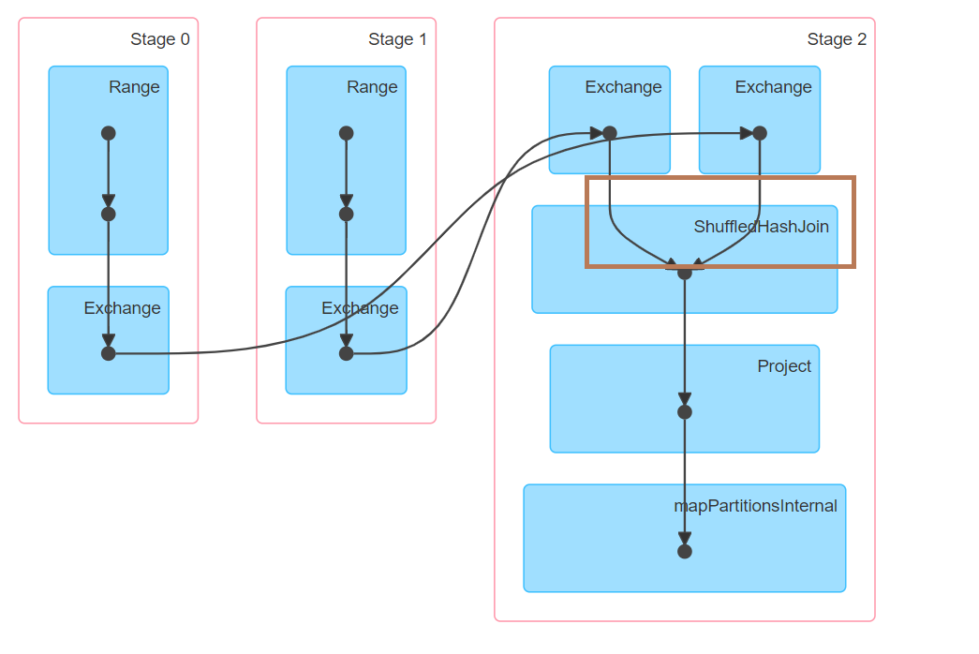

Slide 4
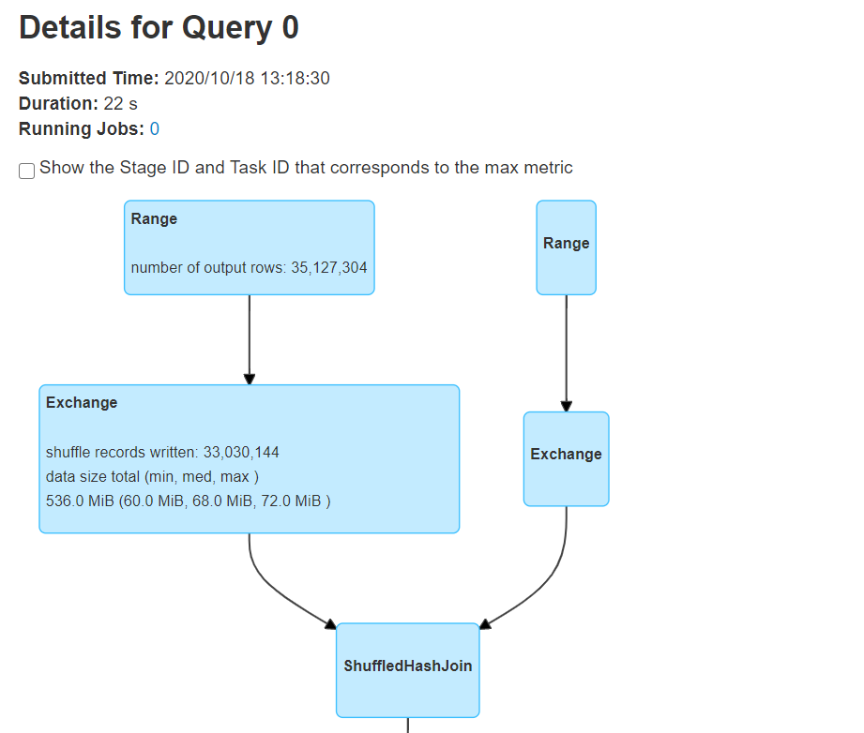

Slide 5
== Analyzed Logical Plan ==
id: bigint
Project [id#2L]
+- Join Inner, (id#2L = id#0L)
:- ResolvedHint (strategy=shuffle_hash)
: +- Range (0, 2147483647, step=1, splits=Some(8))
+- Range (1, 1000000, step=1, splits=Some(8))
== Optimized Logical Plan ==
Project [id#2L]
+- Join Inner, (id#2L = id#0L), leftHint=(strategy=shuffle_hash)
:- Range (0, 2147483647, step=1, splits=Some(8))
+- Range (1, 1000000, step=1, splits=Some(8))
== Physical Plan ==
Project [id#2L]
+- ShuffledHashJoin [id#2L], [id#0L], Inner, BuildLeft
:- Exchange hashpartitioning(id#2L, 200), true, [id=#16]
: +- Range (0, 2147483647, step=1, splits=8)
+- Exchange hashpartitioning(id#0L, 200), true, [id=#17]
+- Range (1, 1000000, step=1, splits=8)

Slide 6
ShuffledHashJoinExec
protected override def doExecute(): RDD[InternalRow] = {
val numOutputRows = longMetric("numOutputRows")
streamedPlan.execute().zipPartitions(buildPlan.execute()) { (streamIter, buildIter) =>
val hashed = buildHashedRelation(buildIter)
join(streamIter, hashed, numOutputRows)
}
}

Slide 7
Summary
1 job
ShuffledHashJoinExec

