Slide 1
Spark “join” deep dive Part2
CrossJoin/CartesianProduct
Nikolay
Join us in telegram t.me/apache_spark
September 2020

Slide 2
val rdd1 = spark.sparkContext.parallelize(Seq(1,1,2,3,4,7,8,1,1,9,8,3,1,2,9,0,1,10),3)
val rdd2 = spark.sparkContext.parallelize(Seq(1,1,2,3,4,7,8,1,1,9,8,3,1,2,9,0,1,10),3)
val ds1 = spark.sqlContext.createDataset(rdd1)
val ds2 = spark.sqlContext.createDataset(rdd2)
ds1.crossJoin(ds2).collect()

Slide 3
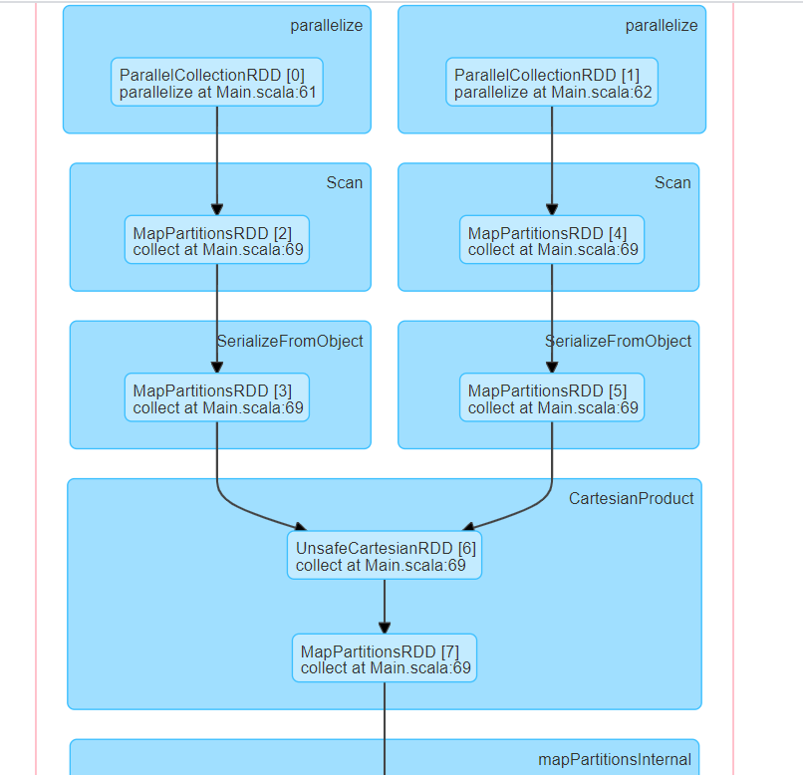
DAG

Slide 4
== Analyzed Logical Plan ==
value: int, value: int
Join Cross
:- SerializeFromObject [input[0, int, false] AS value#2]
: +- ExternalRDD [obj#1]
+- SerializeFromObject [input[0, int, false] AS value#6]
+- ExternalRDD [obj#5]
== Optimized Logical Plan ==
Join Cross
:- SerializeFromObject [input[0, int, false] AS value#2]
: +- ExternalRDD [obj#1]
+- SerializeFromObject [input[0, int, false] AS value#6]
+- ExternalRDD [obj#5]
== Physical Plan ==
CartesianProduct
:- SerializeFromObject [input[0, int, false] AS value#2]
: +- Scan[obj#1]
+- SerializeFromObject [input[0, int, false] AS value#6]
+- Scan[obj#5]

Slide 5
/**
* Explicit cartesian join with another `DataFrame`.
*
* @param right Right side of the join operation.
*
* @note Cartesian joins are very expensive without an extra filter that can be pushed down.
*
* @group untypedrel
* @since 2.1.0
*/
def crossJoin(right: Dataset[_]): DataFrame = withPlan {
Join(logicalPlan, right.logicalPlan, joinType = Cross, None)
}

Slide 6
case class Join(
left: LogicalPlan,
right: LogicalPlan,
joinType: JoinType,
condition: Option[Expression],
hint: JoinHint)
case class CartesianProductExec(
left: SparkPlan,
right: SparkPlan,
condition: Option[Expression])
extends BinaryExecNode
Spark Planner

Slide 7
CartesianProductExec.doExecute(1)
protected override def doExecute(): RDD[InternalRow] = {
val numOutputRows = longMetric("numOutputRows")
val leftResults = left.execute().asInstanceOf[RDD[UnsafeRow]]
val rightResults = right.execute().asInstanceOf[RDD[UnsafeRow]]
val pair = new UnsafeCartesianRDD(
leftResults,
rightResults,
right.output.size,
sqlContext.conf.cartesianProductExecBufferInMemoryThreshold,
sqlContext.conf.cartesianProductExecBufferSpillThreshold)
…..
PS
You can tune cartesianProductExecBufferInMemoryThreshold if you are sure about OOM

Slide 8
CartesianProductExec.doExecute(2)
….
pair.mapPartitionsWithIndexInternal { (index, iter) =>
val joiner = GenerateUnsafeRowJoiner.create(left.schema, right.schema)
val filtered = if (condition.isDefined) {
val boundCondition = newPredicate(condition.get, left.output ++ right.output)
boundCondition.initialize(index)
val joined = new JoinedRow
iter.filter { r =>
boundCondition.eval(joined(r._1, r._2))
}
} else {
iter
}
filtered.map { r =>
numOutputRows += 1
joiner.join(r._1, r._2)
}

Slide 9
UnsafeCartesianRDD extends CartesianRDD
An optimized CartesianRDD for UnsafeRow, which will cache the rows from second child RDD, will be much faster than building the right partition for every row in left RDD, it also materialize the right RDD (in case of the right RDD is nondeterministic).
override def compute(split: Partition, context: TaskContext): Iterator[(UnsafeRow, UnsafeRow)] = {
val rowArray = new ExternalAppendOnlyUnsafeRowArray(inMemoryBufferThreshold, spillThreshold)
val partition = split.asInstanceOf[CartesianPartition]
rdd2.iterator(partition.s2, context).foreach(rowArray.add)
// Create an iterator from rowArray
def createIter(): Iterator[UnsafeRow] = rowArray.generateIterator()
val resultIter =
for (x <- rdd1.iterator(partition.s1, context);
y <- createIter()) yield (x, y)
CompletionIterator[(UnsafeRow, UnsafeRow), Iterator[(UnsafeRow, UnsafeRow)]](
resultIter, rowArray.clear())
}

Slide 10
UnsafeCartesianRDD vs CartesianRDD
override def getPartitions: Array[Partition] = { // create the cross product split val array = new Array[Partition](rdd1.partitions.length * rdd2.partitions.length) for (s1 <- rdd1.partitions; s2 <- rdd2.partitions) { val idx = s1.index * numPartitionsInRdd2 + s2.index array(idx) = new CartesianPartition(idx, rdd1, rdd2, s1.index, s2.index) } array } override def compute(split: Partition, context: TaskContext): Iterator[(T, U)] = { val currSplit = split.asInstanceOf[CartesianPartition] for (x <- rdd1.iterator(currSplit.s1, context); y <- rdd2.iterator(currSplit.s2, context)) yield (x, y) }

Slide 11
The idea
Left Iterator
1
1
3
5
Right Iterator
1
1
2
3
ExternalAppendOnlyUnsafeRowArray
1
1
2
3

Slide 12
Class ExternalAppendOnlyUnsafeRowArray
private val inMemoryBuffer = if (initialSizeOfInMemoryBuffer > 0) { new ArrayBuffer[UnsafeRow](initialSizeOfInMemoryBuffer) } else { null }
An append-only array for UnsafeRows that strictly keeps content in an in-memory array
until numRowsInMemoryBufferThreshold is reached post which it will switch to a mode which
would flush to disk after numRowsSpillThreshold is met (or before if there is
excessive memory consumption). Setting these threshold involves following trade-offs:
If numRowsInMemoryBufferThreshold is too high, the in-memory array may occupy more memory
than is available, resulting in OOM.
- If numRowsSpillThreshold is too low, data will be spilled frequently and lead to
excessive disk writes. This may lead to a performance regression compared to the normal case
of using an ArrayBuffer or Array.

Slide 13
Class ExternalAppendOnlyUnsafeRowArray
def add(unsafeRow: UnsafeRow): Unit = {
if (numRows < numRowsInMemoryBufferThreshold) {
inMemoryBuffer += unsafeRow.copy()
} else {
if (spillableArray == null) {
logInfo(s"Reached spill threshold of $numRowsInMemoryBufferThreshold rows, switching to " +
s"${classOf[UnsafeExternalSorter].getName}")
// We will not sort the rows, so prefixComparator and recordComparator are null
spillableArray = UnsafeExternalSorter.create(
taskMemoryManager,
blockManager,
serializerManager,
taskContext,
null,
null,
initialSize,
pageSizeBytes,
numRowsSpillThreshold,
false)
…
spillableArray.insertRecord

Slide 14
Summary
CartesianProductExec
UnsafeCartesianRDD
ExternalAppendOnlyUnsafeRowArray
for (x <- rdd1.iterator(partition.s1, context);y <- createIter()) yield (x, y)

