Slide 1
Apache Spark Custom Stream Sources V2
Nikolay
Join us in telegram t.me/apache_spark
May 2021

Slide 2
Agenda
SimpleTableProvider, DataSourceRegister
Table, SupportsRead
ScanBuilder
MicroBatchStream
PartitionReader

Slide 3
Lets implement simple stream source
which emits random integers
spark
.readStream
.format("streams2.ConstStreamSource")
.load
.writeStream
.outputMode("append")
.format("console")
.trigger(ProcessingTimeTrigger(10000))
.start("c:\\tmp\\output")
.awaitTermination()

Slide 4
-------------------------------------------
Batch: 1
-------------------------------------------
+-----+---+
|value| ts|
+-----+---+
| 1| 1|
| 2| 2|
+-----+---+
Batch: 4
-------------------------------------------
+-----+---+
|value| ts|
+-----+---+
| 1| 1|
| 2| 2|
+-----+---+

Slide 5
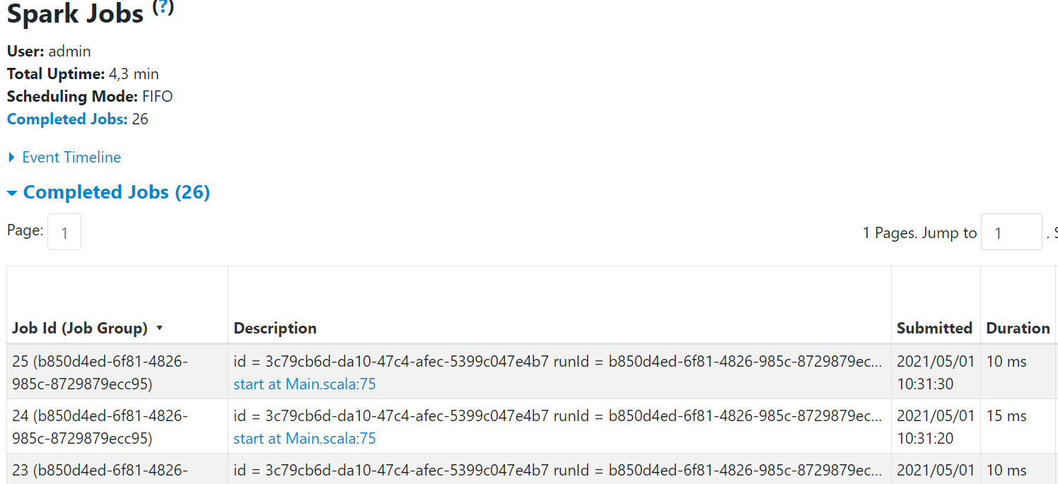

Slide 6
ConstDataSource
class ConstDataSource extends SimpleTableProvider {
override def getTable(options: CaseInsensitiveStringMap): Table = {
new ConstStreamTable()
}
}

Slide 7
/ A simple version of `TableProvider` which doesn't support specified table schema/partitioning
// and treats table properties case-insensitively. This is private and only used in builtin sources.
trait SimpleTableProvider extends TableProvider {
def getTable(options: CaseInsensitiveStringMap): Table
private[this] var loadedTable: Table = _
private def getOrLoadTable(options: CaseInsensitiveStringMap): Table = {
if (loadedTable == null) loadedTable = getTable(options)
loadedTable
}
override def inferSchema(options: CaseInsensitiveStringMap): StructType = {
getOrLoadTable(options).schema()
}
override def getTable(
schema: StructType,
partitioning: Array[Transform],
properties: util.Map[String, String]): Table = {
assert(partitioning.isEmpty)
getOrLoadTable(new CaseInsensitiveStringMap(properties))
}
}

Slide 8
class ConstStreamTable extends Table with SupportsRead {
override def name(): String = ???
override def schema(): StructType = ConstStreamTable.SCHEMA
override def newScanBuilder(options: CaseInsensitiveStringMap): ScanBuilder = () => new Scan {
override def readSchema(): StructType = ConstStreamTable.SCHEMA
override def toMicroBatchStream(checkpointLocation: String): MicroBatchStream = new ConstStreamMicroBatchStream()
override def toContinuousStream(checkpointLocation: String): ContinuousStream = ???
}
override def capabilities(): util.Set[TableCapability] = {
Set(TableCapability.MICRO_BATCH_READ).asJava
}
}
object ConstStreamTable {
val SCHEMA =
StructType(StructField("id", LongType) :: StructField("value", LongType) :: Nil)
}

Slide 9
class ConstStreamMicroBatchStream extends MicroBatchStream {
var count:Long = 0
override def latestOffset(): Offset = { count +=1; LongOffset(count) }
override def planInputPartitions(start: Offset, end: Offset): Array[InputPartition] = Array(ConstStreamMicroBatchStreamInputPartition(1))
override def createReaderFactory(): PartitionReaderFactory = {
new PartitionReaderFactory(){
override def createReader(partition: InputPartition): PartitionReader[InternalRow] = {
new ConstStreamMicroBatchPartitionReader()
}
}
}
override def initialOffset(): Offset = LongOffset(0)
override def deserializeOffset(json: String): Offset = {
LongOffset(json.toLong)
}
override def commit(end: Offset): Unit = {}
override def stop(): Unit = ???
}

Slide 10
case class ConstStreamMicroBatchStreamInputPartition (partitionId: Int) extends InputPartition

Slide 11
class ConstStreamMicroBatchPartitionReader extends PartitionReader[InternalRow]{
private var count: Long = 0
override def next(): Boolean = {
count +=1
count < 10
}
override def get(): InternalRow = {
InternalRow(1L, 1L)
}
override def close(): Unit = {}
}

Slide 12
-------------------------------------------
Batch: 1
-------------------------------------------
+-----+---+
|value| ts|
+-----+---+
| 1| 1|
| 2| 2|
+-----+---+
Batch: 4
-------------------------------------------
+-----+---+
|value| ts|
+-----+---+
| 1| 1|
| 2| 2|
+-----+---+

Slide 13
Agenda
SimpleTableProvider, DataSourceRegister
Table, SupportsRead
ScanBuilder
MicroBatchStream
PartitionReader

Slide 14
References

