Slide 1
Spark “join” deep dive Part3 (DRAFT)
BroadcastHashJoin
Nikolay
Join us in telegram t.me/apache_spark
October 2020

Slide 2
Example
val df1 = spark.range(1,1000000)
val df2 = spark.range(0,Integer.MAX_VALUE)
df2.join( df1,"id").explain(true)

Slide 3
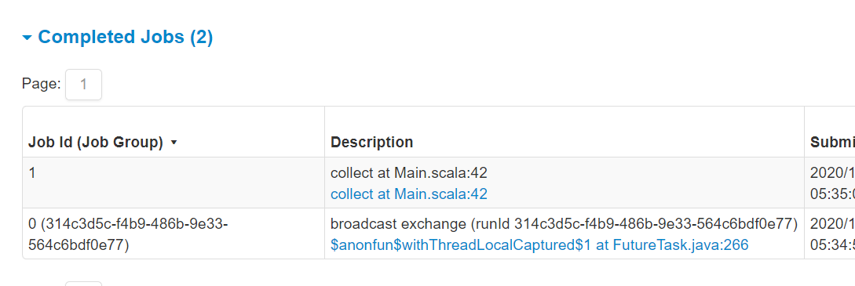
Spark Jobs

Slide 4
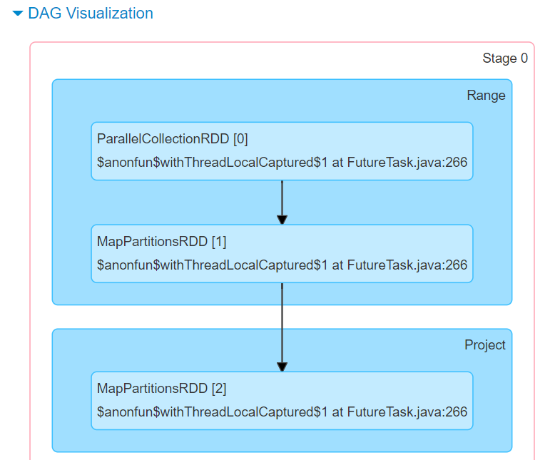
DAG
Job 0

Slide 5
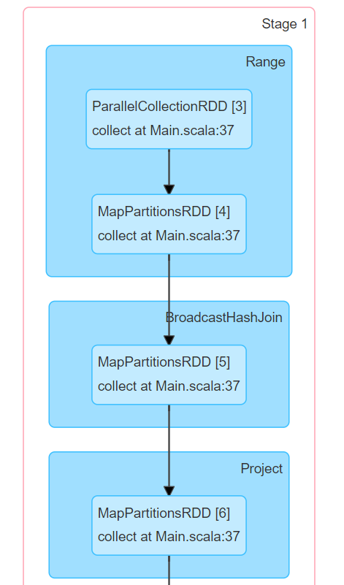
DAG
Job 1

Slide 6
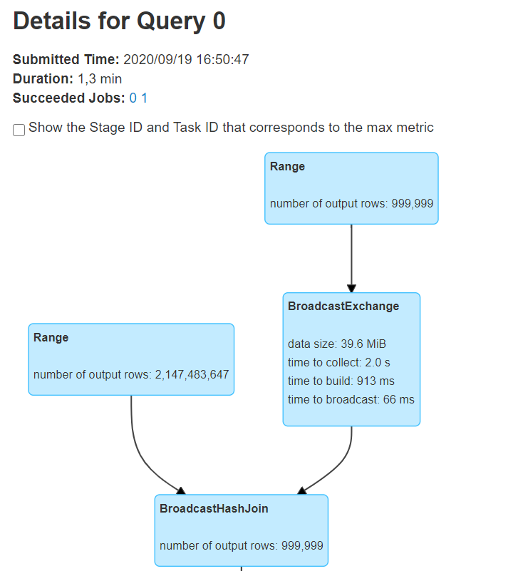

Slide 7
== Parsed Logical Plan ==
'Join UsingJoin(Inner,List(id))
:- Range (0, 2147483647, step=1, splits=Some(8))
+- Range (1, 1000000, step=1, splits=Some(8))
== Analyzed Logical Plan ==
id: bigint
Project [id#2L]
+- Join Inner, (id#2L = id#0L)
:- Range (0, 2147483647, step=1, splits=Some(8))
+- Range (1, 1000000, step=1, splits=Some(8))
== Optimized Logical Plan ==
Project [id#2L]
+- Join Inner, (id#2L = id#0L)
:- Range (0, 2147483647, step=1, splits=Some(8))
+- Range (1, 1000000, step=1, splits=Some(8))
== Physical Plan ==
Project [id#2L]
+- BroadcastHashJoin [id#2L], [id#0L], Inner, BuildRight
:- Range (0, 2147483647, step=1, splits=8)
+- BroadcastExchange HashedRelationBroadcastMode(List(input[0, bigint, false]))
+- Range (1, 1000000, step=1, splits=8)

Slide 8
/**
* Inner equi-join with another `DataFrame` using the given column.
*
* Different from other join functions, the join column will only appear once in the output,
* i.e. similar to SQL's `JOIN USING` syntax.
*
* {{{
* // Joining df1 and df2 using the column "user_id"
* df1.join(df2, "user_id")
* }}}
*
* @param right Right side of the join operation.
* @param usingColumn Name of the column to join on. This column must exist on both sides.
*
* @note If you perform a self-join using this function without aliasing the input
* `DataFrame`s, you will NOT be able to reference any columns after the join, since
* there is no way to disambiguate which side of the join you would like to reference.
*
* @group untypedrel
* @since 2.0.0
*/
def join(right: Dataset[_], usingColumn: String): DataFrame = {
join(right, Seq(usingColumn))
}

Slide 9
case class BroadcastHashJoinExec( leftKeys: Seq[Expression], rightKeys: Seq[Expression], joinType: JoinType, buildSide: BuildSide, condition: Option[Expression], left: SparkPlan, right: SparkPlan)
case class Join(
left: LogicalPlan,
right: LogicalPlan,
joinType: JoinType,
condition: Option[Expression],
hint: JoinHint)
Spark Planner

Slide 10
BroadcastHashJoinExec
protected override def doExecute(): RDD[InternalRow] = { val numOutputRows = longMetric("numOutputRows") val broadcastRelation = buildPlan.executeBroadcast[HashedRelation]() streamedPlan.execute().mapPartitions { streamedIter => val hashed = broadcastRelation.value.asReadOnlyCopy() TaskContext.get().taskMetrics().incPeakExecutionMemory(hashed.estimatedSize) join(streamedIter, hashed, numOutputRows) } }

Slide 11
SparkPlan
Returns the result of this query as a broadcast variable by delegating to
`doExecuteBroadcast ` after preparations. Concrete implementations of SparkPlan should override `doExecuteBroadcast`. final def executeBroadcast[T](): broadcast.Broadcast[T] = executeQuery { if (isCanonicalizedPlan) { throw new IllegalStateException("A canonicalized plan is not supposed to be executed.") } doExecuteBroadcast() }

Slide 12
BroadcastExchangeExec
override protected[sql] def doExecuteBroadcast[T](): broadcast.Broadcast[T] = { try { relationFuture.get(timeout, TimeUnit.SECONDS).asInstanceOf[broadcast.Broadcast[T]] } catch { case ex: TimeoutException => logError(s"Could not execute broadcast in $timeout secs.", ex) if (!relationFuture.isDone) { sparkContext.cancelJobGroup(runId.toString) relationFuture.cancel(true) } throw new SparkException(s"Could not execute broadcast in $timeout secs. " + s"You can increase the timeout for broadcasts via ${SQLConf.BROADCAST_TIMEOUT.key} or " + s"disable broadcast join by setting ${SQLConf.AUTO_BROADCASTJOIN_THRESHOLD.key} to -1", ex) } }

Slide 13
override lazy val relationFuture: Future[broadcast.Broadcast[Any]] = { SQLExecution.withThreadLocalCaptured[broadcast.Broadcast[Any]]( sqlContext.sparkSession, BroadcastExchangeExec.executionContext) { try { // Setup a job group here so later it may get cancelled by groupId if necessary. sparkContext.setJobGroup(runId.toString, s"broadcast exchange (runId $runId)", interruptOnCancel = true) val beforeCollect = System.nanoTime() // Use executeCollect/executeCollectIterator to avoid conversion to Scala types val (numRows, input) = child.executeCollectIterator() if (numRows >= MAX_BROADCAST_TABLE_ROWS) { throw new SparkException( s"Cannot broadcast the table over $MAX_BROADCAST_TABLE_ROWS rows: $numRows rows") } val beforeBuild = System.nanoTime() longMetric("collectTime") += NANOSECONDS.toMillis(beforeBuild - beforeCollect)

Slide 14
// Construct the relation.
val relation = mode.transform(input, Some(numRows))
val dataSize = relation match {
case map: HashedRelation =>
map.estimatedSize
case arr: Array[InternalRow] =>
arr.map(_.asInstanceOf[UnsafeRow].getSizeInBytes.toLong).sum
case _ =>
throw new SparkException("[BUG] BroadcastMode.transform returned unexpected " +
s"type: ${relation.getClass.getName}")
}
longMetric("dataSize") += dataSize
if (dataSize >= MAX_BROADCAST_TABLE_BYTES) {
throw new SparkException(
s"Cannot broadcast the table that is larger than 8GB: ${dataSize >> 30} GB")
}

Slide 15
val beforeBroadcast = System.nanoTime()
longMetric("buildTime") += NANOSECONDS.toMillis(beforeBroadcast - beforeBuild)
// Broadcast the relation
val broadcasted = sparkContext.broadcast(relation)
longMetric("broadcastTime") += NANOSECONDS.toMillis(
System.nanoTime() - beforeBroadcast)
val executionId = sparkContext.getLocalProperty(SQLExecution.EXECUTION_ID_KEY)
SQLMetrics.postDriverMetricUpdates(sparkContext, executionId, metrics.values.toSeq)
promise.trySuccess(broadcasted)
broadcasted

Slide 16
The idea
JOB 1
JOB 0
1
1
2
3
1
1
3
5
Iterator2
Iterator1
collect
1
1
2
3
Array
1
1
2
3
Build broadcast relation
Relation
broadcast

Slide 17
BroadcastHashJoinExec
protected override def doExecute(): RDD[InternalRow] = { val numOutputRows = longMetric("numOutputRows") val broadcastRelation = buildPlan.executeBroadcast[HashedRelation]() streamedPlan.execute().mapPartitions { streamedIter => val hashed = broadcastRelation.value.asReadOnlyCopy() TaskContext.get().taskMetrics().incPeakExecutionMemory(hashed.estimatedSize) join(streamedIter, hashed, numOutputRows) } }

Slide 18
protected def join(
streamedIter: Iterator[InternalRow],
hashed: HashedRelation,
numOutputRows: SQLMetric): Iterator[InternalRow] = {
val joinedIter = joinType match {
case _: InnerLike =>
innerJoin(streamedIter, hashed)
case LeftOuter | RightOuter =>
outerJoin(streamedIter, hashed)
case LeftSemi =>
semiJoin(streamedIter, hashed)
case LeftAnti =>
antiJoin(streamedIter, hashed)
case j: ExistenceJoin =>
existenceJoin(streamedIter, hashed)
case x =>
throw new IllegalArgumentException(
s"BroadcastHashJoin should not take $x as the JoinType")
}

Slide 19
private def innerJoin(
streamIter: Iterator[InternalRow],
hashedRelation: HashedRelation): Iterator[InternalRow] = {
val joinRow = new JoinedRow
val joinKeys = streamSideKeyGenerator()
streamIter.flatMap { srow =>
joinRow.withLeft(srow)
val matches = hashedRelation.get(joinKeys(srow))
if (matches != null) {
matches.map(joinRow.withRight(_)).filter(boundCondition)
} else {
Seq.empty
}
}
}

Slide 20
private def outerJoin( streamedIter: Iterator[InternalRow], hashedRelation: HashedRelation): Iterator[InternalRow] = {
val joinedRow = new JoinedRow();
val keyGenerator = streamSideKeyGenerator()
val nullRow = new GenericInternalRow(buildPlan.output.length)
streamedIter.flatMap { currentRow =>
val rowKey = keyGenerator(currentRow)
joinedRow.withLeft(currentRow)
val buildIter = hashedRelation.get(rowKey)
new RowIterator {
private var found = false
override def advanceNext(): Boolean = {
while (buildIter != null && buildIter.hasNext) {
val nextBuildRow = buildIter.next()
if (boundCondition(joinedRow.withRight(nextBuildRow))) {
found = true
return true
}
}
if (!found) {
joinedRow.withRight(nullRow)
found = true
return true
}
false
}
override def getRow: InternalRow = joinedRow
}.toScala
}
}

Slide 21
private def semiJoin(
streamIter: Iterator[InternalRow],
hashedRelation: HashedRelation): Iterator[InternalRow] = {
val joinKeys = streamSideKeyGenerator()
val joinedRow = new JoinedRow
streamIter.filter { current =>
val key = joinKeys(current)
lazy val buildIter = hashedRelation.get(key)
!key.anyNull && buildIter != null && (condition.isEmpty || buildIter.exists {
(row: InternalRow) => boundCondition(joinedRow(current, row))
})
}
}
A semijoin returns all rows from the left table where there are matching values in the right table, keeping just columns from the left table.

Slide 22
private def existenceJoin(
streamIter: Iterator[InternalRow],
hashedRelation: HashedRelation): Iterator[InternalRow] = {
val joinKeys = streamSideKeyGenerator()
val result = new GenericInternalRow(Array[Any](null))
val joinedRow = new JoinedRow
streamIter.map { current =>
val key = joinKeys(current)
lazy val buildIter = hashedRelation.get(key)
val exists = !key.anyNull && buildIter != null && (condition.isEmpty || buildIter.exists {
(row: InternalRow) => boundCondition(joinedRow(current, row))
})
result.setBoolean(0, exists)
joinedRow(current, result)
}
}

Slide 23
private def antiJoin(
streamIter: Iterator[InternalRow],
hashedRelation: HashedRelation): Iterator[InternalRow] = {
val joinKeys = streamSideKeyGenerator()
val joinedRow = new JoinedRow
streamIter.filter { current =>
val key = joinKeys(current)
lazy val buildIter = hashedRelation.get(key)
key.anyNull || buildIter == null || (condition.isDefined && !buildIter.exists {
row => boundCondition(joinedRow(current, row))
})
}
}
An antijoin return all rows from the left table where there are not matching values in the right table, keeping just columns from the left table

Slide 24
Summary
Job0 and Job1
BroadcastHashJoinExec
innerJoin, outerJoin( flatMap)
semiJoin, antiJoin( filter)
existenceJoin( map)

