Slide 1
Spark “sort” transformation deep dive
Part 1
Nikolay
Join us in telegram t.me/apache_spark
2020

Slide 2
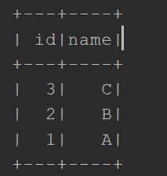
Example
spark.sqlContext .createDataset[Person](Seq(Person(1,"A"),Person(2,"B"),Person(3,"C"))) .sort($"id".desc) :Dataset[Person] .show()

Slide 3
== Parsed Logical Plan ==
'Sort ['id DESC NULLS LAST], true
+- LocalRelation [id#2, name#3]
== Analyzed Logical Plan ==
id: int, name: string
Sort [id#2 DESC NULLS LAST], true
+- LocalRelation [id#2, name#3]
== Optimized Logical Plan ==
Sort [id#2 DESC NULLS LAST], true
+- LocalRelation [id#2, name#3]
== Physical Plan ==
*(1) Sort [id#2 DESC NULLS LAST], true, 0
+- Exchange rangepartitioning(id#2 DESC NULLS LAST, 200), true, [id=#7]
+- LocalTableScan [id#2, name#3]

Slide 4

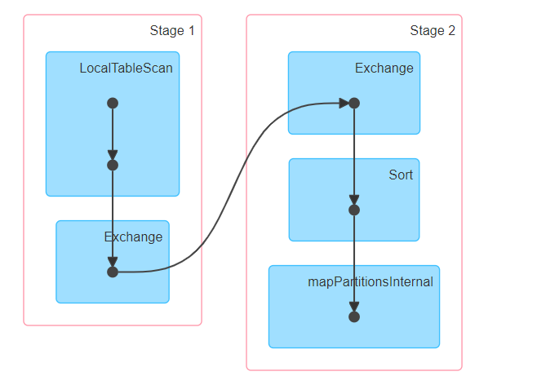

Slide 5
Dataset
/** * Returns a new Dataset sorted by the given expressions.
For example: * {{{ * ds.sort($"col1", $"col2".desc) * }}} * @group typedrel * @since 2.0.0 */ @scala.annotation.varargs def sort(sortExprs: Column*): Dataset[T] = { sortInternal(global = true, sortExprs) }

Slide 6
private def sortInternal(global: Boolean, sortExprs: Seq[Column]): Dataset[T] = {
val sortOrder: Seq[SortOrder] = sortExprs.map { col =>
col.expr match {
case expr: SortOrder =>
expr
case expr: Expression =>
SortOrder(expr, Ascending)
}
}
withTypedPlan {
Sort(sortOrder, global = global, logicalPlan)
}
}

Slide 7
/**
* @param order The ordering expressions
* @param global True means global sorting apply for entire data set,
* False means sorting only apply within the partition.
* @param child Child logical plan
*/
case class Sort(
order: Seq[SortOrder],
global: Boolean,
child: LogicalPlan) extends UnaryNode {
override def output: Seq[Attribute] = child.output
override def maxRows: Option[Long] = child.maxRows
override def outputOrdering: Seq[SortOrder] = order
}

Slide 8
case class SortOrder(
child: Expression,
direction: SortDirection,
nullOrdering: NullOrdering,
sameOrderExpressions: Set[Expression])
case object Ascending extends SortDirection {
override def sql: String = "ASC"
override def defaultNullOrdering: NullOrdering = NullsFirst
}
case object Descending extends SortDirection {
override def sql: String = "DESC"
override def defaultNullOrdering: NullOrdering = NullsLast
}

Slide 9
BasicOperators of SparkPlanner
case logical.Sort(sortExprs, global, child) => execution.SortExec(sortExprs, global, planLater(child)) :: Nil case logical.Project(projectList, child) => execution.ProjectExec(projectList, planLater(child)) :: Nil case logical.Filter(condition, child) => execution.FilterExec(condition, planLater(child)) :: Nil

Slide 10
Class SortExec
// sort performed is local within a given partition so will retain // child operator's partitioning override def outputPartitioning: Partitioning = child.outputPartitioning override def requiredChildDistribution: Seq[Distribution] = if (global) OrderedDistribution(sortOrder) :: Nil else UnspecifiedDistribution :: Nil private val enableRadixSort = sqlContext.conf.enableRadixSort

Slide 11
/**
* Represents data where tuples have been ordered according to the `ordering`
* [[Expression Expressions]]. Its requirement is defined as the following:
* - Given any 2 adjacent partitions, all the rows of the second partition must be larger than or
* equal to any row in the first partition, according to the `ordering` expressions.
*
* In other words, this distribution requires the rows to be ordered across partitions, but not
* necessarily within a partition.
*/
case class OrderedDistribution(ordering: Seq[SortOrder]) extends Distribution {
override def requiredNumPartitions: Option[Int] = None
override def createPartitioning(numPartitions: Int): Partitioning = {
RangePartitioning(ordering, numPartitions)
}
}

Slide 12
Class EnsureRequirements
/** * Ensures that the [[org.apache.spark.sql.catalyst.plans.physical.
Partitioning Partitioning]] * of input data meets the * [[org.apache.spark.sql.catalyst.plans.physical.Distribution
Distribution]]
requirements for * each operator by inserting [[ShuffleExchangeExec]]
Operators where required. Also ensure that * the input partition ordering requirements are met. */

Slide 13
class QueryExecution
protected def preparations: Seq[Rule[SparkPlan]] = Seq( // `AdaptiveSparkPlanExec` is a leaf node. If inserted, all the following rules will be no-op // as the original plan is hidden behind `AdaptiveSparkPlanExec`. InsertAdaptiveSparkPlan(sparkSession, this), PlanDynamicPruningFilters(sparkSession), PlanSubqueries(sparkSession), EnsureRequirements(sparkSession.sessionState.conf), ApplyColumnarRulesAndInsertTransitions(sparkSession.sessionState.conf, sparkSession.sessionState.columnarRules), CollapseCodegenStages(sparkSession.sessionState.conf), ReuseExchange(sparkSession.sessionState.conf), ReuseSubquery(sparkSession.sessionState.conf))

Slide 14
class EnsureRequirements
def apply(plan: SparkPlan): SparkPlan = plan.transformUp {
// TODO: remove this after we create a physical operator for `RepartitionByExpression`.
case operator @ ShuffleExchangeExec(upper: HashPartitioning, child, _) =>
child.outputPartitioning match {
case lower: HashPartitioning if upper.semanticEquals(lower) => child
case _ => operator
}
case operator: SparkPlan =>
ensureDistributionAndOrdering(reorderJoinPredicates(operator))
}

Slide 15
private def ensureDistributionAndOrdering(operator: SparkPlan): SparkPlan = {
val requiredChildDistributions: Seq[Distribution] = operator.requiredChildDistribution
val requiredChildOrderings: Seq[Seq[SortOrder]] = operator.requiredChildOrdering
var children: Seq[SparkPlan] = operator.children
assert(requiredChildDistributions.length == children.length)
assert(requiredChildOrderings.length == children.length)
// Ensure that the operator's children satisfy their output distribution requirements.
children = children.zip(requiredChildDistributions).map {
case (child, distribution) if child.outputPartitioning.satisfies(distribution) =>
child
case (child, BroadcastDistribution(mode)) =>
BroadcastExchangeExec(mode, child)
case (child, distribution) =>
val numPartitions = distribution.requiredNumPartitions
.getOrElse(defaultNumPreShufflePartitions)
ShuffleExchangeExec(distribution.createPartitioning(numPartitions), child)
}

Slide 16
ShuffleExchangeExec
protected override def doExecute(): RDD[InternalRow] = attachTree(this, "execute") {
// Returns the same ShuffleRowRDD if this plan is used by multiple plans.
if (cachedShuffleRDD == null) {
cachedShuffleRDD = createShuffledRDD(None)
}
cachedShuffleRDD
}
def createShuffledRDD(partitionStartIndices: Option[Array[Int]]): ShuffledRowRDD = {
new ShuffledRowRDD(shuffleDependency, readMetrics, partitionStartIndices)
}

Slide 17
ShuffledRowRDD
override def compute(split: Partition, context: TaskContext): Iterator[InternalRow] = { val shuffledRowPartition = split.asInstanceOf[ShuffledRowRDDPartition] val tempMetrics = context.taskMetrics().createTempShuffleReadMetrics() // `SQLShuffleReadMetricsReporter` will update its own metrics for SQL exchange operator, // as well as the `tempMetrics` for basic shuffle metrics. val sqlMetricsReporter = new SQLShuffleReadMetricsReporter(tempMetrics, metrics) // The range of pre-shuffle partitions that we are fetching at here is // [startPreShufflePartitionIndex, endPreShufflePartitionIndex - 1]. val reader = SparkEnv.get.shuffleManager.getReader( dependency.shuffleHandle, shuffledRowPartition.startPreShufflePartitionIndex, shuffledRowPartition.endPreShufflePartitionIndex, context, sqlMetricsReporter) reader.read().asInstanceOf[Iterator[Product2[Int, InternalRow]]].map(_._2) }

Slide 18
Diagram of sort
{1,2,3,4,7,8}
{1,1,9,8,3}
{1,2,9,0,1,10}
{1,2,3,4,1,1,3}
{7,8,9,8,9,10}
{1,1,2,3,3,4}
{7,8,8,9,9,10}

Slide 19
Summary
Sort
SortExec
EnsureRequirements
ShuffleExchangeExec

