Slide 1
Spark “sort” transformation deep dive Part3
RangePartitioner
Nikolay
Join us in telegram t.me/apache_spark
July 2020

Slide 2
Key point of distributed sort in spark
If we have more that 1 partitions to sort we need to divide input on ranges
Question: How to find out ranges
?
{1,2,3,4,1,2,5,8,9}
{1,2,3,6,2,8,7,9}
{1,2,3,1,2,1,2,3,2}
{4,5,6}
{8,9,8,7,9}
1-3
4-6
6-9

Slide 3
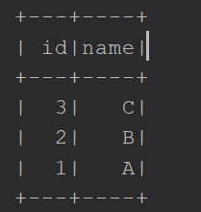
Example
spark.sqlContext .createDataset[Person](Seq(Person(1,"A"),Person(2,"B"),Person(3,"C"))) .sort($"id".desc)
.show()

Slide 4
== Parsed Logical Plan ==
'Sort ['id DESC NULLS LAST], true
+- LocalRelation [id#2, name#3]
== Analyzed Logical Plan ==
id: int, name: string
Sort [id#2 DESC NULLS LAST], true
+- LocalRelation [id#2, name#3]
== Optimized Logical Plan ==
Sort [id#2 DESC NULLS LAST], true
+- LocalRelation [id#2, name#3]
== Physical Plan ==
*(1) Sort [id#2 DESC NULLS LAST], true, 0
+- Exchange rangepartitioning(id#2 DESC NULLS LAST, 200), true, [id=#7]
+- LocalTableScan [id#2, name#3]

Slide 5

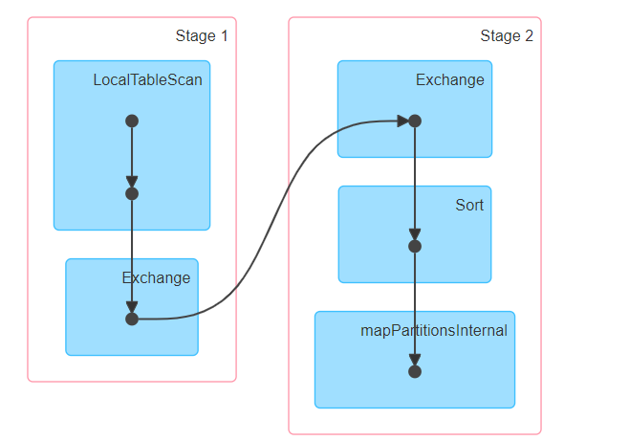

Slide 6
ShuffleExchangeExec
protected override def doExecute(): RDD[InternalRow] = attachTree(this, "execute") {
// Returns the same ShuffleRowRDD if this plan is used by multiple plans.
if (cachedShuffleRDD == null) {
cachedShuffleRDD = createShuffledRDD(None)
}
cachedShuffleRDD
}
def createShuffledRDD(partitionStartIndices: Option[Array[Int]]): ShuffledRowRDD = {
new ShuffledRowRDD(shuffleDependency, readMetrics, partitionStartIndices)
}

Slide 7
class ShuffleExchangeExec
/** * A ShuffleDependency that will partition rows of its child based on * the partitioning scheme defined in `newPartitioning`. Those partitions of * the returned ShuffleDependency will be the input of shuffle. */ @transient lazy val shuffleDependency : ShuffleDependency[Int, InternalRow, InternalRow] = { ShuffleExchangeExec.prepareShuffleDependency( inputRDD, child.output, outputPartitioning, serializer, writeMetrics) }

Slide 8
method prepareShuffleDependency ShuffleExchangeExec
… case RangePartitioning(sortingExpressions, numPartitions) => // Extract only fields used for sorting to avoid collecting large fields that does
//not affect sorting result when deciding partition bounds in RangePartitioner val rddForSampling = rdd.mapPartitionsInternal { iter => val projection = UnsafeProjection.create(sortingExpressions.map(_.child), outputAttributes) val mutablePair = new MutablePair[InternalRow, Null]() // Internally, RangePartitioner runs a job on the RDD that samples keys to compute // partition bounds. To get accurate samples, we need to copy the mutable keys. iter.map(row => mutablePair.update(projection(row).copy(), null)) } … implicit val ordering = new LazilyGeneratedOrdering(orderingAttributes) new RangePartitioner( numPartitions, rddForSampling, ascending = true, samplePointsPerPartitionHint = SQLConf.get.rangeExchangeSampleSizePerPartition)

Slide 9
spark.sql.execution.rangeExchange.sampleSizePerPartition
Number of points to sample per partition in order to determine
the range boundaries for range partitioning, typically used in
global sorting (without limit)
default:100

Slide 10
Class RangePartitioner
A Partitioner that partitions sortable records by range
into roughly equal ranges. The ranges are determined by sampling the content
of the RDD passed in. The actual number of partitions created by the RangePartitioner might
not be the same as the `partitions` parameter, in the case where the number
of sampled records is less than the value of `partitions`.

Slide 11
just to remind
Partitioner is an object that defines how the elements in a key-value pair RDD are partitioned by key.
Maps each key to a partition ID, from 0 to `numPartitions - 1`.
abstract class Partitioner extends Serializable {
def numPartitions: Int
def getPartition(key: Any): Int
}

Slide 12
RangePartitioner
class RangePartitioner[K : Ordering : ClassTag, V](
partitions: Int, rdd: RDD[_ <: Product2[K, V]], private var ascending: Boolean = true, val samplePointsPerPartitionHint: Int = 20) extends Partitioner { // A constructor declared in order to maintain backward compatibility for Java, when we add the // 4th constructor parameter samplePointsPerPartitionHint. See SPARK-22160. // This is added to make sure from a bytecode point of view, there is still a 3-arg ctor. def this(partitions: Int, rdd: RDD[_ <: Product2[K, V]], ascending: Boolean) = { this(partitions, rdd, ascending, samplePointsPerPartitionHint = 20) } def numPartitions: Int = rangeBounds.length + 1

Slide 13
rangeBounds
An array of upper bounds for the first (partitions - 1) partitions
-UB0
-UB1
- UB2
- UB3
- V4
0
1
2
3
4
Example: {1,2,3,4,5} -> {3}

Slide 14
def getPartition(key: Any): Int = { val k = key.asInstanceOf[K] var partition = 0 if (rangeBounds.length <= 128) { // If we have less than 128 partitions naive search while (partition < rangeBounds.length && ordering.gt(k, rangeBounds(partition))) { partition += 1 } } else { // Determine which binary search method to use only once. partition = binarySearch(rangeBounds, k) // binarySearch either returns the match location or -[insertion point]-1 if (partition < 0) { partition = -partition-1 } if (partition > rangeBounds.length) { partition = rangeBounds.length } } if (ascending) {partition } else { rangeBounds.length – partition } }

Slide 15
// An array of upper bounds for the first (partitions - 1) partitions
private var rangeBounds: Array[K] = { if (partitions <= 1) { Array.empty } else { // This is the sample size we need to have roughly balanced output partitions,
capped at 1M. // Cast to double to avoid overflowing ints or longs val sampleSize = math.min( samplePointsPerPartitionHint.toDouble * partitions, 1e6) // Assume the input partitions are roughly balanced and over-sample a little bit. val sampleSizePerPartition = math.ceil(3.0 * sampleSize / rdd.partitions.length).toInt val (numItems, sketched) = RangePartitioner.sketch(rdd.map(_._1), sampleSizePerPartition) if (numItems == 0L) { Array.empty } else { // If a partition contains much more than the average number of items,
we re-sample from it // to ensure that enough items are collected from that partition. val fraction = math.min(sampleSize / math.max(numItems, 1L), 1.0) val candidates = ArrayBuffer.empty[(K, Float)] val imbalancedPartitions = mutable.Set.empty[Int]

Slide 16
/**
* Sketches the input RDD via reservoir sampling on each partition.
*
* rdd the input RDD to sketch
* sampleSizePerPartition max sample size per partition
* (total number of items, an array of (partitionId, number of items, sample))
*/
def sketch[K : ClassTag](
rdd: RDD[K],
sampleSizePerPartition: Int): (Long, Array[(Int, Long, Array[K])]) = {
val shift = rdd.id
// val classTagK = classTag[K] // to avoid serializing the entire partitioner object
val sketched = rdd.mapPartitionsWithIndex { (idx, iter) =>
val seed = byteswap32(idx ^ (shift << 16))
val (sample, n) = SamplingUtils.reservoirSampleAndCount( iter, sampleSizePerPartition, seed)
Iterator((idx, n, sample))
}.collect()
val numItems = sketched.map(_._2).sum
(numItems, sketched)
}

Slide 17
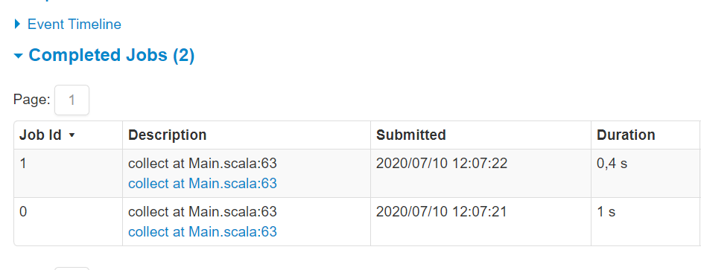
Additional job to find out ranges
spark.sqlContext .createDataset[Person](Seq(Person(1,"A"),Person(2,"B"),Person(3,"C"))) .sort($"id".desc)
.show()

Slide 18
reservoir sampling
{1,2,3,4,7,8}
{1,2,3,4,7,8}
9
2
{1,2,3,4,7,8}
{1,8}

Slide 19
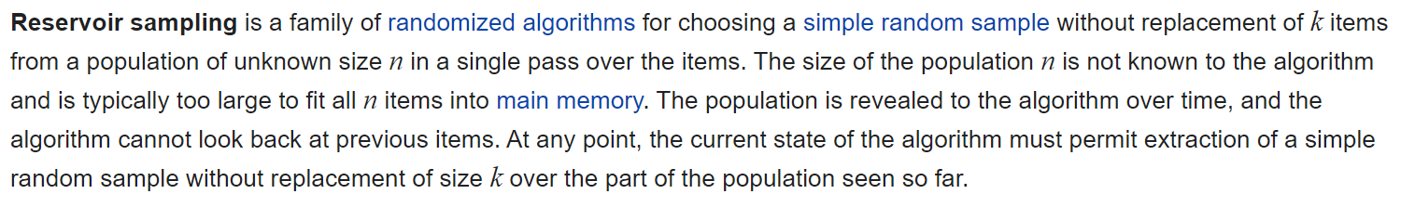
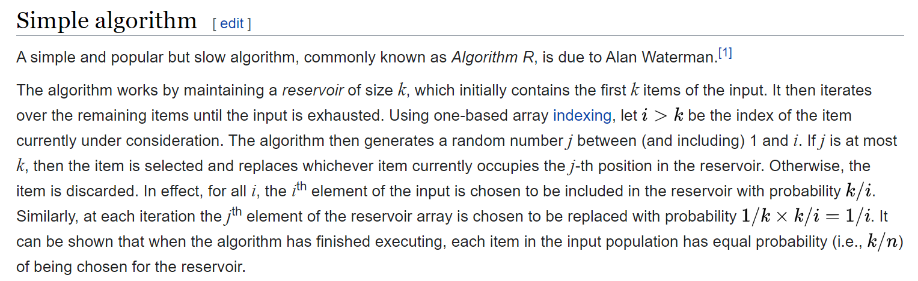
https://en.wikipedia.org/wiki/Reservoir_sampling

Slide 20
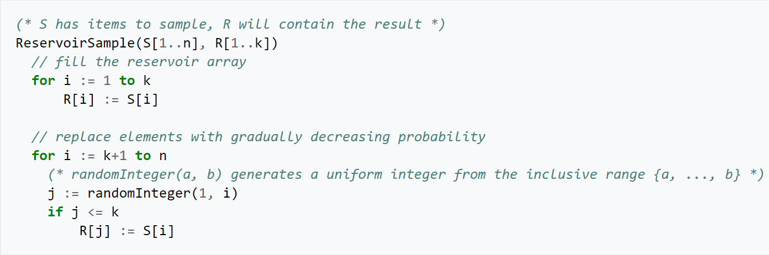
https://en.wikipedia.org/wiki/Reservoir_sampling

Slide 21
/** * Reservoir sampling implementation that also returns the input size. * * @param input input size * @param k reservoir size * @param seed random seed * @return ( samples, input size) */ def reservoirSampleAndCount[T: ClassTag]( input: Iterator[T], k: Int, seed: Long = Random.nextLong()) : (Array[T], Long) = { val reservoir = new Array[T](k) // Put the first k elements in the reservoir. var i = 0 while (i < k && input.hasNext) { val item = input.next() reservoir(i) = item i += 1 }

Slide 22
// If we have consumed all the elements, return them. Otherwise do the replacement.
if (i < k) {
// If input size < k, trim the array to return only an array of input size.
val trimReservoir = new Array[T](i)
System.arraycopy(reservoir, 0, trimReservoir, 0, i)
(trimReservoir, i)
} else {
// If input size > k, continue the sampling process.
var l = i.toLong
val rand = new XORShiftRandom(seed)
while (input.hasNext) {
val item = input.next()
l += 1
// There are k elements in the reservoir, and the l-th element has been
// consumed. It should be chosen with probability k/l. The expression
// below is a random long chosen uniformly from [0,l)
val replacementIndex = (rand.nextDouble() * l).toLong
if (replacementIndex < k) {
reservoir(replacementIndex.toInt) = item
}
}
(reservoir, l)
}

Slide 23
sketched.foreach { case (idx, n, sample) => if (fraction * n > sampleSizePerPartition) { imbalancedPartitions += idx } else { // The weight is 1 over the sampling probability. val weight = (n.toDouble / sample.length).toFloat for (key <- sample) { candidates += ((key, weight)) } } } if (imbalancedPartitions.nonEmpty) { // Re-sample imbalanced partitions with the desired sampling probability. val imbalanced = new PartitionPruningRDD(rdd.map(_._1), imbalancedPartitions.contains) val seed = byteswap32(-rdd.id - 1) val reSampled = imbalanced.sample(withReplacement = false, fraction, seed).collect() val weight = (1.0 / fraction).toFloat candidates ++= reSampled.map(x => (x, weight)) } RangePartitioner.determineBounds(candidates, math.min(partitions, candidates.size)) }

Slide 24
def determineBounds[K : Ordering : ClassTag](
candidates: ArrayBuffer[(K, Float)],
partitions: Int): Array[K] = {
val ordering = implicitly[Ordering[K]]
val ordered = candidates.sortBy(_._1)
val numCandidates = ordered.size; val sumWeights = ordered.map(_._2.toDouble).sum
val step = sumWeights / partitions
var cumWeight = 0.0; var target = step; val bounds = ArrayBuffer.empty[K]
var i = 0; var j = 0
var previousBound = Option.empty[K]
while ((i < numCandidates) && (j < partitions - 1)) {
val (key, weight) = ordered(i)
cumWeight += weight
if (cumWeight >= target) {
// Skip duplicate values.
if (previousBound.isEmpty || ordering.gt(key, previousBound.get)) {
bounds += key
target += step
j += 1
previousBound = Some(key)
}
}
i += 1
}
bounds.toArray
}

Slide 25
Spark sort flow
{1,2,3,4,7,8}
{1,1,9,8,3}
{1,2,9,0,1,10}
{1,2,3,4,1,1,3}
{7,8,9,8,9,10}
{1,1,2,3,3,4}
{7,8,8,9,9,10}

Slide 26
Summary
Sort
ShuffleExchangeExec
RangePartitioner
rangeBounds
Reservoir sampling

