Slide 1
Spark “join” transformation deep dive Part1
SortMergeJoinExec
Nikolay
Join us in telegram t.me/apache_spark
August 2020

Slide 2
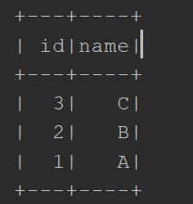
Example
spark.sqlContext .createDataset[Person](Seq(Person(1,"A"),Person(2,"B"),Person(3,"C"))) .sort($"id".desc)
.show()

Slide 3

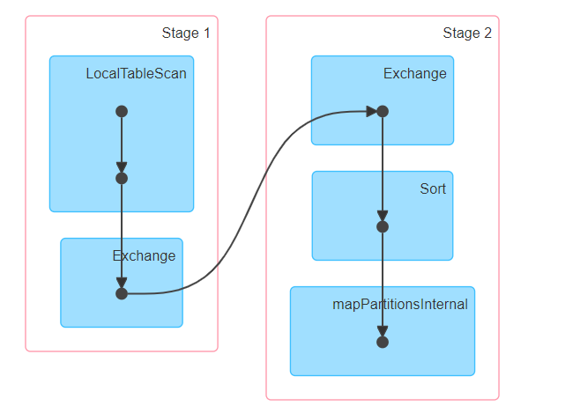

Slide 4
Spark sort flow
{1,2,3,4,7,8}
{1,1,9,8,3}
{1,2,9,0,1,10}
{1,2,3,4,1,1,3}
{7,8,9,8,9,10}
{1,1,2,3,3,4}
{7,8,8,9,9,10}

Slide 5
External sorting
External sorting is a class of sorting algorithms that can handle massive amounts of data. External sorting is required when the data being sorted do not fit into the main memory of a computing device (usually RAM) and instead they must reside in the slower external memory, usually a hard disk drive. Thus, external sorting algorithms are external memory algorithms and thus applicable in the external memory model of computation.
External sorting algorithms generally fall into two types, distribution sorting, which resembles quicksort, and external merge sort, which resembles merge sort. The latter typically uses a hybrid sort-merge strategy. In the sorting phase, chunks of data small enough to fit in main memory are read, sorted, and written out to a temporary file. In the merge phase, the sorted subfiles are combined into a single larger file.
https://en.wikipedia.org/wiki/External_sorting

Slide 6
Alphasort Spark-7079
http://research.microsoft.com/pubs/68249/alphasort.doc
Spark implements a key-prefix optimization in order to improve the cache friendliness of the sort. In naive sort implementations, the sorting algorithm operates on an array of record pointers. To compare two records for ordering, the sorter must dereference these pointers, which likely involves random memory access, then compare the objects themselves.
In a key-prefix sort, the sort operates on an array which stores the record pointer alongside a prefix of the record's key. When comparing two records for ordering, the sorter first compares the the stored key prefixes. If the ordering can be determined from the key prefixes (i.e. the prefixes are unequal), then the sort can avoid directly comparing the records, avoiding random memory accesses and full record comparisons. For example, if we're sorting a list of strings then we can store the first 8 bytes of the UTF-8 encoded string as the key-prefix and can perform unsigned byte-at-a-time comparisons to determine the ordering of strings based on their prefixes, only resorting to full comparisons for strings that share a common prefix. In cases where the sort key can fit entirely in the space allotted for the key prefix (e.g. the sorting key is an integer), we completely avoid direct

Slide 7
key-prefix sort
Record pointer
Key prefix
Record pointer
Key prefix
VS
naive sort implementations
Record pointer
Record pointer
Record pointer
Record pointer

Slide 8
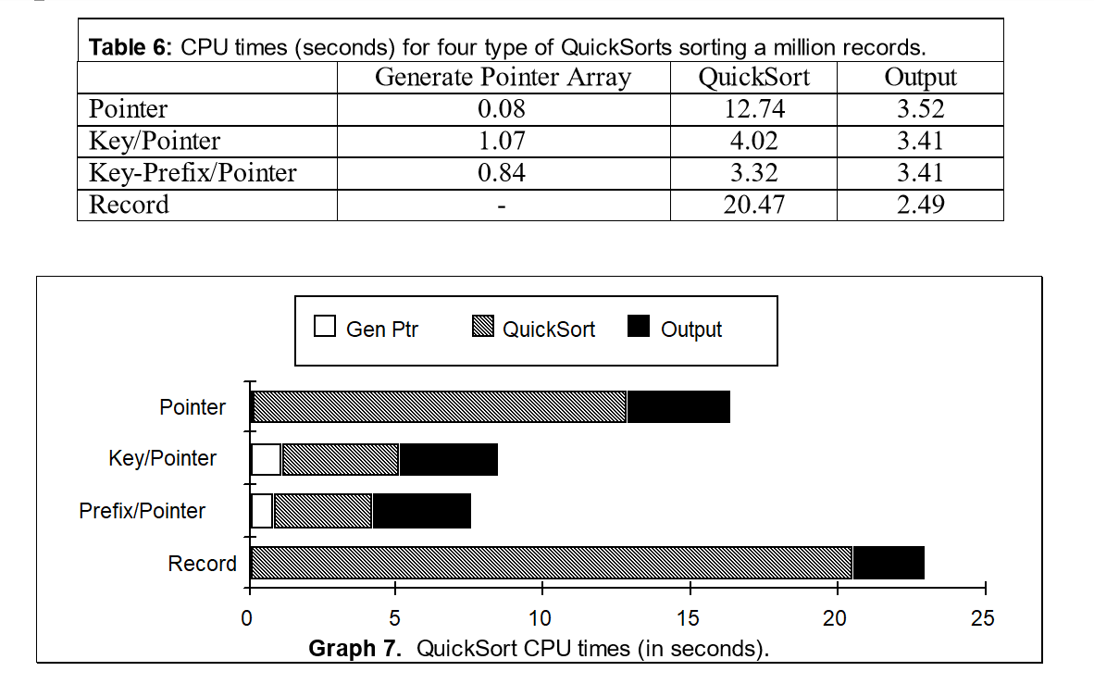

Slide 9
== Parsed Logical Plan ==
'Sort ['id DESC NULLS LAST], true
+- LocalRelation [id#2, name#3]
== Analyzed Logical Plan ==
id: int, name: string
Sort [id#2 DESC NULLS LAST], true
+- LocalRelation [id#2, name#3]
== Optimized Logical Plan ==
Sort [id#2 DESC NULLS LAST], true
+- LocalRelation [id#2, name#3]
== Physical Plan ==
*(1) Sort [id#2 DESC NULLS LAST], true, 0
+- Exchange rangepartitioning(id#2 DESC NULLS LAST, 200), true, [id=#7]
+- LocalTableScan [id#2, name#3]

Slide 10
SortExec
protected override def doExecute(): RDD[InternalRow] = { .. child.execute().mapPartitionsInternal { iter => val sorter = createSorter() …
val sortedIterator = sorter.sort(iter.asInstanceOf[Iterator[UnsafeRow]]) ….. sortedIterator }
}

Slide 11
method createSorter of SortExec
/*
This method gets invoked only once for each SortExec instance
to initialize an UnsafeExternalRowSorter, both `plan.execute`
and code generation are using it. In the code generation code
path, we need to call this function outside the class so we should make it public.
*/

Slide 12
method createSorter of SortExec
// The comparator for comparing prefix val boundSortExpression = BindReferences.bindReference(sortOrder.head, output) val prefixComparator = SortPrefixUtils.getPrefixComparator(boundSortExpression) val canUseRadixSort = enableRadixSort && sortOrder.length == 1 && SortPrefixUtils.canSortFullyWithPrefix(boundSortExpression) // The generator for prefix val prefixExpr = SortPrefix(boundSortExpression) val prefixProjection = UnsafeProjection.create(Seq(prefixExpr)) val prefixComputer = new UnsafeExternalRowSorter.PrefixComputer { private val result = new UnsafeExternalRowSorter.PrefixComputer.Prefix override def computePrefix(row: InternalRow): UnsafeExternalRowSorter.PrefixComputer.Prefix = { val prefix = prefixProjection.apply(row) result.isNull = prefix.isNullAt(0) result.value = if (result.isNull) prefixExpr.nullValue else prefix.getLong(0) result

Slide 13
class SortPrefixUtils
/**
* Returns whether the specified SortOrder can be satisfied with a radix sort on the prefix.
*/
def canSortFullyWithPrefix(sortOrder: SortOrder): Boolean = {
sortOrder.dataType match {
case BooleanType | ByteType | ShortType | IntegerType | LongType | DateType |
TimestampType | FloatType | DoubleType =>
true
case dt: DecimalType if dt.precision <= Decimal.MAX_LONG_DIGITS =>
true
case _ =>
false
}
}

Slide 14
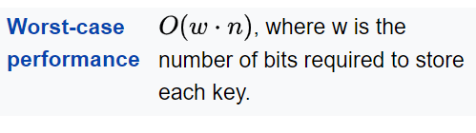
Radix Sort conditions:
enableRadixSort && sortOrder.length == 1 && SortPrefixUtils.canSortFullyWithPrefix(boundSortExpression
In computer science, radix sort is a non-comparative sorting algorithm. It avoids comparison by creating and distributing elements into buckets according to their radix. For elements with more than one significant digit, this bucketing process is repeated for each digit, while preserving the ordering of the prior step, until all digits have been considered. For this reason, radix sort has also been called bucket sort and digital sort.
https://en.wikipedia.org/wiki/Radix_sort

Slide 15
method createSorter(2)
val pageSize = SparkEnv.get.memoryManager.pageSizeBytes
rowSorter = UnsafeExternalRowSorter.create( schema, ordering, prefixComparator, prefixComputer, pageSize,
canUseRadixSort) if (testSpillFrequency > 0) { rowSorter.setTestSpillFrequency(testSpillFrequency) } rowSorter

Slide 16
sort method of UnsafeExternalRowSorter
public Iterator<InternalRow> sort(Iterator<UnsafeRow> inputIterator)
throws IOException { while (inputIterator.hasNext()) { insertRow(inputIterator.next()); } return sort(); }

Slide 17
UnsafeExternalRowSorter
public void insertRow(UnsafeRow row) throws IOException { final PrefixComputer.Prefix prefix = prefixComputer.computePrefix(row); sorter.insertRecord( row.getBaseObject(), row.getBaseOffset(), row.getSizeInBytes(), prefix.value, prefix.isNull ); numRowsInserted++; if (testSpillFrequency > 0 && (numRowsInserted % testSpillFrequency) == 0) { sorter.spill(); } }

Slide 18
public void insertRecord(
Object recordBase, long recordOffset, int length, long prefix, boolean prefixIsNull)
throws IOException {
assert(inMemSorter != null);
if (inMemSorter.numRecords() >= numElementsForSpillThreshold) {
logger.info("Spilling data because number of spilledRecords crossed the threshold " +
numElementsForSpillThreshold);
spill();
}
growPointerArrayIfNecessary();
int uaoSize = UnsafeAlignedOffset.getUaoSize();
// Need 4 or 8 bytes to store the record length.
final int required = length + uaoSize;
acquireNewPageIfNecessary(required);
final Object base = currentPage.getBaseObject();
final long recordAddress = taskMemoryManager.encodePageNumberAndOffset(currentPage, pageCursor);
UnsafeAlignedOffset.putSize(base, pageCursor, length);
pageCursor += uaoSize;
Platform.copyMemory(recordBase, recordOffset, base, pageCursor, length);
pageCursor += length;
inMemSorter.insertRecord(recordAddress, prefix, prefixIsNull);
}

Slide 19
UnsafeInMemorySorter
public void insertRecord(long recordPointer, long keyPrefix, boolean prefixIsNull) {
if (!hasSpaceForAnotherRecord()) {
throw new IllegalStateException("There is no space for new record");
}
if (prefixIsNull && radixSortSupport != null) {
// Swap forward a non-null record to make room for this one at the beginning of the array.
array.set(pos, array.get(nullBoundaryPos));
pos++;
array.set(pos, array.get(nullBoundaryPos + 1));
pos++;
// Place this record in the vacated position.
array.set(nullBoundaryPos, recordPointer);
nullBoundaryPos++;
array.set(nullBoundaryPos, keyPrefix);
nullBoundaryPos++;
} else {
array.set(pos, recordPointer);
pos++;
array.set(pos, keyPrefix);
pos++;
}
}

Slide 20
LongArray
private LongArray array
Within this buffer, position {2 * i} holds a pointer to the record at
index {@code i}, while position {2 * i + 1} in the array holds an 8-byte key prefix.
Only part of the array will be used to store the pointers, the rest part is preserved as
temporary buffer for sorting.
Record pointer
Key prefix
Record pointer
Key prefix

Slide 21
UnsafeExternalRowSorter
public Iterator<InternalRow> sort() throws IOException {
try {
final UnsafeSorterIterator sortedIterator = sorter.getSortedIterator();
if (!sortedIterator.hasNext()) {
// Since we won't ever call next() on an empty iterator, we need to clean up resources
// here in order to prevent memory leaks.
cleanupResources();
}
return new RowIterator() {
private final int numFields = schema.length();
private UnsafeRow row = new UnsafeRow(numFields);
@Override
public boolean advanceNext() {
try {
if (!isReleased && sortedIterator.hasNext()) {
sortedIterator.loadNext();
……..

Slide 22
public UnsafeSorterIterator getSortedIterator() throws IOException {
assert(recordComparatorSupplier != null);
if (spillWriters.isEmpty()) {
assert(inMemSorter != null);
readingIterator = new SpillableIterator(inMemSorter.getSortedIterator());
return readingIterator;
} else {
final UnsafeSorterSpillMerger spillMerger = new UnsafeSorterSpillMerger(
recordComparatorSupplier.get(), prefixComparator, spillWriters.size());
for (UnsafeSorterSpillWriter spillWriter : spillWriters) {
spillMerger.addSpillIfNotEmpty(spillWriter.getReader(serializerManager));
}
if (inMemSorter != null) {
readingIterator = new SpillableIterator(inMemSorter.getSortedIterator());
spillMerger.addSpillIfNotEmpty(readingIterator);
}
return spillMerger.getSortedIterator();
}
}

Slide 23
public UnsafeSorterIterator getSortedIterator() {
int offset = 0;
long start = System.nanoTime();
if (sortComparator != null) {
if (this.radixSortSupport != null) {
offset = RadixSort.sortKeyPrefixArray(
array, nullBoundaryPos, (pos - nullBoundaryPos) / 2L, 0, 7,
radixSortSupport.sortDescending(), radixSortSupport.sortSigned());
} else {
MemoryBlock unused = new MemoryBlock(
array.getBaseObject(),
array.getBaseOffset() + pos * 8L,
(array.size() - pos) * 8L);
LongArray buffer = new LongArray(unused);
Sorter<RecordPointerAndKeyPrefix, LongArray> sorter =
new Sorter<>(new UnsafeSortDataFormat(buffer));
sorter.sort(array, 0, pos / 2, sortComparator);
}
}

Slide 24
TimSort
/**
* A simple wrapper over the Java implementation [[TimSort]].
*
* The Java implementation is package private, and hence it cannot be called outside package
* org.apache.spark.util.collection. This is a simple wrapper of it that is available to spark.
*/
private[spark]
class Sorter[K, Buffer](private val s: SortDataFormat[K, Buffer]) {
private val timSort = new TimSort(s)
/**
* Sorts the input buffer within range [lo, hi).
*/
def sort(a: Buffer, lo: Int, hi: Int, c: Comparator[_ >: K]): Unit = {
timSort.sort(a, lo, hi, c)
}
}

Slide 25
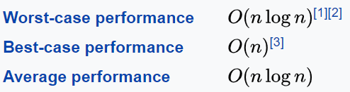
TimSort
Timsort is a hybrid stable sorting algorithm, derived from merge sort and insertion sort, designed to perform well on many kinds of real-world data. It was implemented by Tim Peters in 2002 for use in the Python programming language. The algorithm finds subsequences of the data that are already ordered (runs) and uses them to sort the remainder more efficiently. This is done by merging runs until certain criteria are fulfilled. Timsort has been Python's standard sorting algorithm since version 2.3. It is also used to sort arrays of non-primitive type in Java SE 7,[4] on the Android platform,[5] in GNU Octave,[6] on V8,[7] and Swift.[8]
Timsort was designed to take advantage of runs of consecutive ordered elements that already exist in most real-world data, natural runs. It iterates over the data collecting elements into runs and simultaneously putting those runs in a stack. Whenever the runs on the top of the stack match a merge criterion, they are merged together.
https://en.wikipedia.org/wiki/Timsort

Slide 26
public UnsafeSorterIterator getSortedIterator() throws IOException {
assert(recordComparatorSupplier != null);
if (spillWriters.isEmpty()) {
assert(inMemSorter != null);
readingIterator = new SpillableIterator(inMemSorter.getSortedIterator());
return readingIterator;
} else {
final UnsafeSorterSpillMerger spillMerger = new UnsafeSorterSpillMerger(
recordComparatorSupplier.get(), prefixComparator, spillWriters.size());
for (UnsafeSorterSpillWriter spillWriter : spillWriters) {
spillMerger.addSpillIfNotEmpty(spillWriter.getReader(serializerManager));
}
if (inMemSorter != null) {
readingIterator = new SpillableIterator(inMemSorter.getSortedIterator());
spillMerger.addSpillIfNotEmpty(readingIterator);
}
return spillMerger.getSortedIterator();
}
}

Slide 27
getSortedIterator of UnsafeSorterSpillMerger
return new UnsafeSorterIterator() {
private UnsafeSorterIterator spillReader;
@Override
public boolean hasNext() {
return !priorityQueue.isEmpty() || (spillReader != null && spillReader.hasNext());
}
@Override
public void loadNext() throws IOException {
if (spillReader != null) {
if (spillReader.hasNext()) {
spillReader.loadNext();
priorityQueue.add(spillReader);
}
}
spillReader = priorityQueue.remove();
}
@Override
public Object getBaseObject() { return spillReader.getBaseObject(); }

Slide 28
1
{1,3,5,7}
Queue{1,2,10}
2
{2,4,6}
10
{10,10,20}
{1,2,3….

Slide 29
Summary of Part4
Sort
SortExec
Alphasort
prefixComputer
UnsafeExternalRowSorter
RadixSort
TimSort
UnsafeSorterSpillMerger
PriorityQueue
Join us in telegram t.me/apache_spark

