Slide 1
Spark “group by” transformation deep dive
Part 1
Introduction
Nikolay
Join us in telegram t.me/apache_spark
2020

Slide 2
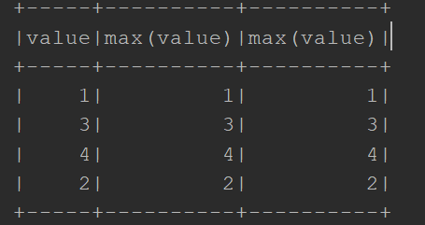
Example
val rdd = spark.sparkContext.parallelize(Seq(1,1,2,2,2,3,3,3,4),2)
val ds0: Dataset[Int] = spark.sqlContext.createDataset(rdd)
val ds1 = ds0.groupBy(col("value")).max("value","value")
ds1.show()

Slide 3
Class Dataset method groupBy
/** * Groups the Dataset using the specified columns, so we can run aggregation on them. See * [[RelationalGroupedDataset]] for all the available aggregate functions. * * {{{ * // Compute the average for all numeric columns grouped by department. * ds.groupBy($"department").avg() * * // Compute the max age and average salary, grouped by department and gender. * ds.groupBy($"department", $"gender").agg(Map( * "salary" -> "avg", * "age" -> "max" * )) * }}} * * @group untypedrel * @since 2.0.0 */ @scala.annotation.varargs def groupBy(cols: Column*): RelationalGroupedDataset = { RelationalGroupedDataset(toDF(), cols.map(_.expr), RelationalGroupedDataset.GroupByType) }

Slide 4
Class RelationalGroupedDataset
/** * A set of methods for aggregations on a `DataFrame`, created by [[Dataset#groupBy groupBy]], * [[Dataset#cube cube]] or [[Dataset#rollup rollup]] (and also `pivot`). * * The main method is the `agg` function, which has multiple variants. This class also contains * some first-order statistics such as `mean`, `sum` for convenience. * * @note This class was named `GroupedData` in Spark 1.x. * * @since 2.0.0 */
class RelationalGroupedDataset protected[sql] (
private[sql] val df: DataFrame,
private[sql] val groupingExprs: Seq[Expression],
groupType: RelationalGroupedDataset.GroupType
)

Slide 5
max method of RelationalGroupedDataset
/** * Compute the max value for each numeric columns for each group. * The resulting `DataFrame` will also contain the grouping columns. * When specified columns are given, only compute the max values for them. * * @since 1.3.0 */ @scala.annotation.varargs def max(colNames: String*): DataFrame = { aggregateNumericColumns(colNames : _*)(Max) }

Slide 6
agg method of RelationalGroupedDataset
/** * (Scala-specific) Compute aggregates by specifying a map from column name to * aggregate methods. The resulting `DataFrame` will also contain the grouping columns. * * The available aggregate methods are `avg`, `max`, `min`, `sum`, `count`. * {{{ * // Selects the age of the oldest employee and the aggregate expense for each department * df.groupBy("department").agg(Map( * "age" -> "max", * "expense" -> "sum" * )) * }}} * * @since 1.3.0 */ def agg(exprs: Map[String, String]): DataFrame = { toDF(exprs.map { case (colName, expr) => strToExpr(expr)(df(colName).expr) }.toSeq) }

Slide 7
toDF method of RelationalGroupedDataset
private[this] def toDF(aggExprs: Seq[Expression]): DataFrame = { val aggregates = if (df.sparkSession.sessionState.conf.dataFrameRetainGroupColumns) { groupingExprs ++ aggExprs } else { aggExprs } val aliasedAgg = aggregates.map(alias) groupType match { case RelationalGroupedDataset.GroupByType => Dataset.ofRows(df.sparkSession, Aggregate(groupingExprs, aliasedAgg, df.logicalPlan)) case RelationalGroupedDataset.RollupType => Dataset.ofRows( df.sparkSession, Aggregate(Seq(Rollup(groupingExprs)), aliasedAgg, df.logicalPlan)) case RelationalGroupedDataset.CubeType => Dataset.ofRows( df.sparkSession, Aggregate(Seq(Cube(groupingExprs)), aliasedAgg, df.logicalPlan)) case RelationalGroupedDataset.PivotType(pivotCol, values) => val aliasedGrps = groupingExprs.map(alias) Dataset.ofRows( df.sparkSession, Pivot(Some(aliasedGrps), pivotCol, values, aggExprs, df.logicalPlan)) } }

Slide 8
method ofRows of Dataset class
def ofRows(sparkSession: SparkSession, logicalPlan: LogicalPlan): DataFrame = { val qe = sparkSession.sessionState.executePlan(logicalPlan) qe.assertAnalyzed() new Dataset[Row](sparkSession, qe, RowEncoder(qe.analyzed.schema)) }

Slide 9
sparkPlan
class SparkPlanner( val sparkContext: SparkContext, val conf: SQLConf, val experimentalMethods: ExperimentalMethods) extends SparkStrategies { def numPartitions: Int = conf.numShufflePartitions override def strategies: Seq[Strategy] = experimentalMethods.extraStrategies ++ extraPlanningStrategies ++ ( LogicalQueryStageStrategy :: PythonEvals :: DataSourceV2Strategy :: FileSourceStrategy :: DataSourceStrategy(conf) :: SpecialLimits :: Aggregation :: Window :: JoinSelection :: InMemoryScans :: BasicOperators :: Nil)

Slide 10
object Aggregation extends Strategy { def apply(plan: LogicalPlan): Seq[SparkPlan] = plan match { case Aggregation(groupingExpressions, aggExpressions, resultExpressions, child) ….
… val aggregateOperator = if (functionsWithDistinct.isEmpty) { aggregate.AggUtils.planAggregateWithoutDistinct( normalizedGroupingExpressions, aggregateExpressions, resultExpressions, planLater(child)) } else { aggregate.AggUtils.planAggregateWithOneDistinct( normalizedGroupingExpressions, functionsWithDistinct, functionsWithoutDistinct, resultExpressions, planLater(child)) } aggregateOperator

Slide 11
def planAggregateWithoutDistinct( groupingExpressions: Seq[NamedExpression], aggregateExpressions: Seq[AggregateExpression], resultExpressions: Seq[NamedExpression], child: SparkPlan): Seq[SparkPlan] = { // Check if we can use HashAggregate. // 1. Create an Aggregate Operator for partial aggregations. val groupingAttributes = groupingExpressions.map(_.toAttribute) val partialAggregateExpressions = aggregateExpressions.map(_.сорус(mode = Partial)) val partialAggregateAttributes = partialAggregateExpressions.flatMap(_.aggregateFunction.aggBufferAttributes) val partialResultExpressions = groupingAttributes ++ partialAggregateExpressions.flatMap(_.aggregateFunction.inputAggBufferAttributes) val partialAggregate = createAggregate( requiredChildDistributionExpressions = None, groupingExpressions = groupingExpressions, aggregateExpressions = partialAggregateExpressions, aggregateAttributes = partialAggregateAttributes, initialInputBufferOffset = 0, resultExpressions = partialResultExpressions, child = child)

Slide 12
// 2. Create an Aggregate Operator for final aggregations. val finalAggregateExpressions = aggregateExpressions.map(_.copy(mode = Final)) // The attributes of the final aggregation buffer, which is presented as input to the result // projection: val finalAggregateAttributes = finalAggregateExpressions.map(_.resultAttribute) val finalAggregate = createAggregate( requiredChildDistributionExpressions = Some(groupingAttributes), groupingExpressions = groupingAttributes, aggregateExpressions = finalAggregateExpressions, aggregateAttributes = finalAggregateAttributes, initialInputBufferOffset = groupingExpressions.length, resultExpressions = resultExpressions, child = partialAggregate) finalAggregate :: Nil

Slide 13
private def createAggregate( requiredChildDistributionExpressions: Option[Seq[Expression]] = None, groupingExpressions: Seq[NamedExpression] = Nil, aggregateExpressions: Seq[AggregateExpression] = Nil, aggregateAttributes: Seq[Attribute] = Nil, initialInputBufferOffset: Int = 0, resultExpressions: Seq[NamedExpression] = Nil, child: SparkPlan): SparkPlan = { val useHash = HashAggregateExec.supportsAggregate( aggregateExpressions.flatMap(_.aggregateFunction.aggBufferAttributes)) if (useHash) { HashAggregateExec( requiredChildDistributionExpressions = requiredChildDistributionExpressions, groupingExpressions = groupingExpressions, aggregateExpressions = aggregateExpressions, aggregateAttributes = aggregateAttributes, initialInputBufferOffset = initialInputBufferOffset, resultExpressions = resultExpressions, child = child) } else {

Slide 14
if (useHash) { HashAggregateExec( requiredChildDistributionExpressions = requiredChildDistributionExpressions, groupingExpressions = groupingExpressions, aggregateExpressions = aggregateExpressions, aggregateAttributes = aggregateAttributes, initialInputBufferOffset = initialInputBufferOffset, resultExpressions = resultExpressions, child = child) } else { val objectHashEnabled = child.sqlContext.conf.useObjectHashAggregation val useObjectHash = ObjectHashAggregateExec.supportsAggregate(aggregateExpressions) if (objectHashEnabled && useObjectHash) { ObjectHashAggregateExec( requiredChildDistributionExpressions = requiredChildDistributionExpressions, groupingExpressions = groupingExpressions, aggregateExpressions = aggregateExpressions, aggregateAttributes = aggregateAttributes, initialInputBufferOffset = initialInputBufferOffset, resultExpressions = resultExpressions, child = child) } else { SortAggregateExec( requiredChildDistributionExpressions = requiredChildDistributionExpressions, groupingExpressions = groupingExpressions, aggregateExpressions = aggregateExpressions, aggregateAttributes = aggregateAttributes, initialInputBufferOffset = initialInputBufferOffset, resultExpressions = resultExpressions, child = child) }

Slide 15
protected override def doExecute(): RDD[InternalRow] = attachTree(this, "execute") { val numOutputRows = longMetric("numOutputRows") val peakMemory = longMetric("peakMemory") val spillSize = longMetric("spillSize") val avgHashProbe = longMetric("avgHashProbe") val aggTime = longMetric("aggTime") child.execute().mapPartitionsWithIndex { (partIndex, iter) => val beforeAgg = System.nanoTime() val hasInput = iter.hasNext val res = if (!hasInput && groupingExpressions.nonEmpty) { // This is a grouped aggregate and the input iterator is empty, // so return an empty iterator. Iterator.empty } else { val aggregationIterator = new TungstenAggregationIterator( partIndex, groupingExpressions, aggregateExpressions, aggregateAttributes, initialInputBufferOffset, resultExpressions, (expressions, inputSchema) => newMutableProjection(expressions, inputSchema, subexpressionEliminationEnabled), child.output,

Slide 16
== Parsed Logical Plan ==
'Aggregate ['value], [unresolvedalias('value, None), max(value#2) AS max(value)#7]
+- SerializeFromObject [input[0, int, false] AS value#2]
+- ExternalRDD [obj#1]
== Analyzed Logical Plan ==
value: int, max(value): int
Aggregate [value#2], [value#2, max(value#2) AS max(value)#7]
+- SerializeFromObject [input[0, int, false] AS value#2]
+- ExternalRDD [obj#1]
== Optimized Logical Plan ==
Aggregate [value#2], [value#2, max(value#2) AS max(value)#7]
+- SerializeFromObject [input[0, int, false] AS value#2]
+- ExternalRDD [obj#1]
== Physical Plan ==
*(2) HashAggregate(keys=[value#2], functions=[max(value#2)], output=[value#2, max(value)#7])
+- Exchange hashpartitioning(value#2, 200), true, [id=#20]
+- *(1) HashAggregate(keys=[value#2], functions=[partial_max(value#2)], output=[value#2, max#11])
+- *(1) SerializeFromObject [input[0, int, false] AS value#2]
+- Scan[obj#1]

Slide 17
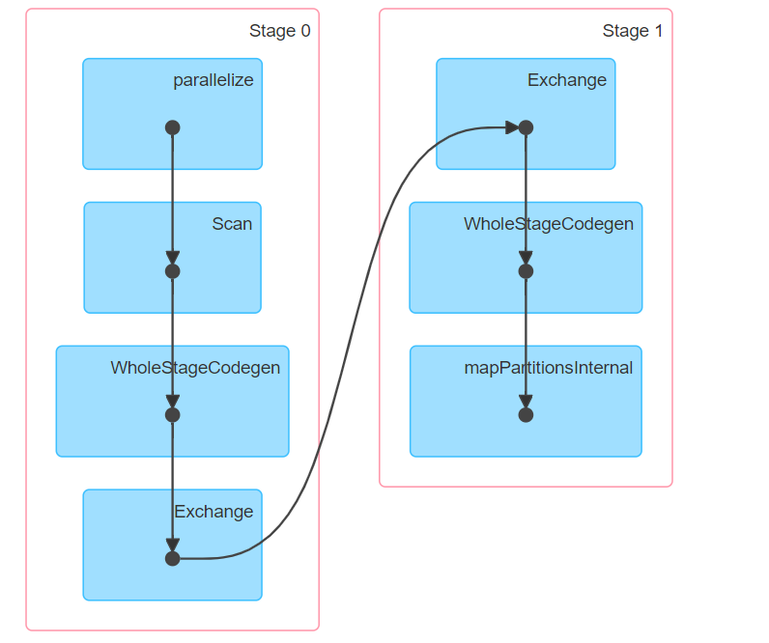

Slide 18
Conf: spark.sql.shuffle.partitions

Slide 19
Summary
HashAggregateExec
to define aggregation we need to pass list of columns and list of aggregation functions
Spark can use either “Hash” or “Sort” aggregation
Next time we will talk about TungstenAggregationIterator

