Slide 1
Spark “group by” deep dive
Part 2
TungstenAggregationIterator
Nikolay
Join us in telegram t.me/apache_spark
2020

Slide 2
Example
val ds3 = ds2.groupBy(col("value")).max("value")
+-----+-----------------+
|value|max(value)|
+-----+-----------------+

Slide 3
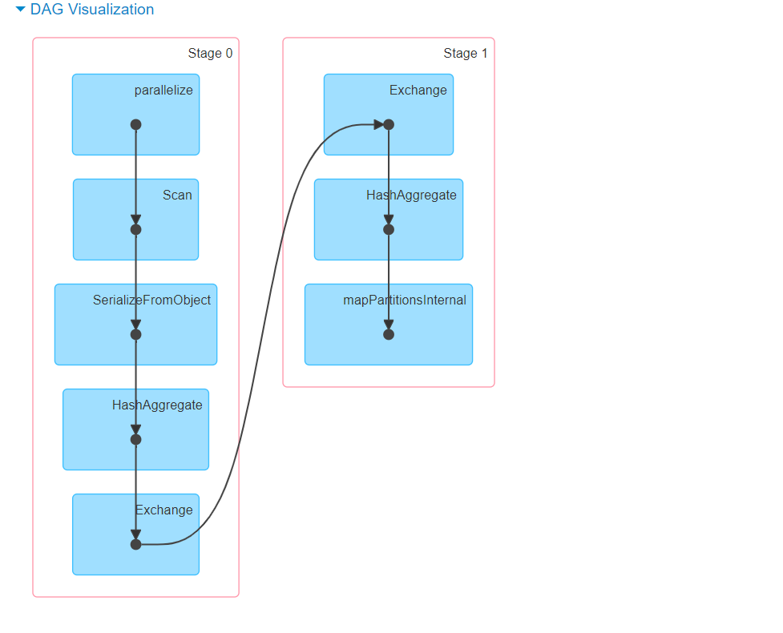

Slide 4
Conf: spark.sql.shuffle.partitions

Slide 5
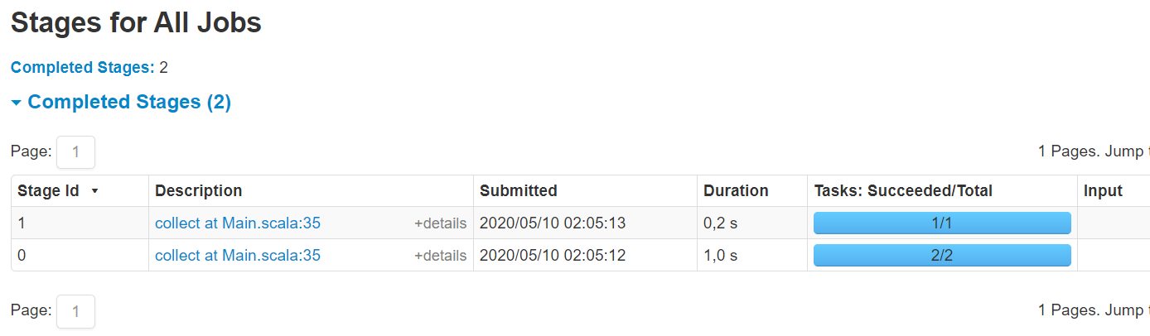
spark.sql.shuffle.partitions == 1

Slide 6
== Parsed Logical Plan ==
'Aggregate [value#2], [value#2, 'max(value#2) AS max(value)#6]
+- SerializeFromObject [input[0, int, false] AS value#2]
+- ExternalRDD [obj#1]
== Analyzed Logical Plan ==
value: int, max(value): int
Aggregate [value#2], [value#2, max(value#2) AS max(value)#6]
+- SerializeFromObject [input[0, int, false] AS value#2]
+- ExternalRDD [obj#1]
== Optimized Logical Plan ==
Aggregate [value#2], [value#2, max(value#2) AS max(value)#6]
+- SerializeFromObject [input[0, int, false] AS value#2]
+- ExternalRDD [obj#1]
== Physical Plan ==
HashAggregate(keys=[value#2], functions=[max(value#2)], output=[value#2, max(value)#6])
+- Exchange hashpartitioning(value#2, 200), true, [id=#14]
+- HashAggregate(keys=[value#2], functions=[partial_max(value#2)], output=[value#2, max#11])
+- SerializeFromObject [input[0, int, false] AS value#2]
+- Scan[obj#1

Slide 7
method doExecute() of HashAggregateExec
child.execute().mapPartitionsWithIndex { (partIndex, iter) => val beforeAgg = System.nanoTime() val hasInput = iter.hasNext val res = if (!hasInput && groupingExpressions.nonEmpty) { Iterator.empty } else { val aggregationIterator = new TungstenAggregationIterator( partIndex, groupingExpressions, aggregateExpressions, aggregateAttributes, initialInputBufferOffset, resultExpressions, (expressions, inputSchema) => newMutableProjection(expressions, inputSchema, subexpressionEliminationEnabled), child.output, iter, testFallbackStartsAt, numOutputRows, peakMemory, spillSize, avgHashProbe) if (!hasInput && groupingExpressions.isEmpty) { numOutputRows += 1 Iterator.single[UnsafeRow](aggregationIterator.outputForEmptyGroupingKeyWithoutInput()) } else { aggregationIterator } } aggTime += NANOSECONDS.toMillis(System.nanoTime() - beforeAgg) res }

Slide 8
Child Iterator
Child Iterator
TungstenAggregationIterator
mode = Partial
TungstenAggregationIterator
mode = Partial
mode = Final
TungstenAggregationIterator

Slide 9
TungstenAggregationIterator
/**
* An iterator used to evaluate aggregate functions. It operates on [[UnsafeRow]]s.
*
* This iterator first uses hash-based aggregation to process input rows. It uses
* a hash map to store groups and their corresponding aggregation buffers. If
* this map cannot allocate memory from memory manager, it spills the map into disk
* and creates a new one. After processed all the input, then merge all the spills
* together using external sorter, and do sort-based aggregation.
*
* The process has the following step:
* - Step 0: Do hash-based aggregation.
* - Step 1: Sort all entries of the hash map based on values of grouping expressions and
* spill them to disk.
* - Step 2: Create an external sorter based on the spilled sorted map entries and reset the map.
* - Step 3: Get a sorted [[KVIterator]] from the external sorter.
* - Step 4: Repeat step 0 until no more input.
* - Step 5: Initialize sort-based aggregation on the sorted iterator.
* Then, this iterator works in the way of sort-based aggregation.
* */

Slide 10
TungstenAggregationIterator
* The code of this class is organized as follows:
* - Part 1: Initializing aggregate functions.
* - Part 2: Methods and fields used by setting aggregation buffer values,
* processing input rows from inputIter, and generating output
* rows.
* - Part 3: Methods and fields used by hash-based aggregation.
* - Part 4: Methods and fields used when we switch to sort-based aggregation.
* - Part 5: Methods and fields used by sort-based aggregation.
* - Part 6: Loads input and process input rows.
* - Part 7: Public methods of this iterator.
* - Part 8: A utility function used to generate a result when there is no
* input and there is no grouping expression.

Slide 11
UnsafeFixedWidthAggregationMap
// This is the hash map used for hash-based aggregation. It is
//backed by an UnsafeFixedWidthAggregationMap and it is used
//to store all groups and their corresponding aggregation buffers for hash-based aggregation.
private[this] val hashMap = new UnsafeFixedWidthAggregationMap( initialAggregationBuffer, StructType.fromAttributes(aggregateFunctions.flatMap(_.aggBufferAttributes)), StructType.fromAttributes(groupingExpressions.map(_.toAttribute)), TaskContext.get(), 1024 * 16, // initial capacity TaskContext.get().taskMemoryManager().pageSizeBytes )

Slide 12
processInputs
// The function used to read and process input rows. When processing input rows, // it first uses hash-based aggregation by putting groups and their buffers in // hashMap. If there is not enough memory, it will multiple hash-maps, spilling // after each becomes full then using sort to merge these spills, finally do sort // based aggregation.
private def processInputs(fallbackStartsAt: (Int, Int)): Unit = { if (groupingExpressions.isEmpty) { // If there is no grouping expressions, we can just reuse the same buffer
// over and over again. // Note that it would be better to eliminate the hash map entirely in the
// future. val groupingKey = groupingProjection.apply(null) val buffer: UnsafeRow = hashMap.getAggregationBufferFromUnsafeRow(groupingKey) while (inputIter.hasNext) { val newInput = inputIter.next() processRow(buffer, newInput) } } else {

Slide 13
processInputs(1)
while (inputIter.hasNext) { val newInput = inputIter.next() val groupingKey = groupingProjection.apply(newInput) var buffer: UnsafeRow = null if (i < fallbackStartsAt._2) { buffer = hashMap.getAggregationBufferFromUnsafeRow(groupingKey) } if (buffer == null) { val sorter = hashMap.destructAndCreateExternalSorter() if (externalSorter == null) { externalSorter = sorter } else { externalSorter.merge(sorter) } i = 0 buffer = hashMap.getAggregationBufferFromUnsafeRow(groupingKey) if (buffer == null) { // failed to allocate the first page // scalastyle:off throwerror throw new SparkOutOfMemoryError("No enough memory for aggregation") // scalastyle:on throwerror } } processRow(buffer, newInput) i += 1 }

Slide 14
processInputs(2)
if (externalSorter != null) { val sorter = hashMap.destructAndCreateExternalSorter() externalSorter.merge(sorter) hashMap.free() switchToSortBasedAggregation() } }

Slide 15
processRow
// Initializing functions used to process a row.
protected def generateProcessRow(
expressions: Seq[AggregateExpression],
functions: Seq[AggregateFunction],
inputAttributes: Seq[Attribute]): (InternalRow, InternalRow) => Unit = {
val joinedRow = new JoinedRow
...
val updateFunctions = functions.zipWithIndex.collect {
case (ae: ImperativeAggregate, i) =>
expressions(i).mode match {
case Partial | Complete =>
(buffer: InternalRow, row: InternalRow) => ae.update(buffer,row)
case PartialMerge | Final =>
(buffer: InternalRow, row: InternalRow) => ae.merge(buffer,row)
}
}.toArray
...

Slide 16
processRow(2)
(currentBuffer: InternalRow, row: InternalRow) => {
// Process all expression-based aggregate functions.
updateProjection.target(currentBuffer)(joinedRow(currentBuffer, row))
// Process all imperative aggregate functions.
var i = 0
while (i < updateFunctions.length) {
updateFunctions(i)(currentBuffer, row)
i += 1
}
}
...

Slide 17
/** * Start processing input rows. */
processInputs(testFallbackStartsAt.getOrElse((Int.MaxValue, Int.MaxValue))) // If we did not switch to sort-based aggregation in processInputs, // we pre-load the first key-value pair from the map (to make hasNext idempotent). if (!sortBased) { // First, set aggregationBufferMapIterator. aggregationBufferMapIterator = hashMap.iterator() // Pre-load the first key-value pair from the aggregationBufferMapIterator. mapIteratorHasNext = aggregationBufferMapIterator.next() // If the map is empty, we just free it. if (!mapIteratorHasNext) { hashMap.free() } }

Slide 18
next method of TungstenAggregationIterator
override final def next(): UnsafeRow = {
if (hasNext) {
val res = if (sortBased) {
// Process the current group.
processCurrentSortedGroup()
// Generate output row for the current group.
val outputRow = generateOutput(currentGroupingKey, sortBasedAggregationBuffer)
// Initialize buffer values for the next group.
sortBasedAggregationBuffer.copyFrom(initialAggregationBuffer)
outputRow
}

Slide 19
next method of TungstenAggregationIterator(2)
} else { // We did not fall back to sort-based aggregation. val result = generateOutput( aggregationBufferMapIterator.getKey, aggregationBufferMapIterator.getValue) // Pre-load next key-value pair form aggregationBufferMapIterator to make hasNext // idempotent. mapIteratorHasNext = aggregationBufferMapIterator.next() if (!mapIteratorHasNext) { // If there is no input from aggregationBufferMapIterator, we copy current result. val resultCopy = result.copy() // Then, we free the map. hashMap.free() resultCopy } else { result }

Slide 20
generateOutput
if (modes.contains(Final) || modes.contains(Complete)) {
val evalExpressions = aggregateFunctions.map {
case ae: DeclarativeAggregate => ae.evaluateExpression
case agg: AggregateFunction => NoOp
}
…
(currentGroupingKey: UnsafeRow, currentBuffer: InternalRow) => {
// Generate results for all expression-based aggregate functions.
expressionAggEvalProjection(currentBuffer)
// Generate results for all imperative aggregate functions.
var i = 0
while (i < allImperativeAggregateFunctions.length) {
aggregateResult.update(
allImperativeAggregateFunctionPositions(i),
allImperativeAggregateFunctions(i).eval(currentBuffer))
i += 1
}
resultProjection(joinedRow(currentGroupingKey, aggregateResult))
}
}

Slide 21
Summary
TungstenAggregationIterator
hashMap
processInputs
Mode=Partial,Final
processRow
Next
Next meeting we will talk in details about
AggregateFunction:
ImperativeAggregate( update, merge, eval)
DeclarativeAggregate( updateExpressions, mergeExpressions, evaluateExpression)

