Slide 1
Spark “group by” transformation deep dive
Part 3
User defined aggregate functions(UDAF)
Nikolay
Join us in telegram t.me/apache_spark
2020

Slide 2
aggregation diagram for group by value % 2 max(value)
{1,1,2,3,4}
{1,1,1,2,2,2,2}
{1,2}
Mode =Partial
Mode =Partial
Mode =Partial
{(0,4),(1,3)}
{(0,1),(1,2)}
{(1,2)}
update
update
index
{(1,3}
In
de
x
{(1,2)}
In
de
x
{(1,2)}
{(0,4)}
{(0,1)}
{}
({0,4})
({1,3})
merge
Mode = Final
merge
Mode = Final
eval
spark.sql.shuffle.partitions == 2
eval

Slide 3
Spark >= 1.5
The base class for implementing user-defined aggregate functions (UDAF)
UserDefinedAggregateFunction

Slide 4
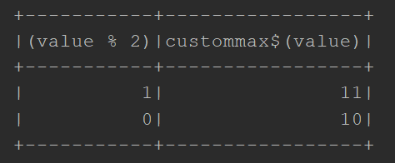
Example
val ds0 = spark.sqlContext.createDataset(spark.sparkContext.parallelize(Seq(1,2,3,2,2,2,2,1,1,1,11,10),2))
val ds2 = ds0.groupBy($"value" % 2).agg(CustomMax($"value"))
ds2.show()

Slide 5
object CustomMax extends UserDefinedAggregateFunction {
override def inputSchema: StructType = StructType(Seq(StructField("a", LongType, true)))
override def bufferSchema: StructType = StructType(Seq(StructField("b", LongType, true)))
override def dataType: DataType = LongType
override def deterministic: Boolean = true
override def initialize(buffer: MutableAggregationBuffer): Unit = buffer.update(0, Long.MinValue)
override def update(buffer: MutableAggregationBuffer, input: Row): Unit = if (!input.isNullAt(0))
buffer.update(0, Math.max(input.getLong(0),buffer.getLong(0)))
override def merge(buffer1: MutableAggregationBuffer, buffer2: Row): Unit = {
buffer1.update(0, Math.max( buffer1.getLong(0), buffer2.getLong(0)))
}
override def evaluate(buffer: Row): Any = buffer.getLong(0)
}

Slide 6
abstract class UserDefinedAggregateFunction
/** * A `StructType` represents data types of input arguments of this aggregate
* function. For example, if a [[UserDefinedAggregateFunction]] expects two
* input arguments with type of `DoubleType` and `LongType`, the returned
`StructType` will look like * * ``` * new StructType() * .add("doubleInput", DoubleType) * .add("longInput", LongType) * ``` * * The name of a field of this `StructType` is only used to identify the
corresponding input argument. Users can choose names to identify the input
arguments. */ def inputSchema: StructType

Slide 7
/**
* A `StructType` represents data types of values in the aggregation buffer.
* For example, if a [[UserDefinedAggregateFunction]]'s buffer has two values
* (i.e. two intermediate values) with type of `DoubleType` and `LongType`,
* the returned `StructType` will look like
*
* ```
* new StructType()
* .add("doubleInput", DoubleType)
* .add("longInput", LongType)
* ```
*
* The name of a field of this `StructType` is only used to identify the corresponding
* buffer value. Users can choose names to identify the input arguments.
*
* @since 1.5.0
*/
def bufferSchema: StructType

Slide 8
/**
* The `DataType` of the returned value of this [[UserDefinedAggregateFunction]].
*
* @since 1.5.0
*/
def dataType: DataType
/**
* Returns true iff this function is deterministic, i.e. given the same input,
* always return the same output.
*
* @since 1.5.0
*/
def deterministic: Boolean

Slide 9
/**
* Initializes the given aggregation buffer, i.e. the zero value of the aggregation buffer.
*
* The contract should be that applying the merge function on two initial buffers should just
* return the initial buffer itself, i.e.
* `merge(initialBuffer, initialBuffer)` should equal `initialBuffer`.
*
* @since 1.5.0
*/
def initialize(buffer: MutableAggregationBuffer): Unit
/**
* Updates the given aggregation buffer `buffer` with new input data from `input`.
*
* This is called once per input row.
*
* @since 1.5.0
*/
def update(buffer: MutableAggregationBuffer, input: Row): Unit

Slide 10
/**
* Merges two aggregation buffers and stores the updated buffer values back to `buffer1`.
*
* This is called when we merge two partially aggregated data together.
*
* @since 1.5.0
*/
def merge(buffer1: MutableAggregationBuffer, buffer2: Row): Unit
/**
* Calculates the final result of this [[UserDefinedAggregateFunction]] based on the given
* aggregation buffer.
*
* @since 1.5.0
*/
def evaluate(buffer: Row): Any

Slide 11
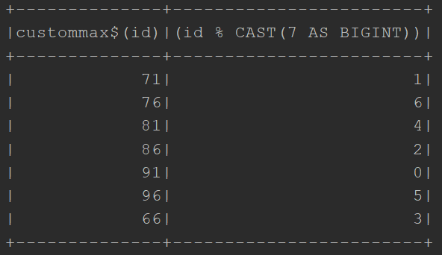
Example in SQL
spark.udf.register("custom_max",CustomMax)
spark.sql("select custom_max(id) , id%7 from range(1,100,5) group by id%7")
.show()

Slide 12
object CustomAvg extends UserDefinedAggregateFunction {
override def inputSchema: StructType = StructType(Seq(StructField("", DoubleType, true)))
override def bufferSchema: StructType = StructType(Seq(StructField("cnt", LongType, true),StructField("acc", DoubleType, true)))
override def dataType: DataType = DoubleType
override def deterministic: Boolean = true
override def initialize(buffer: MutableAggregationBuffer): Unit = {
buffer(0) = 0L;buffer(1) = 0.0
}
override def update(buffer: MutableAggregationBuffer, input: Row): Unit = {
buffer.update(0,buffer.getLong(0)+1);buffer.update(1,buffer.getDouble(1) + input.getDouble(0))
}
override def merge(buffer1: MutableAggregationBuffer, buffer2: Row): Unit = {
buffer1.update(0,buffer1.getLong(0) + buffer2.getLong(0))
buffer1.update(1,buffer1.getDouble(1) + buffer2.getDouble(1))
}
override def evaluate(buffer: Row): Any = buffer.getDouble(1)/buffer.getLong(0)
}

Slide 13
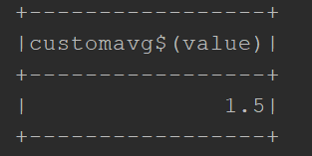
Example
val ds0 = spark.sqlContext.createDataset(spark.sparkContext.parallelize(Seq(1L,2)))
val ds2 = ds0.agg(CustomAvg($"value"))
ds2.show()

Slide 14
object CustomCollectList extends UserDefinedAggregateFunction{
override def inputSchema: StructType = StructType(Array(StructField("inp", LongType, true)))
override def bufferSchema: StructType = StructType(Array(StructField("elements", ArrayType(LongType))))
override def dataType: DataType = ArrayType(LongType)
override def deterministic: Boolean = true
override def initialize(buffer: MutableAggregationBuffer): Unit = buffer.update( 0, Seq.empty[Long])
override def update(buffer: MutableAggregationBuffer, input: Row): Unit = {
buffer.update(0, buffer.getAs[Seq[Long]](0) :+ input.getLong(0))
}
override def merge(buffer1: MutableAggregationBuffer, buffer2: Row): Unit = {
buffer1.update(0, buffer1.getAs[Seq[Long]](0) ++ buffer2.getAs[Seq[Long]](0))
}
override def evaluate(buffer: Row): Any = {
buffer.getAs[Seq[Long]](0)
}
}

Slide 15
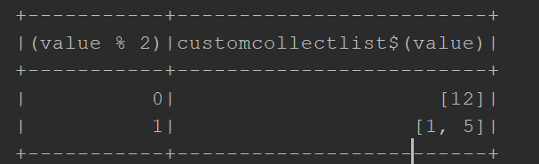
Example
val ds0 = spark.sqlContext.createDataset(spark.sparkContext.parallelize(Seq(1L,5,12),2))
val ds2 = ds0.groupBy($"value" % 2).agg(CustomCollectList($"value"))
ds2.show()

Slide 16
Spark >= 2.0
case class CustomMin(col: String)
extends Aggregator[Row, Long, Long] with Serializable {
def zero = Long.MaxValue
def reduce(acc: Long, x: Row) =
Math.min(acc, Option(x.getAs[Long](col)).getOrElse(zero))
def merge(acc1: Long, acc2: Long) = Math.min(acc1, acc2)
def finish(acc: Long) = acc
def bufferEncoder: Encoder[Long] = Encoders.scalaLong
def outputEncoder: Encoder[Long] = Encoders.scalaLong
}

Slide 17
/**
* A base class for user-defined aggregations, which can be used in `Dataset` operations to take
* all of the elements of a group and reduce them to a single value.
*
* For example, the following aggregator extracts an `int` from a specific class and adds them up:
* {{{
* case class Data(i: Int)
*
* val customSummer = new Aggregator[Data, Int, Int] {
* def zero: Int = 0
* def reduce(b: Int, a: Data): Int = b + a.i
* def merge(b1: Int, b2: Int): Int = b1 + b2
* def finish(r: Int): Int = r
* }.toColumn()
*
* val ds: Dataset[Data] = ...
* val aggregated = ds.select(customSummer)
* }}}
* Based loosely on Aggregator from Algebird: https://github.com/twitter/algebird
* @since 1.6.0
*/

Slide 18
abstract class Aggregator[-IN, BUF, OUT] extends Serializable {
/**
* A zero value for this aggregation. Should satisfy the property that any b + zero = b.
*/
def zero: BUF
/**
* Combine two values to produce a new value. For performance, the function may modify `b` and
* return it instead of constructing new object for b.
*/
def reduce(b: BUF, a: IN): BUF
/**
* Merge two intermediate values.
*/
def merge(b1: BUF, b2: BUF): BUF
/**
* Transform the output of the reduction.
*/
def finish(reduction: BUF): OUT

Slide 19
collect_set
class CustomCollectSet[T:TypeTag](col: String)
extends Aggregator[Row, Set[T], Set[T]] with Serializable {
def zero = Set.empty[T]
def reduce(acc: Set[T], x: Row) =
acc + x.getAs[T](0)
def merge(acc1: Set[T], acc2: Set[T]) = acc1 ++ acc2
def finish(acc: Set[T]) = acc
def bufferEncoder: Encoder[Set[T]] = Encoders.kryo[Set[T]]
def outputEncoder: Encoder[Set[T]] = ExpressionEncoder[Set[T]]()
}

Slide 20
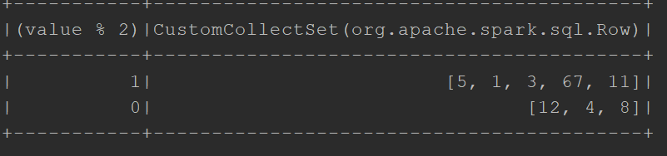
val ds0 = spark.sqlContext.createDataset(spark.sparkContext.parallelize(Seq(1L,11,12,3,4,5,67,1,4,8),2))
val ds2 = ds0.groupBy($"value" % 2).agg(new CustomCollectSet[Long]("value").toColumn)
ds2.show()

Slide 21
Spark >= 3.0
Scala UserDefinedAggregateFunction is being deprecated (SPARK-30423 Deprecate UserDefinedAggregateFunction) in favor of registered Aggregator

Slide 22
Summary
UserDefinedAggregateFunction
update
merge
evaluate
Aggregator
reduce
merge
finish

Slide 23
https://jaceklaskowski.gitbooks.io/mastering-spark-sql/spark-sql-Aggregator.html
https://gist.github.com/zyxue/69100fa70e2b26abc46d229022f2d1ef
https://stackoverflow.com/questions/41483774/apply-a-custom-spark-aggregator-on-multiple-columns-spark-2-0
https://towardsdatascience.com/udaf-and-aggregators-custom-aggregation-approaches-for-datasets-in-apache-spark-68dc4d09796d
http://blog.nuvola-tech.com/2017/10/spark-custom-window-function-for-sessionization/
http://baahu.in/spark-custom-partitioner-java-example/
https://www.youtube.com/watch?v=fk-5LeH_tjw
https://stackoverflow.com/questions/47293454/spark-udaf-with-arraytype-as-bufferschema-performance-issues

