Slide 1
Spark Whole Stage Code Generation
Part 1
Nikolay
Join us in telegram t.me/apache_spark
2020

Slide 2
Simple example
val ds0: Dataset[Int] = spark.sqlContext.createDataset(Seq(1,2,3,4,5,6,7,8,9,10,11,12,13,14,15,16)) val ds1: Dataset[Int] = ds0.filter(_ < 10) val ds2: Dataset[Int] = ds1.filter(_ < 2) println(ds2.collect().mkString(","))

Slide 3
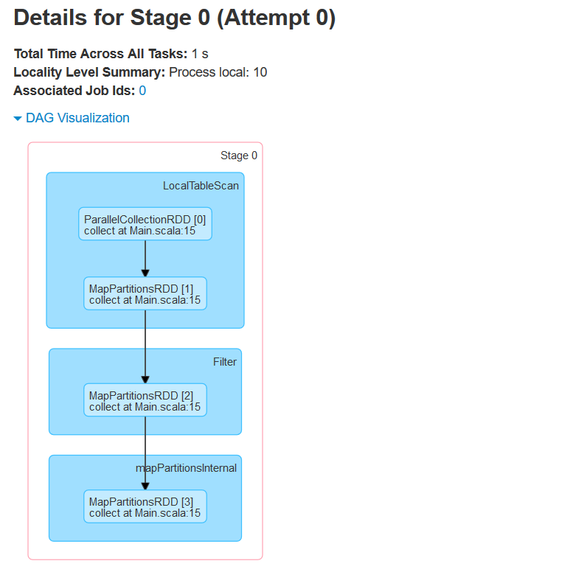
spark.sql.codegen.wholeStage == false

Slide 4
spark.sql.codegen.wholeStage == false
== Parsed Logical Plan ==
'TypedFilter catalyst.Main$$$Lambda$1010/1146867354@2cfe272f, int, [StructField(value,IntegerType,false)], unresolveddeserializer(assertnotnull(upcast(getcolumnbyordinal(0, IntegerType), IntegerType, - root class: "scala.Int")))
+- TypedFilter catalyst.Main$$$Lambda$1008/948451889@73893ec1, int, [StructField(value,IntegerType,false)], assertnotnull(cast(value#1 as int))
+- LocalRelation [value#1]
== Analyzed Logical Plan ==
value: int
TypedFilter catalyst.Main$$$Lambda$1010/1146867354@2cfe272f, int, [StructField(value,IntegerType,false)], assertnotnull(cast(value#1 as int))
+- TypedFilter catalyst.Main$$$Lambda$1008/948451889@73893ec1, int, [StructField(value,IntegerType,false)], assertnotnull(cast(value#1 as int))
+- LocalRelation [value#1]
== Optimized Logical Plan ==
TypedFilter org.apache.spark.sql.catalyst.optimizer.CombineTypedFilters$$$Lambda$1055/529621529@1fb2eec, int, [StructField(value,IntegerType,false)], value#1: int
+- LocalRelation [value#1]
== Physical Plan ==
Filter org.apache.spark.sql.catalyst.optimizer.CombineTypedFilters$$$Lambda$1055/529621529@1fb2eec.apply$mcZI$sp
+- LocalTableScan [value#1]

Slide 5
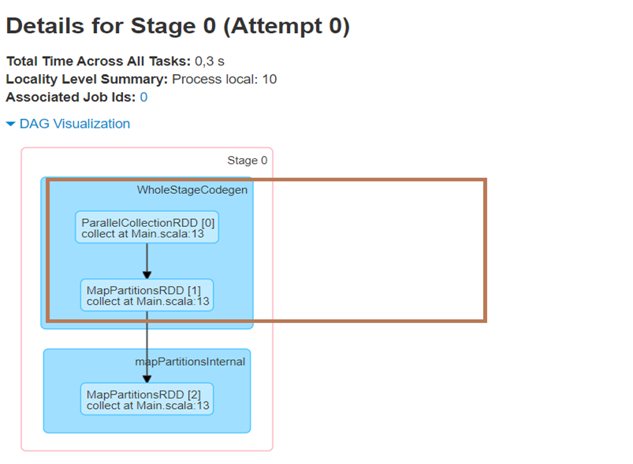
spark.sql.codegen.wholeStage == true

Slide 6
spark.sql.codegen.wholeStage == true
== Parsed Logical Plan ==
'TypedFilter catalyst.Main$$$Lambda$1009/665255666@101bdd1c, int, [StructField(value,IntegerType,false)], unresolveddeserializer(assertnotnull(upcast(getcolumnbyordinal(0, IntegerType), IntegerType, - root class: "scala.Int")))
+- TypedFilter catalyst.Main$$$Lambda$1007/132326253@3c88191b, int, [StructField(value,IntegerType,false)], assertnotnull(cast(value#1 as int))
+- LocalRelation [value#1]
== Analyzed Logical Plan ==
value: int
TypedFilter catalyst.Main$$$Lambda$1009/665255666@101bdd1c, int, [StructField(value,IntegerType,false)], assertnotnull(cast(value#1 as int))
+- TypedFilter catalyst.Main$$$Lambda$1007/132326253@3c88191b, int, [StructField(value,IntegerType,false)], assertnotnull(cast(value#1 as int))
+- LocalRelation [value#1]
== Optimized Logical Plan ==
TypedFilter org.apache.spark.sql.catalyst.optimizer.CombineTypedFilters$$$Lambda$1054/1835638995@443a06ad, int, [StructField(value,IntegerType,false)], value#1: int
+- LocalRelation [value#1]
== Physical Plan ==
*(1) Filter org.apache.spark.sql.catalyst.optimizer.CombineTypedFilters$$$Lambda$1054/1835638995@443a06ad.apply$mcZI$sp
+- *(1) LocalTableScan [value#1]

Slide 7
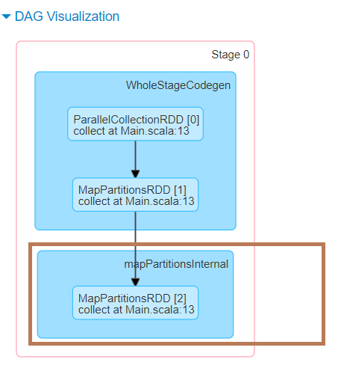

Slide 8
Class QueryExecution
lazy val executedPlan: SparkPlan = tracker.measurePhase(QueryPlanningTracker.PLANNING) { // clone the plan to avoid sharing the plan instance between different stages like analyzing, // optimizing and planning. prepareForExecution(sparkPlan.clone()) }

Slide 9
Class QueryExecution
/** * Prepares a planned [[SparkPlan]] for execution by inserting shuffle operations and internal * row format conversions as needed. */ protected def prepareForExecution(plan: SparkPlan): SparkPlan = { preparations.foldLeft(plan) {
case (sp, rule) => rule.apply(sp)
} }

Slide 10
Class QueryExecution
/** A sequence of rules that will be applied in order to the
physical plan before execution. */ protected def preparations: Seq[Rule[SparkPlan]] = Seq( // `AdaptiveSparkPlanExec` is a leaf node. If inserted, all the following rules will be no-op // as the original plan is hidden behind `AdaptiveSparkPlanExec`. InsertAdaptiveSparkPlan(sparkSession, this), PlanDynamicPruningFilters(sparkSession), PlanSubqueries(sparkSession), EnsureRequirements(sparkSession.sessionState.conf), ApplyColumnarRulesAndInsertTransitions(sparkSession.sessionState.conf, sparkSession.sessionState.columnarRules), CollapseCodegenStages(sparkSession.sessionState.conf), ReuseExchange(sparkSession.sessionState.conf), ReuseSubquery(sparkSession.sessionState.conf))

Slide 11
Class CollapseCodegenStages
/**
* Find the chained plans that support codegen, collapse them together as WholeStageCodegen.
*
* The `codegenStageCounter` generates ID for codegen stages within a query plan.
* It does not affect equality, nor does it participate in destructuring pattern matching
* of WholeStageCodegenExec.
*
* This ID is used to help differentiate between codegen stages. It is included as a part
* of the explain output for physical plans, e.g.
*
*/

Slide 12
Class CollapseCodegenStages
* == Physical Plan ==
* *(5) SortMergeJoin [x#3L], [y#9L], Inner
* :- *(2) Sort [x#3L ASC NULLS FIRST], false, 0
* : +- Exchange hashpartitioning(x#3L, 200)
* : +- *(1) Project [(id#0L % 2) AS x#3L]
* : +- *(1) Filter isnotnull((id#0L % 2))
* : +- *(1) Range (0, 5, step=1, splits=8)
* +- *(4) Sort [y#9L ASC NULLS FIRST], false, 0
* +- Exchange hashpartitioning(y#9L, 200)
* +- *(3) Project [(id#6L % 2) AS y#9L]
* +- *(3) Filter isnotnull((id#6L % 2))
* +- *(3) Range (0, 5, step=1, splits=8)
*
* where the ID makes it obvious that not all adjacent codegen'd plan operators are of the
* same codegen stage.

Slide 13
Class CollapseCodegenStages
* The codegen stage ID is also optionally included in the name of the generated classes as
* a suffix, so that it's easier to associate a generated class back to the physical operator.
* This is controlled by SQLConf: spark.sql.codegen.useIdInClassName
*
* The ID is also included in various log messages.
*
* Within a query, a codegen stage in a plan starts counting from 1, in "insertion order".
* WholeStageCodegenExec operators are inserted into a plan in depth-first post-order.
* See CollapseCodegenStages.insertWholeStageCodegen for the definition of insertion order.
*
* 0 is reserved as a special ID value to indicate a temporary WholeStageCodegenExec object
* is created, e.g. for special fallback handling when an existing WholeStageCodegenExec
* failed to generate/compile code.

Slide 14
Class CollapseCodegenStages
def apply(plan: SparkPlan): SparkPlan = { if (conf.wholeStageEnabled) { insertWholeStageCodegen(plan) } else { plan } }

Slide 15
Class CollapseCodegenStages
/** * Inserts a WholeStageCodegen on top of those that support codegen. */ private def insertWholeStageCodegen(plan: SparkPlan): SparkPlan = { plan match { // For operators that will output domain object, do not insert WholeStageCodegen for it as // domain object can not be written into unsafe row. case plan if plan.output.length == 1 && plan.output.head.dataType.isInstanceOf[ObjectType] => plan.withNewChildren(plan.children.map(insertWholeStageCodegen)) case plan: LocalTableScanExec => // Do not make LogicalTableScanExec the root of WholeStageCodegen // to support the fast driver-local collect/take paths. plan case plan: CodegenSupport if supportCodegen(plan) => // The whole-stage-codegen framework is row-based. If a plan supports columnar execution, // it can't support whole-stage-codegen at the same time. assert(!plan.supportsColumnar) WholeStageCodegenExec(insertInputAdapter(plan))(codegenStageCounter.incrementAndGet()) case other => other.withNewChildren(other.children.map(insertWholeStageCodegen)) } }

Slide 16
Class CollapseCodegenStages
/**
* Inserts an InputAdapter on top of those that do not support codegen.
*/
private def insertInputAdapter(plan: SparkPlan): SparkPlan = {
plan match {
case p if !supportCodegen(p) =>
// collapse them recursively
InputAdapter(insertWholeStageCodegen(p))
case j: SortMergeJoinExec =>
// The children of SortMergeJoin should do codegen separately.
j.withNewChildren(j.children.map(
child => InputAdapter(insertWholeStageCodegen(child))))
case p => p.withNewChildren(p.children.map(insertInputAdapter))
}
}

Slide 17
insertInputAdapter travers SparkPlan and when it meets new node that does not support it breaks current WholeStageCodegenExec by creating InputAdapter

Slide 18
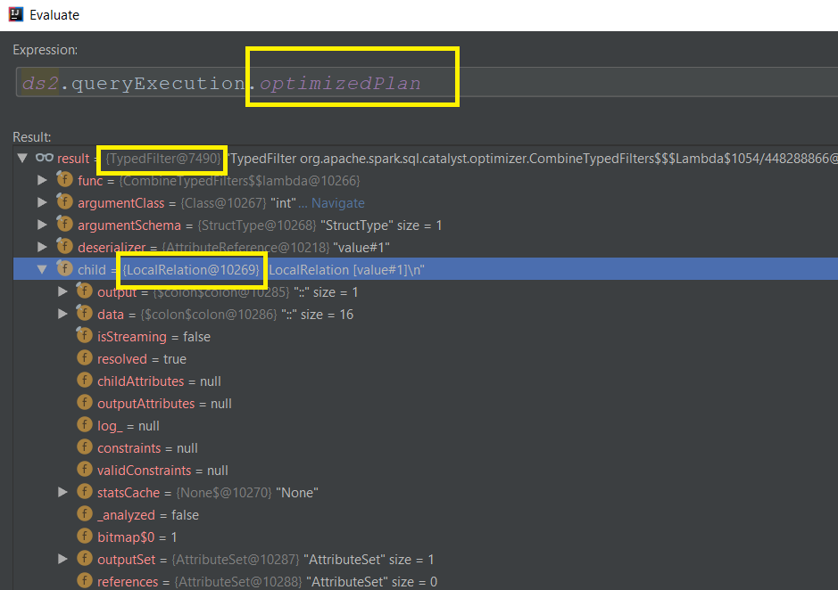
Optimized Logical Plan

Slide 19
Physical Plan

Slide 20
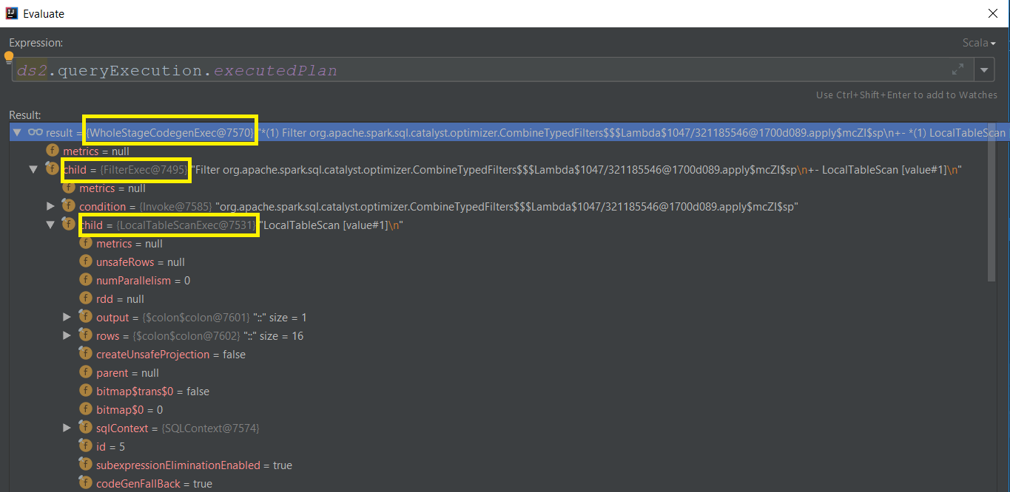
executedPlan

Slide 21
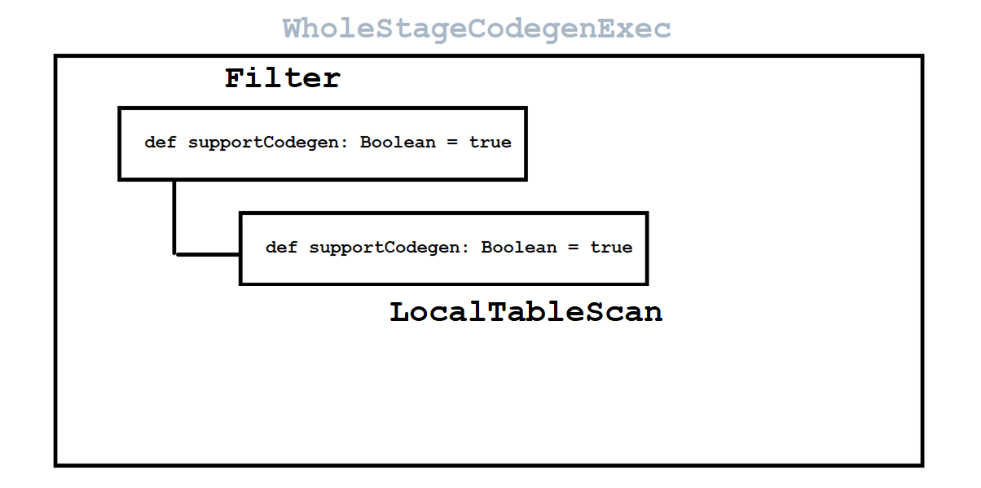

Slide 22
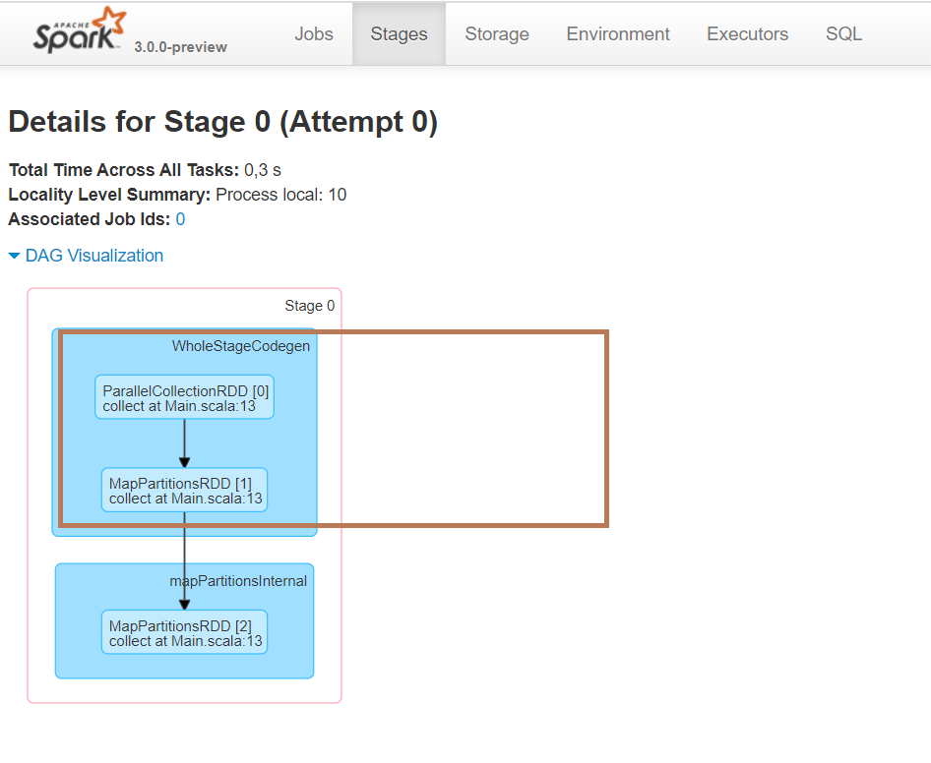

Slide 23
One more example
val ds0: Dataset[Int] = spark.sqlContext.createDataset(Seq(1,2,3,4,5,6,7,8,9,10,11,12,13,14,15,16)) val ds1: Dataset[Int] = ds0.filter(_ < 10) val ds2: Dataset[Int] = ds1.repartition(2).filter(_ < 2)

Slide 24
== Parsed Logical Plan ==
'TypedFilter catalyst.Main$$$Lambda$1010/1411054469@62c3f556, int, [StructField(value,IntegerType,false)], unresolveddeserializer(assertnotnull(upcast(getcolumnbyordinal(0, IntegerType), IntegerType, - root class: "scala.Int")))
+- Repartition 2, true
+- TypedFilter catalyst.Main$$$Lambda$1007/132326253@fb5aeed, int, [StructField(value,IntegerType,false)], assertnotnull(cast(value#1 as int))
+- LocalRelation [value#1]
== Analyzed Logical Plan ==
value: int
TypedFilter catalyst.Main$$$Lambda$1010/1411054469@62c3f556, int, [StructField(value,IntegerType,false)], assertnotnull(cast(value#1 as int))
+- Repartition 2, true
+- TypedFilter catalyst.Main$$$Lambda$1007/132326253@fb5aeed, int, [StructField(value,IntegerType,false)], assertnotnull(cast(value#1 as int))
+- LocalRelation [value#1]
== Optimized Logical Plan ==
TypedFilter catalyst.Main$$$Lambda$1010/1411054469@62c3f556, int, [StructField(value,IntegerType,false)], value#1: int
+- Repartition 2, true
+- TypedFilter catalyst.Main$$$Lambda$1007/132326253@fb5aeed, int, [StructField(value,IntegerType,false)], value#1: int
+- LocalRelation [value#1]
== Physical Plan ==
*(2) Filter catalyst.Main$$$Lambda$1010/1411054469@62c3f556.apply$mcZI$sp
+- Exchange RoundRobinPartitioning(2), false, [id=#16]
+- *(1) Filter catalyst.Main$$$Lambda$1007/132326253@fb5aeed.apply$mcZI$sp
+- *(1) LocalTableScan [value#1]

Slide 25
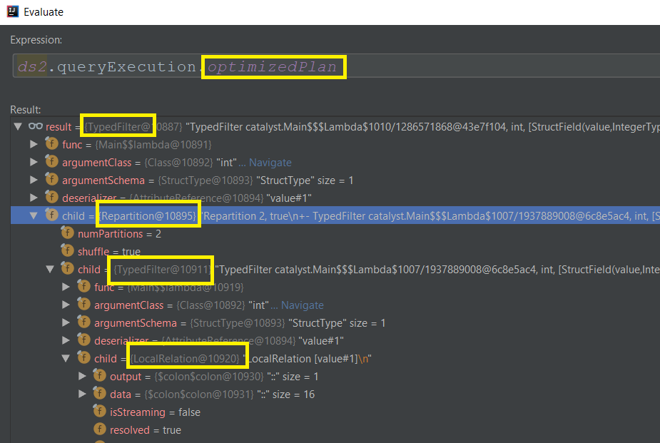
Optimized Logical Plan

Slide 26
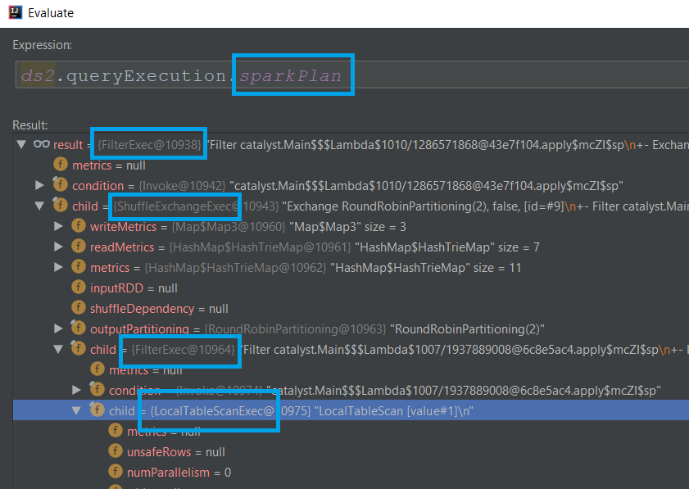
Physical Plan

Slide 27
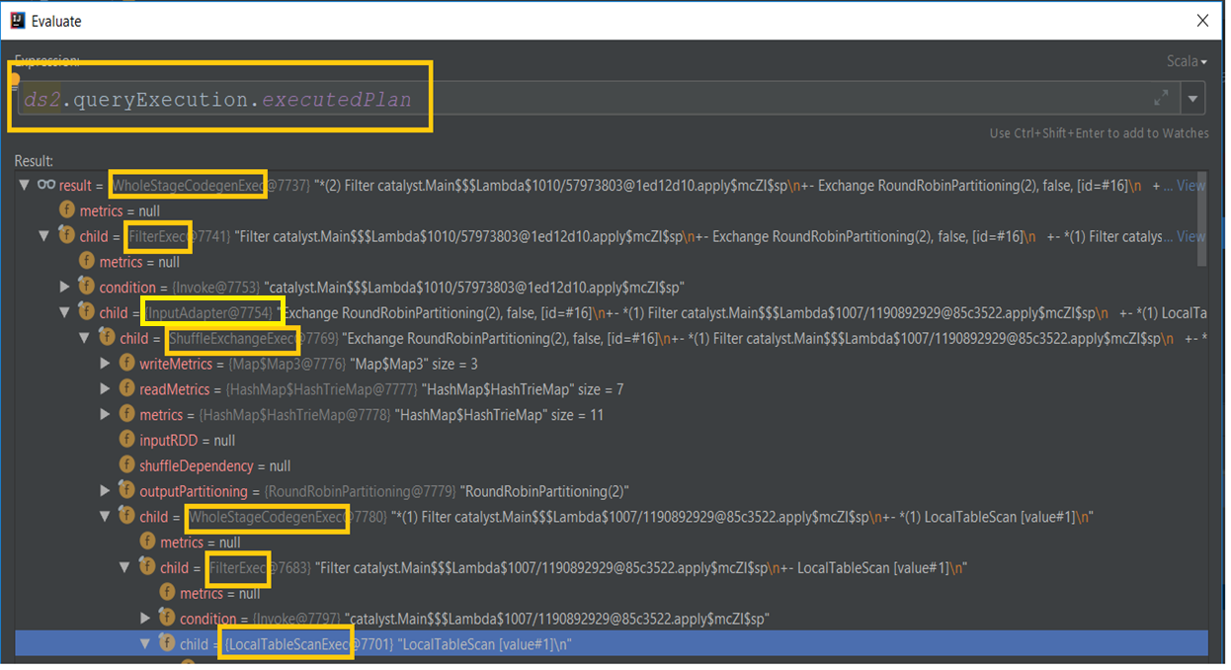
executedPlan

Slide 28
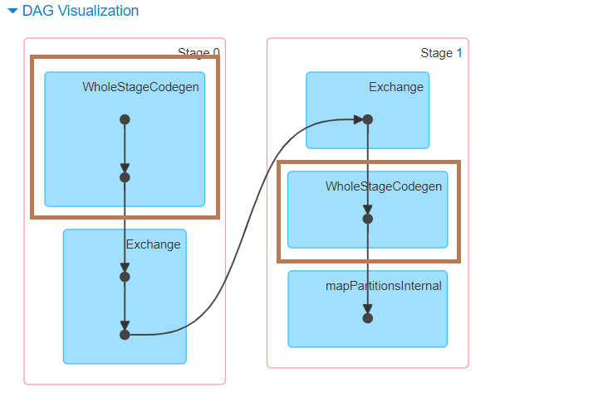

Slide 29
Summary
spark.sql.codegen.wholeStage
insertWholeStageCodegen(plan: SparkPlan): SparkPlan
insertInputAdapter(plan: SparkPlan): SparkPlan

