Slide 1
Spark Whole Stage Code Generation
Part 2
Nikolay
Join us in telegram t.me/apache_spark
2020

Slide 2
As we know Dataset is LogicalPlan + Encoder
class Dataset[T] private[sql]( @transient private val _sparkSession: SparkSession, @DeveloperApi @Unstable @transient val queryExecution: QueryExecution, @DeveloperApi @Unstable @transient val encoder: Encoder[T]) extends Serializable {
class QueryExecution (
val sparkSession: SparkSession,
val logical: LogicalPlan,
val tracker: QueryPlanningTracker = new QueryPlanningTracker) {
…
…
}

Slide 3
As we know LogicalPlan is being converted to SparkPlan
/**
* The base class for physical operators.
*
* The naming convention is that physical operators end with "Exec" suffix, e.g. [[ProjectExec]].
*/
abstract class SparkPlan extends QueryPlan[SparkPlan]... {
...
/**
* Returns the result of this query as an RDD[InternalRow] by delegating to `doExecute` after
* preparations.
*
* Concrete implementations of SparkPlan should override `doExecute`.
*/
final def execute(): RDD[InternalRow] = executeQuery {
if (isCanonicalizedPlan) {
throw new IllegalStateException("A canonicalized plan is not supposed to be executed.")
}
doExecute()
}
...
}

Slide 4
Simple example
val ds0: Dataset[Int] = spark.sqlContext.createDataset(Seq(1,2,3,4,5,6,7,8,9,10,11,12,13,14,15,16)) val ds1: Dataset[Int] = ds0.filter(_ < 5) val ds2: Dataset[Int] = ds1.map(2 * ) println(ds2.collect().mkString(","))

Slide 5
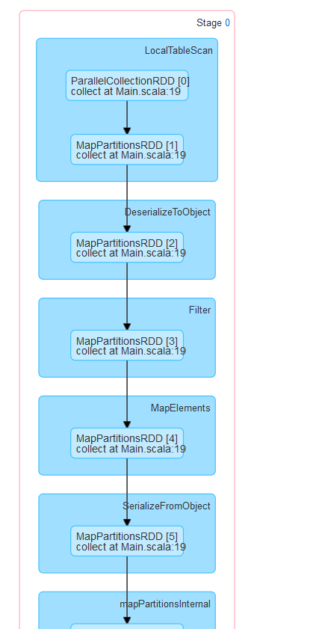
spark.sql.codegen.wholeStage == false

Slide 6
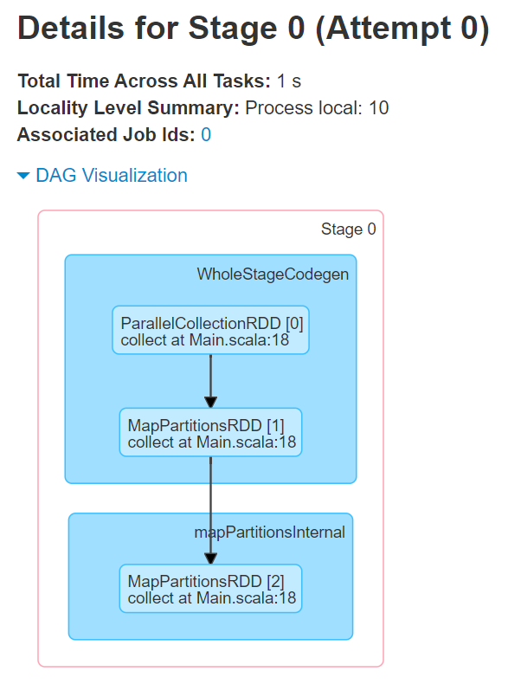

Slide 7
== Analyzed Logical Plan ==
value: int
SerializeFromObject [input[0, int, false] AS value#9]
+- MapElements catalyst.Main$$$Lambda$1009/1146867354@2d28fb02, int, [StructField(value,IntegerType,false)], obj#8: int
+- DeserializeToObject assertnotnull(cast(value#1 as int)), obj#7: int
+- TypedFilter catalyst.Main$$$Lambda$1007/948451889@61b65d54, int, [StructField(value,IntegerType,false)], assertnotnull(cast(value#1 as int))
+- LocalRelation [value#1]
== Optimized Logical Plan ==
SerializeFromObject [input[0, int, false] AS value#9]
+- MapElements catalyst.Main$$$Lambda$1009/1146867354@2d28fb02, int, [StructField(value,IntegerType,false)], obj#8: int
+- Filter catalyst.Main$$$Lambda$1007/948451889@61b65d54.apply$mcZI$sp
+- DeserializeToObject value#1: int, obj#7: int
+- LocalRelation [value#1]
== Physical Plan ==
*(1) SerializeFromObject [input[0, int, false] AS value#9]
+- *(1) MapElements catalyst.Main$$$Lambda$1009/1146867354@2d28fb02, obj#8: int
+- *(1) Filter catalyst.Main$$$Lambda$1007/948451889@61b65d54.apply$mcZI$sp
+- *(1) DeserializeToObject value#1: int, obj#7: int
+- *(1) LocalTableScan [value#1]

Slide 8
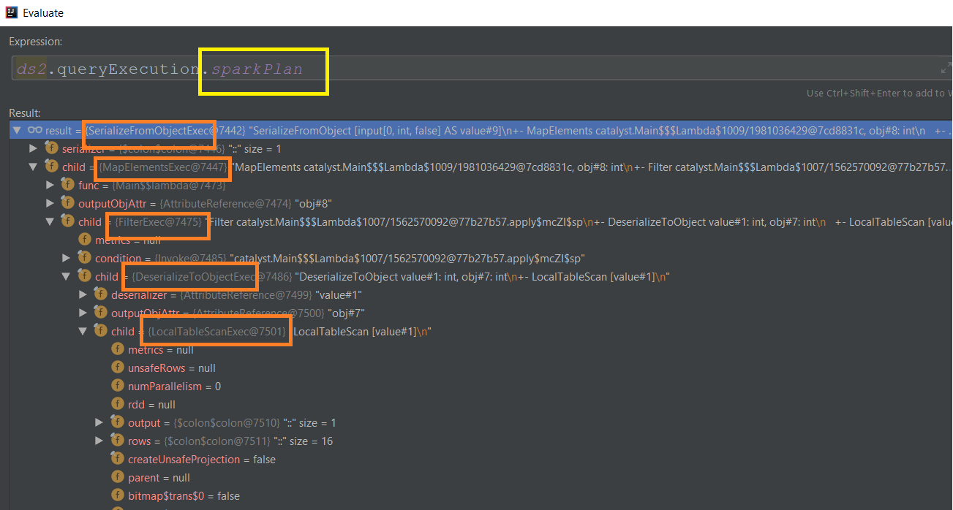

Slide 9
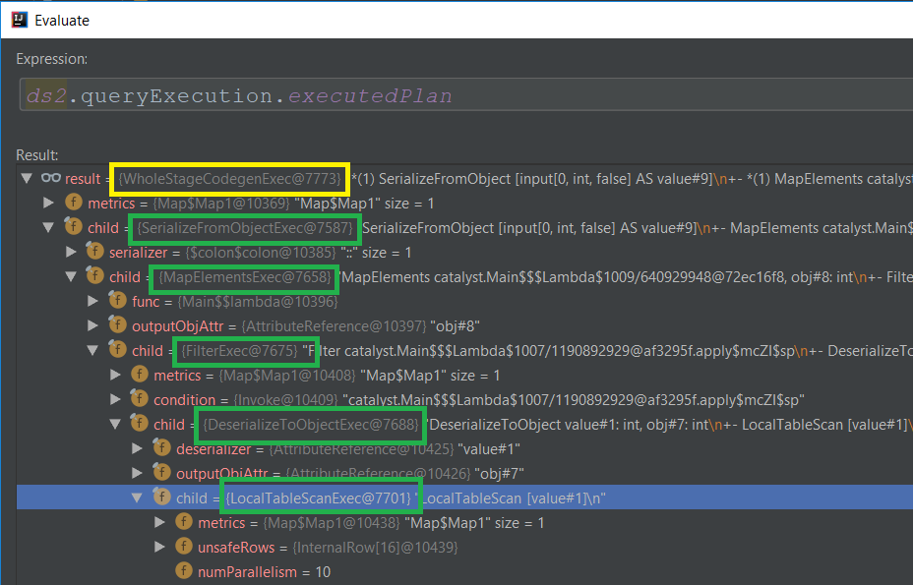
WholeStageCodegenExec

Slide 10
WholeStageCodegenExec method doExecute()
override def doExecute(): RDD[InternalRow] = {
val (ctx, cleanedSource) = doCodeGen()
….
val rdds = child.asInstanceOf[CodegenSupport].inputRDDs()
rdds.head.mapPartitionsWithIndex { (index, iter) =>
val (clazz, _) = CodeGenerator.compile(cleanedSource)
val buffer = clazz.generate(references).asInstanceOf[BufferedRowIterator]
buffer.init(index, Array(iter))
new Iterator[InternalRow] {
override def hasNext: Boolean = {
val v = buffer.hasNext
if (!v) durationMs += buffer.durationMs()
v
}
override def next: InternalRow = buffer.next()
}
}

Slide 11
public abstract class BufferedRowIterator {
protected LinkedList<InternalRow> currentRows = new LinkedList<>();
public boolean hasNext() throws IOException {
if (currentRows.isEmpty()) {
processNext();
}
return !currentRows.isEmpty();
}
public InternalRow next() {
return currentRows.remove();
}
public abstract void init(int index, Iterator<InternalRow>[] iters);
public void append(InternalRow row) {
currentRows.add(row);
}
public boolean shouldStop() { return !currentRows.isEmpty(); }
protected abstract void processNext() throws IOException;
}

Slide 12
WholeStageCodegenExec method doCodeGen ()
def doCodeGen(): (CodegenContext, CodeAndComment) = {
val ctx = new CodegenContext
val code = child.asInstanceOf[CodegenSupport].produce(ctx, this)
// main next function.
ctx.addNewFunction("processNext",
s"""
protected void processNext() throws java.io.IOException {
${code.trim}
}
""", inlineToOuterClass = true)
val className = generatedClassName()

Slide 13
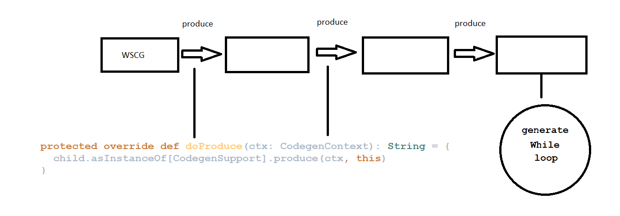
Produce method

Slide 14
trait InputRDDCodegen
override def doProduce(ctx: CodegenContext): String = { // Inline mutable state since an InputRDDCodegen is used once in a task for WholeStageCodegen val input = ctx.addMutableState("scala.collection.Iterator", "input", v => s"$v = inputs[0];", forceInline = true) val row = ctx.freshName("row") val outputVars = if (createUnsafeProjection) { // creating the vars will make the parent consume add an unsafe projection. ctx.INPUT_ROW = row ctx.currentVars = null output.zipWithIndex.map { case (a, i) => BoundReference(i, a.dataType, a.nullable).genCode(ctx) } } else { null } val updateNumOutputRowsMetrics = if (metrics.contains("numOutputRows")) { val numOutputRows = metricTerm(ctx, "numOutputRows") s"$numOutputRows.add(1);" } else { "" } s""" | while ($limitNotReachedCond $input.hasNext()) { | InternalRow $row = (InternalRow) $input.next(); | ${updateNumOutputRowsMetrics} | ${consume(ctx, outputVars, if (createUnsafeProjection) null else row).trim} | ${shouldStopCheckCode} | } """.stripMargin }

Slide 15
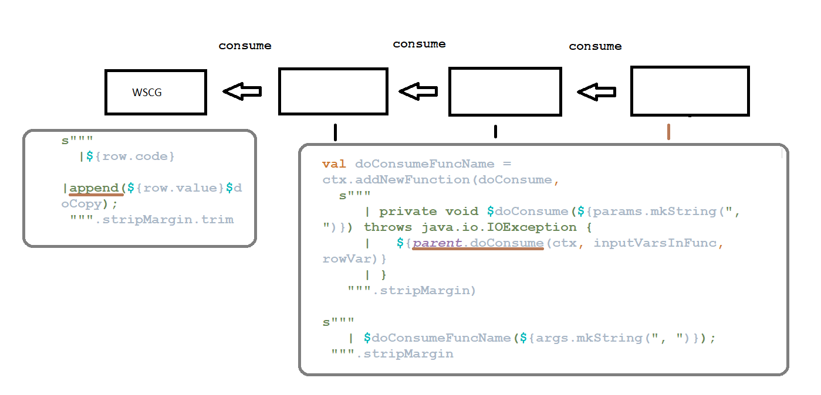
Consume method

Slide 16
WholeStageCodegenExec method doCodeGen ()
continue …
val source = s"""
public Object generate(Object[] references) {
return new $className(references);
}
….
final class $className extends ${classOf[BufferedRowIterator].getName} {
private Object[] references;
private scala.collection.Iterator[] inputs;
${ctx.declareMutableStates()}
public $className(Object[] references) {
this.references = references;
}
public void init(int index, scala.collection.Iterator[] inputs) {
partitionIndex = index;
this.inputs = inputs;
${ctx.initMutableStates()}
${ctx.initPartition()}
}
}
""".trim

Slide 17
== Subtree 1 / 1 (maxMethodCodeSize:108; maxConstantPoolSize:120(0,18% used); numInnerClasses:0) ==
*(1) SerializeFromObject [input[0, int, false] AS value#9]
+- *(1) MapElements catalyst.Main$$$Lambda$1035/1146867354@755b5f30, obj#8: int
+- *(1) Filter catalyst.Main$$$Lambda$1033/948451889@75882261.apply$mcZI$sp
+- *(1) DeserializeToObject value#1: int, obj#7: int
+- *(1) LocalTableScan [value#1]
Generated code:
/* 001 */ public Object generate(Object[] references) {
/* 002 */ return new GeneratedIteratorForCodegenStage1(references);
/* 003 */ }
/* 004 */
/* 005 */ // codegenStageId=1
/* 006 */ final class GeneratedIteratorForCodegenStage1 extends org.apache.spark.sql.execution.BufferedRowIterator {
/* 007 */ private Object[] references;
/* 008 */ private scala.collection.Iterator[] inputs;
/* 009 */ private scala.collection.Iterator localtablescan_input_0;
/* 010 */ private int filter_argValue_0;
/* 011 */ private int mapelements_argValue_0;
/* 012 */ private org.apache.spark.sql.catalyst.expressions.codegen.UnsafeRowWriter[] deserializetoobject_mutableStateArray_0 = new org.apache.spark.sql.catalyst.expressions.codegen.UnsafeRowWriter[6];
/* 013 */
/* 014 */ public GeneratedIteratorForCodegenStage1(Object[] references) {
/* 015 */ this.references = references;
/* 016 */ }

Slide 18
/* 018 */ public void init(int index, scala.collection.Iterator[] inputs) {
/* 019 */ partitionIndex = index;
/* 020 */ this.inputs = inputs;
/* 021 */ localtablescan_input_0 = inputs[0];
/* 022 */ deserializetoobject_mutableStateArray_0[0] = new org.apache.spark.sql.catalyst.expressions.codegen.UnsafeRowWriter(1, 0);
/* 023 */
/* 024 */ deserializetoobject_mutableStateArray_0[1] = new org.apache.spark.sql.catalyst.expressions.codegen.UnsafeRowWriter(1, 0);
/* 025 */ deserializetoobject_mutableStateArray_0[2] = new org.apache.spark.sql.catalyst.expressions.codegen.UnsafeRowWriter(1, 0);
/* 026 */ deserializetoobject_mutableStateArray_0[3] = new org.apache.spark.sql.catalyst.expressions.codegen.UnsafeRowWriter(1, 0);
/* 027 */ deserializetoobject_mutableStateArray_0[4] = new org.apache.spark.sql.catalyst.expressions.codegen.UnsafeRowWriter(1, 0);
/* 028 */ deserializetoobject_mutableStateArray_0[5] = new org.apache.spark.sql.catalyst.expressions.codegen.UnsafeRowWriter(1, 0);
/* 029 */
/* 030 */ }
/* 031 */

Slide 19
/* 032 */ private void mapelements_doConsume_0(int mapelements_expr_0_0) throws java.io.IOException {
/* 033 */ boolean mapelements_isNull_1 = true;
/* 034 */ int mapelements_value_1 = -1;
/* 035 */ if (!false) {
/* 036 */ mapelements_argValue_0 = mapelements_expr_0_0;
/* 037 */
/* 038 */ mapelements_isNull_1 = false;
/* 039 */ if (!mapelements_isNull_1) {
/* 040 */ mapelements_value_1 = ((scala.Function1) references[3] /* literal */).apply$mcII$sp(mapelements_argValue_0);
/* 041 */ }
/* 042 */ }
/* 043 */
/* 044 */ serializefromobject_doConsume_0(mapelements_value_1);
/* 045 */
/* 046 */ }

Slide 20
/* 048 */ private void deserializetoobject_doConsume_0(InternalRow localtablescan_row_0, int deserializetoobject_expr_0_0) throws java.io.IOException {
/* 049 */ do {
/* 050 */ boolean filter_isNull_0 = true;
/* 051 */ boolean filter_value_0 = false;
/* 052 */ if (!false) {
/* 053 */ filter_argValue_0 = deserializetoobject_expr_0_0;
/* 054 */
/* 055 */ filter_isNull_0 = false;
/* 056 */ if (!filter_isNull_0) {
/* 057 */ filter_value_0 = ((scala.Function1) references[2] /* literal */).apply$mcZI$sp(filter_argValue_0);
/* 058 */ }
/* 059 */ }
/* 060 */ if (filter_isNull_0 || !filter_value_0) continue;
/* 061 */
/* 062 */ ((org.apache.spark.sql.execution.metric.SQLMetric) references[1] /* numOutputRows */).add(1);
/* 063 */
/* 064 */ mapelements_doConsume_0(deserializetoobject_expr_0_0);
/* 065 */
/* 066 */ } while(false);
/* 067 */
/* 068 */ }

Slide 21
/* 070 */ private void serializefromobject_doConsume_0(int serializefromobject_expr_0_0) throws java.io.IOException {
/* 071 */ deserializetoobject_mutableStateArray_0[5].reset();
/* 072 */
/* 073 */ deserializetoobject_mutableStateArray_0[5].write(0, serializefromobject_expr_0_0);
/* 074 */ append((deserializetoobject_mutableStateArray_0[5].getRow()));
/* 075 */
/* 076 */ }
/* 077 */
/* 078 */ protected void processNext() throws java.io.IOException {
/* 079 */ while ( localtablescan_input_0.hasNext()) {
/* 080 */ InternalRow localtablescan_row_0 = (InternalRow) localtablescan_input_0.next();
/* 081 */ ((org.apache.spark.sql.execution.metric.SQLMetric) references[0] /* numOutputRows */).add(1);
/* 082 */ int localtablescan_value_0 = localtablescan_row_0.getInt(0);
/* 083 */
/* 084 */ deserializetoobject_doConsume_0(localtablescan_row_0, localtablescan_value_0);
/* 085 */ if (shouldStop()) return;
/* 086 */ }
/* 087 */ }

Slide 22
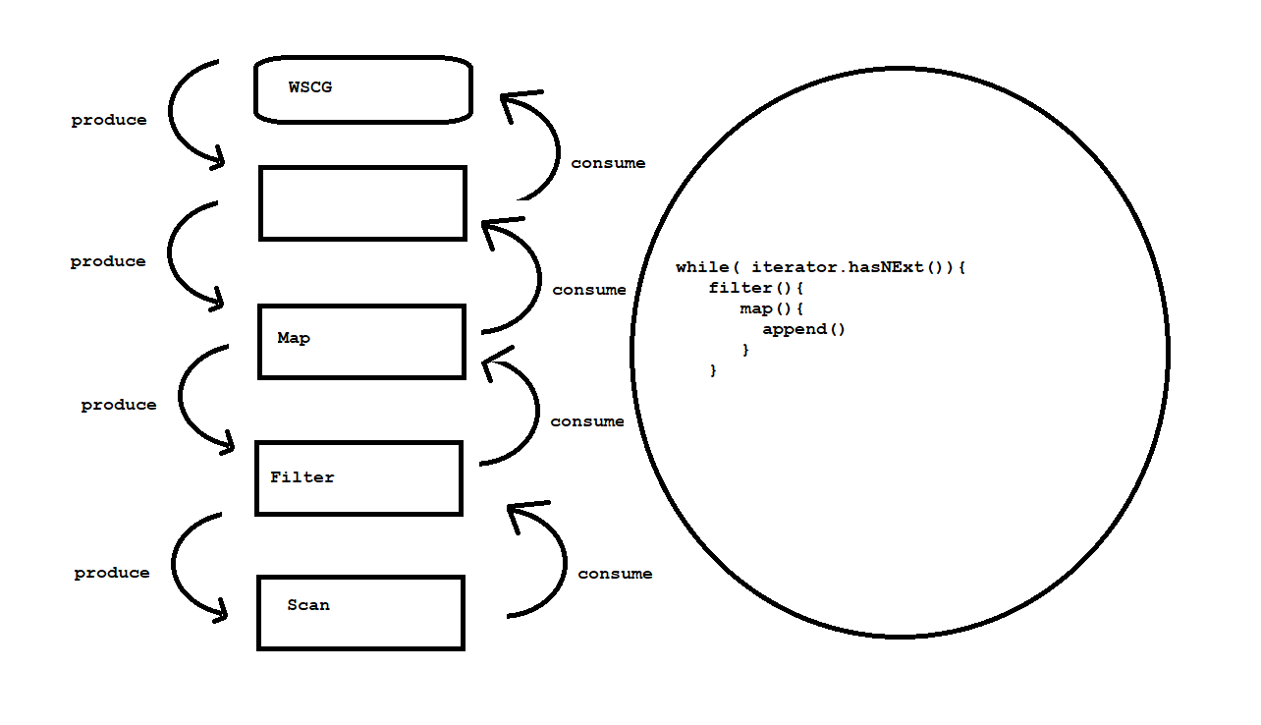
Summary

