Slide 1
Learn Spark “join” strategies from source code Part4
ShuffledHashJoin
Nikolay
Join us in telegram t.me/apache_spark
November 2020

Slide 2
Example
val df1 = spark.range(1,1000000)
val df2 = spark.range(0,Integer.MAX_VALUE)
df2. .hint("shuffle_hash").join( df1,"id").collect()
http://blog.madhukaraphatak.com/spark-3-introduction-part-9/#:~:text=Shuffle%20Hash%20Join%20Hint,be%20forced%20using%20shuffle_hash%20hint.&text=The%20same%20can%20be%20observed%20in%20spark%20UI%20also.,-.

Slide 3
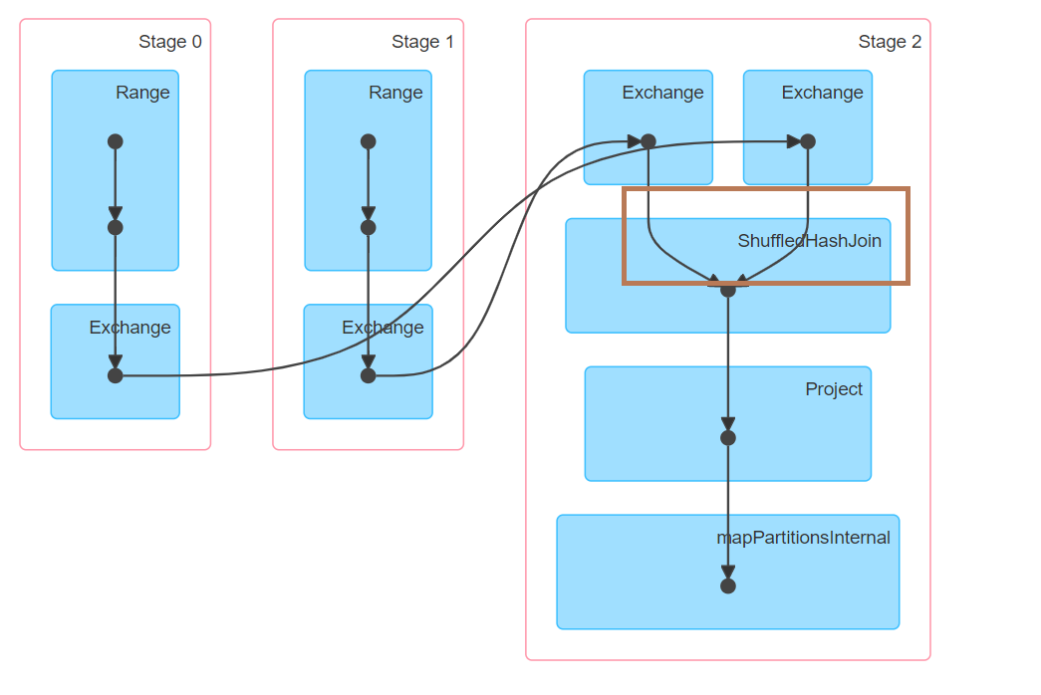

Slide 4
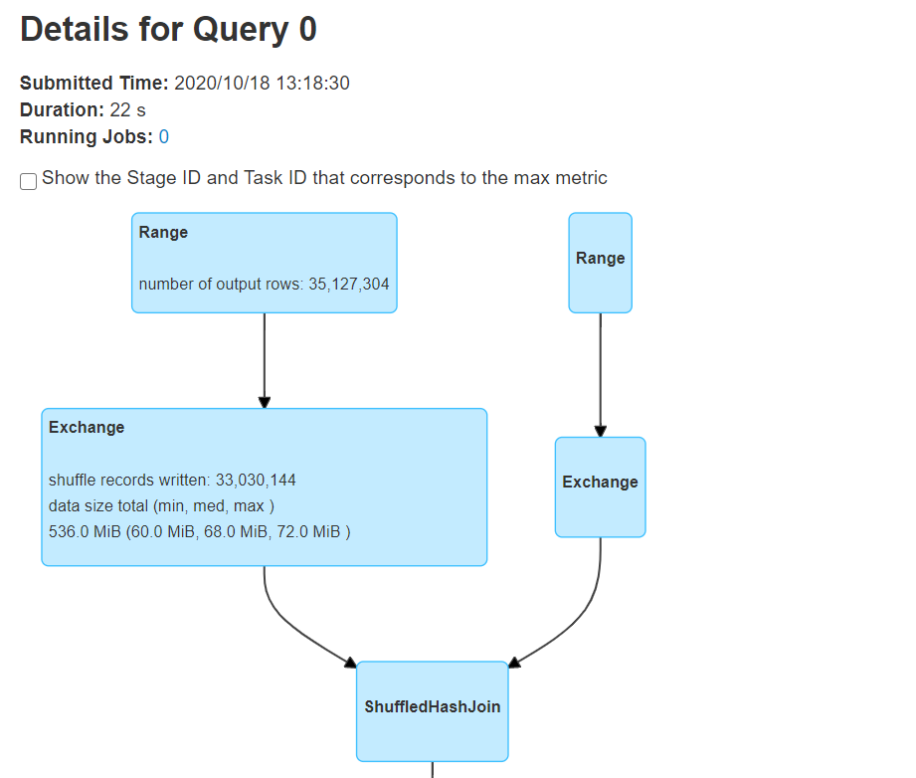

Slide 5
The idea of shuffle hash join
Iterator1
Iterator2
IteratorPart0
IteratorPart1
IteratorPart2
IteratorPart3

Slide 6
Stage2
JOB 1
K1
K1
K3
K5
IteratorN
(K1,(V1,V2))
(K2,V2)
(K3,V3)
HashRelation

Slide 7
== Analyzed Logical Plan ==
id: bigint
Project [id#2L]
+- Join Inner, (id#2L = id#0L)
:- ResolvedHint (strategy=shuffle_hash)
: +- Range (0, 2147483647, step=1, splits=Some(8))
+- Range (1, 1000000, step=1, splits=Some(8))
== Optimized Logical Plan ==
Project [id#2L]
+- Join Inner, (id#2L = id#0L), leftHint=(strategy=shuffle_hash)
:- Range (0, 2147483647, step=1, splits=Some(8))
+- Range (1, 1000000, step=1, splits=Some(8))
== Physical Plan ==
Project [id#2L]
+- ShuffledHashJoin [id#2L], [id#0L], Inner, BuildLeft
:- Exchange hashpartitioning(id#2L, 200), true, [id=#16]
: +- Range (0, 2147483647, step=1, splits=8)
+- Exchange hashpartitioning(id#0L, 200), true, [id=#17]
+- Range (1, 1000000, step=1, splits=8)

Slide 8
ShuffledHashJoinExec
protected override def doExecute(): RDD[InternalRow] = {
val numOutputRows = longMetric("numOutputRows")
streamedPlan.execute().zipPartitions(buildPlan.execute()) { (streamIter, buildIter) =>
val hashed = buildHashedRelation(buildIter)
join(streamIter, hashed, numOutputRows)
}
}

Slide 9
ShuffledHashJoinExec
private def buildHashedRelation(iter: Iterator[InternalRow]): HashedRelation = {
val buildDataSize = longMetric("buildDataSize")
val buildTime = longMetric("buildTime")
val start = System.nanoTime()
val context = TaskContext.get()
val relation = HashedRelation(iter, buildKeys, taskMemoryManager = context.taskMemoryManager())
buildTime += NANOSECONDS.toMillis(System.nanoTime() - start)
buildDataSize += relation.estimatedSize
// This relation is usually used until the end of task.
context.addTaskCompletionListener[Unit](_ => relation.close())
relation
}

Slide 10
HashedRelation
def apply(
input: Iterator[InternalRow],
key: Seq[Expression],
sizeEstimate: Int = 64,
taskMemoryManager: TaskMemoryManager = null): HashedRelation = {
val mm = Option(taskMemoryManager).getOrElse {
new TaskMemoryManager(
new UnifiedMemoryManager(
new SparkConf().set(MEMORY_OFFHEAP_ENABLED.key, "false"),
Long.MaxValue,
Long.MaxValue / 2,
1),
0)
}
if (key.length == 1 && key.head.dataType == LongType) {
LongHashedRelation(input, key, sizeEstimate, mm)
} else {
UnsafeHashedRelation(input, key, sizeEstimate, mm)
}
}

Slide 11
LongHashedRelation
def apply(
input: Iterator[InternalRow],
key: Seq[Expression],
sizeEstimate: Int,
taskMemoryManager: TaskMemoryManager): LongHashedRelation = {
val map = new LongToUnsafeRowMap(taskMemoryManager, sizeEstimate)
val keyGenerator = UnsafeProjection.create(key)
// Create a mapping of key -> rows
var numFields = 0
while (input.hasNext) {
val unsafeRow = input.next().asInstanceOf[UnsafeRow]
numFields = unsafeRow.numFields()
val rowKey = keyGenerator(unsafeRow)
if (!rowKey.isNullAt(0)) {
val key = rowKey.getLong(0)
map.append(key, unsafeRow)
}
}
map.optimize()
new LongHashedRelation(numFields, map)
}

Slide 12
ShuffledHashJoinExec
protected override def doExecute(): RDD[InternalRow] = {
val numOutputRows = longMetric("numOutputRows")
streamedPlan.execute().zipPartitions(buildPlan.execute()) { (streamIter, buildIter) =>
val hashed = buildHashedRelation(buildIter)
join(streamIter, hashed, numOutputRows)
}
}

Slide 13
protected def join(
streamedIter: Iterator[InternalRow],
hashed: HashedRelation,
numOutputRows: SQLMetric): Iterator[InternalRow] = {
val joinedIter = joinType match {
case _: InnerLike =>
innerJoin(streamedIter, hashed)
case LeftOuter | RightOuter =>
outerJoin(streamedIter, hashed)
case LeftSemi =>
semiJoin(streamedIter, hashed)
case LeftAnti =>
antiJoin(streamedIter, hashed)
case j: ExistenceJoin =>
existenceJoin(streamedIter, hashed)
case x =>
throw new IllegalArgumentException(
s"BroadcastHashJoin should not take $x as the JoinType")
}

Slide 14
private def innerJoin(
streamIter: Iterator[InternalRow],
hashedRelation: HashedRelation): Iterator[InternalRow] = {
val joinRow = new JoinedRow
val joinKeys = streamSideKeyGenerator()
streamIter.flatMap { srow =>
joinRow.withLeft(srow)
val matches = hashedRelation.get(joinKeys(srow))
if (matches != null) {
matches.map(joinRow.withRight(_)).filter(boundCondition)
} else {
Seq.empty
}
}
}

Slide 15
private def outerJoin( streamedIter: Iterator[InternalRow], hashedRelation: HashedRelation): Iterator[InternalRow] = {
val joinedRow = new JoinedRow();
val keyGenerator = streamSideKeyGenerator()
val nullRow = new GenericInternalRow(buildPlan.output.length)
streamedIter.flatMap { currentRow =>
val rowKey = keyGenerator(currentRow)
joinedRow.withLeft(currentRow)
val buildIter = hashedRelation.get(rowKey)
new RowIterator {
private var found = false
override def advanceNext(): Boolean = {
while (buildIter != null && buildIter.hasNext) {
val nextBuildRow = buildIter.next()
if (boundCondition(joinedRow.withRight(nextBuildRow))) {
found = true
return true
}
}
if (!found) {
joinedRow.withRight(nullRow)
found = true
return true
}
false
}
override def getRow: InternalRow = joinedRow
}.toScala
}
}

Slide 16
A semijoin returns all rows from the left table where there are matching values in the right table, keeping just columns from the left table.
private def semiJoin(
streamIter: Iterator[InternalRow],
hashedRelation: HashedRelation): Iterator[InternalRow] = {
val joinKeys = streamSideKeyGenerator()
val joinedRow = new JoinedRow
streamIter.filter { current =>
val key = joinKeys(current)
lazy val buildIter = hashedRelation.get(key)
!key.anyNull && buildIter != null && (condition.isEmpty || buildIter.exists {
(row: InternalRow) => boundCondition(joinedRow(current, row))
})
}
}

Slide 17
private def existenceJoin(
streamIter: Iterator[InternalRow],
hashedRelation: HashedRelation): Iterator[InternalRow] = {
val joinKeys = streamSideKeyGenerator()
val result = new GenericInternalRow(Array[Any](null))
val joinedRow = new JoinedRow
streamIter.map { current =>
val key = joinKeys(current)
lazy val buildIter = hashedRelation.get(key)
val exists = !key.anyNull && buildIter != null && (condition.isEmpty || buildIter.exists {
(row: InternalRow) => boundCondition(joinedRow(current, row))
})
result.setBoolean(0, exists)
joinedRow(current, result)
}
}

Slide 18
An antijoin return all rows from the left table where there are not matching values in the right table, keeping just columns from the left table
private def antiJoin(
streamIter: Iterator[InternalRow],
hashedRelation: HashedRelation): Iterator[InternalRow] = {
val joinKeys = streamSideKeyGenerator()
val joinedRow = new JoinedRow
streamIter.filter { current =>
val key = joinKeys(current)
lazy val buildIter = hashedRelation.get(key)
key.anyNull || buildIter == null || (condition.isDefined && !buildIter.exists {
row => boundCondition(joinedRow(current, row))
})
}
}

Slide 19
Summary
1 job
ShuffledHashJoinExec
No spills now!
innerJoin, outerJoin( flatMap)
semiJoin, antiJoin( filter)
existenceJoin( map)

