Slide 1
Apache Spark Custom Stream Sources
Nikolay
Join us in telegram t.me/apache_spark
May 2021

Slide 2
Attention
Spark has moved to the V2 API
As for me it’s better to understand old way as well

Slide 3
Lets implement simple stream source
which emits random integers
spark
.readStream
.format("streams.CustomStreamSource")
.load
.writeStream
.outputMode("append")
.format("console")
.trigger(ProcessingTimeTrigger(10000))
.start("c:\\tmp\\output")
.awaitTermination()

Slide 4
-------------------------------------------
Batch: 1
-------------------------------------------
+-----+---+
|value| ts|
+-----+---+
| 1| 1|
| 2| 2|
+-----+---+
Batch: 4
-------------------------------------------
+-----+---+
|value| ts|
+-----+---+
| 1| 1|
| 2| 2|
+-----+---+

Slide 5
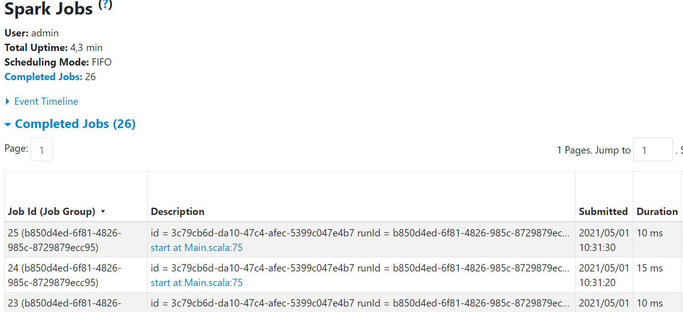

Slide 6
Step 1 to create custom Stream Source
Need to define class which extends of StreamSourceProvider and DataSourceRegister
class CustomStreamSource extends StreamSourceProvider with DataSourceRegister {
override def sourceSchema(sqlContext: SQLContext, schema: Option[StructType], providerName: String, parameters: Map[String, String]): (String, StructType) = {
(shortName(), RandomInt.schema)
}
override def createSource(sqlContext: SQLContext, metadataPath: String, schema: Option[StructType], providerName: String, parameters: Map[String, String]): Source = {
new RandomInt(sqlContext)
}
override def shortName(): String = "Random Int"
}

Slide 7
StreamSourceProvider
Implemented by objects that can produce a streaming `Source` for a specific format or system
trait StreamSourceProvider {
def sourceSchema(
sqlContext: SQLContext,
schema: Option[StructType],
providerName: String,
parameters: Map[String, String]): (String, StructType)
def createSource(
sqlContext: SQLContext,
metadataPath: String,
schema: Option[StructType],
providerName: String,
parameters: Map[String, String]): Source
}

Slide 8
DataSourceRegister
/**
* Data sources should implement this trait so that they can register an alias to their data source.
* This allows users to give the data source alias as the format type over the fully qualified
* class name.
*
* A new instance of this class will be instantiated each time a DDL call is made.
*/
trait DataSourceRegister {
/**
* The string that represents the format that this data source provider uses. This is
* overridden by children to provide a nice alias for the data source. For example:
*
* {{{
* override def shortName(): String = "parquet"
* }}}
*/
def shortName(): String
}

Slide 9
CustomSource
class CustomSource extends StreamSourceProvider with DataSourceRegister {
override def sourceSchema(sqlContext: SQLContext, schema: Option[StructType], providerName: String, parameters: Map[String, String]): (String, StructType) = {
(shortName(), RandomInt.schema)
}
override def createSource(sqlContext: SQLContext, metadataPath: String, schema: Option[StructType], providerName: String, parameters: Map[String, String]): Source = {
new RandomInt(sqlContext)
}
override def shortName(): String = "Random Int"
}

Slide 10
Source
/**
* A source of continually arriving data for a streaming query. A [[Source]] must have a
* monotonically increasing notion of progress that can be represented as an [[Offset]]. Spark
* will regularly query each [[Source]] to see if any more data is available.
*
* Note that, we extends `SparkDataStream` here, to make the v1 streaming source API be compatible
* with data source v2.
*/

Slide 11
trait Source
/** Returns the schema of the data from this source */
def schema: StructType
/**
* Returns the maximum available offset for this source.
* Returns `None` if this source has never received any data.
*/
def getOffset: Option[Offset]
/**
* Informs the source that Spark has completed processing all data for offsets less than or
* equal to `end` and will only request offsets greater than `end` in the future.
*/
def commit(end: Offset) : Unit = {}

Slide 12
trait Source
/**
* Returns the data that is between the offsets (`start`, `end`]. When `start` is `None`,
* then the batch should begin with the first record. This method must always return the
* same data for a particular `start` and `end` pair; even after the Source has been restarted
* on a different node.
*
* Higher layers will always call this method with a value of `start` greater than or equal
* to the last value passed to `commit` and a value of `end` less than or equal to the
* last value returned by `getOffset`
*
* It is possible for the [[Offset]] type to be a [[SerializedOffset]] when it was
* obtained from the log. Moreover, [[StreamExecution]] only compares the [[Offset]]
* JSON representation to determine if the two objects are equal. This could have
* ramifications when upgrading [[Offset]] JSON formats i.e., two equivalent [[Offset]]
* objects could differ between version. Consequently, [[StreamExecution]] may call
* this method with two such equivalent [[Offset]] objects. In which case, the [[Source]]
* should return an empty [[DataFrame]]
*/
def getBatch(start: Option[Offset], end: Offset): DataFrame

Slide 13
Step 2 (RandomInt)
class RandomInt(sqlContext: SQLContext) extends Source {
override def schema: StructType = RandomInt.schema
override def commit(end: Offset): Unit = {
println(" commit" + offset)
}
private var offset: LongOffset = LongOffset(1)
override def getOffset: Option[Offset] = this.synchronized {
if (offset.offset == -1) None else Some(offset)
}

Slide 14
RandomInt
override def getBatch(start: Option[Offset], end: Offset): DataFrame = {
offset = offset.+(1)
val data = Seq((1,1),(2,2))
val rdd = sqlContext
.sparkContext
.parallelize(data)
.map { case (v, l) => InternalRow( v, l.toLong) }
sqlContext.sparkSession.internalCreateDataFrame(rdd, schema,isStreaming = true)
}
override def stop(): Unit = {}
}
object RandomInt {
lazy val schema = StructType(List(StructField("value", IntegerType), StructField("ts", LongType)))
}

Slide 15
Summary
StreamSourceProvider
DataSourceRegister
Source

Slide 16
References
https://www.signifytechnology.com/blog/2019/01/spark-custom-stream-sources-by-nicolas-a-perez

