Slide 1
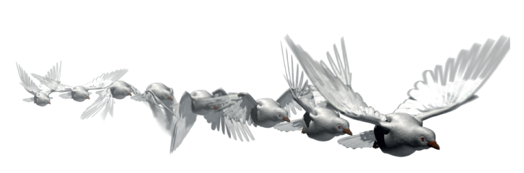

Shallow Neural Networks, Transfer Learning, and Template Matching Applied to Bird Audio Classification
By: Nathan Kueterman
12/11/2018

Slide 2
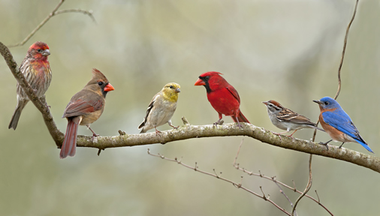
Motivation
Personal Interest
Curiosity
Conservation
Ecology
Archival

Slide 3
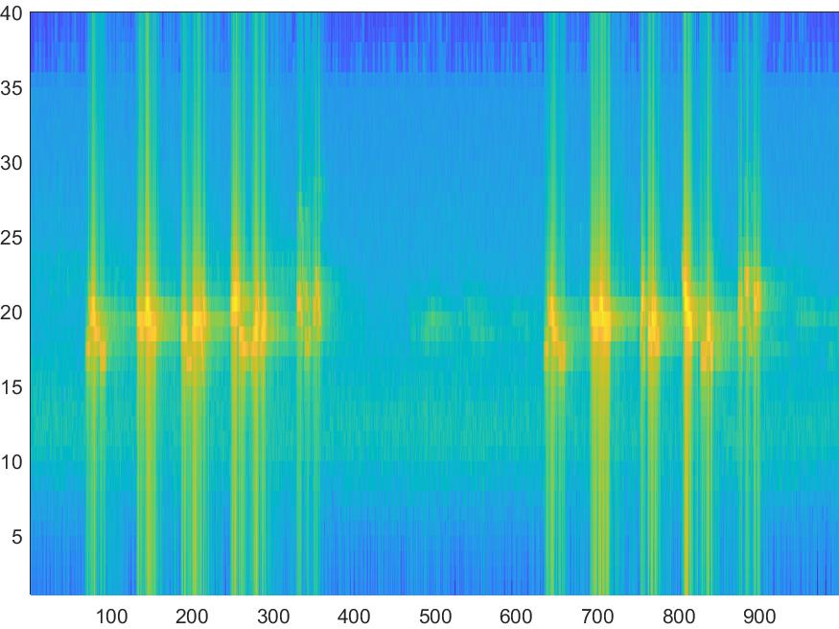
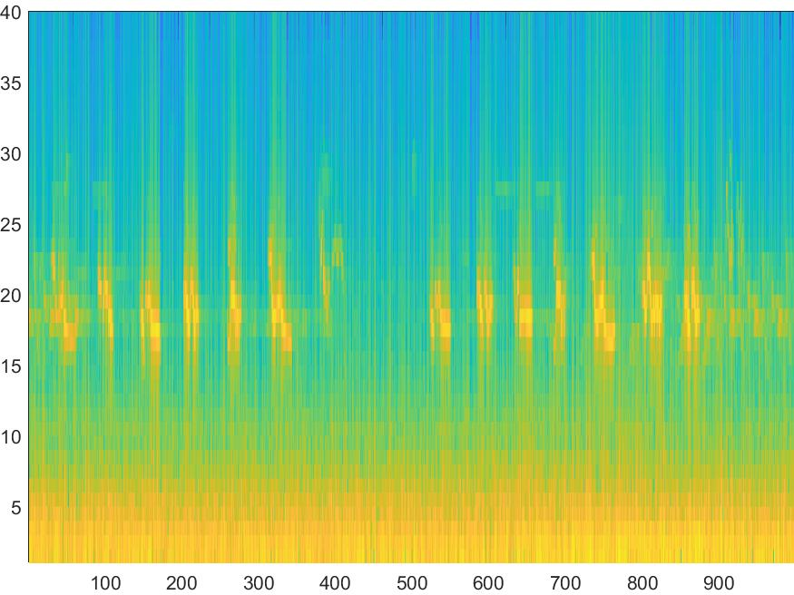
Background
Data
Bird call .mp3 files from Xeno-Canto.org database
Segmented into 10 second clips
Wide spread variety of recording conditions

Slide 4
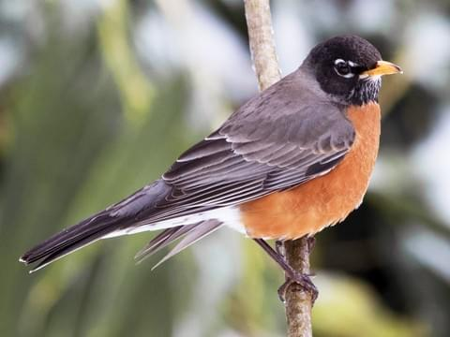
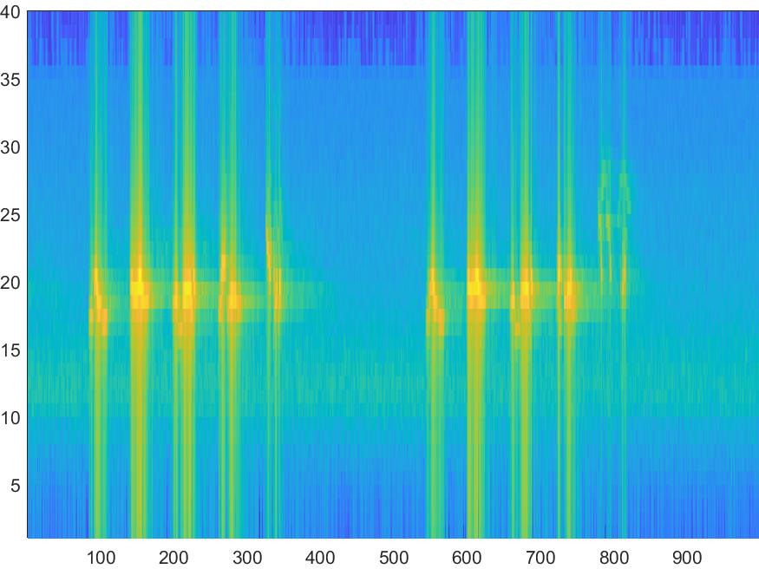
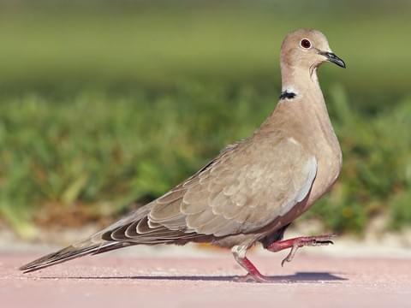
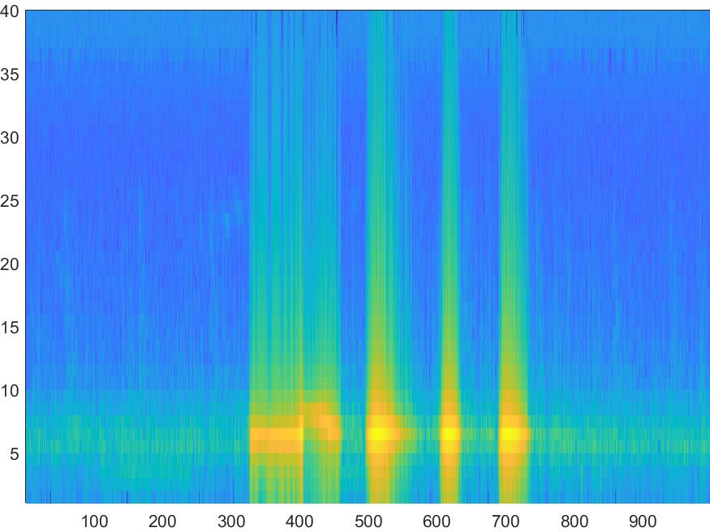
Background
Classes
American Robin
Mourning Dove
Shallow Neural Network
Transfer Learning with AlexNet
Template Matching (SAM)

Slide 5

Approach – Shallow Neural Network
Architecture based off network for OCR
Modify input/output to match data dimensionality
Design requirements
Minimal number of layers
Ability to extract spatial characteristics
~450 training/validation samples per class
Randomly segmented in 7:3 ratio

Slide 6

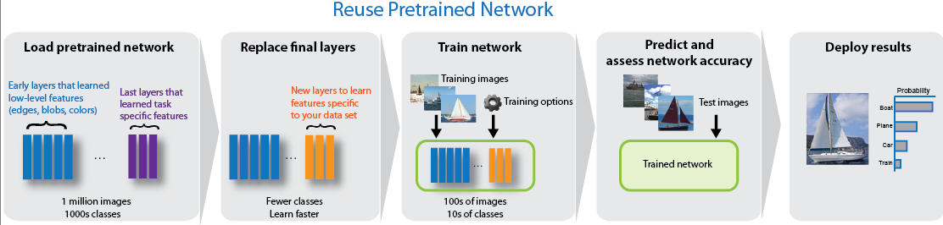
Approach – Transfer Learning (Alexnet)
Readily available pretrained network
Retrain with ~450 training/validation samples per class
Augment size to match input layer
Modify output to 2 classes
Analyze accuracy of the predictions
https://www.mathworks.com/help/deeplearning/examples/transfer-learning-using-alexnet.html

Slide 7

Approach – Sam template matching
Comparison of two spectra
Single signature (truth) clip for each class
922 test samples (raw .mp3’s)
Perform score calculation in one vector operation

Slide 8
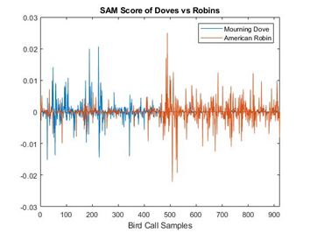
Experimental Methodology – Sam template matching
Determine decision threshold for classification
Experimentally determined
Higher absolute magnitude for each sample
Compute confusion matrix from predictions

Slide 9
Experimental Methodology - Neural Networks
Input the 320 test spectrograms into the networks
Augment for AlexNet
Compare outputs to ground truth provided by Xeno-Canto
Simple binary comparison
Create confusion matrix
Comparative analysis of methods via overall accuracy

Slide 10
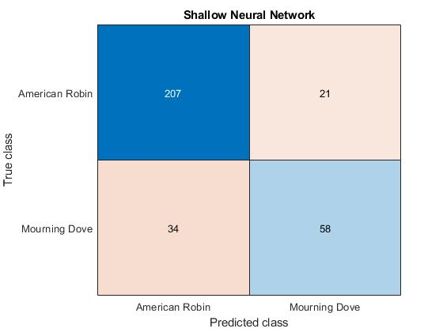
Results – Shallow Neural NEtwork
Anomaly during 30th epoch of training
Limited training process
Validation accuracy
100 epochs: 51%
30 epochs: 91%
Test accuracy
Using 30 epoch limited network: 82.8%

Slide 11
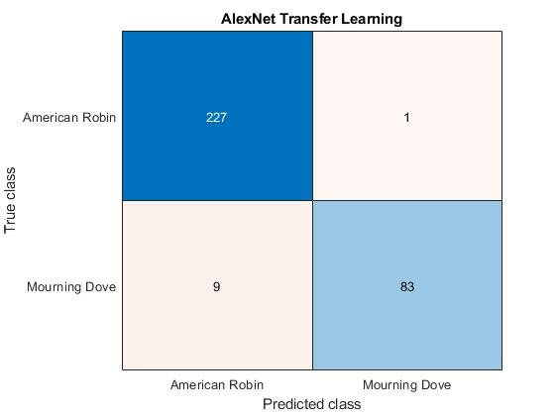
Results – Transfer learning (Alexnet)
Validation accuracy
6 epochs: 97.8%
Test accuracy: 96.9%
Training process took longer than shallow neural network

Slide 12
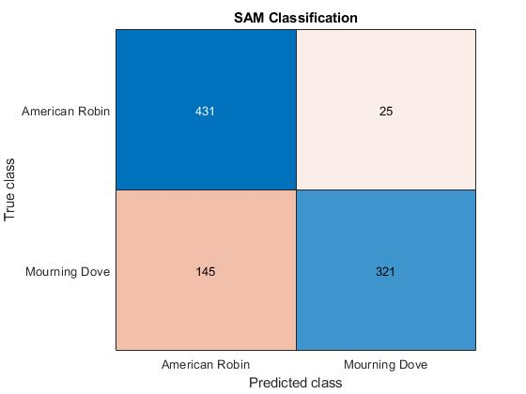
Results – SAM template matching
Utilizing thresholds used for HSI data
Mean/Median of signature, etc.
Accuracy near 50%
Test accuracy: 81.6%
Much more false alarms for Mourning Doves

Slide 13
Conclusion
Study yields promising results for application of these tools for bioacoustics classification
Trade-off between speed and accuracy
Data required for neural network implementation is a concern
Data availability
Diversity in available data
Pre-processing and augmentation pose speed bottlenecks in real-time application
Scalability of each classification method
Neural networks show promise
 | Shallow CNN | AlexNet | SAM
Time per Classification (s) | 0.0214 | 0.0279 | 0.0064

Slide 14
Future Work
Increase number of classes
Explore different methods of pre-processing
Try different neural networks
Pretrained
Original
Implementation
Mobile application
Application specific device

Slide 15

Acknowledgements
Xeno-Canto
Dr. Kaufman
Birds
Questions?

