Slide 1

Data Analysis
RX Sales
Project Presentation
GROUP A-22
Anurag Thakur
Rishabh Raj
Neeraj Kumar

Slide 2
CONTENTS
Introduction
Requirements
About
Objective
Data Model
Features
Advantages
Output
Conclusion

Slide 3
Project Introduction
1
OPENING

Slide 4
Introduction
What is RX Sales??
This Rx Sales measures and monitors the performance of a UK pharmaceutical sales representative in areas where there are dispensing doctors.
1
A Sales Representative or Sales Manager would use this to see how they are performing with respect to their peers.
They may also use this application to analyse good and bad performing areas within there territory.
2

Slide 5
Project Introduction
2
Requirements

Slide 6
System Analysis
The proposed system is an application software and which has an intention to begin a conductive and direct interchanging the statistics in a secure platform to coalesce with data analysts.
1
HARDWARE REQUIREMENTS:-
1. Processor: Intel core i3
2. RAM: 8 GB
3. Hard Disk: 500 GB
2
SOFTWARE REQUIREMENTS:-
1. Operating System: Windows 10/11
2. Software: PowerBI.

Slide 7
Project Introduction
3
About

Slide 8
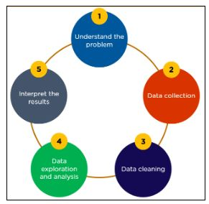
About
Data analysis is a process of inspecting, cleansing, transforming, and modelling data with the goal of discovering useful information, informing conclusions, and supporting decision-making.
In today's business world, data analysis plays a role in making decisions more scientific and helping businesses operate more effectively.
Data Analysis is used everywhere because of it’s numerical benefits, high demand and automated decision making.

Slide 9
Project Introduction
4
Objective

Slide 10
Objective
The main purpose of this project is to analyse pharmaceutical sales data.
It makes studying data a lot simpler and more accurate.
It helps the researchers to interpret the data.
It helps to analyse data from different outlooks.

Slide 11
Project Details
5
Data Model

Slide 12
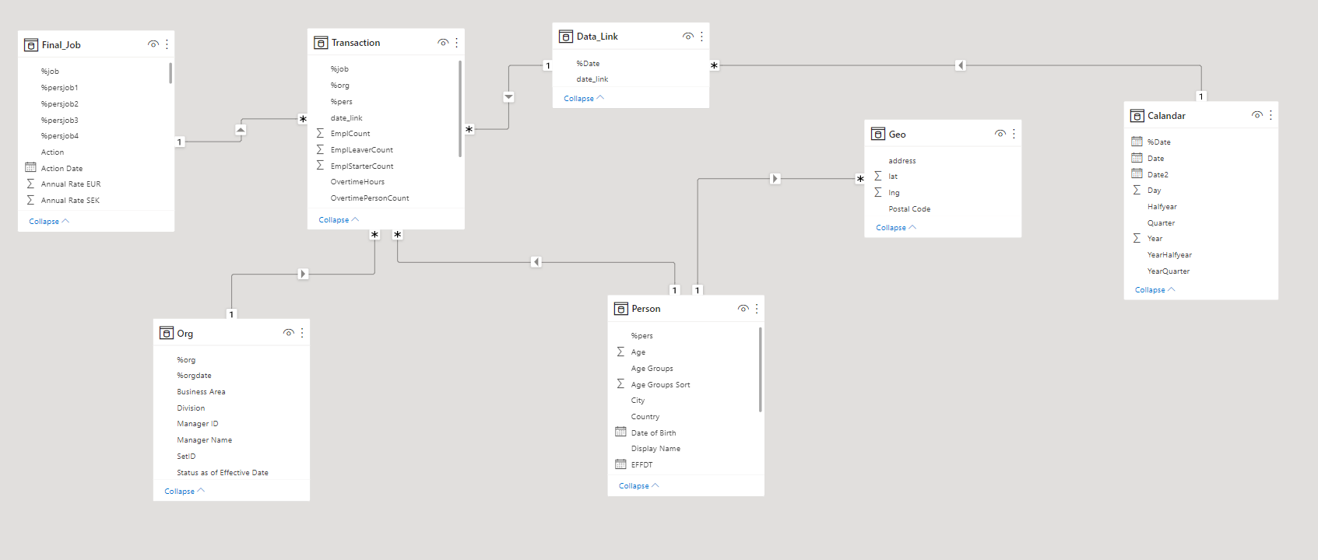
DATA MODEL

Slide 13
Project
6
Features

Slide 14
Features
Report
E-Prescription
SMS and Notification
Multi-Store and Multi-Location Support
User Management Module
Generates real time alerting

Slide 15
Project
7
Advantages

Slide 16
Advantages
Better & Accurate Analysis
Better Understanding
Build Strong relationships with your Buyers
Change the mindset of buyers which they are paying the payment
Sales coaching for pharma sales team

Slide 17
Project
8
Output

Slide 18
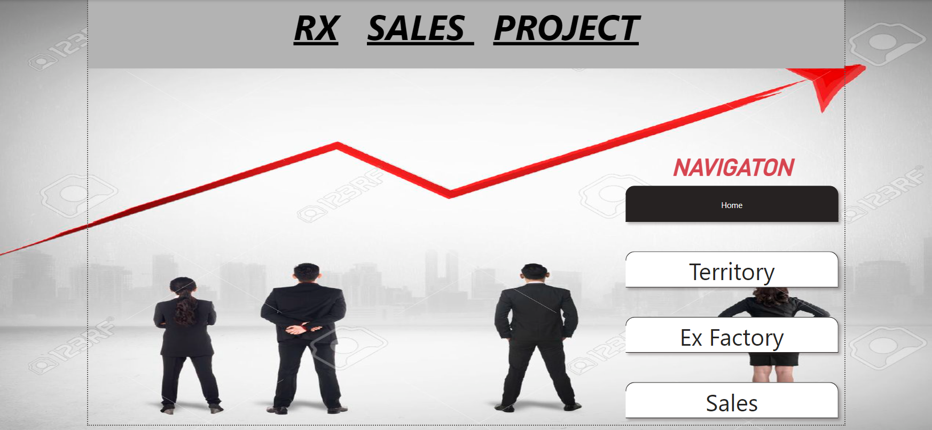
Landing Page

Slide 19
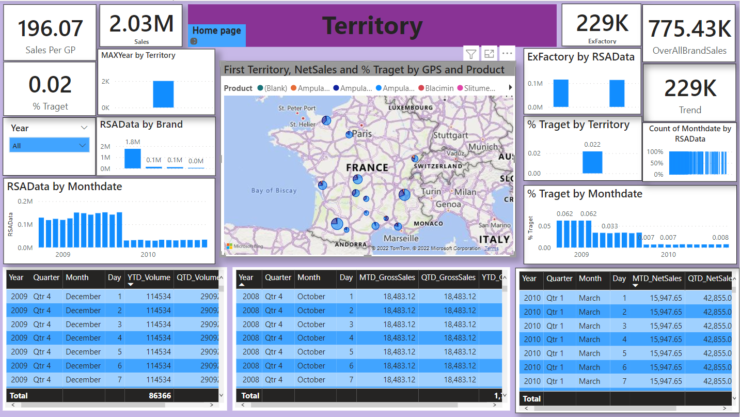
Territory

Slide 20
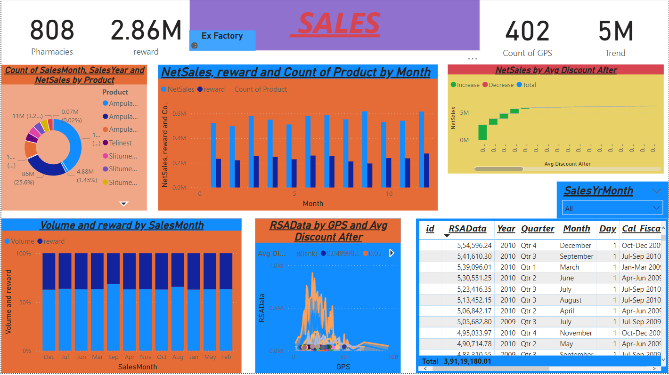
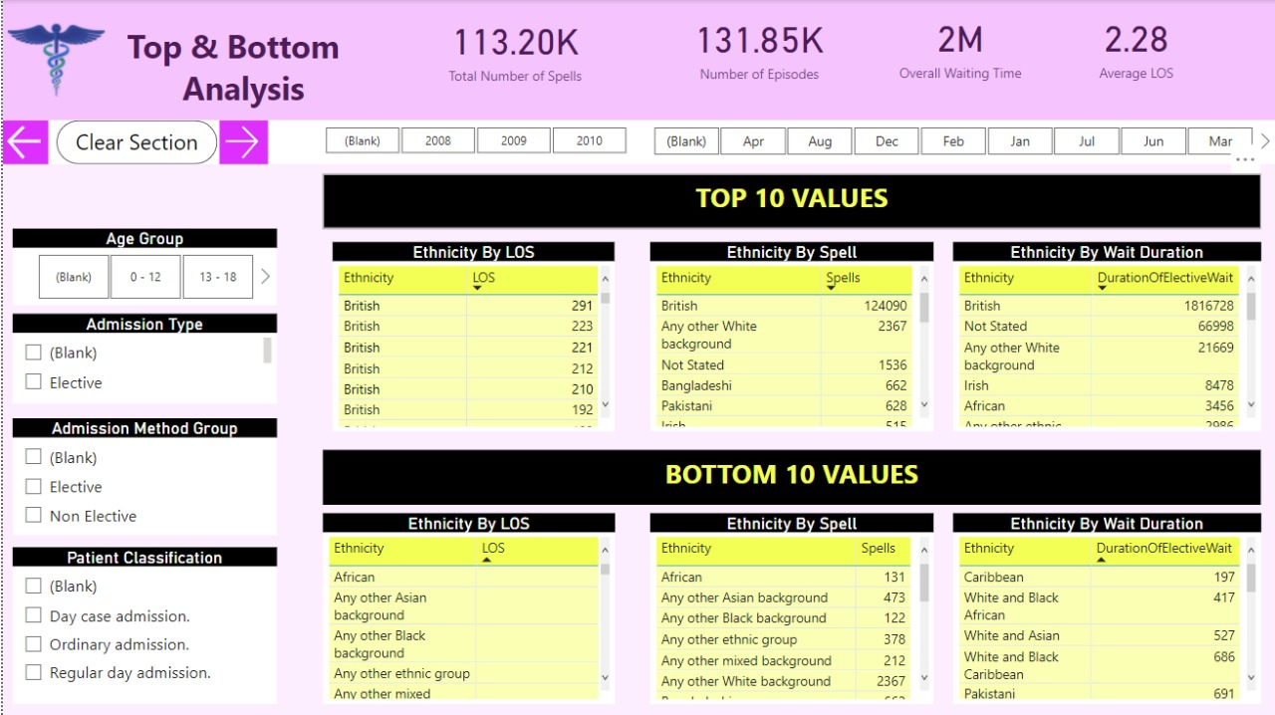
Sales

Slide 21
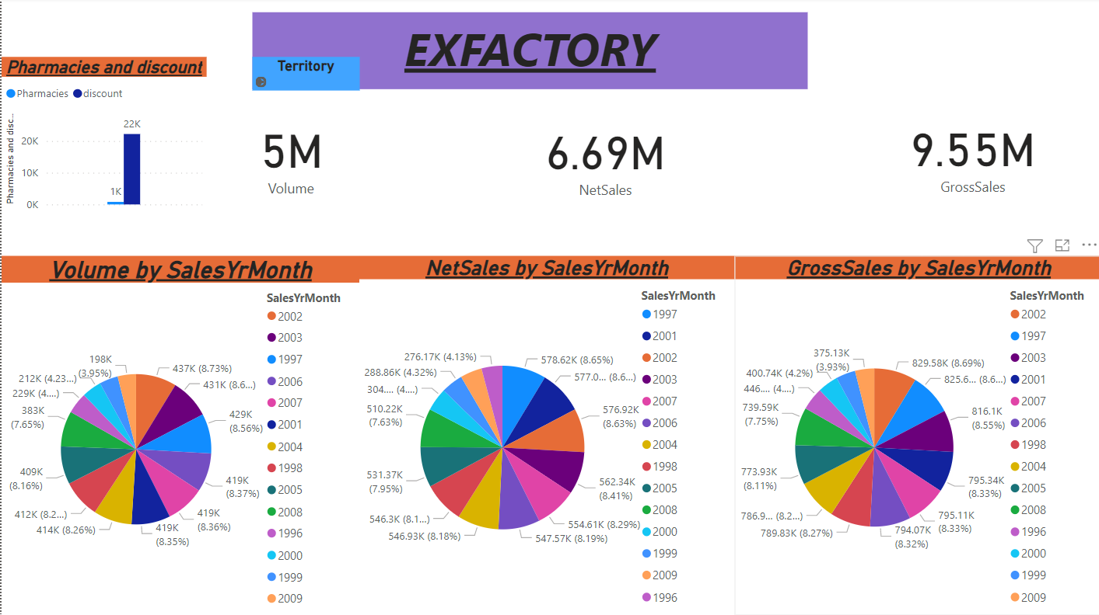
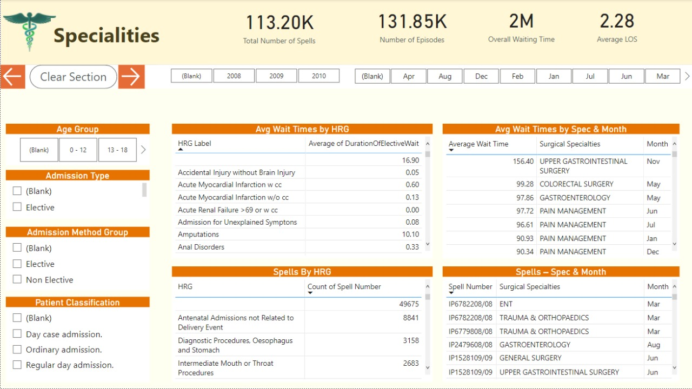
Ex Factory

Slide 22
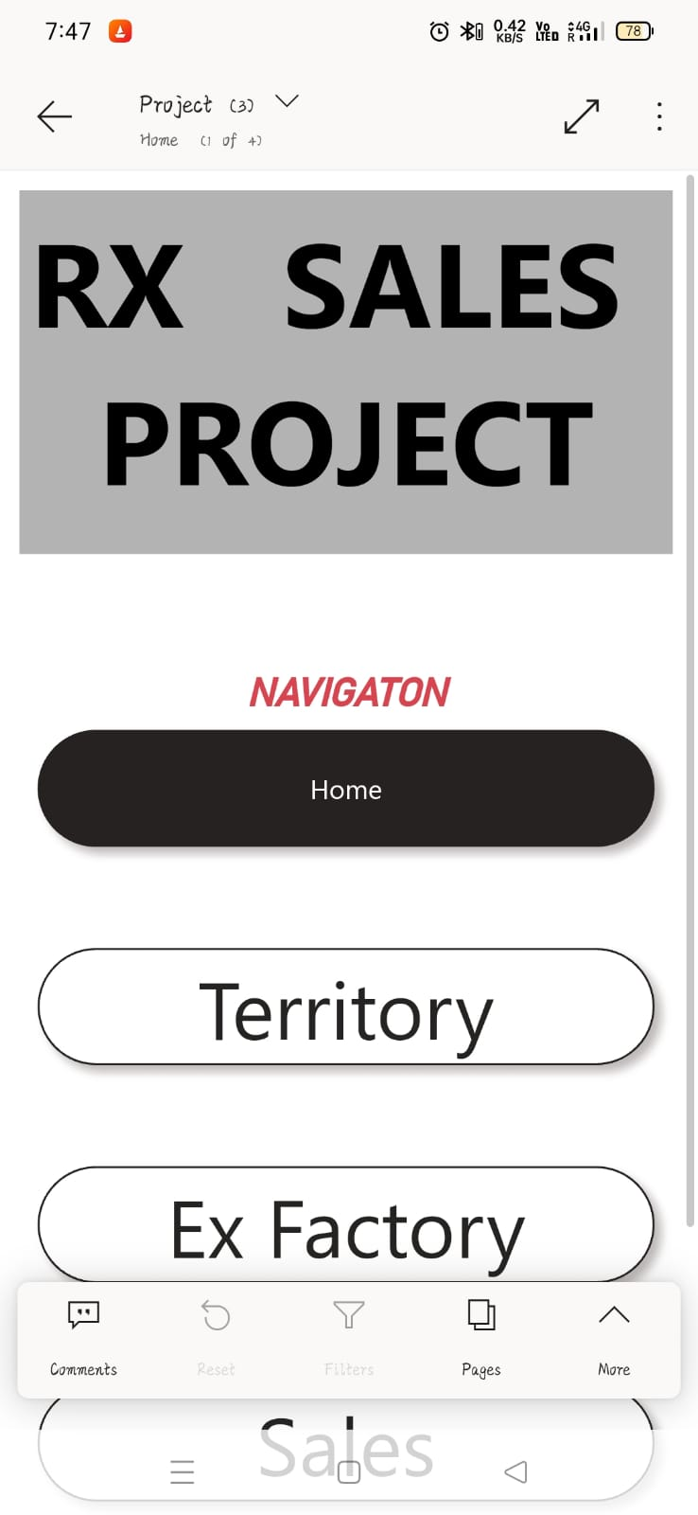
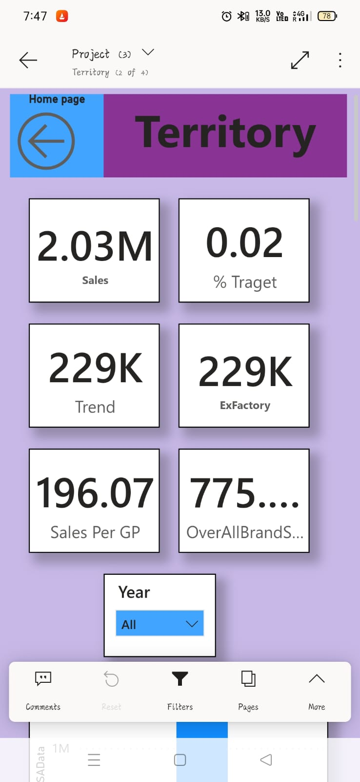
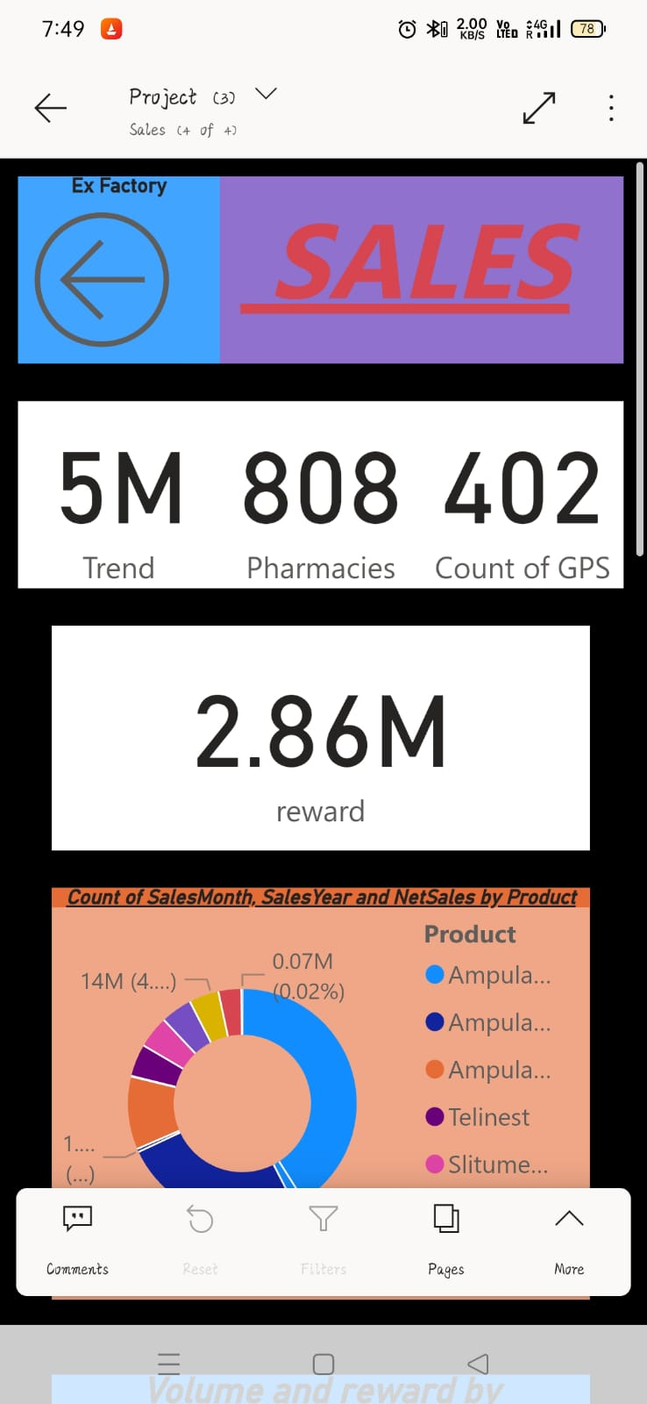
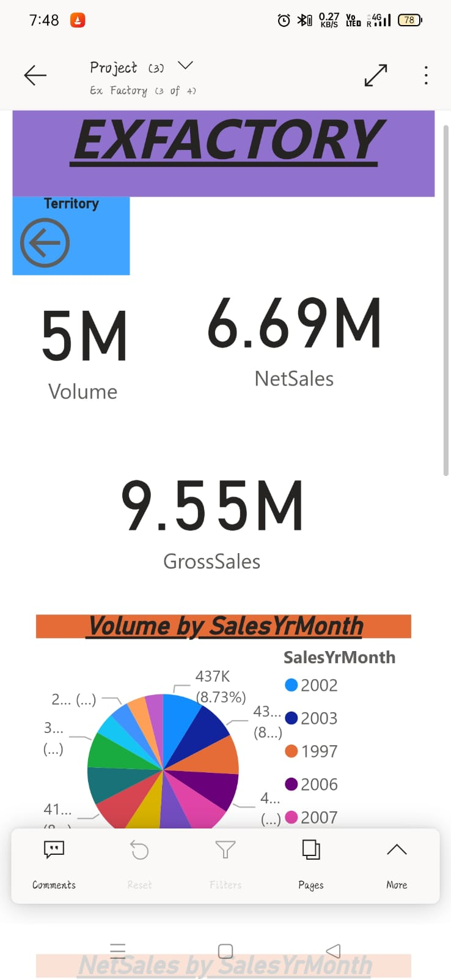
Mobile Layout

Slide 23
Project
9
Conclusion

Slide 24
Conclusion
CONCLUSION
The purpose of this project was to identify the effective strategies for dealing with Power BI tool in order to enhance the visualizations for different reports thereby making the analysis of data much simpler and easier to understand.
This project was a complete hands on experience for our team and the entire work was completed by us.

Slide 25
THANK YOU !
TEAM A22

