Slide 1

Project: Yelp Business Intelligence Analysis
Neha Kumari
MSIT – Clark University

Slide 2

Introduction
Yelp Inc. is an American multinational company
It was founded in October 2004 by Russel Simmons and Jeremy Stoppelman.
It is headquartered in San Francisco, California.
It is basically a type of social networking site where users submit reviews about the products and services, using one-to-five-star rating scale.
It publishes advertising and crowd-sourced reviews about businesses.

Slide 3

Goals and vision
The goal of Yelp is to connect people with local businesses.
Their vision is to provide a one-stop solution for customers to discover, connect and transact with local businesses of all sizes.
Overall, they want to provide a one stop solution for all the helpful information possible by providing the users the services like making reservations, appointments, purchases and much more.

Slide 4
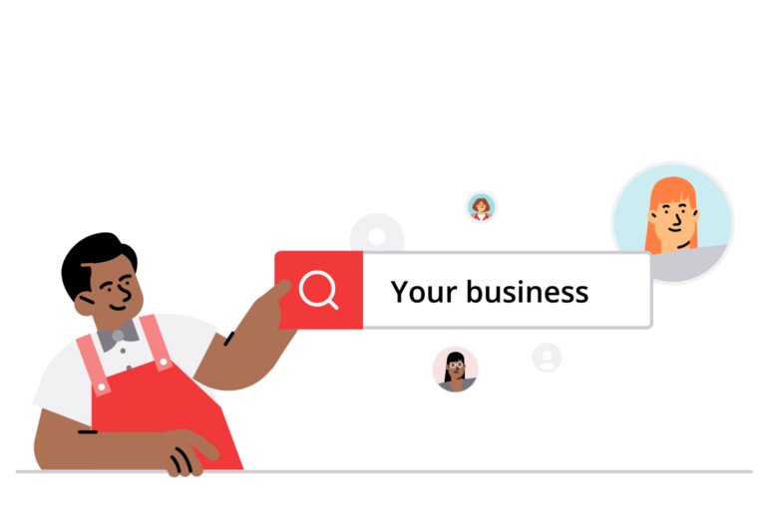
Challenges faced by Yelp
Astroturfing
Alleged unfair business practices
Competition
Litigation over review content
User experience

Slide 5
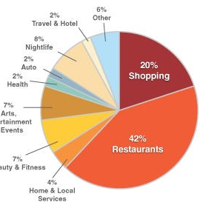
Roles of Business Intelligence for Yelp
Business Intelligence help Yelp in analyzing user review, rating, and feedback to spot patterns and trends.
To identify popular eateries, dishes, and culinary trends for the users.
With the use of BI Yelp can foresee the businesses demand forecasting.
They can take more strategic and well-informed decisions.
Yelp can use the power of data wisely to stay ahead of their competitors and keep growing quickly.

Slide 6
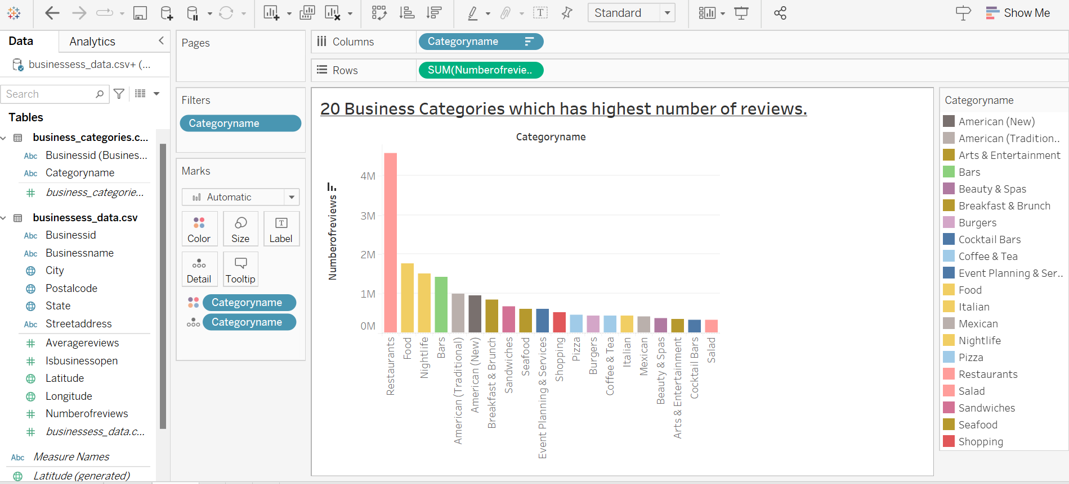
Data Visualization using Business Intelligence Tool: Tableau.

Slide 7
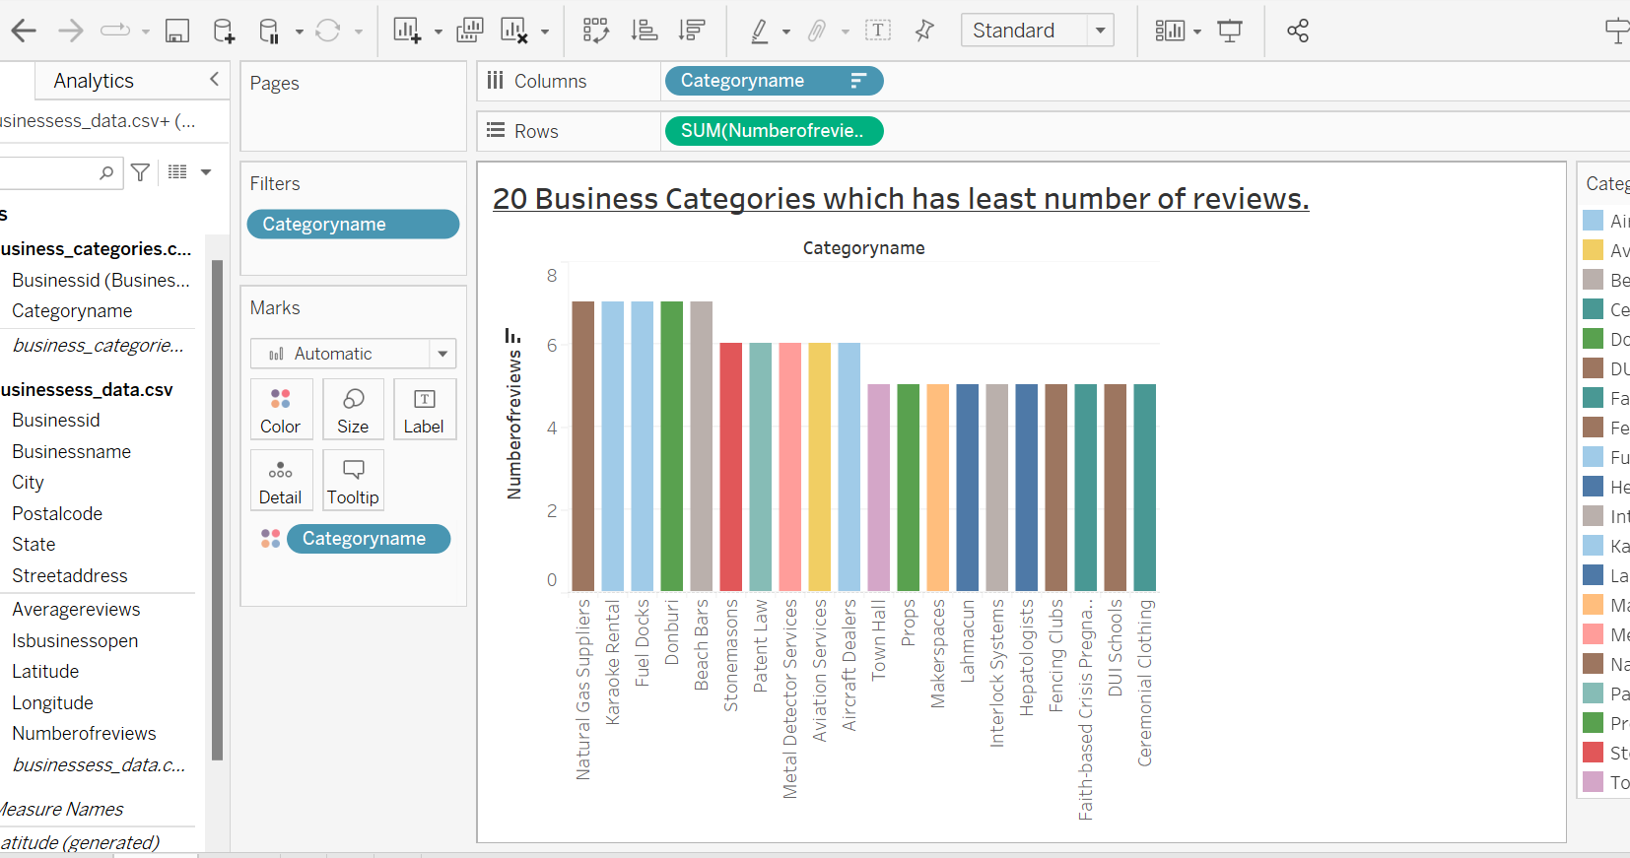

Slide 8
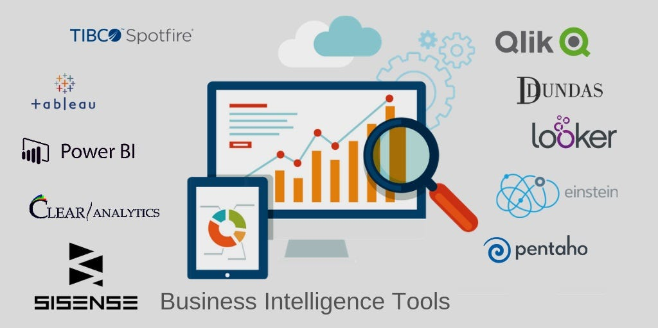
Business Intelligence Tool Used by Yelp
Tableau
Looker
AWS
Hadoop
Spark

Slide 9

Software Used by Yelp
Linux Ubuntu – An operating System
Apache – A web server
MySQL – A relational database management system
Python/PHP – Programming Languages

Slide 10


Types of Data on Yelp
Enterprise Data
Users Data
Reviews Data
Digital Data such as Photos and Videos.
Yelp’s own gathered data from open-source locations.

Slide 11
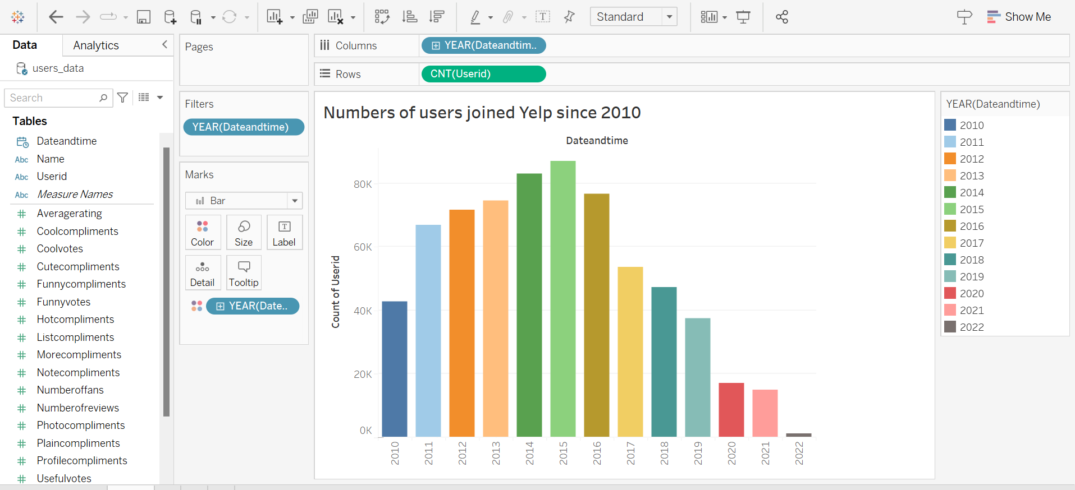

Slide 12
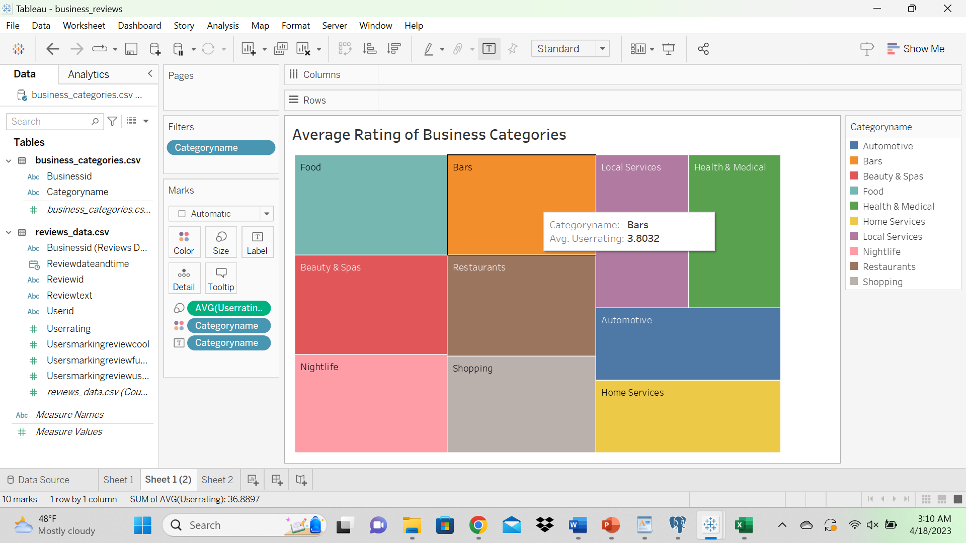

Slide 13
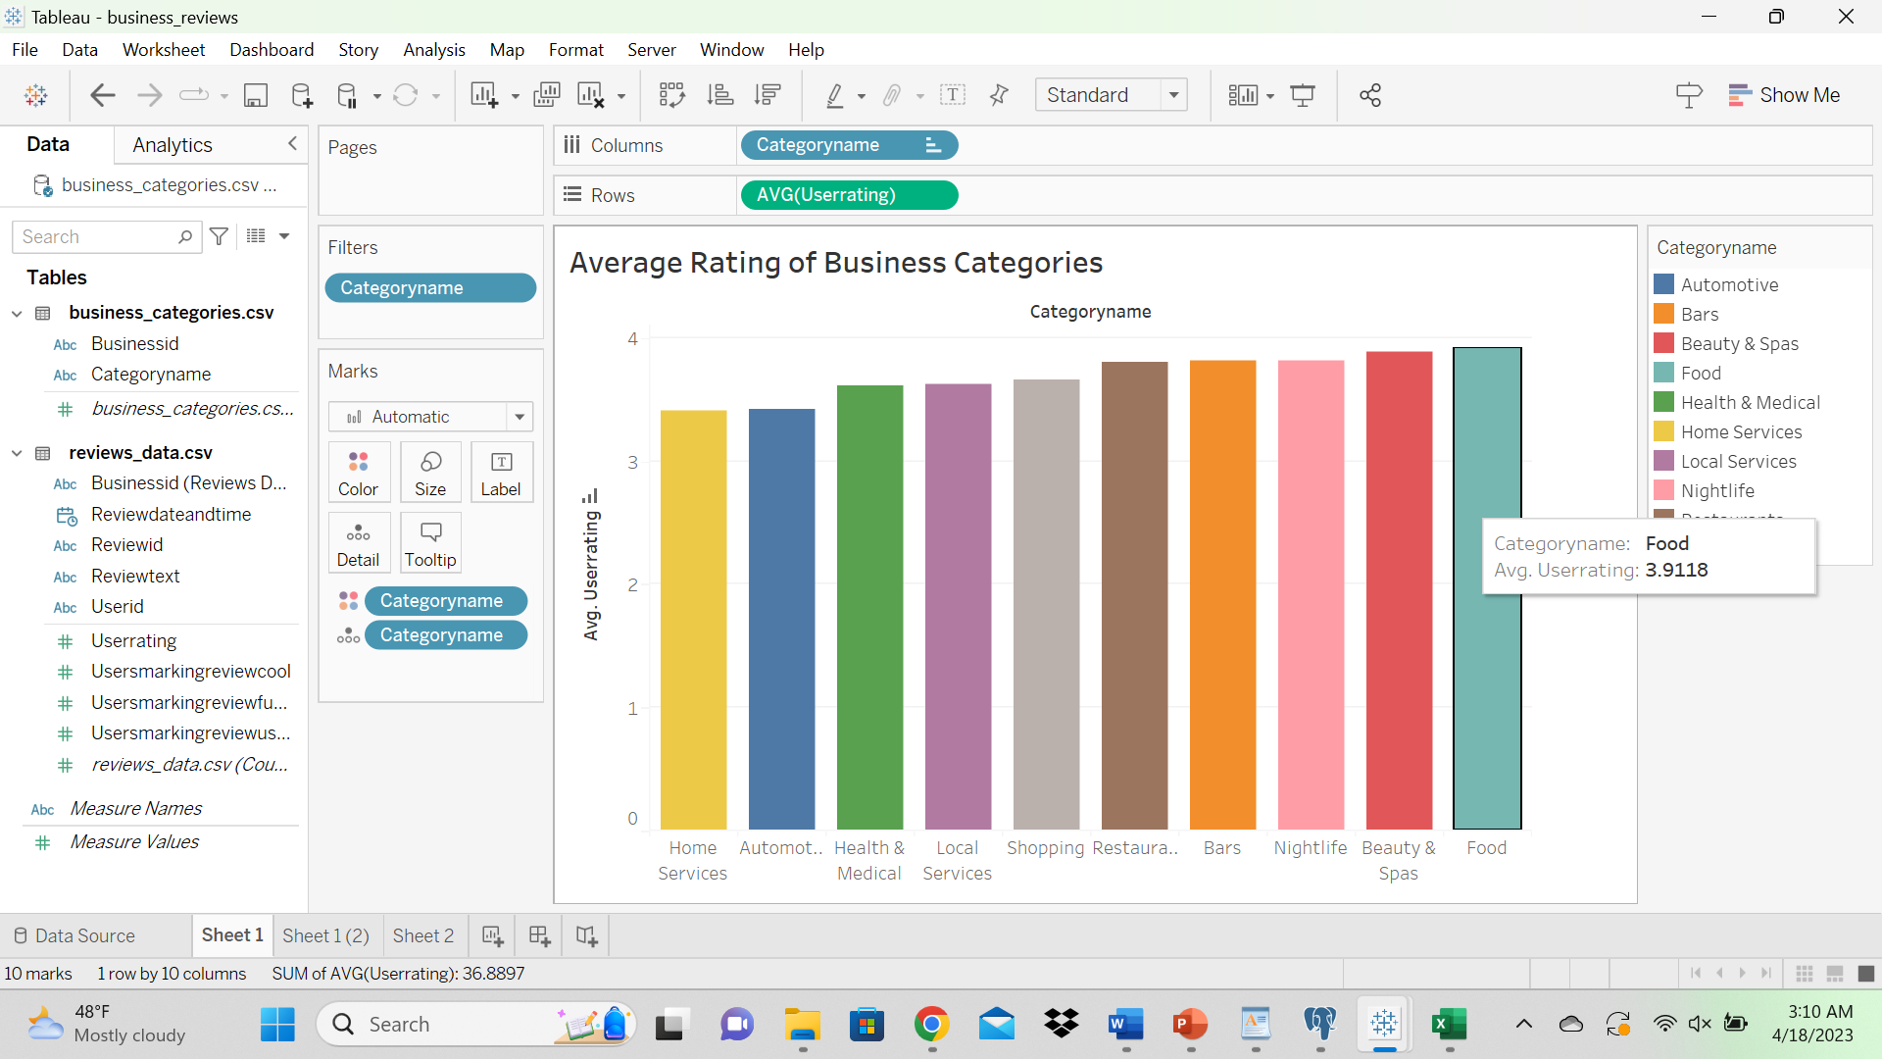

Slide 14

Issues with Data on Yelp
Data Security
Data Privacy
Fake and Negative Reviews
Data Quality Issues
Unstructured data
Data from multiple sources

Slide 15
Components to Analyze and Solve Yelp’s Business Problems
Data Sources
Preparation of Data
Fact Table
Dimensions Table
Primary & Foreign Keys
Measurements

Slide 16
Steps Taken by Yelp to achieve their Goals
Business Process Optimization
Market Analysis and Strategic Planning
Cost Management
Revenue Optimization
Data Analytics and Insights

Slide 17

5. Recommendation to Yelp
Expand Data Sources
Increase Data Integration
Improve Data Analysis Capabilities
Improve Data Visualization
Enhance data Quality and Governance
Promote Data Driven Decision Making Culture
Use Cloud based Solutions.

Slide 18


Slide 19
Sample Data of Yelp’s Users
userid | name | numberofreviews | dateandtime | usefulvotes | funnyvotes | coolvotes | numberoffans | averagerating
hjJULwAKSrz7jscP-e2u5A | Jesiree | 125 | 1/17/2007 8:57 | 553 | 406 | 452 | 17 | 4.08
PcOmYz824970UY3v7W9lOA | cindy | 78 | 10/28/2010 17:49 | 34 | 12 | 18 | 1 | 4.48
Ig2ttf1xX2Ihlm0nsykaTw | Ken | 250 | 3/30/2006 17:39 | 776 | 248 | 261 | 28 | 3.82
qTjcvqkIszo2otqIxGmbKw | Bradey | 105 | 8/23/2008 16:58 | 144 | 18 | 35 | 2 | 4.19
amI_rxESh1EPIVvMnyV4kA | Karissa | 149 | 5/6/2009 22:40 | 221 | 53 | 71 | 3 | 3.68
bDwBtC0jk3is-qLFlxWGWw | Gabriel | 196 | 7/8/2011 21:40 | 712 | 308 | 292 | 24 | 3.78
_NBVFt_RvD9fKceDT_9Hcw | Cerpin | 39 | 8/18/2009 14:54 | 56 | 26 | 47 | 1 | 3.85
wB8ATiDKotKsP-jEPJgwtw | Chris | 678 | 6/18/2009 2:09 | 1074 | 295 | 427 | 23 | 3.63
a19tRkiGNa2XD3bazeMjDg | Diana | 76 | 12/31/2009 6:54 | 115 | 64 | 32 | 1 | 3.03
vzPTjVZG0-5MO7jGGeNwTw | Ferdinand | 181 | 11/8/2007 0:24 | 473 | 413 | 231 | 19 | 3.04

Slide 20
Sample of Yelp’s Reviews Data
reviewid | userid | businessid | userrating | usersmarkingreviewuseful
c6Mr8b1tPBrU0e5pqFdBew | J4a0YR8lfdd91TlqQtC0HQ | MmIF3ZlBPwOknea6-IzlQg | 4 | 0
oUMRz8udZn5QDOSjxIy5zw | X8S-7D4lVR4JIcvXtFTjcg | HfOLOAYMKNUer3eXXTLHew | 5 | 0
8IfFX3meYWYFFt5vkzd_tg | 6Mv-qMJyxSokCu8YFM1o0A | i4iZdyneMKGEc729ogQhcw | 3 | 3
yHeMzK2zggdfWD92WPzLEw | WIdUAxJqXKp2imC_BfcxMg | wUnLSg_GKfEIQ5CQQ770_g | 3 | 6
gkKMCZVvKkaF92LVLsaASw | mC4OulqBTGqckNSg9usmvg | ulCYqxUWKXCadvyr8OugaQ | 5 | 0
GNm0fjPtxGRf0Hc1idNoIA | 60D1sIdiSfbkqBhfL-uCkw | fGXhWKQV5YwjIjgP-DBNBw | 5 | 0
yBcH9ECWDeL2zzfoCBXZyQ | LRc6JI-u-4PvHq9J3Jv96Q | t0XZeA0MP0P66QyLQn_NUw | 5 | 2
7bK-DeA5dJIehd5PSHrfqQ | XkM2_UnZ3Sh8A2tFpGDEng | DeVlppoc8dPBhOCPrm4wmg | 4 | 0
OzzitjFxc0Pgr18vvdopvg | bNmUR65_N55C91N1hZC-Vw | ZNdy7JaPmZpIYprPU-2wnw | 1 | 0
ATtUHJ6MeDph60ejpQzFyw | bQuGtIkqMrfK2UM9s5chGQ | v72HalBu5fQIFTD-oqhSgQ | 5 | 1

Slide 21
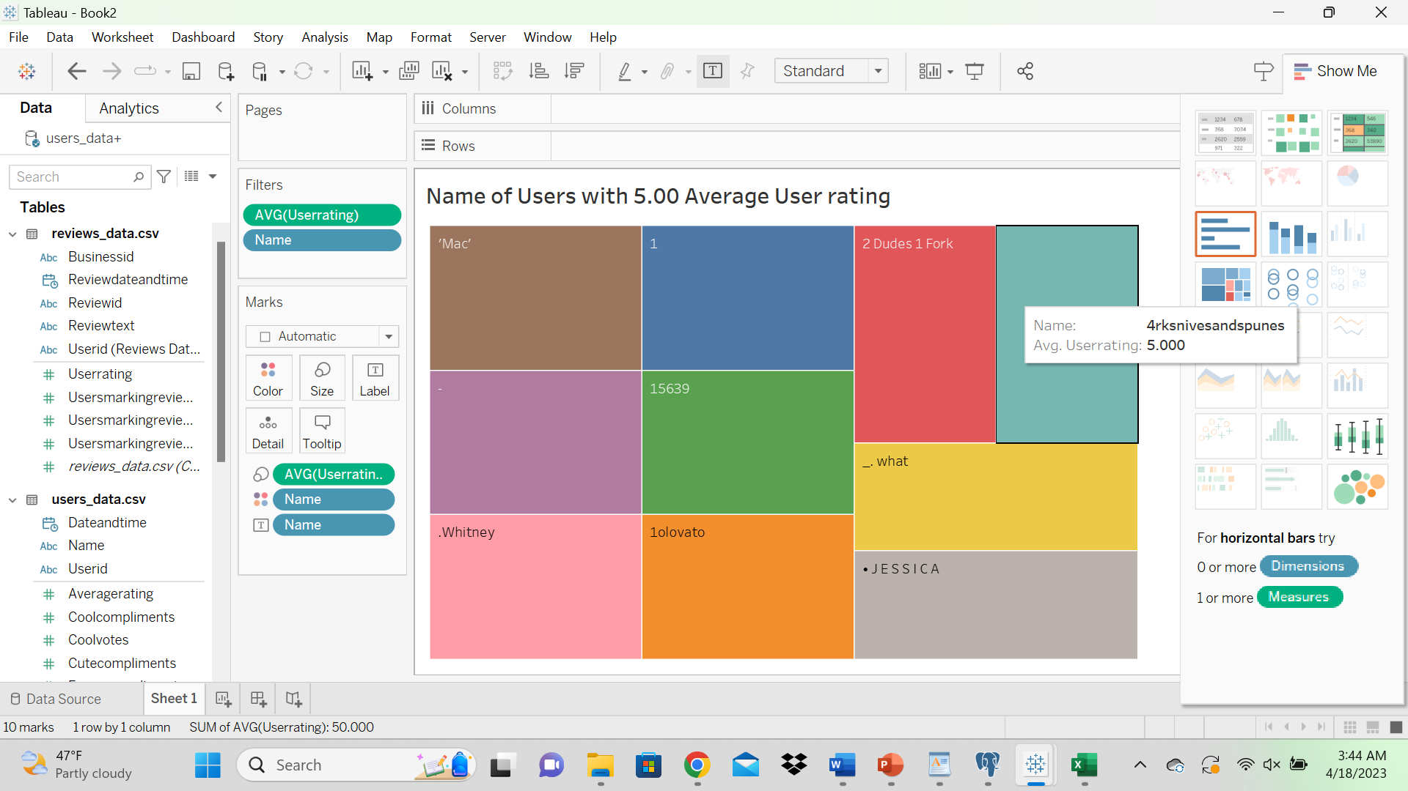

Slide 22
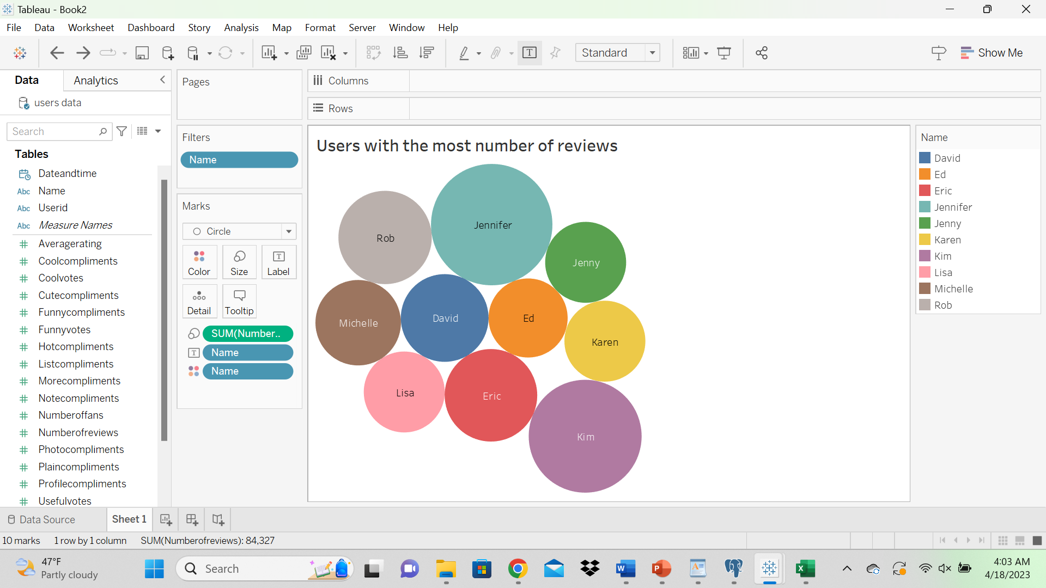

Slide 23
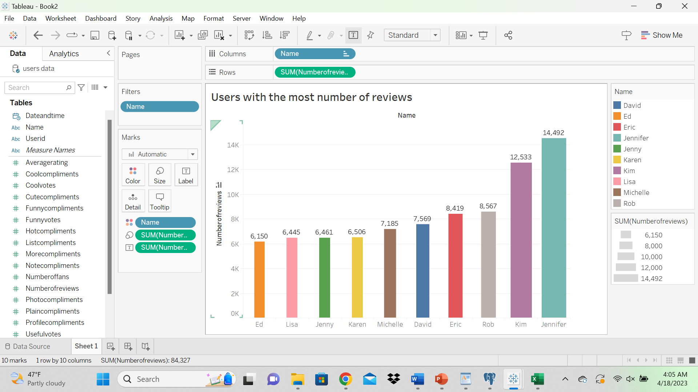

Slide 24
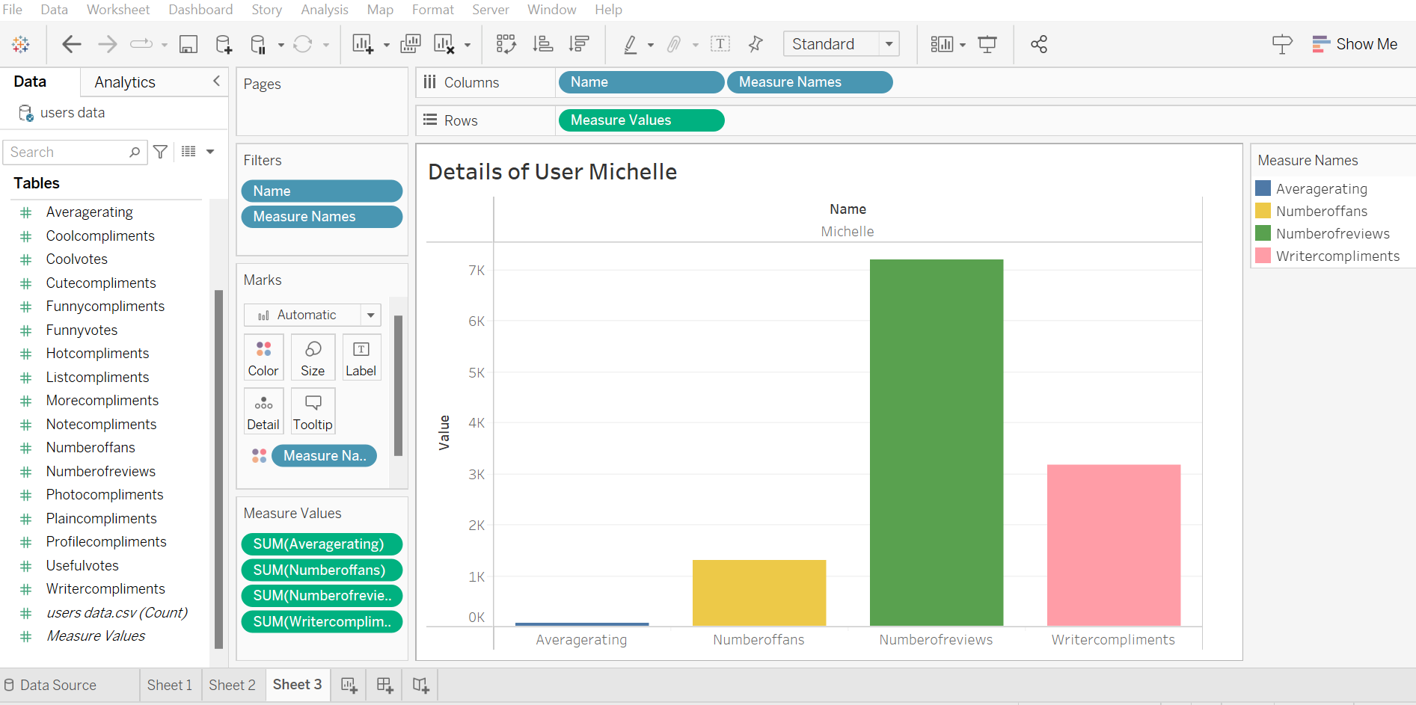

Slide 25
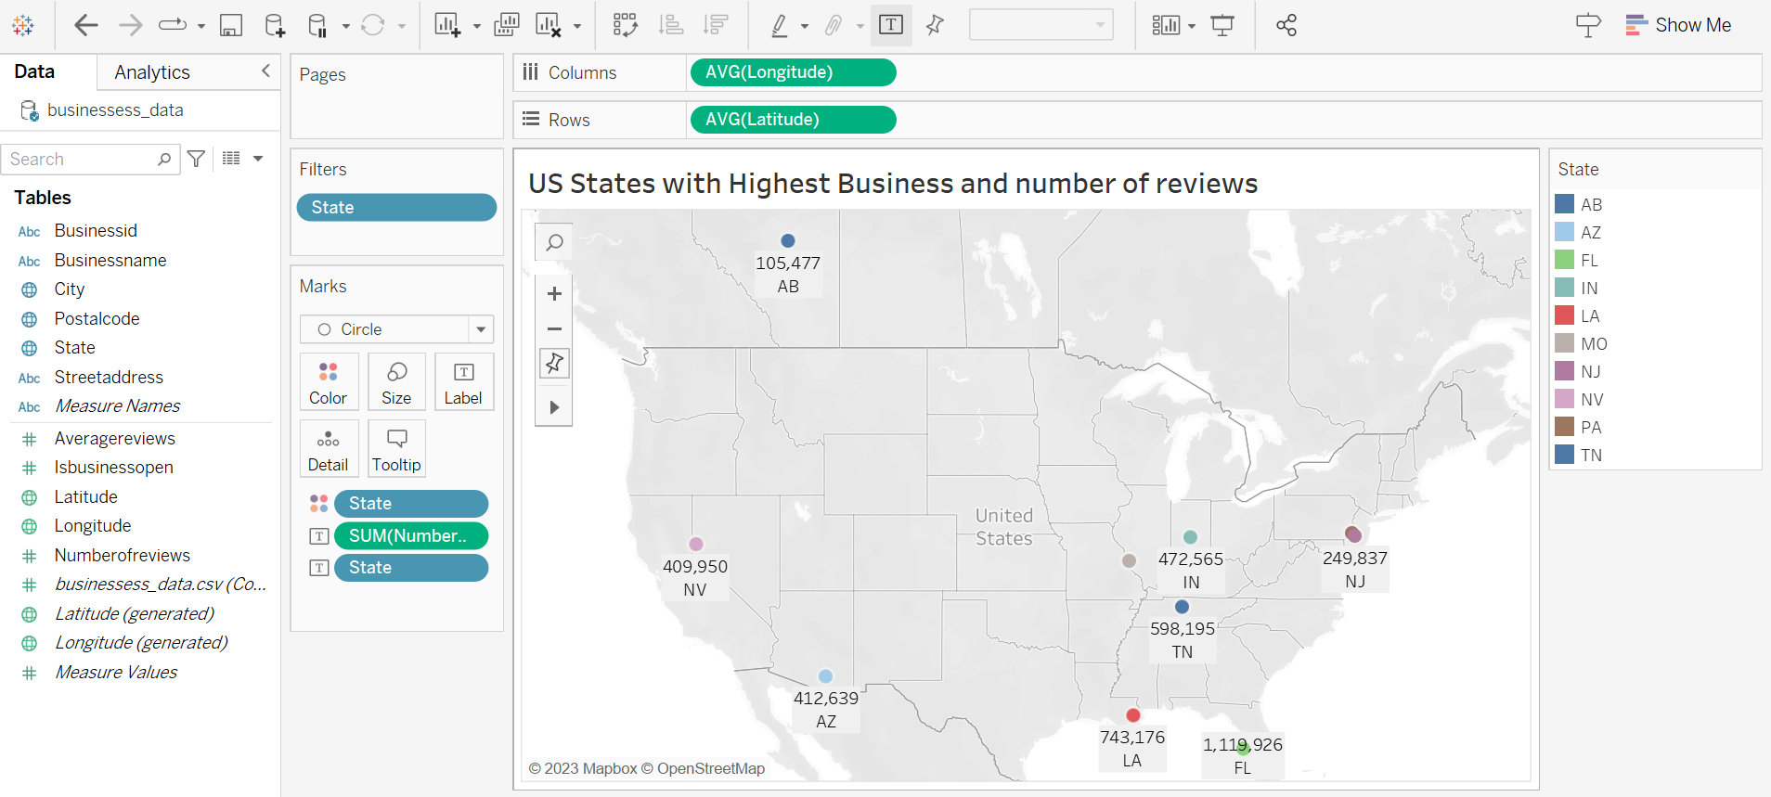

Slide 26


Slide 27


