Slide 1
RAG, Explained Simply
How retrieval-augmented generation finds the right evidence
— and why chunks, embeddings and rerankers each have exactly one job

Slide 2
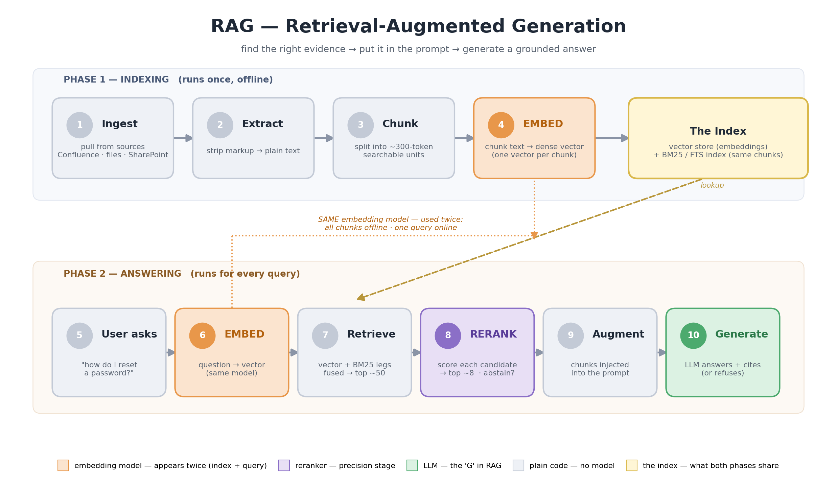
The whole picture in one slide
Two phases — build the index once, then use it for every question

Slide 3
The core idea: searching a book for one fact
Every RAG concept maps to a person working with pieces of a book
📖 The setup
A 200-page manual holds the answer — but it's too big to hand over whole.
So we CUT the book into pieces first.
That cutting is called chunking.
Then two people work with those pieces…
Person 1 — the Indexer (embedding model)
Reads each piece once, writes a summary card.
Question arrives → matches it to all cards → ~50 candidates.
Person 2 — the Editor (the reranker)
Reads the question + EACH candidate pair carefully —
picks the few that TRULY answer → best ~8 on the desk.
Can also say "none of these are good enough."
Person 3 — the Answerer (the LLM)
Reads only those final ~8 pieces,
writes the grounded answer + citations — or refuses.

Slide 4
Three models, three jobs
Each stage optimizes a different thing — that's why they exist separately
EMBEDDING MODEL
Job: recall — make sure the answer is SOMEWHERE in the candidate set.
Used twice:
• once for every chunk (index time)
• once for the question (query time)
Fast: ~5ms per piece.
RERANKER
Job: precision — order the candidates honestly; pick the true top few.
Sees question + candidate TOGETHER → fine-grained relevance.
Slow per pair → only ever sees ~50 candidates, never the whole index.
LLM
Job: generation — read the top chunks and write the grounded answer.
Most expensive model → it sees the LEAST text.
The whole pipeline exists to protect its desk.

Slide 5
Why cut the book into pieces?
Three independent reasons all point the same direction
1 · The indexer can't read big pieces
The embedding model reads ~500 tokens max.
Longer piece → it silently stops reading.
The tail is invisible to search. Forever.
No error. No warning.
2 · The answerer's desk is small
The LLM sees a limited amount at once —
instructions + history + question + chunks + its answer.
8 paragraphs fit. 8 chapters don't.
3 · Big pieces make fuzzy summaries
A 3000-word piece covers many topics →
its summary is a blurry average of all of them.
Small piece = one idea = sharp match.

Slide 6
So how big should a chunk be?
The model sets the ceiling — the content picks the size under it
TOO SMALL (~50 tokens)
Fragments: "…you must then reset it within 24"
Reset WHAT? No context.
Answers get split across pieces — neither half matches.
SWEET SPOT (~300 tokens)
One complete idea:
"To reset a password: Settings → Security → Reset. Link expires in 24h."
Sharp summary → strong match → complete, usable piece.
Plus ~15% overlap so boundary answers survive.
TOO BIG (>500 tokens)
Above ~500: embedder literally can't read the tail.
Legal but big: several topics smeared into one fuzzy vector —
outranked by sharper pieces.
Rule of thumb: smallest piece that still contains one complete thought.

Slide 7
Correlation #2 — the answerer's desk (the math)
Chunk size and 'how many chunks' are the same dial
What the LLM sees — one flat budget
[ instructions + persona ] ~1,000 tokens
[ conversation history ] varies
[ the question ] ~50
[ ███ EVIDENCE (chunks) ███ ] ← what remains (~6,000)
[ its answer ] ~500 reserved
chunks fed × chunk size ≤ evidence budget
Fits ✅
8 chunks × 300 tokens = 2,400
comfortable — room to spare
Doesn't fit ❌
8 chunks × 3,000 tokens = 24,000
→ chunks get silently dropped (maybe the right one!)

Slide 8
Why several small pieces beat one big piece
Fitting isn't the same as being used well
1 · Evidence mixing
Real answers need pieces from DIFFERENT places:
policy + exception note + config reference.
Small chunks = 8 best slivers from anywhere.
Giant chunks = 2 chapters, 90% irrelevant.
2 · "Lost in the middle"
LLMs read the start and end of long inputs carefully —
and get fuzzy about what's buried in between.
A fact inside a 3,000-token chunk is HARDER to use
than the same sentence in a 300-token chunk.
3 · Cost
Every stuffed token is paid for, every query.
8 × 300 = 2.4k tokens
8 × 3,000 = 24k tokens ← 10× the cost,
for WORSE answers. The expensive option loses twice.

Slide 9
The pipeline in three numbers
Set at different times, sized against each other
~50 candidates
RETRIEVE — recall.
vector + keyword search,
don't miss anything.
top ~8 chunks
RERANK — precision.
keep only the honest best.
× ~300 tokens each
CHUNK — the unit.
small enough to fit,
big enough to mean something.
8 × 300 ≈ 2,400 tokens of evidence — fits the desk perfectly.
The 50 protects recall. The 8 protects precision. The 300 makes both fit.

Slide 10
What happens without each piece?
Same system, parts removed
No embedding model
Only keyword search left.
"reset a password" can't find
"credential recovery" — zero shared words.
→ synonym/paraphrase recall collapses.
No reranker
Raw top-50 goes straight to the desk.
Desk fills with near-misses →
LLM answers from the wrong piece,
or gives up when the right one was buried.
No RAG at all
LLM answers from memory alone:
• hallucination-prone
• stale (frozen in time)
• no citations
RAG IS these stages — remove them and there's nothing.

Slide 11
Take it home in five lines
1. RAG = build an index once → for each question, find the right pieces → let the LLM answer from them.
2. The embedding model is the indexer's memory — it turns every chunk into a findable summary, and the question into a comparable one.
3. The reranker is the editor — 50 candidates in, honest top-8 out, with the power to say "nothing here is good enough."
4. Chunks ~300 tokens because: embedder's reading limit above, complete thought below, LLM desk-space sideways.
5. Each stage is cheap for its job — that's the architecture: spend compute only where it's scarce.
Retriever decides what the system can possibly know — the reranker decides how honest it is.

