Slide 1

How are countries adapting to cyber warfare?
Noé
KURATA
Epitech, Tek01 IT, 06/12/2022

Slide 2
What is Cyberwarfare?
The cloud?

Slide 3
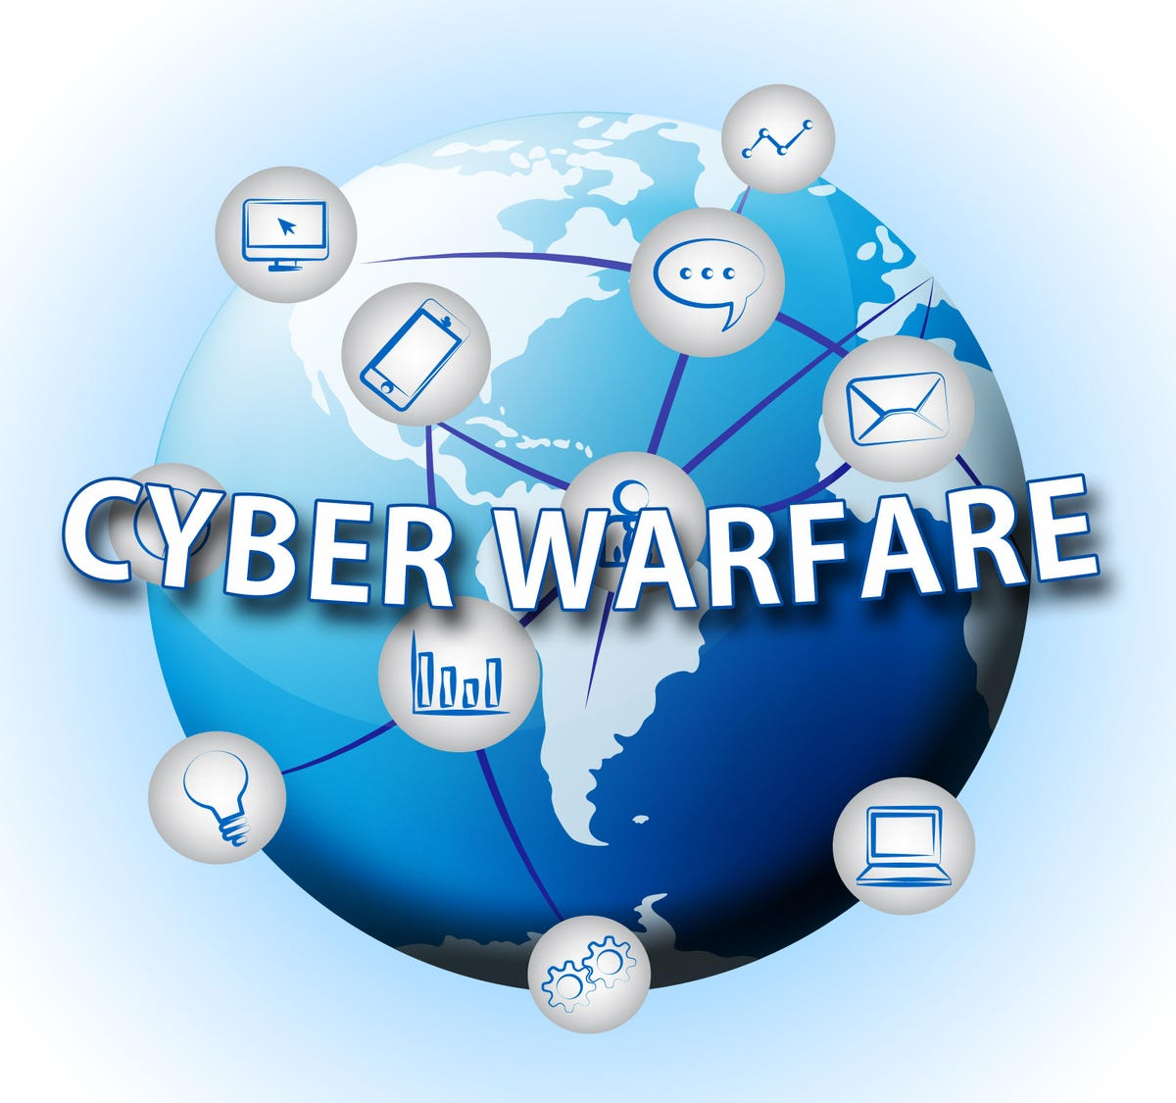
AN Electronic attack?
Cripple vital activities of a country
Global network = place of military conflict
Internet makes it possible to infiltrate the most sensitive networks
Launched by groups of hackers searching for: a challenge, money

Slide 4
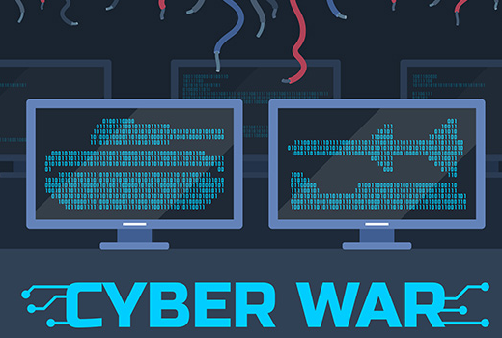
Why engage in cyberwarfare?
Cyberattacks?

Slide 5
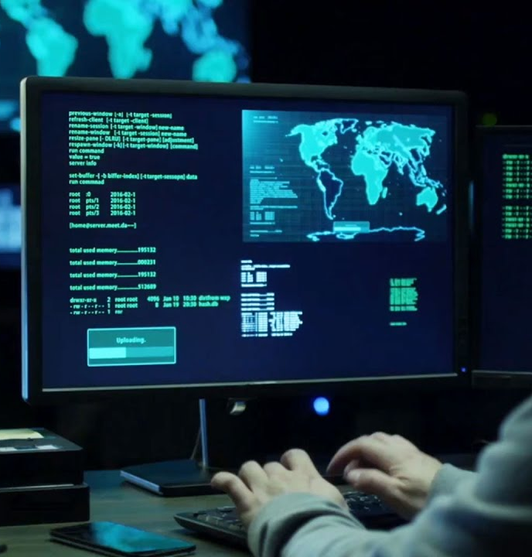
Can be started by anyone
Data: element serves as basis for reasoning and starting point for research
Cyber warfare can be started by anyone; but why would someone trigger a cyberattack? :
Recover Data
Destroy Data
Espionage

Slide 6

How to avoid Cyberwarfare?
VPN?

Slide 7
How do countries protect themselves from cyberattacks
how can cyberwarfare be avoided?
Cyber ​​Defense Command 5
VPNs
United States : USCYBERCOM part of United States Law Enforcement
Launch cyberattacks against threats in the United States
Serves to defend against these attacks.
In 2017 France decided to create COMCYBER, under the authority of the Chief of Défense Staff and fulfils the same functions
VPN = Virtual Private Network
Can be owned by anyone
A service that encrypts your activity on the internet and keeps your identity hidden while navigating the internet
VPN technology was first used in 1996 when a Microsoft employee developed the PPTP

Slide 8
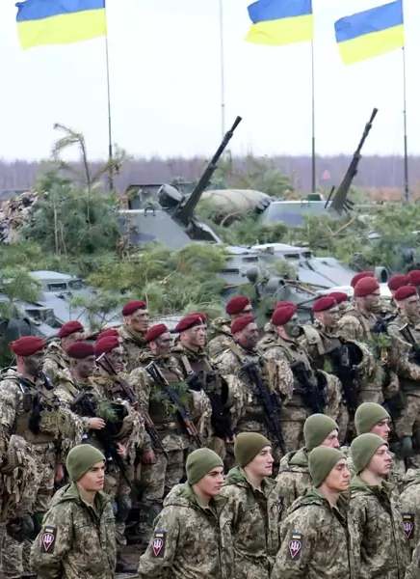
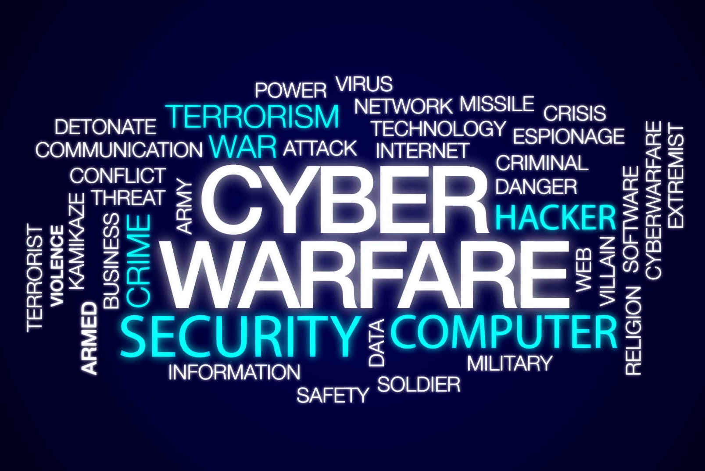

Image SLide
In conlusion, Cyberwarfare has existed for years with different degrees of intensity

Slide 9



THANK YOU
Noé Kurata
noe.kurata@epitech.eu
www.bit.ly/designedbynoe

