Slide 1
Research Title: ENHANCING CREDIT RISK MANAGEMENT OF COMMERCIAL BANKS IN TANZANIA USING PREDICTIVE MODELING TECHNIQUES
Name of Candidate: Mntambo, Stephen W
Reg. Number: 2022-06-01734
Proposed Degree: Master of Science in Data Science

Slide 2
Introduction
The banking sector's stability and profitability hinge upon effective credit risk management, a critical process in assessing and mitigating potential lending risks. Innovative strategies are imperative to sustain secure lending practices inTanzania banking sector. Despite this, non-performing loan ratios persistently exceed the desired threshold set by regulatory authorities. Machine learning, a subset of artificial intelligence, offers a transformative approach to credit risk assessment. By harnessing predictive modeling techniques, it enables data-driven, accurate risk evaluations.

Slide 3
Statement of the problem
Recently the use of traditional credit risk management techniques often rely on manual processes and limited statistical models, which may not fully capture the complexity and dynamics of credit portfolios, hence many of Tanzanian banks experiencing a high Non-Performing Loan (NPL) ratio above the desired one, 5% by the Bank of Tanzania.

Slide 4
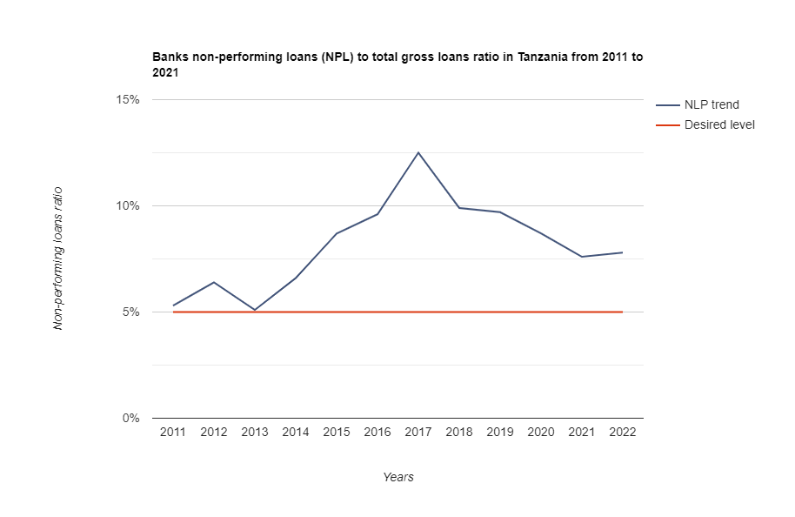

Slide 5
Therefore this research aims to address the limitations of credit scoring modeling by leveraging machine learning techniques. Identifying the key determinants of credit risk, including both traditional factors (e.g., credit history, income, and collateral) and non-traditional factors (e.g., social media data, transactional patterns, and macroeconomic indicators), integration of economic effects, and improvement of model explainability to develop more accurate, robust, and transparent credit risk assessment models.

Slide 6
Objectives
Main Objective: Leveraging predictive modeling to develop robust models that can accurately assess credit risk, predict credit default probabilities, and improve the overall credit risk management practices within Tanzanian banks.

Slide 7
Specific Objectives
To build a comprehensive dataset for model development by collecting historical credit data from Tanzanian banks, including loan performance, borrower information, and relevant financial indicators.
To develop predictive models for credit risk management using machine learning techniques.
To evaluate the performance of the predictive models in terms of accuracy.

Slide 8
Significance of the Study
Enabling Tanzanian banks to make more accurate and data-driven decisions regarding credit approvals, loan pricing, and credit risk mitigation.
The study will contribute to improving the overall financial stability of Tanzanian banks by reducing non-performing loans, enhancing the quality of loan portfolios.
The research will contribute to the development of accurate and reliable predictive models for credit risk assessment.

Slide 9
Literature Review And Research Gap
One significant research gap is the exploration of alternative data sources and the integration of economic effects to improve the accuracy and interpretability of credit scoring models (Teng & Lee, 2019)
Currently, the availability of sensitive and confidential data from financial institutions poses a challenge, leading to limited access for researchers (Simão, n.d.). Therefore, this research focus on identifying and utilizing new data sources, such as the vast amount of digital information recorded on social networks and mobile applications.

Slide 10
The external economic environment also impacts loan performance. Factors such as unemployment rates and house prices can influence borrowers' ability to repay loans. Hence, this research investigates the integration of detailed economic information into credit scoring models, aiming to improve their accuracy and interpretability by considering the broader economic context.

Slide 11
Research Methodology
Research Approach and Design
The research approach for this study will be quantitative.
A longitudinal design will be employed to track credit risk over a specific time period, with a focus on assessing the impact of machine learning on risk assessment.
Additionally, a comparative design will be used to evaluate the effectiveness of machine learning-based models in comparison to traditional credit risk assessment methods.

Slide 12
Research Methods
The primary research methods will include data collection, data preprocessing, algorithm selection and implementation, model training, model validation, and performance evaluation.
Machine learning algorithms such as logistic regression, decision trees, random forests, and neural networks will be employed to develop predictive credit risk models.

Slide 13
Study Area
The study will focus on the Tanzanian banking sector. Specifically, it will target a diverse set of banks within Tanzania to ensure a representative sample and comprehensive understanding of credit risk management practices in the country.
Sample Size
The sample size will be determined based on the availability of historical credit data from Tanzanian banks. The aim is to collect a sufficiently large and diverse dataset to ensure the robustness of the developed machine learning models.

Slide 14
Materials
The primary materials for this study will include historical credit data from Tanzanian banks, economic indicators (such as unemployment rates, inflation, GDP growth), alternative data sources (potentially social media data), machine learning software/tools for model development (Python, R, or relevant libraries), and computing resources for model training and analysis.

Slide 15
Data Analysis
Data analysis will involve various steps, including exploratory data analysis (EDA) to understand the characteristics of the credit data, feature engineering to extract relevant features for the models, model training and validation, and statistical analysis to evaluate the performance of the machine learning models. Advanced techniques such as cross-validation and AUC-ROC analysis will be used for model evaluation.

Slide 16
Ethical Practices/Procedures
The study will adhere to ethical guidelines for data privacy and security, ensuring that all sensitive information is anonymized and protected. Additionally, the research will be conducted in accordance with relevant regulatory standards and research clearance letter will be obtained from UDSM and provided to the banks.

Slide 17
Proposed Budget – Self-funded
ITEM | COST(TSH)
Data Collection and Preparation | 500,000/=
Software and tools | 300,000/=
Research materials | 300,000/=
Computing resources | 2,500,000/=
Travel | 200,000/=
Miscellaneous expenses | 500,000/=
TOTAL | 4,300,000/=

Slide 18
Duration of the study
Activity | 2023 |  |  |  |  | 2024
 | Aug | Sept | Oct | Nov | Dec | Jan | Feb | Mar | Apr | May | Jun | Jul
Literature Review and Refinement
Data Collection and Preprocessing
Exploratory Data Analysis and Algorithm Selection
Model Development and Integration of Economic Factors
Incorporation of Alternative Data Sources and Model Interpretability
Model Fine-Tuning and Optimization
Ethical Considerations and Model Explainability
Model Validation and Results Analysis
Impact Assessment and Recommendations
Research Paper Finalization
Submission and Presentation

Slide 19


