Slide 1
Schematron QuickFix (update)
on XML Prague
Thursday, 09 February 2017

Slide 2
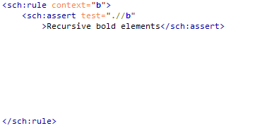
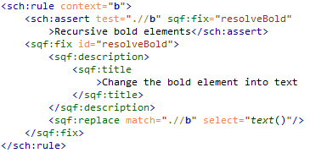
QuickFix Concept Summary
Extension language of Schematron:
Read more on www.schematron-quickfix.com
Supported by Oxygen since version 17.0
ID
Title
Action

Slide 3
Second Draft – News Summary
Complete specification
Generic QuickFixes (Attribute use-for-each)
New content model of the sqf:fix element
Multiple descriptions for different languages
Plans, open issues, ideas
RELAX NG schema
unparsed-copy mode to avoid resolving entities / default attribute values
Localisation by extracting the human readable language into external files (open discussion).

Slide 4
QuickFix Content Model
In the old Content Model, the sqf:call-fix was useless
The new Content Model is very lax:
sqf:fix
- sqf:param*,
- (
- sqf:description+, ( sqf:call-fix | sqf:actionElements )+
- ) | (
- sqf:call-fix
- )
Additional Rules:
There should not be two descriptions for the same language
A call-fix inherits the descriptions of the called QF
which have a language other than those of the calling QF
If there is no other sqf:call-fix or action element in the same QF

Slide 5
Use Cases

Slide 6
Use Cases

Slide 7
Use Cases

Slide 8
Use Cases

Slide 9
Use Cases

Slide 10
Use Cases
Specify an abstract QF with parameters, use a specific description
QF contains one ore more sqf:description and one sqf:call-fix element.
Specify an abstract QF and description by parameters
QF contains exactly one sqf:call-fix element.
Extend the function of an abstract QF by additional actions
Combine sqf:call-fix with action elements.
You need a specific description.
Combine the actions of multiple QFs
Combine multiple sqf:call-fix elements.
You need a specific description.
Add a description in a specific language to an existing QF
Combine one or multiple sqf:description with exactly one sqf:call-fix element.

Slide 11
Escali Web Implementation
http://www.escali.schematron-quickfix.com

