Slide 1
CS 4476 Project 3
Nakul Kuttua
nkuttua3@gatech.edu
nkuttua3
903520821

Slide 2
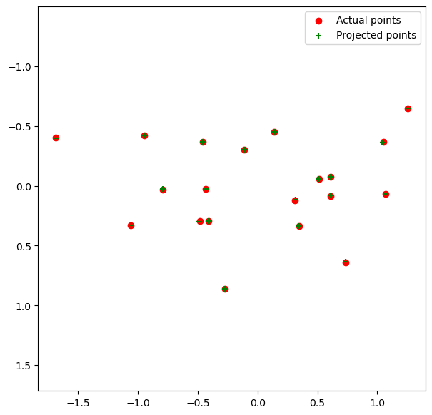
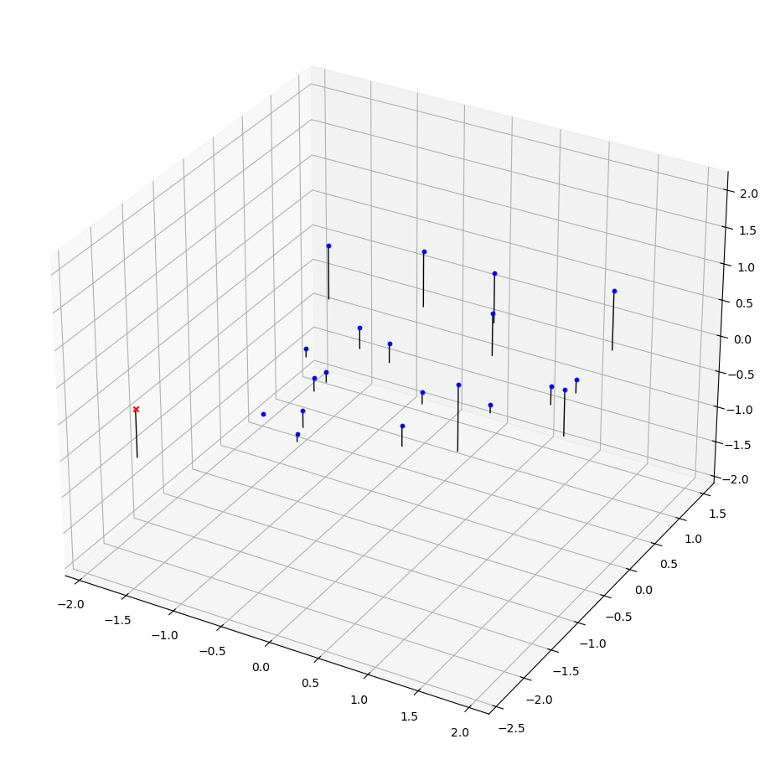
Part 1: Projection matrix

Slide 3
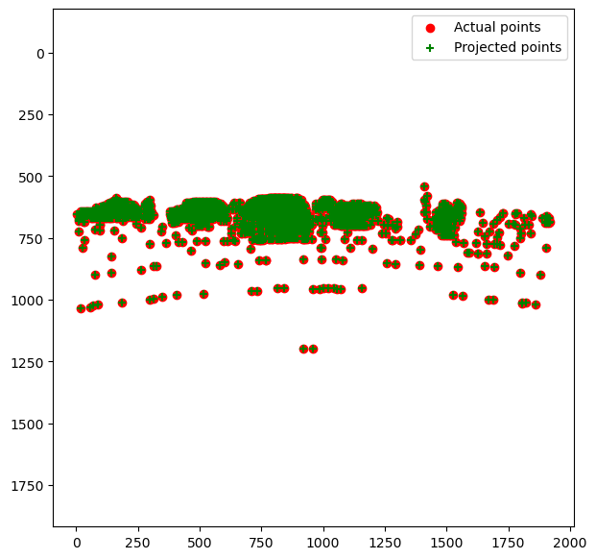
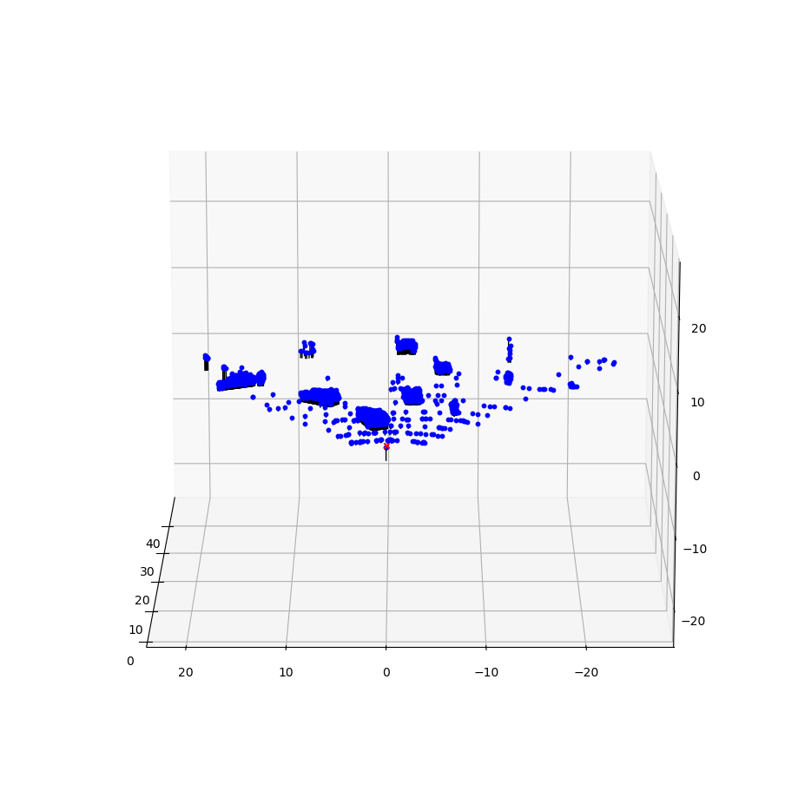
Part 1: Projection matrix

Slide 4
Part 1: Projection matrix
[What two quantities does the camera matrix relate?]
The camera matrix relates the 2d image coordinates and 3d world coordinates.
[What quantities can the camera matrix be decomposed into?]
The quantities can be decomposed into the Intrinsic Matrix and Extrinsic Matrix for Rotating and Translating.
[List any 3 factors that affect the camera projection matrix.]
3 factors that affect the camera projection matrix are Rotation, Translation, and Focal Length.

Slide 5
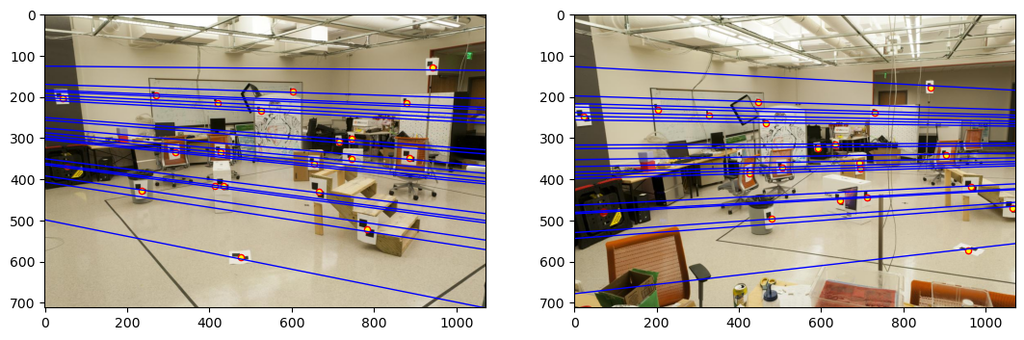
Part 2: Fundamental matrix

Slide 6
Part 2: Fundamental matrix
[Why is it that points in one image are projected by the fundamental matrix onto epipolar lines in the other image?]
Every point in one image can be projected onto the respective epipolar line of the image because we are multiplying the transpose of the coordinates to the function, so it is (x^T)Fx = 0.
[What happens to the epipoles and epipolar lines when you take two images where the camera centers are within the images? Why?]
If the cameras are centered within the images, then the epipoles should also be near the center, and the camera will catch edges in which certain points are similar. The lines themselves should also protrude out from the center.

Slide 7
Part 2: Fundamental matrix
[What does it mean when your epipolar lines are all horizontal across the two images?]
If they are all horizontal, then that means the difference is only a translation and not a rotation.
[Why is the fundamental matrix defined up to a scale?]
Because we can multiply any scalar to the equation (x^T)Fx = 0 which would then scale it.
[Why is the fundamental matrix rank 2?]
The fundamental matrix comes from the essential matrix where the essential matrix itself is a rank 2 matrix.

Slide 8
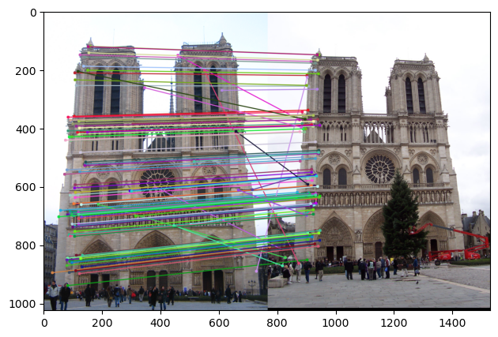
Part 3: RANSAC

Slide 9
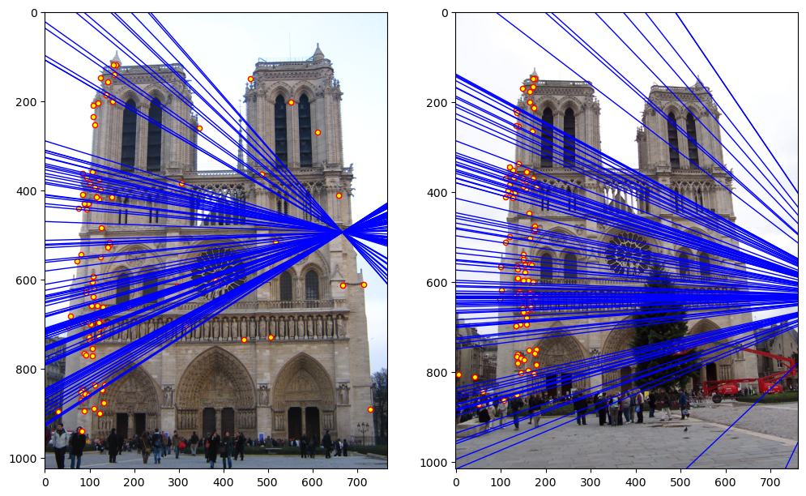
Part 3: RANSAC

Slide 10
Part 3: RANSAC
[How many RANSAC iterations would we need to find the fundamental matrix with 99.9% certainty from your Mt. Rushmore and Notre Dame SIFT results assuming that they had a 90% point correspondence accuracy if there are 9 points?]
We would need 2593 for Mt Rushmore and 794 for Notre Dame
[One might imagine that if we had more than 9 point correspondences, it would be better to use more of them to solve for the fundamental matrix. Investigate this by finding the # of RANSAC iterations you would need to run with 18 points.]
We would need 569 for the Notre Dame.
[If our dataset had a lower point correspondence accuracy, say 70%, what is the minimum # of iterations needed to find the fundamental matrix with 99.9% certainty?]
We would need 111 iterations.

Slide 11
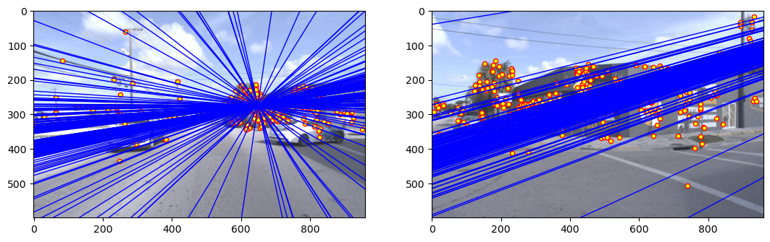
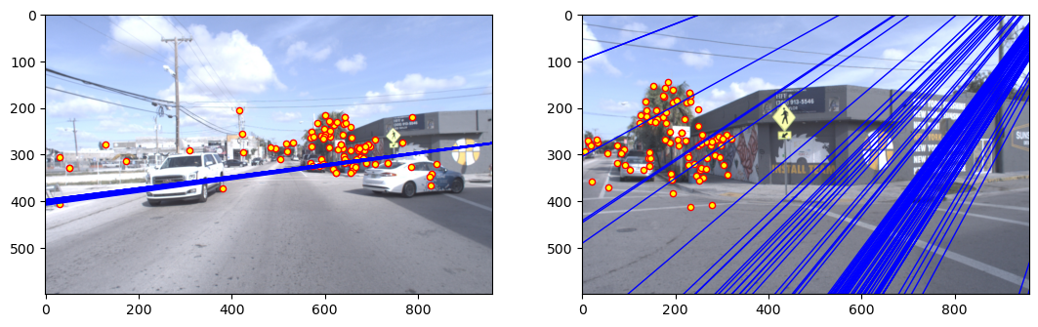
Part 4: Performance comparison

Slide 12
Part 4: Performance comparison
[Describe the different performance of the two methods.]
Without RANSAC, the epipoles are dispersed throughout the images even on parallel planes. But this phenomenon does not happen when we use the RANSAC method.
[Why do these differences appear?]
The reason why is because of the many outliers in the image which get considered without the inclusion of RANSAC. But when we use RANSAC, these outliers are not considered and thus the epipoles are in more accurate places.
[Which one should be more robust in real applications? Why?]
In real applications, RANSAC of course should be more robust. It eliminates outliers in an image, and this can be very beneficial for images that may potentially many outliers.

Slide 13
Part 5: Visual odometry
[How can we use our code from part 2 and part 3 to determine the “ego-motion” of a camera attached to a robot (i.e., motion of the robot)?]
We can use RANSAC and estimate the fundamental matrix. From the fundamental matrix, we can get the rotation and translation information to determine the ego-motion of the camera.
[In addition to the fundamental matrix, what additional camera information is required to recover the ego-motion?]
We would need the focal length of the camera.

Slide 14
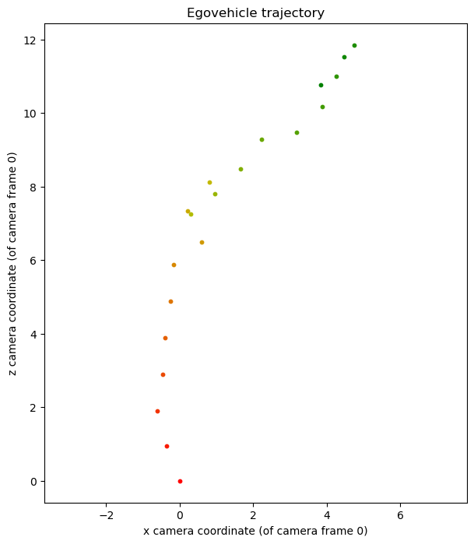
Part 5: Visual odometry

Slide 15
Part 6: Panorama Stitching
[Please add a README style documentation here for your implementation of panorama stitching with: description of what you implemented, instructions on how to replicate the results in clear steps that can be followed by course staff. Failure to replicate results by following this documentation will result in point penalties on this question of the assignment.]

Slide 16
Part 6: Panorama Stitching
[Insert visualizations of your stitched panorama here along with the 2 images you used to stitch this panorama (there should be 3 images in this slide)].

