Slide 1
Interpreted vs Compiled Programming languages
Or How I learned to stop worrying and love the compiler
Nathaniel Weeks
Notes:
Hello

Slide 2

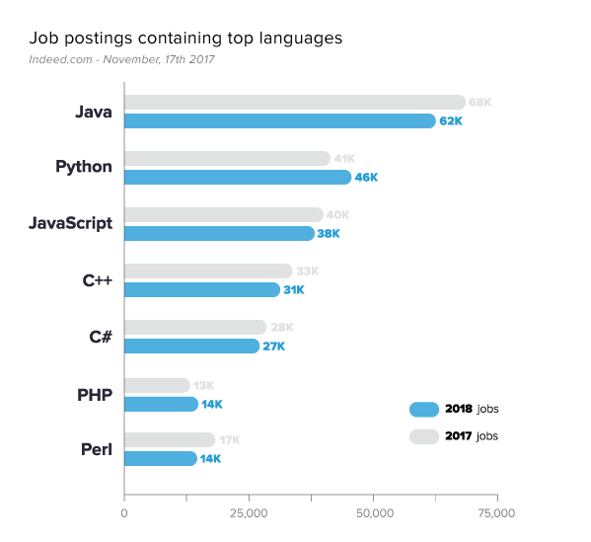
Choosing a language
Reasons to choose a language:
Jobs!
User/beginner friendliness
User community
School/Classes
and SPEED

Slide 3
Hypothesis
Compiled would be faster but not in a meaningful way
“Meaningful” was something I defined as between 2x and 10x speed
The line in the sand
Went with 10x
Branching, Calculations, Loops

Slide 4
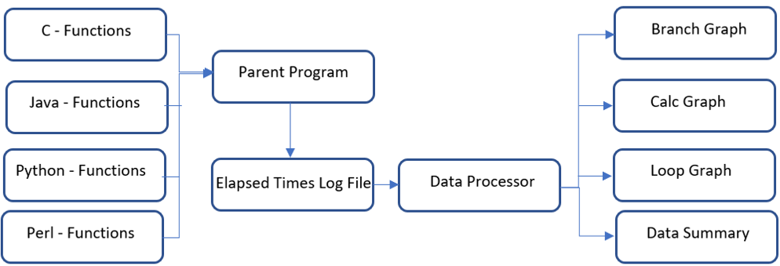
dataflow

Slide 5
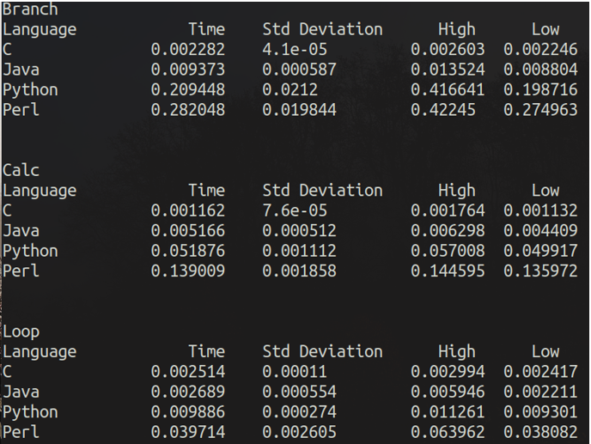
Data Summary
Analysis
Compiled was fast
Branching
84.34079x
Calculations
30.16514x
Looping
9.53296x

Slide 6

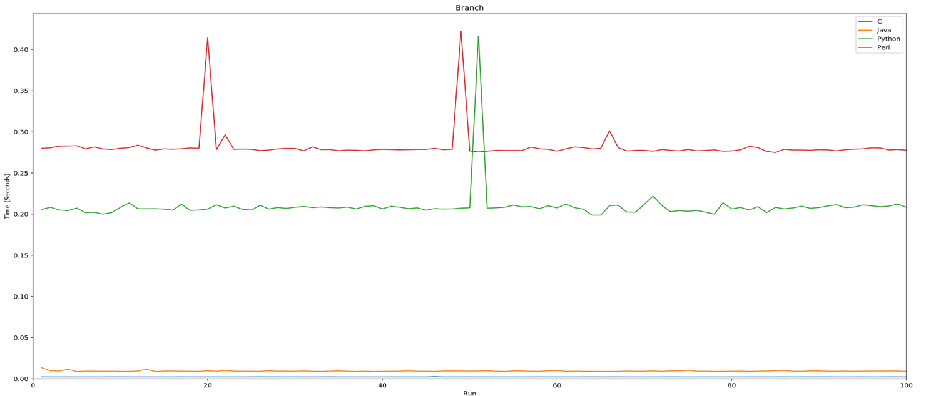

Slide 7
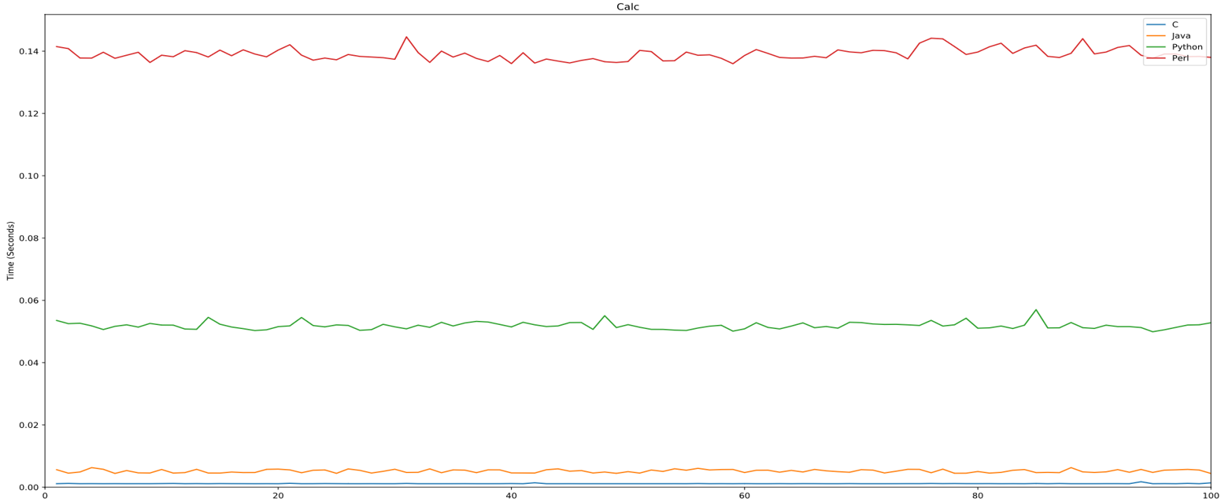

Slide 8
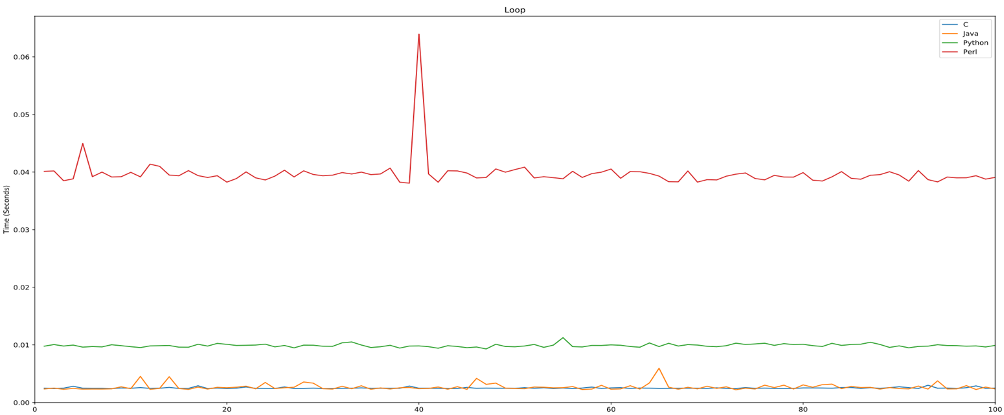

Slide 9
Caveats & Conclusions
Caveats
Conclusions
Core functionality tested
Many libraries exist to accelerate these languages
GUI programming not considered
Compiled languages were an average of 41.35 times faster across all tests performed
Compiled languages are “meaningfully” faster

Slide 10

Github:
https://github.com/nkweeks/capstone

