Slide 1
Interpreted vs Compiled Programming languages
Or How I learned to stop worrying and love the compiler
Nathaniel Weeks
Notes:
Hello

Slide 2

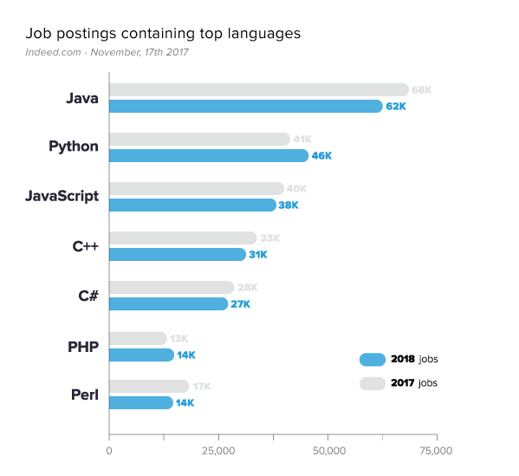
Choosing a language
Reasons to choose a language:
Jobs!
User/beginner friendliness
User community
School/Classes
and SPEED

Slide 3
Hypothesis
Compiled would be faster but not in a meaningful way
“Meaningful” was something I defined as between 2x and 10x speed
The line in the sand
Went with 10x
Branching, Calculations, Loops

Slide 4
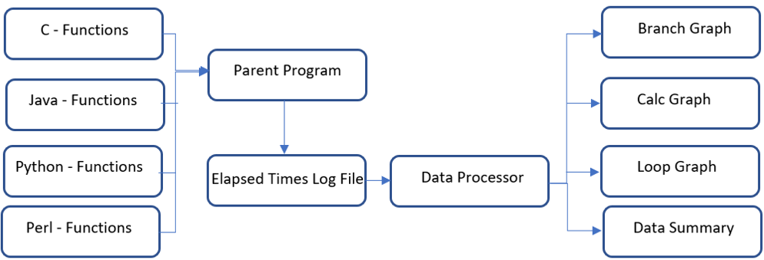
dataflow

Slide 5
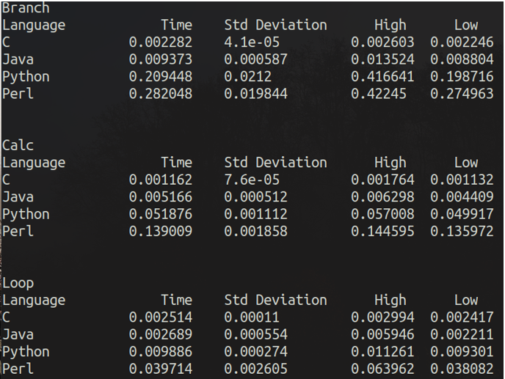
Data Summary
Analysis
Compiled was fast
Low variability

Slide 6

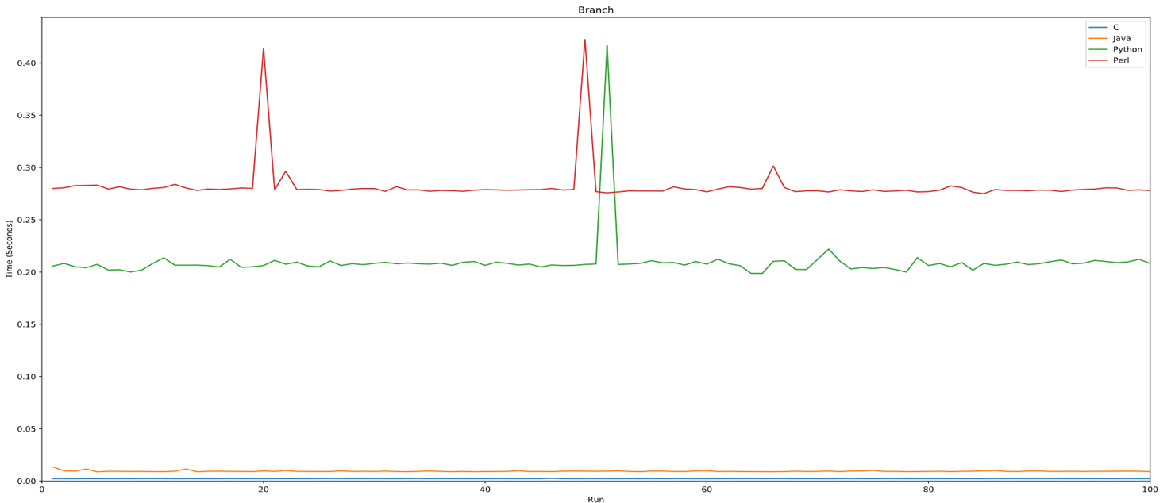

Slide 7
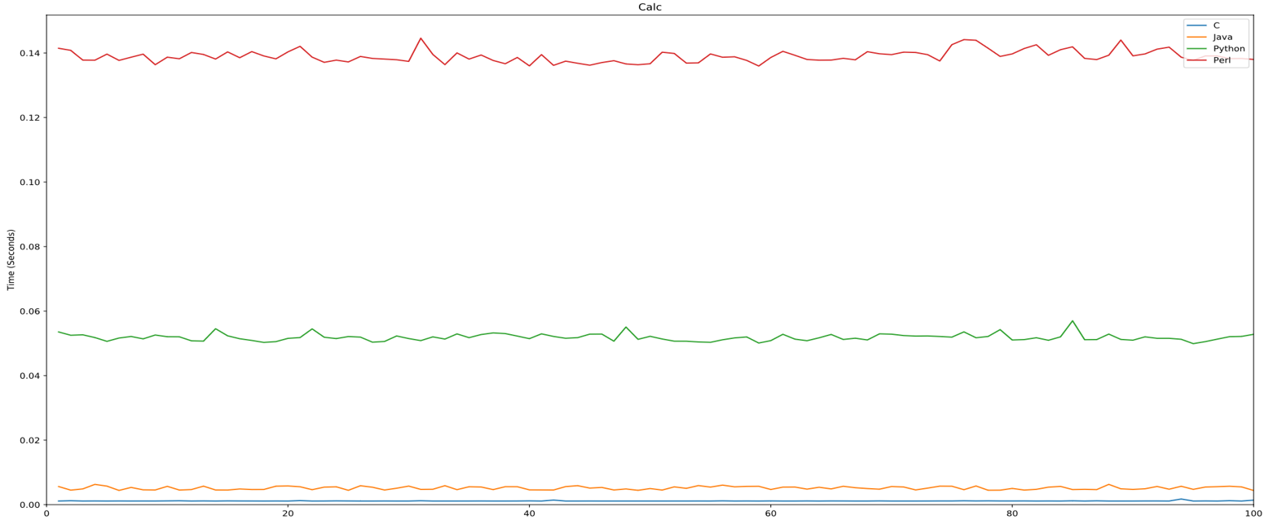

Slide 8
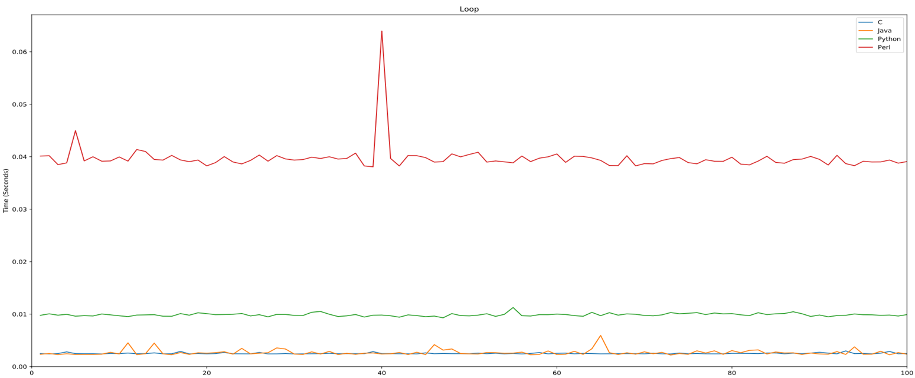

Slide 9
Caveats & Conclusions
Caveats
Conclusions
Core functionality tested
Many libraries exist to accelerate these languages
GUI programming not considered
Compiled languages are “meaningfully” faster

Slide 10

Github:
https://github.com/nkweeks/capstone

