Slide 1
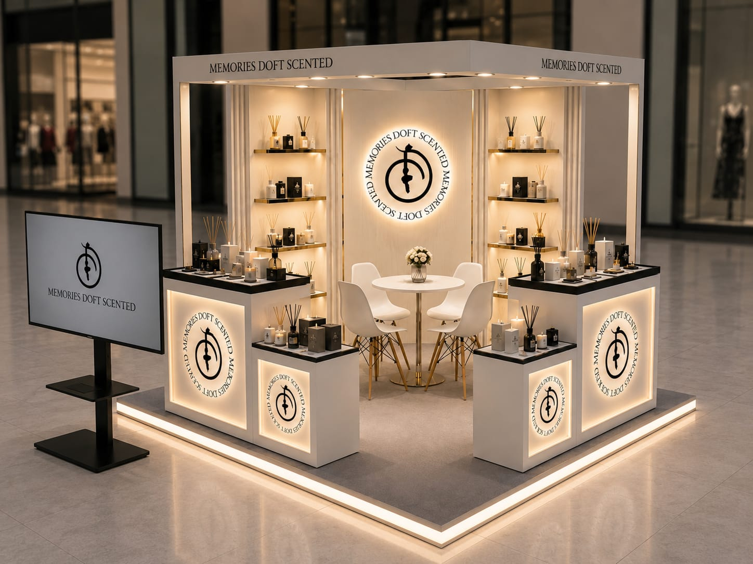
DOFT
SCENTED MEMORIES
Diwali Pop-Up
Boutique Kiosk
Concept Design · Premium home-fragrance salon
8 ft × 8 ft · 14 malls · ~6 weeks festive window
PRESENTED BY
ProMarcom
Notes:
Cover: DOFT Diwali Pop-Up boutique kiosk, premium home-fragrance salon, 8x8 ft, 14 malls, by ProMarcom.

Slide 2
THE OPPORTUNITY
A premium festive stage
for Doft Candles
14
8×8
Doft Candles is a premium home-fragrance brand. For the Diwali gifting season we take the brand into India's highest-footfall malls with a turnkey pop-up boutique kiosk, a warm and luminous salon that invites shoppers to sit, smell and gift. Product range: scented candles · reed diffusers · room sprays · wax melts · premium gift hampers.
Premium malls
Pan-India
Feet kiosk
64 sq ft
~6
Turnkey
Weeks festive
+ Xmas / NY
Design → build →
operate
DOFT · SCENTED MEMORIES · Diwali Pop-Up Kiosk Concept
2
ProMarcom
Notes:
The opportunity: premium home fragrance, Diwali gifting, 14 malls, 8x8 boutique kiosk, turnkey.

Slide 3
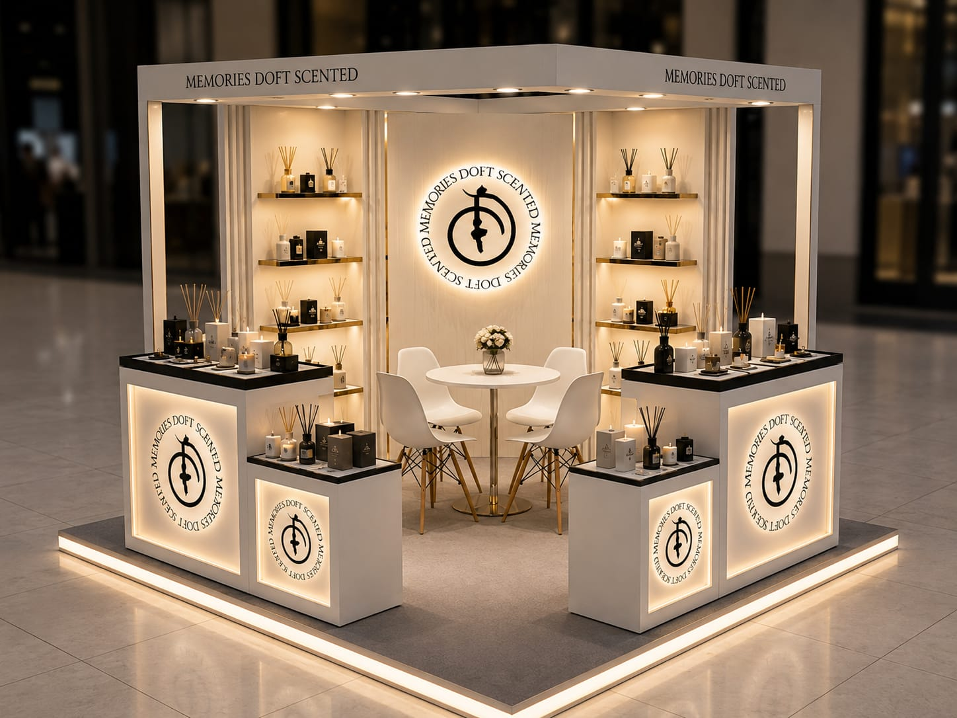
DESIGN CONCEPT
The DOFT boutique kiosk
A warm, luminous fragrance salon with a backlit brand wall, brass gallery shelving and a place to sit, smell and gift.
Backlit brand-seal wall
The illuminated DOFT seal anchors the kiosk as a warm beacon across the mall court.
Brass gallery shelving
Warm-lit floating shelves stage candles, diffusers and gift sets like a boutique.
Consultation seating
A central table and chairs invite shoppers to sit, sample scents and choose gifts.
Digital brand screen
A screen at the aisle plays the Doft film and draws footfall in.
DOFT · SCENTED MEMORIES · Diwali Pop-Up Kiosk Concept
3
ProMarcom
Notes:
Design concept: warm boutique fragrance salon: backlit brand wall, brass shelving, consultation seating, digital screen.

Slide 4
DESIGN · PERSPECTIVE
Three-quarter view
· Backlit MEMORIES DOFT SCENTED seal wall
· Warm-lit brass gallery shelving
· White counters with black-stone tops
· Backlit seal counter fronts
DOFT · SCENTED MEMORIES · Diwali Pop-Up Kiosk Concept
4
ProMarcom

Slide 5
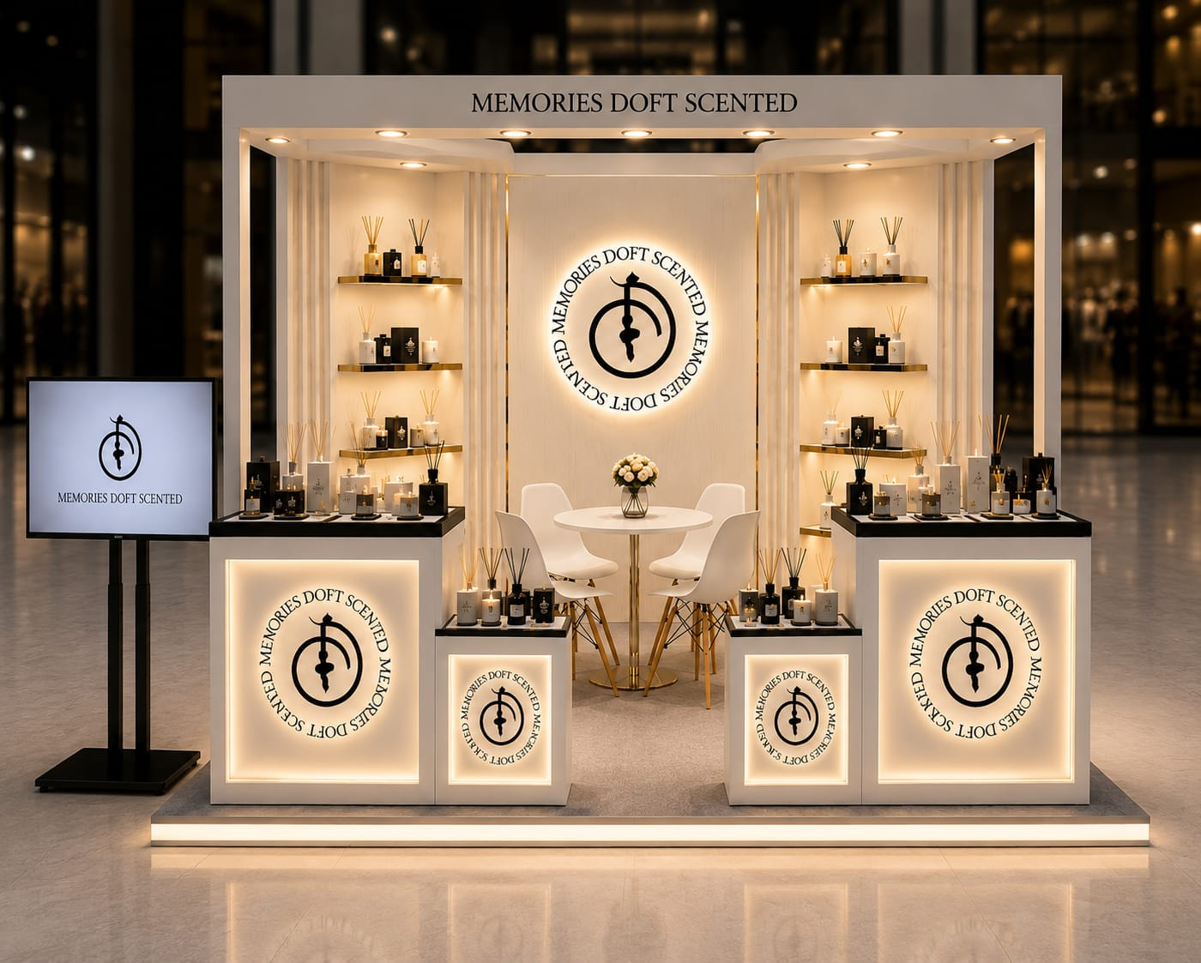
DESIGN · STOREFRONT
Front elevation
· Symmetrical premium storefront
· Illuminated brand seal as the hero
· Reed diffusers, candles & gift sets staged
· Downlit header fascia & warm LED base
DOFT · SCENTED MEMORIES · Diwali Pop-Up Kiosk Concept
5
ProMarcom

Slide 6
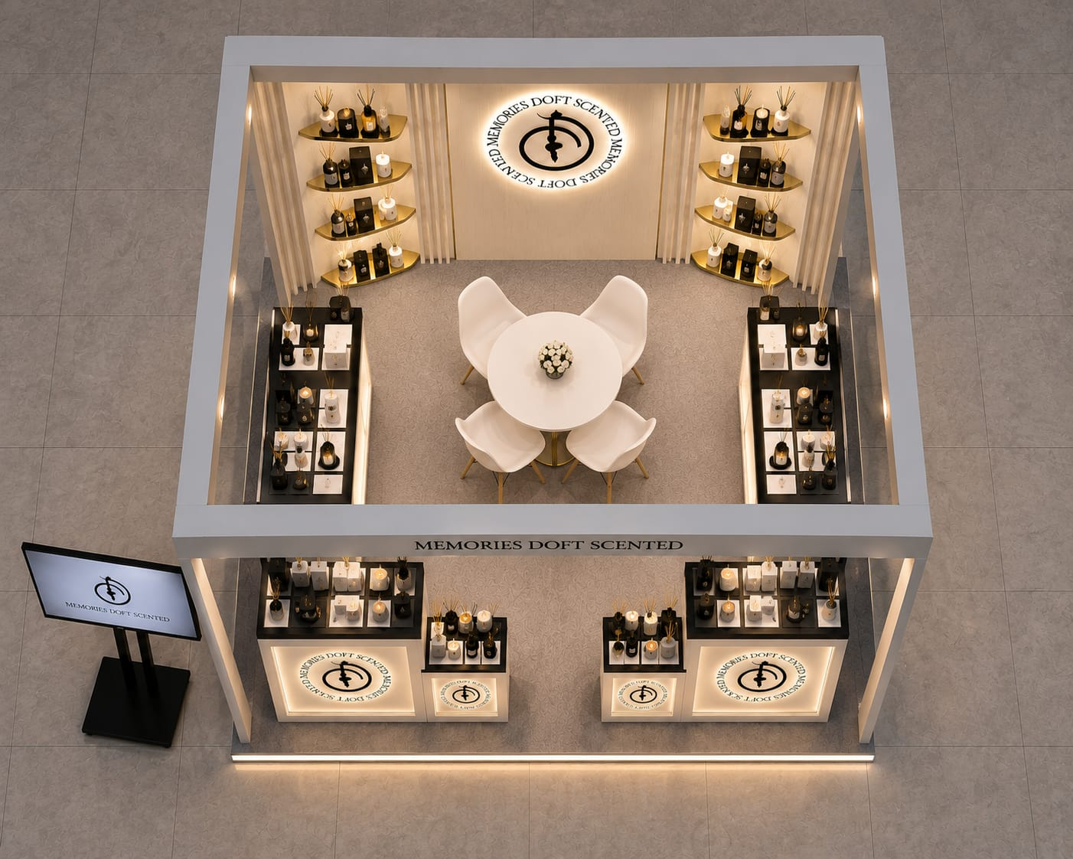
DESIGN · LAYOUT
Interior view
· Open-corner customer entry
· U-counter wraps the display zone
· Central table & seating for gifting consults
· Digital brand screen at the aisle
DOFT · SCENTED MEMORIES · Diwali Pop-Up Kiosk Concept
6
ProMarcom

Slide 7
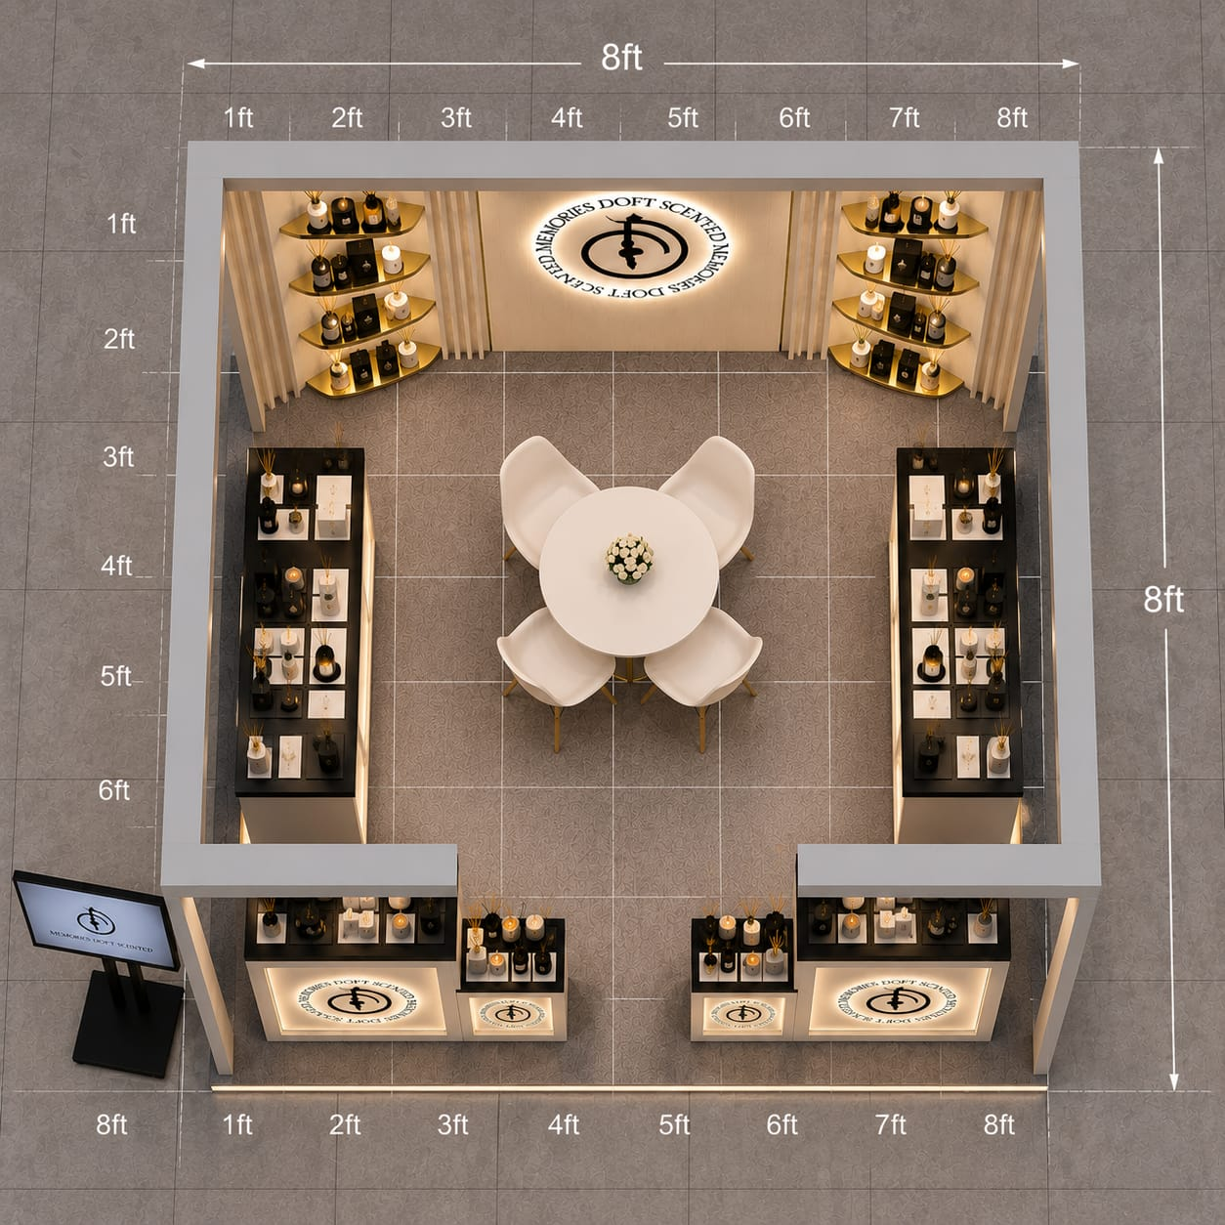
TOP LAYOUT · PLAN
8 ft × 8 ft kiosk footprint
KEY ZONES
Backlit brand wall
Illuminated seal + gallery shelving
Perimeter counters
U-display wraps three sides
Consultation seating
Central table + four chairs
Open-corner entries
Easy customer flow in & out
Digital screen
Brand film at the aisle edge
DOFT · SCENTED MEMORIES · Diwali Pop-Up Kiosk Concept
7
ProMarcom
Notes:
Top layout: dimensioned 8x8 ft plan: backlit brand wall, perimeter U-counter, central seating, open-corner entries, digital screen.

Slide 8
MATERIALS & FINISHES
A warm, premium material palette
Warm white lacquer
Brushed brass
Black-stone top
Body & display walls
Shelving, trims & legs
Counter surfaces
Backlit brand seal
Warm LED glow
Digital screen
Illuminated acrylic panels
Perimeter & downlights
Brand film & catalogue
DOFT · SCENTED MEMORIES · Diwali Pop-Up Kiosk Concept
8
ProMarcom
Notes:
Materials: warm white lacquer, brushed brass, black stone, backlit acrylic seal, warm LED, digital screen.

Slide 9
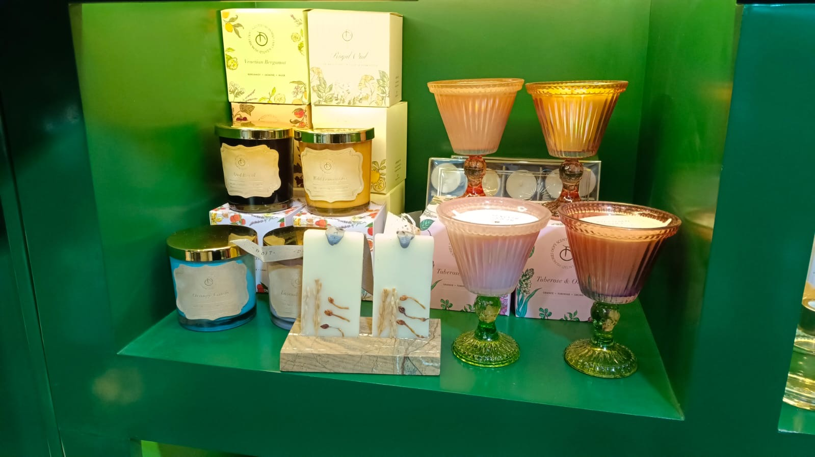
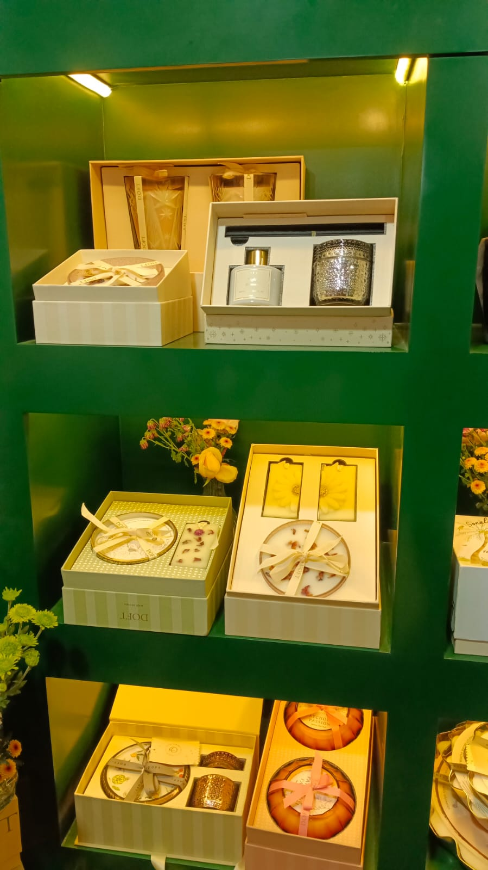
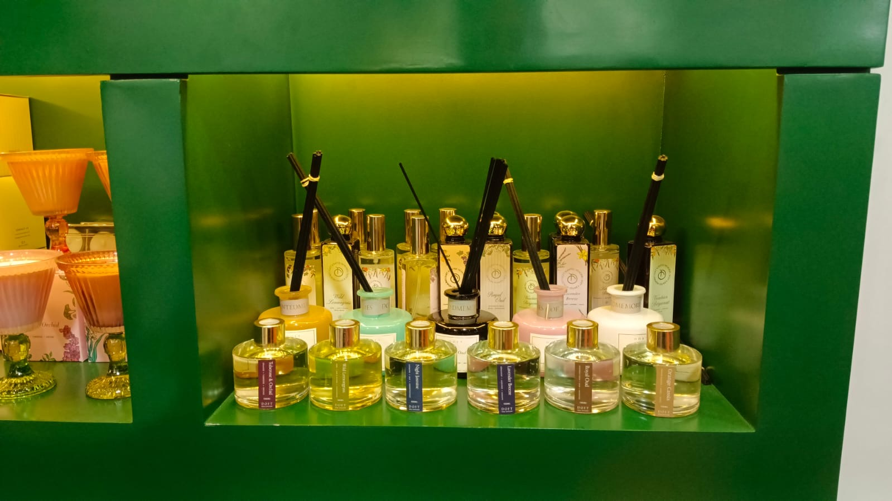
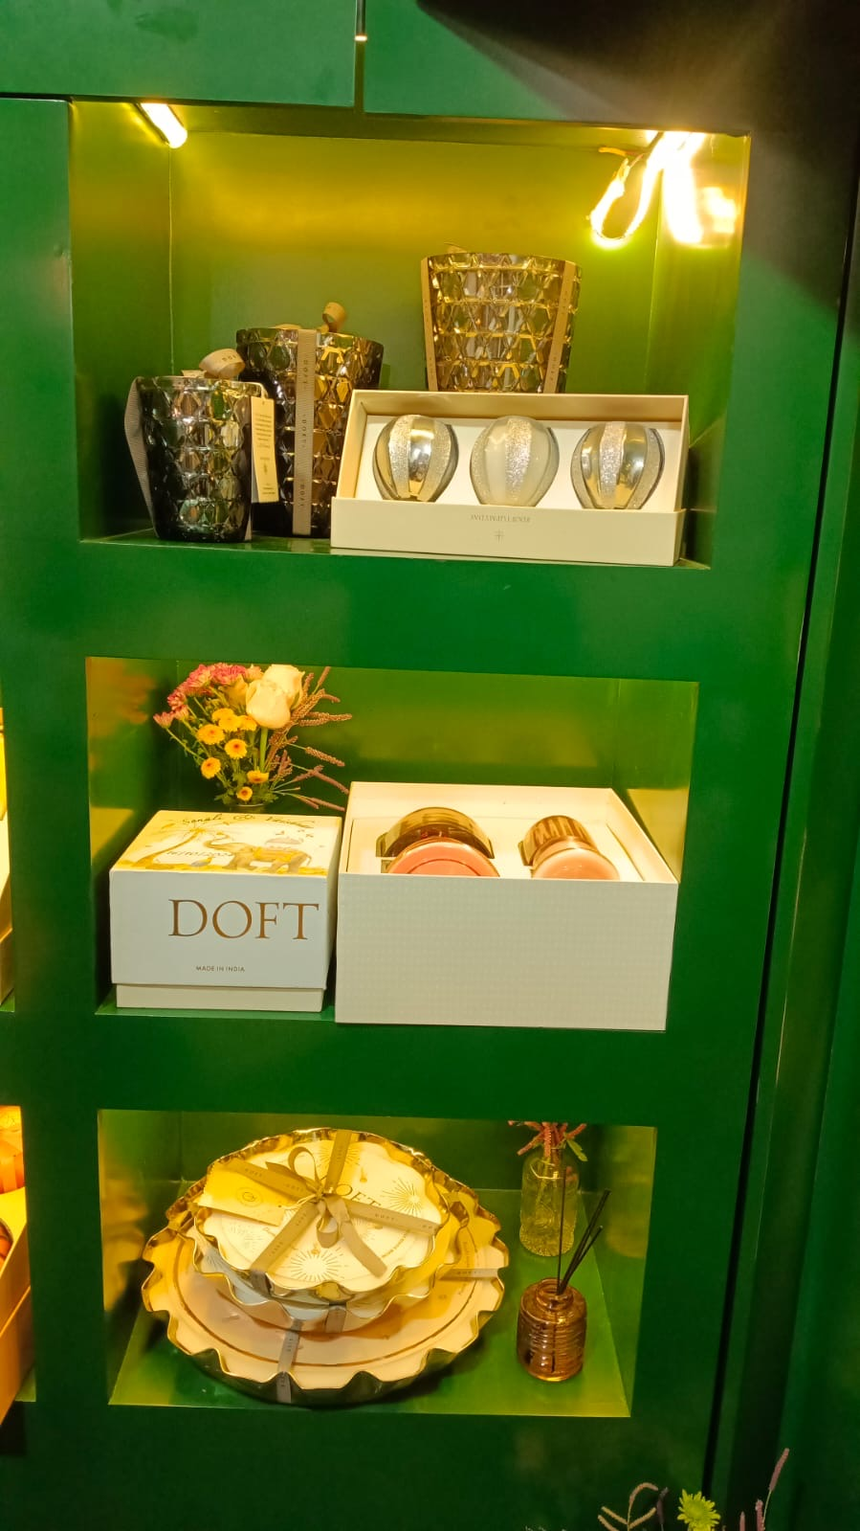
THE RANGE
Merchandising the Doft story
Backlit brass shelving and counter displays stage the full gifting range at eye level.
Scented candles
Gift hampers
Reed diffusers & sprays
Festive gift boxes
DOFT · SCENTED MEMORIES · Diwali Pop-Up Kiosk Concept
9
ProMarcom
Notes:
Product story: candles, gift hampers, reed diffusers, room sprays & wax melts on backlit shelving.

Slide 10
FOOTPRINT
14 premium malls, pan-India
Delhi Select Citywalk
Mumbai · BKC Jio World Mall
Chennai Phoenix Marketcity
Noida DLF Mall of India
Mumbai · Lower Parel Phoenix Mall
Bengaluru Phoenix Marketcity
Gurgaon Ambience Mall
Ahmedabad Phoenix Mall
Hyderabad Phoenix Mall
Chandigarh Elante Mall
Nagpur VR Mall
Kochi Lulu International Mall
Lucknow Lulu Mall
Kolkata South City Mall
Same festive window across all locations. Select high-performing malls extended through Christmas & New Year.
DOFT · SCENTED MEMORIES · Diwali Pop-Up Kiosk Concept
10
ProMarcom
Notes:
14 malls pan-India per revised client list. Same window; select extend to Xmas/NY.

Slide 11
EXTENDING REACH · CHANNEL 2
Adding multiplex activation
Premium atrium space on a six-week rental is limited and highly contested. To secure reach across every target city we propose a parallel Doft activation inside the PVR / INOX multiplexes located in the same malls, a captive, premium, high-dwell audience already in a leisure and gifting mindset.
14
107
~20,000
8×8 ft
Multiplexes
Screens
Seats / show
Foyer stall
PVR & INOX
across the network
combined capacity
6-week window
DOFT · SCENTED MEMORIES · Diwali Pop-Up Kiosk Concept
11
ProMarcom
Notes:
Rationale: atrium space limited; propose PVR/INOX multiplex foyer activation in the same malls. 14 multiplexes, 107 screens, ~20,000 seats/show.

Slide 12
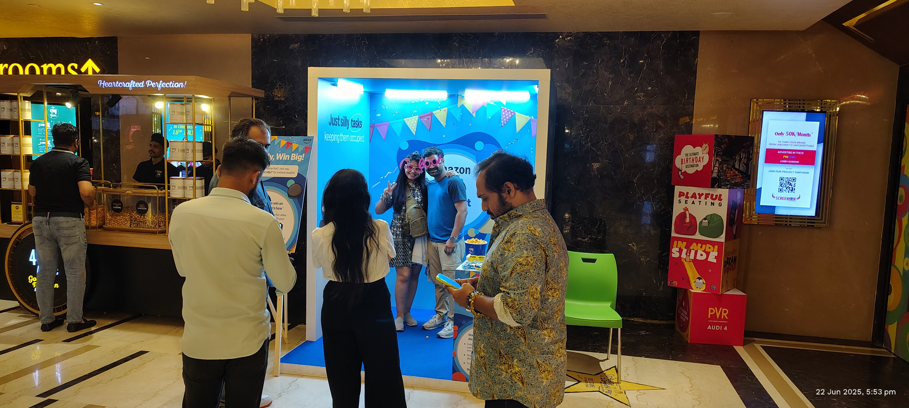
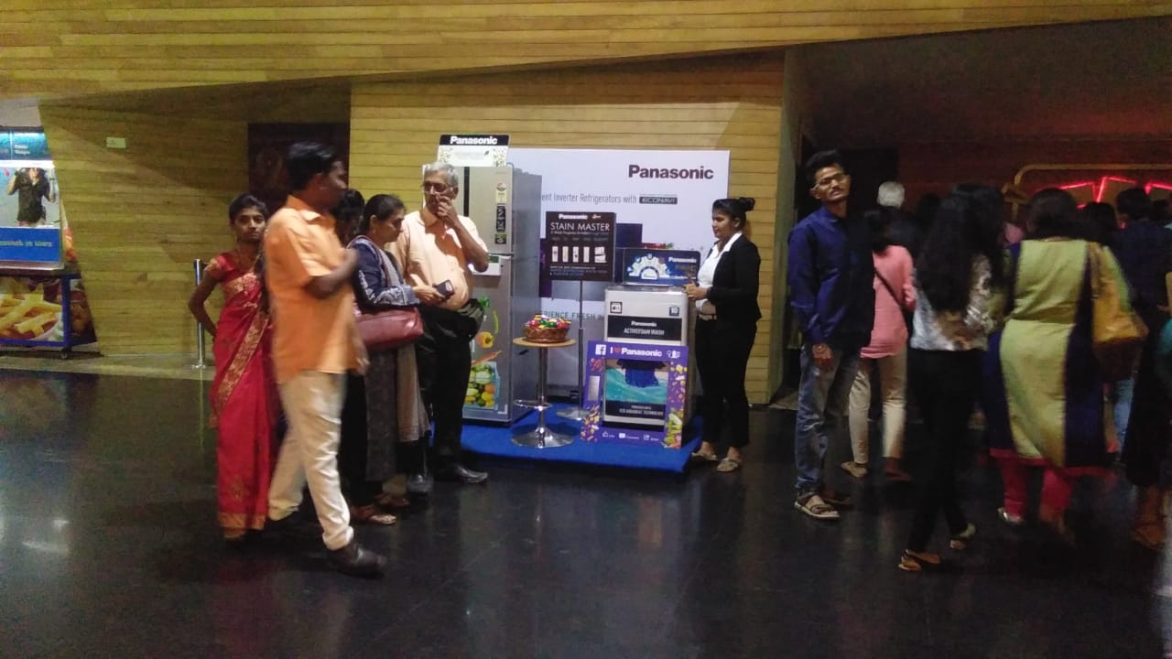
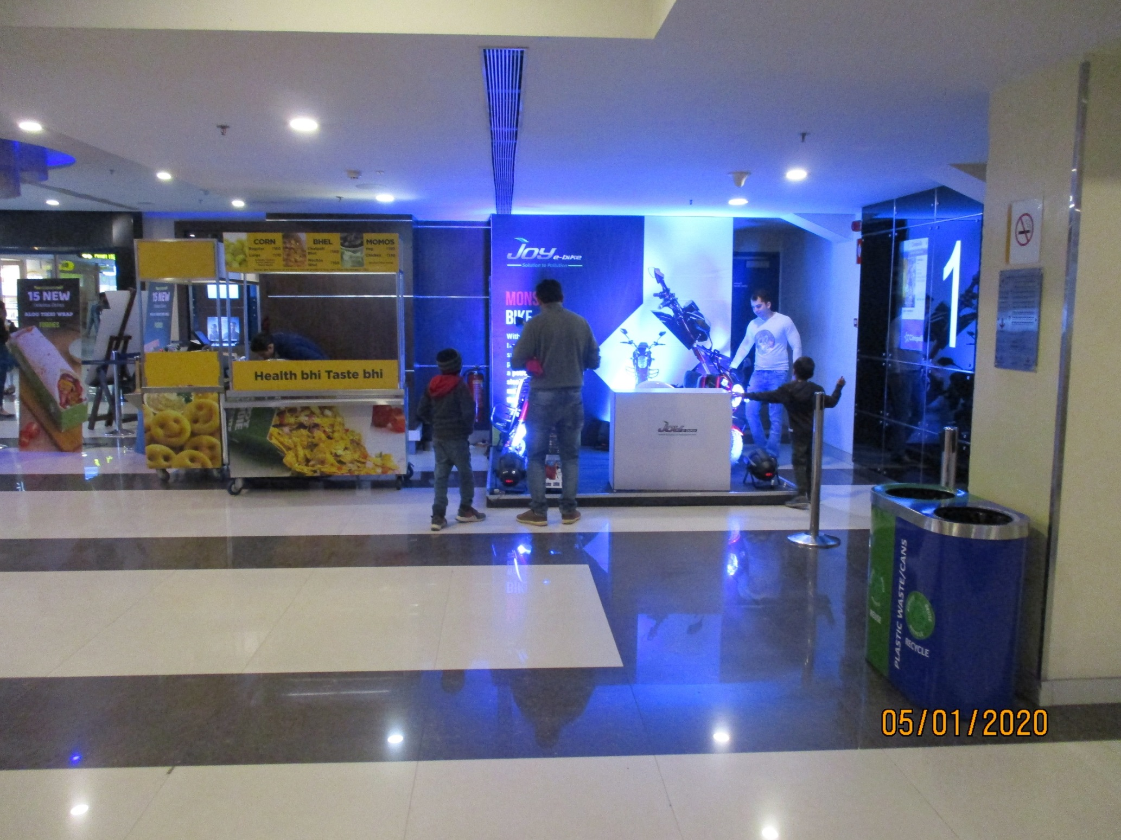
MULTIPLEX ACTIVATION
Brand presence in the cinema foyer
An 8x8 ft Doft activation stall in the foyer, seen by every patron entering, waiting and exiting: high dwell time, a festive gifting mindset, live sampling and direct sales.
Reference foyer activations · PVR / INOX network
DOFT · SCENTED MEMORIES · Diwali Pop-Up Kiosk Concept
12
ProMarcom
Notes:
Multiplex concept: 8x8 foyer activation stall, high dwell, sampling and direct sales. Reference activation photos.

Slide 13
THE NETWORK
14 premium multiplexes, pan-India
City | Multiplex / Cinema | Screens | Seats / show | Space
Mumbai · Lower Parel | PVR Phoenix (Worli) | 7 | 1,275 | 8×8
Mumbai · BKC | PVR Maison BKC | 6 | 882 | 6×6
Ahmedabad | PVR Palladium | 9 | 1,283 | 8×8
Delhi · Saket | PVR Select Citywalk | 6 | 1,056 | 8×8
Noida | PVR DT · Mall of India | 7 | 1,712 | 8×8
Gurgaon | PVR Ambience Mall | 11 | 1,122 | 8×8
Chandigarh | PVR Nexus Elante | 8 | 1,599 | 6×6
Lucknow | PVR Superplex · Lulu | 11 | 1,841 | 8×8
Kolkata | INOX City Centre | 4 | 1,144 | 8×8
Kolkata | INOX City Centre II | 4 | 1,190 | 8×8
Hyderabad | PVR Icon · Hitech City | 5 | 936 | 8×8
Bengaluru | PVR Phoenix Market City | 9 | 1,401 | 6×6
Chennai | INOX Luxe · Phoenix | 11 | 2,688 | 6×6
Kochi | PVR Lulu Mall | 9 | 1,926 | 8×8
Totals: 14 multiplexes · 107 screens · ~20,000 seats per show (PVR + INOX)
DOFT · SCENTED MEMORIES · Diwali Pop-Up Kiosk Concept
13
ProMarcom
Notes:
Network: 14 PVR/INOX multiplexes in the same malls; 107 screens; ~20,000 seats/show.

Slide 14
14-CITY · 42-DAY ACTIVATION PROGRAM
Activation Cost
Kiosk setup & build (14 kiosks)
₹77,57,600
Manpower (sales, billing, supervision, city managers)
₹1,70,38,000
Other elements (logistics, insurance, hardware, operations)
₹65,52,000
Sub-total (ex-GST)
₹3,13,47,600
Agency fee (10%)
₹31,34,760
GST (18%)
₹62,06,825
Total (incl. GST)
₹4,06,89,185
Turnkey operations for all 14 cities across the 42-day program. Add a media option (Multiplex or Atrium) for the all-in cost.
DOFT · SCENTED MEMORIES · Diwali Pop-Up Kiosk Concept
14
ProMarcom
Notes:
Activation Cost : client-facing quoted figures only.

Slide 15
14-CITY · 42-DAY ACTIVATION PROGRAM
Multiplex Option
Cinema-foyer media · 14 PVR / INOX sites × ₹3,00,000 (6 wk)
₹42,00,000
GST (18%)
₹7,56,000
Media sub-total (incl. GST)
₹49,56,000
Operations (incl. GST, from Activation Cost)
₹4,06,89,185
Programme total, Multiplex (incl. GST)
₹4,56,45,185
PVR / INOX foyer activation, managed by ProMarcom. 100% advance; availability to be confirmed; rates subject to change.
DOFT · SCENTED MEMORIES · Diwali Pop-Up Kiosk Concept
15
ProMarcom
Notes:
Multiplex Option : client-facing quoted figures only.

Slide 16
14-CITY · 42-DAY ACTIVATION PROGRAM
Atrium Option
Mall-atrium media · 14 malls, per rate card (ex-GST)
₹1,45,11,750
GST (18%)
₹26,12,115
Media sub-total (incl. GST)
₹1,71,23,865
Operations (incl. GST, from Activation Cost)
₹4,06,89,185
Programme total, Atrium (incl. GST)
₹5,78,13,050
Mall-atrium activation at the 14 preferred malls. Several locations subject to availability; rates indicative, per the rate card.
DOFT · SCENTED MEMORIES · Diwali Pop-Up Kiosk Concept
16
ProMarcom
Notes:
Atrium Option : client-facing quoted figures only.

Slide 17
TURNKEY SCOPE
ProMarcom runs the whole programme
1
Kiosk build
2
Transport & install
3
Manpower
Fabrication to the approved design
Delivery, on-site setup & finishing
Sales, billing, supervision, city managers
4
Logistics
5
Licences
6
Daily operations
Stock movement & replenishment
Mall space negotiation & permissions
Reporting, cash management, upkeep
DOFT · SCENTED MEMORIES · Diwali Pop-Up Kiosk Concept
17
ProMarcom
Notes:
Turnkey scope: build, transport/install, manpower, logistics, licences, daily operations & reporting.

Slide 18
DOFT
Let's light up Diwali.
Next: detailed commercial proposal & costing:
setup, manpower, location charges, logistics, insurance & hardware.
ProMarcom
Retail activation · pop-up · experiential
Notes:
Closing: next step is the detailed commercial proposal & costing (separate workbook).

