Slide 1


D O F T
client logo — placeholder
CONTRACTOR EXECUTION & PARTNERSHIP PROPOSAL
Diwali Pop-Up
Retail Operations
For Doft Candles · Diwali Seasons 2026 · 2027 · 2028
“Experiencing the world through scent.”
Prepared by

Slide 2
THE ASK
Understanding your brief
Premium seasonal pop-up kiosks in leading malls — staffed and run end-to-end, as a long-term partner for Diwali 2026–28.
3–5 wks
~300 sq ft
2–4
Operating window before Diwali, each season
Kiosk footprint, plus a ~90 sq ft stockroom
Pop-ups per region, across multiple cities
12 / kiosk
1-day
Doft supplies
Full staffing team at every pop-up
Doft product & sales training, 100% attendance
Stock, furniture, POS/EDC, returnable uniforms
ProMarcom × Doft Candles
01

Slide 3
WHY PROMARCOM
A partner built for premium mall retail
ProMarcom delivers below-the-line, retail and experiential marketing end to end — concept, design, fabrication, manpower, operations and reporting.
1
2
3
4
Mall & Retail Promotions
Premium Retail VM
Manpower at Scale
Exhibitions & Events
Multi-month mall activations and in-shop demonstrations for global brands.
Show-windows & VM for Burberry, Louis Vuitton, LG, Samsung across 90+ cities.
Recruit, train, deploy and manage large field teams with tracking and reporting.
1,000–24,000 sqm exhibitions; events for LG, Samsung, HP, ICC World Cup.
ProMarcom × Doft Candles
02

Slide 4
CREDENTIALS
A proven track record
90+
3,000
24,000
6+ yrs
Cities covered for retail VM & activations
Man-days on one multi-city retail rollout
Sqm of exhibition floor managed (max)
As LG's BTL / retail / digital partner
Trusted by leading brands
LG
Samsung
Hewlett-Packard
Bajaj
Castrol
Pepsi
ITC
Burberry
Louis Vuitton
Panasonic
Pearson
ICC World Cup
Illustrative selection from ProMarcom credentials.
ProMarcom × Doft Candles
03

Slide 5
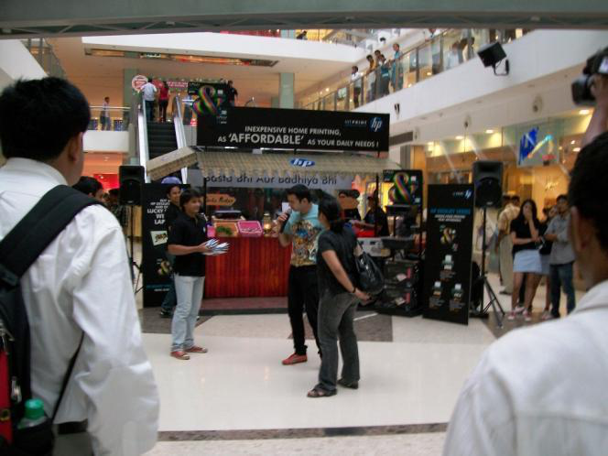
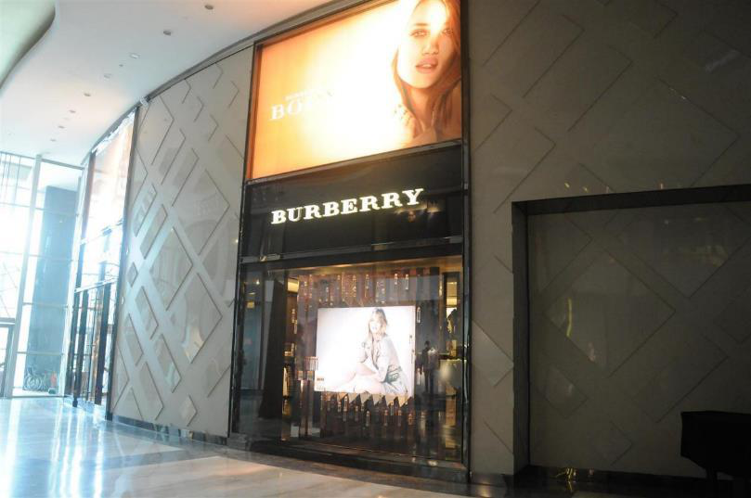
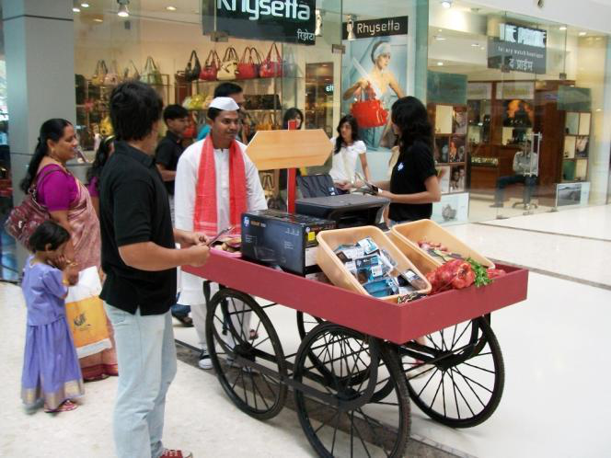
RELEVANT EXPERIENCE
We have run exactly this before
HP — Mall Promotions
Burberry & Louis Vuitton
LG Cookie Pep Carnival
Mumbai & Bengaluru
Premium Retail VM
70+ cities · 3,000 man-days
3-month mall promotion: fabrication, manpower, props, merchandising, logistics & reporting.
Luxury show-windows, in-shop props & merchandise — the premium standard Doft demands.
Shop-to-shop retail activation across India — multi-city manpower at scale.
ProMarcom × Doft Candles
04

Slide 6
OUR APPROACH
One accountable partner, end to end
1
2
3
4
Kiosk Build
Mall & Legal
Logistics
Recruit & Staff
On-site fabrication & install to Doft design
Liaison, licences, permits, approvals
Ghaziabad pickup, replenishment, returns
Hire, BGV, payroll, statutory compliance
5
6
7
Training
Store Ops
Reporting
100% attendance + a trained bench
Open–close, sales, POS, VM, cash
Daily sales, footfall, stock, attendance
A single Team Leader on ProMarcom's payroll owns daily operations at every kiosk — your one point of contact.
ProMarcom × Doft Candles
05

Slide 7
STAFFING
12 people per kiosk — exactly to brief
6
Sales Executives
2
Sales Support
1
Helper
Female, 22–25, fluent English, retail experience
Merchandising, stock, queue management
Housekeeping & material handling
1
Cashier
1
Driver
1
Team Leader
Experienced on POS / EDC machines
Stock transport & replenishment runs
Permanent ProMarcom employee — ops owner
12 per kiosk × pop-ups = your deployed field force. Illustrative 9-kiosk rollout = 108 trained staff
ProMarcom × Doft Candles
06

Slide 8
PEOPLE
Recruit · Train · Guarantee
1
Recruit & Verify
2
Train to Doft Standard
3
Zero-Gap Guarantee
City-level sourcing & referrals
Prioritise proven prior-season staff
Background verification before deploy
Onboard to payroll, full compliance
100% attendance at Doft's 1-day training
Scheduled 10–21 days before go-live
Completion tracked per candidate
Replacements trained too — always equal
~15% trained bench held per city
Immediate same-day replacement
Attrition covered at no extra cost
Trading never stops for a vacancy
Contractual commitment: any attrition after training or during operations is replaced immediately with equally-trained staff — at no additional cost to Doft.
ProMarcom × Doft Candles
07

Slide 9
SETUP
Kiosk, mall coordination & compliance
Kiosk fabrication & install
On-site fabrication to Doft-approved design; transport, install, maintain, dismantle & return fixtures — with a 3-day buffer before go-live.
1
Mall coordination
Liaison with mall management; electricity, access passes, loading/unloading and operational approvals.
2
Legal & licensing
All permissions, licences and documentation — started at T-7 weeks to de-risk go-live.
3
Compliance sign-off
Shops & Establishment, GST/e-invoicing, PF/ESIC, insurance, fire & electrical, staff BGV — signed before opening.
4
ProMarcom × Doft Candles
08

Slide 10
SUPPLY CHAIN
Logistics & stock replenishment
1
→
2
→
3
→
4
Ghaziabad Warehouse
Stockroom · ~90 sq ft
Kiosk Shelf
Reconcile & Return
Collect from Doft's warehouse; insured in transit
Local buffer beside each kiosk for fast refill
Daily fill to plan; reorder at minimum levels
Daily counts; unsold stock returned & reconciled
Timely replenishment protects peak-day sales — no stock-outs when footfall is highest.
ProMarcom × Doft Candles
09

Slide 11
OPERATIONS
Daily operations & reporting
Consistent open-to-close execution, with a standard daily report to Doft per kiosk — consolidated by city.
Sales
Footfall
Conversion
Inventory
Replenishment
Attendance
Customer Feedback
Operational Issues
GOVERNANCE CADENCE
Daily written report · Weekly city review call · End-of-season reconciliation
ProMarcom × Doft Candles
10

Slide 12
PLAN
Project timeline
T-8w
T-6w
T-2w
T
Award & kick-off
Recruit & BGV
Doft training
Go-live — ops
T-7w
T-3w
T-1w
T+6w
Malls & licences
Kiosk fit-out
Stock & first fill
Dismantle & review
Relative to go-live (T). Operations run 3–5 weeks per the brief. Full per-region Gantt is in the operations workbook.
ProMarcom × Doft Candles
11

Slide 13
ROLLOUT
An illustrative first-season footprint
A starting scenario for a premium brand — fully scalable. Final cities & kiosk counts are yours to set.
Delhi-NCR
Mumbai
Bengaluru
3 kiosks
3 kiosks
3 kiosks
9
108
3–5 wks
2028
Total kiosks
Trained staff
Operating window
Committed through
Scenario only — the brief specifies 2–4 pop-ups per region across multiple cities. Change two inputs in the workbook to re-scope.
ProMarcom × Doft Candles
12

Slide 14
COMMERCIALS
A transparent, built-up cost model
Priced bottom-up per kiosk, then rolled up. Every line is an editable input in the workbook.
Direct cost / kiosk
₹ 11.3 L
+ Management margin (15%)
₹ 1.7 L
Contract value / kiosk (pre-GST)
₹ 12.9 L
× 9 kiosks (illustrative)
₹ 1.16 Cr
+ GST (18%)
₹ 0.21 Cr
Total programme (incl. GST)
₹ 1.37 Cr
* Mall licence / space fee is the biggest swing item and is often reimbursed by the brand. Figures illustrative at placeholder rates.
ProMarcom × Doft Candles
13

Slide 15
ASSURANCE
How we protect the season
RISK
MITIGATION
Staff attrition after training
15% trained bench; same-day no-cost replacement
Mall permission delays
Licensing kicked off at T-7w; parallel mall shortlist
Stock-out on peak days
Reorder levels + daily replenishment from stockroom
POS / EDC downtime
Backup EDC + connectivity failover; trained cashier
Kiosk fabrication delay
Vendor SLA + 3-day buffer before go-live
ProMarcom × Doft Candles
14

Slide 16
TOOLKIT
The operations workbook
This deck ships with a live Excel workbook — the operating system for the engagement. Edit the assumptions; everything recalculates.
01
Assumptions
02
Project Timeline
03
Staffing Plan
04
Manpower Cost
05
Budget Summary
06
Recruitment Tracker
07
Attendance
08
Daily Sales
09
Inventory & Replenish
10
Footfall & Conversion
11
Customer Feedback
12
Compliance Checklist
13
Risk Register
ProMarcom × Doft Candles
15

Slide 17
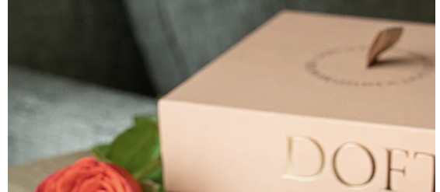
Let's make Doft's Diwali unmissable.
A premium retail partner with proven mall, VM and multi-city manpower experience — committed to Doft for Diwali 2026, 2027 and 2028.
Prepared by
D O F T
client logo — placeholder
Prashant
Web · USA
+91 99538 88889
www.eventsactive.com
prashant@eventsactive.com
Padma · +1 (408) 679-7148
Prepared as a planning response to the Doft Candles Request for Contractor. Figures illustrative at placeholder rates.

