Slide 1
Machine learning vs. Statistics
Machine learning
AI
Statistics
t-test
ANOVA
classification
regression

Slide 2
Variables vs. Constants
Variables (input or output): may change
Types: Numerical vs. Nominal
e.g. temperature = {32.7° F, 90° F, 0° C}
e.g. country = {‘Portugal’, ‘Ireland’, ‘Italy’, ‘Greece’, Spain’}
Constants: not change
e.g. π = 3.141592…

Slide 3
in-out mapping in a function
Classification: Num-Nom
Regression: Num-Num
t-test, ANOVA: Nom-Num

Slide 4
classification: Num-Nom
smoke양 – cancer유무

Slide 5
regression: Num-Num
hours of studying– math score

Slide 6
t-test, ANOVA: Nom-Num
gender – math score

Slide 7
statistics
input: independent variable (IV)
독립변수
output: dependent variable (DV)
종속변수

Slide 8
statistics
A study on the effect/impact/influence of IV on DV
A study on the effect of sleep, calory & workout on weight
regression: 학습량이 수학점수에 미치는 영향
r = 0.7, p = 0.012
t-test (or ANOVA): 성별이 수학점수에 미치는 영향
p = 0.09

Slide 9
statistics
Regression: 학습량이 수학점수에 미치는 영향
R = correlation coefficient
상관계수

Slide 10
statistics
t-test: 성별이 수학점수에 미치는 영향
Comparing two groups’ normal distributions

Slide 11
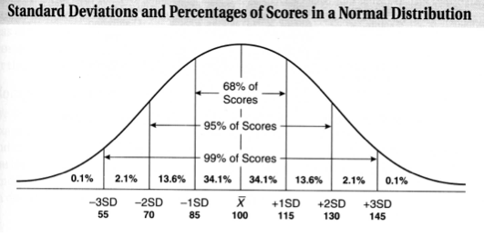
Normal distribution
mean = 100
SD= 15

Slide 12
Normal distribution
Normal distribution
salary
life span
height & weight
non-normal distribution
throwing a dice/ flipping a coin
sunrise or sunset time
wealth in communist countries (?)

Slide 13
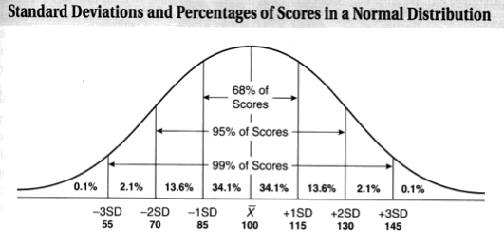
Comparing two groups’ normal distributions
group A
p > 0.05
not significantly different
group B

Slide 14
Comparing two groups’ normal distributions
group A
p = 0.012
p < 0.05
significantly different
group B

Slide 15
T-test practices
A = 30, B = 35, std = 2
A = 60, B = 80, std = 10.5
A와 B는 통계적으로 유의미하게 (p < 0.05) 차이 있나?

