Slide 1
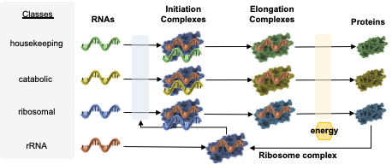
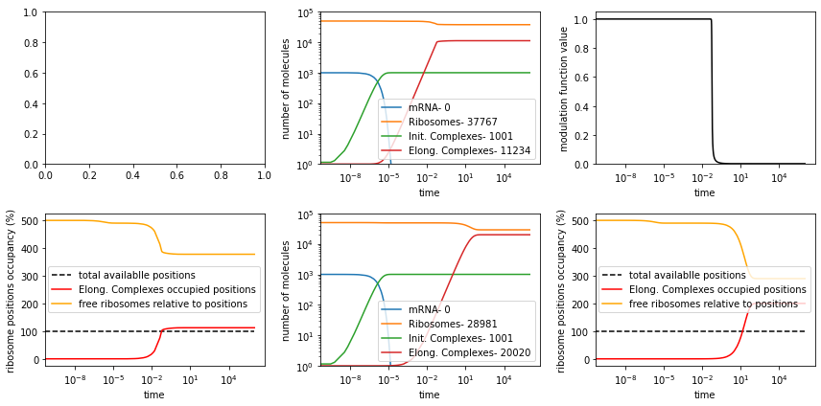
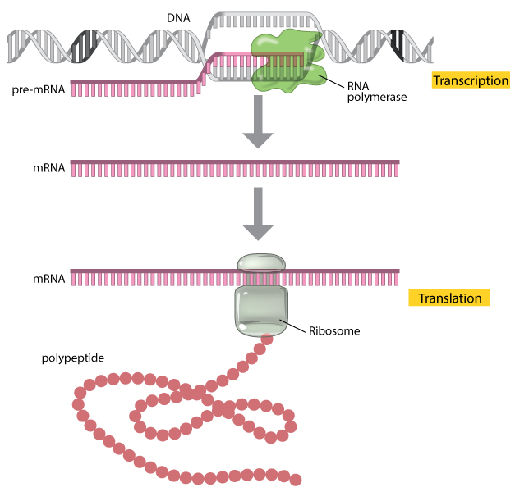
polysomes of elongating
ribocomplexes
EC
EC
EC
EC
R
R
R
free
ribosomes
mRNA

Slide 2

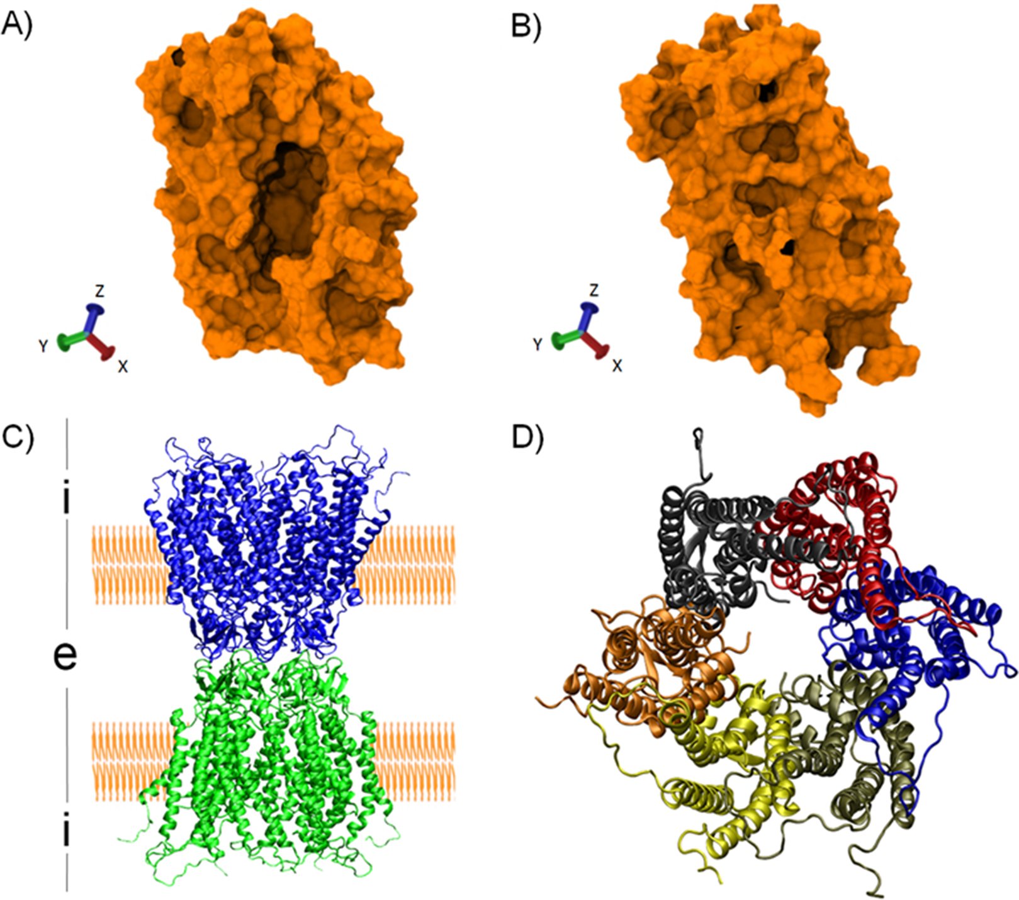

Classes
RNAs
Initiation Complexes
Elongation Complexes
Proteins
housekeeping
Bacterial cell – coarse grained proteome partition
catabolic
Nutrients
Surveying the cell’s habitat
ribosomal
energy
rRNA
Ribosome complex
Lifestyle
proteins
Determined by genes expression rates
resulting from cellular resource constrains
$$cell growth rate= \frac{ protein synthesis rate}{cell mass}$$
Catabolic
proteins
ENERGY
Replication of cell mass
ribosome
Ribosome
Normalisation of protein synthesis to the mass value of a cell (equivalent to cell division)

Slide 3

Classes
RNAs
Initiation Complexes
Elongation Complexes
Proteins
housekeeping
Bacterial cell – coarse grained proteome partition
catabolic
Nutrients
Surveying the cell’s habitat
ribosomal
energy
Ribosome complex
Lifestyle
proteins
Determined by genes expression rates
resulting from cellular resource constrains
$$cell growth rate= \frac{ protein synthesis rate}{cell mass}$$
Catabolic
proteins
ENERGY
Replication of cell mass
ribosome
Ribosome
Normalisation of protein synthesis to the mass value of a cell (equivalent to cell division)

Slide 4
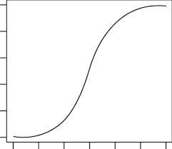
Classes
RNAs
Initiation Complexes
Elongation Complexes
Proteins
biosynthesis
rate
=
Cell growth
rate
housekeeping
Cell size
energy
energy
metabolic
ribosomal
Cell
Energy
E
E
E
Ribosome complex
E
E
E

Slide 5

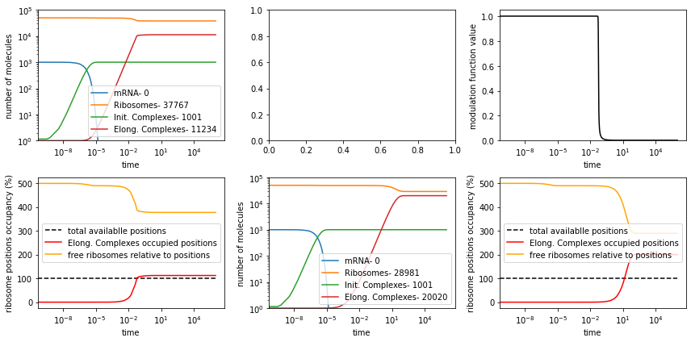







cellular ribosomes
resource pool
Translation process allocation strategy
housekeeping
catabolic
ribosomal
Initiation Complexes
Elongation Complexes
polysomes of elongating
ribocomplexes
$k_{c} ∗ \frac{1}{1+ {\left(\frac{elongation complexes}{\left(mRNAs+initiation complexes\right)∗\left(\frac{ mRNA length }{ribosome footprint }\right)}\right)}^{n}}$
EC
EC
EC
EC
R
R
R
free
ribosomes
mRNA
$instantaneous ribosome positions available$
$$= \left(mRNAs+ICs\right)∗\left(\frac{ mRNA length }{ribosome footprint }\right)$$
$$occupancy ratio= \frac{ECs}{available positions}$$
$$modulation function value= \frac{1}{1+ {occupancy ratio}^{n}}$$
$instantaneous ribosome positions available$
$$= \left(mRNAs+ICs\right)∗\left(\frac{ mRNA length }{ribosome footprint }\right)$$
$$occupancy ratio= \frac{ECs}{available positions}$$
$$modulation function value= \frac{1}{1+ {occupancy ratio}^{n}}$$

Slide 6
polysomes of elongating
ribocomplexes
EC
EC
EC
EC
R
R
free
ribosomes
mRNA
k_{on}
k_{c}*ƒ(a)
k_{Τ}*ƒ(a)
PROTEIN
R
R
+
RBS
EC
+
IC
k_{off}
RBS
R
R
RBS
+
RBS
R
RBS
R
mRNA
Implicit polysomes structure

