Slide 1
Network Address Translation (NAT)
12.10.2009
Prof. Sasu Tarkoma

Slide 2
Contents
Overview
Background
Basic Network Address Translation
Solutions
  STUN
  TURN
  ICE
Summary

Slide 3
What is NAT
Expand IP address space by deploying private address and translating them into publicly registered addresses
Private address space (RFC 1918)
  10.0.0.0 - 10.255.255.255 (10.0.0.0/8)
  172.16.0.0 - 172.31.255.255 (172.16.0.0/12)
  192.168.0.0 - 192.168.255.255 (192.168.0.0/16)
First described in RFC 1631
Technique of rewriting IP addresses in headers and application data streams according to a defined policy
Based on traffic source and/or destination IP address

Slide 4
NATs and Firewalls
Firewalls
  Security main concern
  Demilitarized zone
  Increasingly complex rules (what is filtered, how)
NATs
  Lightweight security devices
    Topology hiding and firewalling
  Increasing number in deployment
    Solves some of the address space problems of IPv4 (Port Translation, NAPT)
  IPv6 solves the addressing problem so NATs are not needed for this

Slide 5
Port Ranges
Well-known
  1-1023
Registered
  1024-49151
Dynamic/Private
  49152-65535

Slide 6
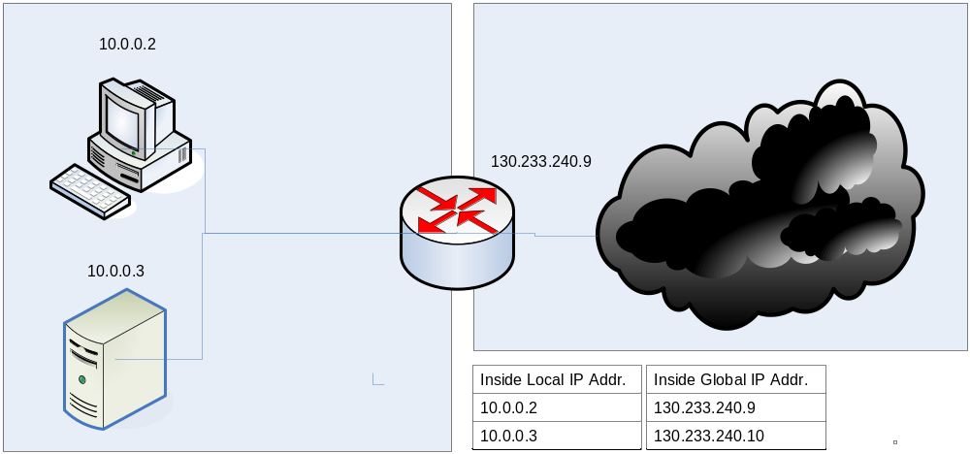
NAT Example

Slide 7
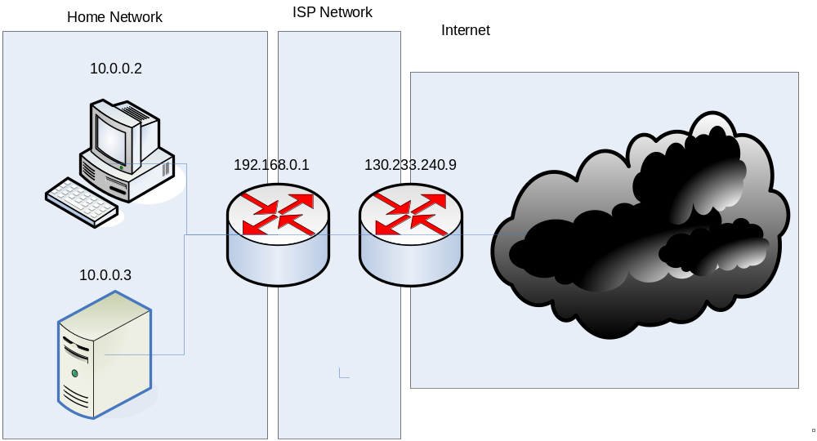
Two NATs

Slide 8
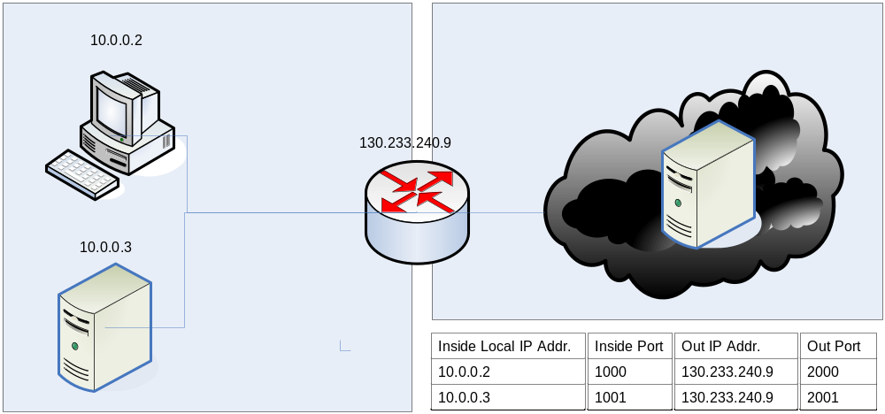
Web Access Example
Response sent to 130.233.240.9 port 2001
Request from host forwarded to server, source 130.233.240.9 port 2001
Response forwarded to 10.0.0.3 port 1001
Connection request to port 80 from host to web server, source 10.0.0.3, port 1001

Slide 9
NAT traffic supported
Traffic Types/Applications Supported
Traffic Types/Applications not Supported
Any TCP/UDP Traffic that Does Not Carry Source and/or Destination IP Addresses in the Application Data Stream
IP Multicast
HTTP
Routing Table Updates
TFTP
DNS Zone Transfers
Telnet
BOOTP
archie
Talk, Ntalk
finger
H.323
NTP
VDOLive
NFS
NetShow
rlogin, rsh, rcp
VXtreme
Although the Following Traffic Types Carry IP
Addresses in the Application Data Stream, they
are Supported by Cisco IOS NAT:
SNMP
ICMP
SMTP
FTP (Including PORT and PASV Commands)
NetBIOS over TCP/IP
Progressive Networks RealAudio
White Pines CuSeeMe
DNS "A" and "PTR" Queries
Xing Technologies StreamWorks

Slide 10
Timeouts
It is crucial how mappings are removed
  Done using timers
Mapping refresh
  Outbound refresh: internal to external
  Inbound refresh: external to internal
    May be used, subject to attacks
A NAT UDP mapping must not expire in less than 2 minutes
Established connections
  Cisco default for TCP: 24 hours
  Shouldn’t be less than 2 hours and 4 minutes
  TCP sends keep alives
NATs can have application-specific timers

Slide 11
NAT Features
NAT provides transparent and bi-directional connectivity between networks having arbitrary addressing schemes
NAT eliminates costs associated with host renumbering
NAT conserves IP addresses
NAT eases IP address management
Load Balancing
NAT enhances network privacy
Address migration through translation
IP masquerading
Load balancing

Slide 12
NAT Concerns
Performance
  IP address modification, NAT boxes need to recalculate IP header checksum
  Port number modification requires TCP checksum recalculation
Fragmentation
  Fragments should have the same destination
End-to-end connectivity
  NAT destroys universal end-to-end reachability
  NATted hosts are often unreachable

Slide 13
NAT Concerns
Applications with IP-address content
  Need AGL (Application Level Gateway)
  Typically applications that rely on IP addresses in payload do not work across a private-public network boundary
  Some NATs can translate IP addresses in payload
NAT device can be a target for attacks
NAT behaviour is not deterministic
NATs attempt to be transparent
  Challenges for network troubleshooting

Slide 14
NAT Traversal
Challenge: how to allow two natted hosts communicate?
Straighforward solution: use a relay with a public address that is not natted
  Connection reversal possible if a node has a public address
    Relay is a rendezvous point
More complicated solutions
  Detect presence of NATs
  Hole punching

Slide 15
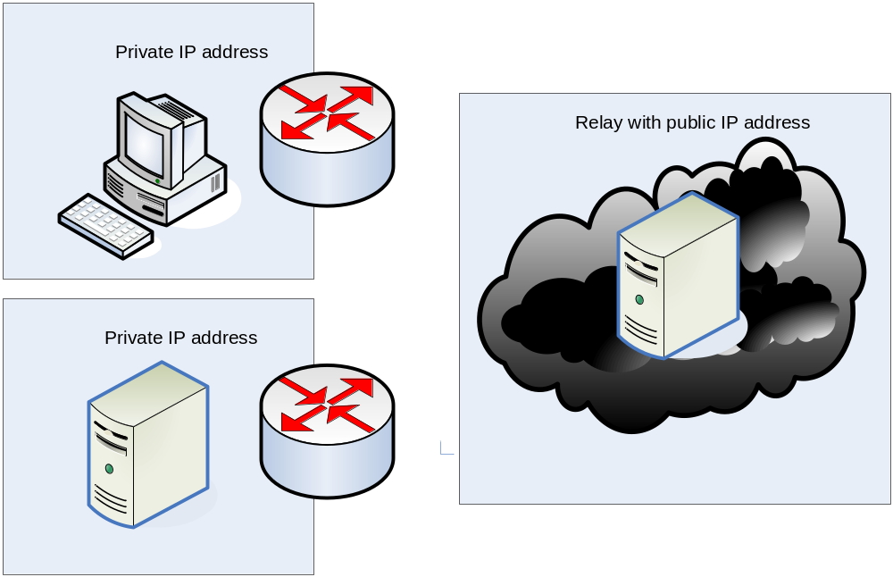
Relaying
Simplest solution: traffic goes through relay

Slide 16
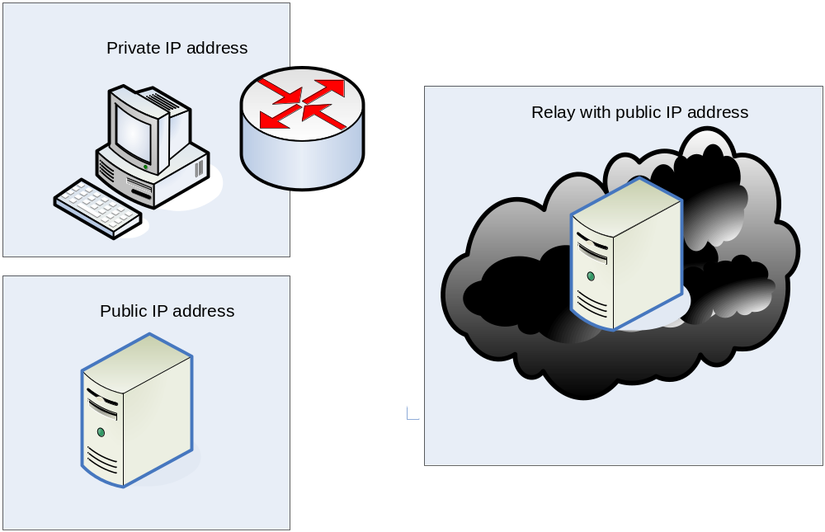
Connection reversal
B with public address uses relay to send the address to NATed node

Slide 17
NAT Policies I/II
RFC3489
Full cone NAT
  All requests from the same internal IP address and port are mapped to the same public IP address and port.
  Once a mapping is created, all incoming traffic to the public address is routed to the internal host without checking the address of the remote host.
Restricted cone NAT
  Unlike a full cone NAT, a remote host (with IP address X) can send a packet to the internal host only if the internal host had previously sent a packet to IP address X.

Slide 18
NAT Policies II
Port restricted cone NAT
  A port restricted cone NAT is like a restricted cone NAT, but the restriction includes port numbers.
  An external host can send a packet, with source IP address X and source port P, to the internal host only if the internal host had previously sent a packet to IP address X and port P.
Symmetric NAT
  A symmetric NAT is a NAT where all requests from the same internal IP address and port to a specific destination IP address and port are mapped to the same external source IP address and port. If the same internal host sends a packet with the same source address and port to a different destination, a different mapping is used.
  Only the external host that receives a packet can send a UDP packet back to the internal host

Slide 19
Hole Punching

Slide 20
Hole Punching
Hole punching is a technique to allow traffic from/to a host behind a firewall/NAT without the collaboration of the NAT itself
The simplest way is to use UDP packets

Slide 21

Hole Punching with Full Cone
NAT routes the packet to the rendezvous who acquires the public address ip:port. A mapping is created and a hole is punched
Host looks up the public address of the device (NAT’s IP)
No restrictions on IP traffic arriving at the NAT

Slide 22
Hole Punching with Restricted Cone
NAT routes the packet to the rendezvous who acquires the public address ip:port. A mapping is created.
Natted host sends message to host. Hole is punched
Host looks up the public address of the device (NAT’s IP)
Restricts traffic based on public IP address (not on port)
(X,y) sends to (A,z) through (N,q)
(A,w) can send back to (N,q)

Slide 23
Hole Punching with Port Restricted Cone
NAT routes the packet to the rendezvous who acquires the public address ip:port. A mapping is created.
Natted host sends message to host. Hole is punched
Host looks up the public address of the device (NAT’s IP)
Similar as restricted cone, but source port of remote generated packed must be
the same addressed by host A in the first packet.

Slide 24
Symmetric NATs
Punching a hole in symmetric NAT is impossible
  NAT assigns new mappings for different destinations
  Random port numbers
  Only recipient can send packet back to internal host
Rendezvous is not useful here because NAT will assign new public address to packets for other hosts than the rendezvous
The only way to traverse this NAT is by Connection Reversal or Relaying.

Slide 25
Additional Note
A symmetric NAT does not maintain a consistent port binding.It creates a new mapping/binding for each new session. This means that hole punching does not work, because there is no consistent opening for incoming packets.

Slide 26
TURN, STUN, ICE

Slide 27
TURN
IETF MIDCOM draft ”Traversal Using Relay NAT (TURN)” RFC 5389
TURN is a protocol for UDP/TCP relaying behind a NAT
Unlike STUN there is no hole punching and data are bounced to a public server called the TURN server
TURN is the last resource. For instance behind a symmetric NAT
It introduces a relay
  Located in customers DMZ or Service Provider network
  Single point of failure
  Requires a high performance server

Slide 28
TURN Elements
A TURN client is an entity that generates TURN requests (Binding request)
A TURN Server is an entity that receives TURN requests, and sends TURN responses.
The server is a data relay, receiving data on the address it provides to clients, and forwarding them to the clients
Discovery, for example using Anycast over UDP or DNS
Security is supported by establishing a shared secret with TLS (after discovery)

Slide 29
STUN
IETF RFC 3489 ”STUN – Simple Traversal of User Datagram Protocol (UDP) Through Network Address Translators (NATs)”
A client-server protocol to discover the presence and types of NAT and firewalls between them and the public Internet
STUN allows applications to determine the public IP addresses allocated to them by the NAT
Defines the operations and the message format needed to understand the type of NAT
The STUN server is contacted on UDP port 3478
The server will hint clients to perform tests on alternate IP and port numbers (STUN servers have two IP addresses)

Slide 30
How STUN works
The client sends a request to the server
The server returns a response which contains the source IP of the packet received from the client (inside the payload) i.e. the mapped IP address
The client compares its IP address with the mapped IP address returned by the server
If they are different then the client is behind a NAT
The client can set some flags in the message which tell the server to send a packet from another IP/port or to another IP/port (the server has 2 public IP addresses)

Slide 31
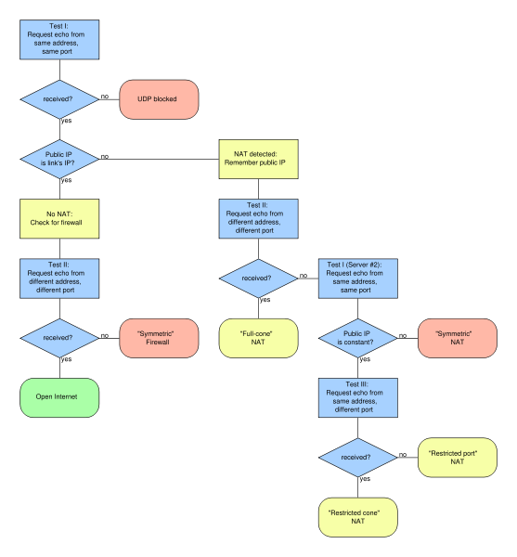
Source: http://en.wikipedia.org/wiki/Image:STUN_Algorithm3.svg

Slide 32
STUN Limitations
Does not work with symmetric NATs used by most corporate environments
Does not work if both clients are behind the same NAT
Additional deployment of a STUN server placed in the public space
STUN NAT detection not reliable!

Slide 33
Additional Note
Once a client has discovered its external addresses, it can relate it to its peers. If the NATs are full cone then either side can initiate communication. If they are restricted cone or restricted port cone both sides must start transmitting together.
The trick is using STUN to discover the presence of NAT, and to learn and use the bindings they allocate.

Slide 34
Revised STUN
Revised specification in RFC 5389
  "Session Traversal Utilities for NAT“
  Classical STUN not deployable
  STUN is not a complete solution, rather it is a tool
    ICE
    SIP Outbound, ..
  Binding discovery, NAT keep-alives, Short-term password, Relay (previously TURN)
Can run on UDP, TCP, TLS
http://tools.ietf.org/html/rfc5489

Slide 35
STUN Relay
Previously TURN
STUN server located using DNS SRV records
Allocate request/response
  Allocate an external address at the relay
Send indication
  Data to remote endpoint using relay
Data indication
  Data received from remote endpoints using relay
Connect request and response
  Request relay to establish TCP connection with remote endpoint
Connection status indication
  Relay informs endpoint about status of TCP connection: LISTEN, ESTABLISH, CLOSED

Slide 36
ICE
IETF MMUSIC draft ”Interactive Connectivity Establishment (ICE): A Methodology for Network Address Translator (NAT)”
Allows peers to discover NAT types and client capabilities
Provide alternatives for establishing connectivity, namely STUN and TURN
Works with all types of NATs, P2P NAT traversal
Designed for SIP and VoIP. Can be applied to any session-oriented protocol
The detailed operation of ICE can be broken into six steps: gathering, prioritizing, encoding, offering and answering, checking, and completing.

Slide 37
ICE Step 1
Gathering
  Caller gathers IP addresses and ports
  Each is a potential candidate for communications
  A candidate is gathered from each interface
  The agent contacts STUN server from each host interface
  Result is a set of server-reflexive candidates
    IP addresses that route to the outermost NAT between the agent and the STUN server
  Relayed candidates from TURN servers
    IP addresses and ports on the relay servers

Slide 38
ICE Step 2
Prioritizing
  Each candidate is assigned a priority value
Prioritizing addresses
  Priority = 2²⁴ (type preference) + 2⁸ (local preference) + 2 (256 – component ID)

Slide 39
ICE Step 3
Encoding
  Body of a SIP request contains SDP message
  IP addresses and port numbers
  ICE extends SDP by several new SDP attributes
    Candidate attribute, used to transfer candidates (IP address, port, priority)
    Credential information for securing STUN messaging

Slide 40
ICE Step 4
Offering and Answering
  SIP INVITE + SDP is sent to the called party
  The called party performs the same gathering, prioritizing, and encoding that the caller performed
  A provisional SIP response with SDP message including the candidates

Slide 41
ICE Step 5
Checking
  The caller and called party have exchanged SDP messages
  ICE performs the work of selecting the communication parameters
  Each agent computes a priority for the candidate pair by combining the priority of each candidate
Verification
  ICE uses a STUN transaction from each agent towards the other to find working candidate pairs
    Connectivity check
  Checks are performed sequantially (n squared!)
  Ordered by priority, check every 20 ms
    When receives a STUN request, generate a request in the other direction (triggered check)

Slide 42
ICE Step 6
Completing
  Once a check is complete, the agent knows that it has found a working pair
  A final check is generated towards the other agent
  After this final transaction is sent, the SIP phone will ring (called agent)
  Answering will generate a SIP 200 OK message
ICE increases connection setup delays

Slide 43
NATs and SIP
Client will generate SIP INVITE and 200 OK responses with private addresses
  In the SDP as the target for receipt of media
    Solved by ICE (difficult)
  In the Contact of a REGISTER
    Solved by SIP Outbound
  In the Via of a request
    Solved by rport (RFC 3581)
Recipient will not be able to send messages to the private address
  Incoming calls do not work
  Media will be discarded
  Responses are not received

Slide 44
IPTABLES
IPTABLES is a tool for firewall and NAT functionality
Uses several tables and each table can have several chains
Each table/chain can have rules that determine how packets are handled
PREROUTING, INPUT, FORWARD, OUTPUT, POSTROUTING
NAT is done with PREROUTING, POSTROUTING
Firewall is done with INPUT, FORWARD, OUTPUT
Tables: nat, filter, mangle, raw

Slide 45
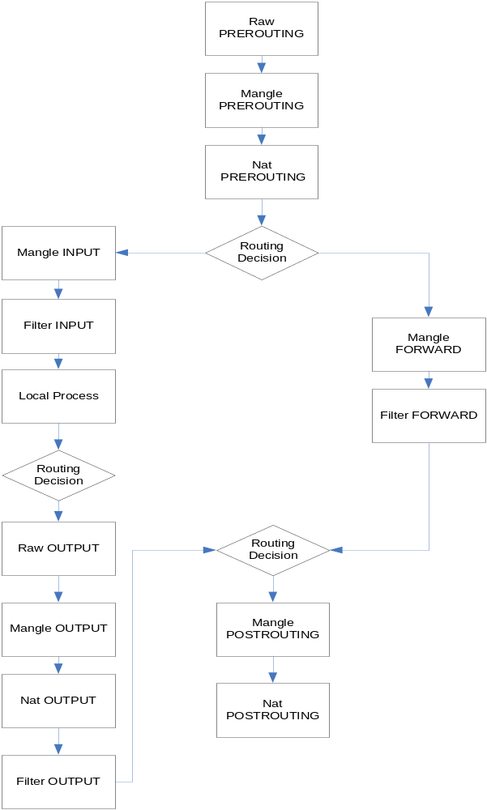

Slide 46
IETF BEHAVE WG
IETF BEHAVE Working Group is working on classification of NAT behaviours
  Behavior Engineering for Hindrance Avoidance
Recommendations for NAT vendors
  Towards deterministic operation
http://www.ietf.org/html.charters/behave-charter.html

Slide 47
Summary
NATs are popular on the Internet
  Private address spaces
  End-to-end reachability problems
Four main types of NATs
  Hole punching and relays basic mechanisms
A number of solutions for NAT traversal
  STUN
  TURN
  ICE
  SIP Client-initiated Outbound Connections

Slide 48
Additional Notes I
Hole Punching
  UDP hole punching uses a public relay (typically a STUN server)
  Address information is exchanged
  Direct communication is tried
  Idea: each UDP send operation opens a hole
    Very similar to connection reversal
  Does not work with symmetric NATs
  Can be used with TCP as well but this case is more complex

Slide 49
Additional Notes II
Difference between symmetric and port restricted cone NAT
  The terminology is confusing (well-known issue)
  In practice it is difficult to classify NAT behaviour
  For port restricted the mapping is consistent (iAddr:port -> eAddr:port)
  If an outside node received a packet from the internal node, it can send a packet back
  Hole punching is possible
  Other way to define: ingress filter on address/port
For symmetric, only if a node receives a packet, can it send a packet back
  The mapping changes for each destination
  Hole punching is not possible

Slide 50
Additional Notes III
Connection reversal and hole punching
  Connection reversal can be used when one node is behind a NAT
  Hole punching can be used even if both are behind NATs (same idea)

