Slide 1

Soul Wizard
HOMEPAGE

Slide 2
Introduction
Web-based game
RTS-ish
Written in JavaScript
With the help of:
Crafty Game Engine
Tiled Map Editor
Notes:
For our WebApps Project, we decided to write a web-based game. In our initial idea this will be a RTS-ish with some RPG elements. We chose JavaScript for our game. *if big audience(As some of you may know) It's gonna be hard to write a game engine from scratch, so we acquired the help of : ...

Slide 3
Language Choosing
JavaScript
Universal
Easy to implement.
Stable and powerful
Notes:
So why JavaScript?
this is the first language that comes to mind in web programming. So it's the first choice for our game.
It's easy to learn. Took me a week to learn and be comfortable. Should take you guys even less.
There are other languages but JS seems to have a larger development community, hence stable and powerful.
Welp, However we havent tried using any other langs (Python, Lua etc), so this might not be the most optimal choice

Slide 4
Language Choosing
PHP
Integrates with HTML & JavaScript
Wild use
Easy to Learn
Database Communication
Good for starter

Slide 5
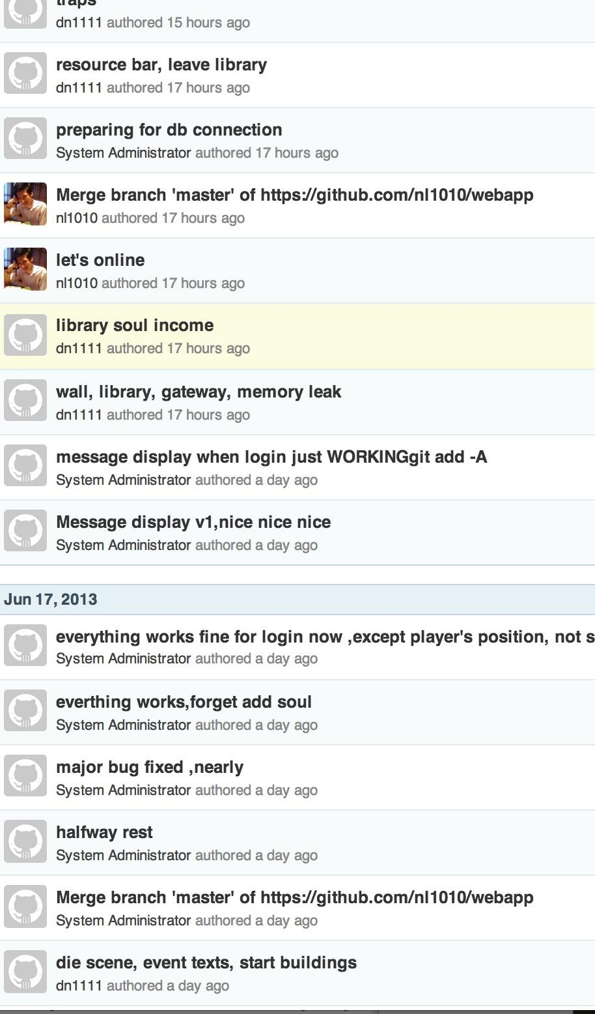
GitHub
1.Version Control
2.Work in different
computers remotely
and synchronize

Slide 6
Our aims
We might not have enough time to make a large detailed map and storyline.
So, basic functions of the game:
Movement
Resource Gathering
Constructions
Fighting System
Notes:
Our initial aim was much bigger, but we quickly realised we won't have enough time to meet all of them.
So we reduced our aim into:
Character movements
Resource Gathering
Basic buildings
Basic Fighting System

Slide 7
Interactions - Login
Registration System
Login System
Database demo
Notes:
So our first goal is to create a reg/login system, with which players can create their own userID and play under it.
*Demonstration registration and logging in.
*Show the database changing?
demo later, to show technical part

Slide 8
The Game - Overall
Very small map
Basic Fourway movement
Basic resource gathering
Basic building system
Need tech/buildings/units
Battle system
Notes:
Now that we've successfully logged in as a new, fresh player. You can see the very simple map that is quickly created just for demo purpose. We used the Fourway control scheme instead of mouse click, just because of nostalgia. I can gather resources by simply walking up to them. Same with the monsters. *demonstrate a death. At this stage of the game, you will just die when facing a monster, so let's not provoke the guy for now.
With the resources, you can build stuff. *demonstrate ...
As you can see we only have 2 buildings for now as we didnt have time to create a complete building tree and tech tree.
We also didnt have time to implement a fighting system. So we ended up with a primitive way to kill monsters. By throwing stuff against them.

Slide 9
Interactions - Save/Load
We added some little things to the story: time and space in the Island is distorted.
Only save the resources and location. Monsters will respawn
Notes:
this game is an online web-game, so we want our progress to be saved when we log out. But that proved to be a problem for us. There is no way to save the whole map's information with our current Engine. Writing one by ourselves seem to be hard too.
So our solution:
We create a system to save the game
We will do a demo later, so we can also show the technical part of it
*Bonfire demo

Slide 10
Message System - (in develop)
Theme of the game: depressing hopeless
So we want to create a system to 'bring' players together.
Placing 'shared' Messages on the Ground
Notes:
My favourite feature of the game is the message system. We're these guys who got thrown into an island with undying, respawning monsters. We want to trade resources, etc.
So the story: there are different instances of the island in parallel universe and all that jazz. But the wizards are powerful, so they can send messages through time and space. hence our system.
*demo.
*trap demo too

Slide 11
Implementation Overview
- The Game
Separation of the actual game code and the assets (map, sprites)
Separation of the game components and scenes.
The game engine helps a lot in this scheme
Notes:
So this is my first time designing a web-game or a game, so I followed a few tutorials online to organise my game folder.
The game engine is actually really helpful.

Slide 12
Implementation Overview
- Database/Server
The PHP Host
www.doc.ic.ac.uk
The Postgresql Database Host
db.doc.ic.ac.uk

Slide 13
Database/Server
- languages
Client
Http + Javascript (incl. jQuery,Ajax)
Server
PHP
Database
SQL

Slide 14
Implementation Overview
-Other Techniques In Database/Server
JQuery and Ajax
Super convenience for both
JS<-> HTML & JS<->PHP
Json (JavaScript Object Notation)
Make life easy
encode query result --send-to--> JS/PHP decode
Sessions
PHP<---->PHP
Cookies
share data JS<---->PHP
reduce communication times with server & database

Slide 15
Database/Server
MVC structure
CLIENT
HTML,
Javascript
SERVER
PHPs
registr.php
C
V
M
Database
postgresDB

Slide 16
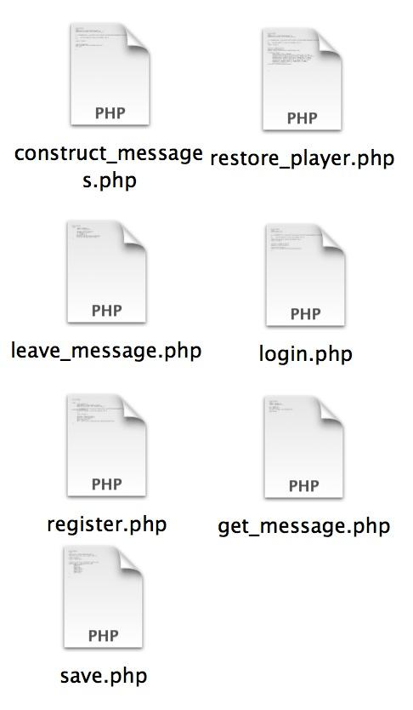

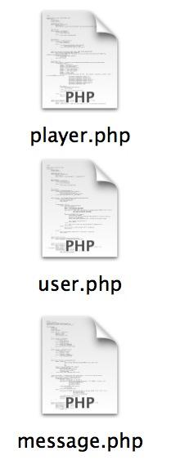
SERVER STRUCTURE
php script+php class(entities)
PHP SCRIPTS
PHP
ENTITIES

Slide 17
DATABASE STRUCTURE
3 main tables currently :
table_register :
server the registration and login request
table_player:
server the game player's resources
table_message:
server the message system which makes player can share experience on the game
AND MORE...

Slide 18
Database & Server structure
Advantages
1. Easy to read and debug
2. Easy to get understand the logic
3. Easy to implement new things and new Feature
4. Make structure nice and tidy

Slide 19
Main Feature
1.Registration
OK!
check validity,ok
CLIENT
register.html with javascripts
SERVER
register.php
SELECT username and check existence
unique user_id
generated and stored in the same row
Database
table_register
INSERT username and password

Slide 20
Main Feature
2.Login
cookies
OK , with uid fetched
CLIENT
login.html with javascripts
SERVER
login.php+user.php
restore_playe.phpr+player.php
json obj
GAME
SELECT password WHERE username=xx
CONSTRUCT
construct_message.php+
message.php
SELECT * ,WHERE uid==xx
Database
table_register
table_player
table_message
SELECT *

Slide 21

Gaming data & Saving system
COOKIE
CLIENT
SERVER
move,
fight,
mining..etc
save.php+player entity
GAME
Database
table_player
INSERT / UPDATE

Slide 22


3.Global Message System and communication
"someone try o/ to me --- I beat him to death"
"lol"
"lol"
"someone try o/ to me --- I beat him to death"
read!
P2
CLIENT
SERVER
leave_message.php
+message entity
idiot.
P1
GAME
read_message.php+message entity
UPDATE, message++
INSERT x,y,message
Database
SELECT message WHERE x,y
table_message
"someone try o/ to me -- I beat him to death"
"someone try o/ to me --- I beat him to death"
"lol"

Slide 23
What we've accomplished
The core features:
Basic interactions
A frame to work on later
With some interesting feature (to work on):
Hidden events (traps)
Messaging System
Notes:
So in conclusion, we have changed our plan a lot from the start.
We've covered some core features of the game, as mentioned before.
Technically, this might not be much, but I've enjoyed working on the messaging system and the trap system.

Slide 24
What's left to do
Class System. Importing equipments
Player Summoning System. For trading and PvP.
Units/Items/Spells.
Complete Building/Tech Trees.
Monster variation.
Better UI/Graphics/Sounds
Make the game actually fun to play.
Larger and complex map with war fog
Storyline,quests,missions
Notes:
Of course there are much left to do. *Read that shit

Slide 25
Some experiences
Using open source tools (game engines) can gain you access to the community's wisdom. Especially when you are learning the language.
There are sites that contain free sprites you can use.
Set up the server as soon as you start.
Notes:
-I've learned a lot from the Crafty google group
-I didnt realise there are free sprites everywhere, so ended up wasting time finding images
-This is an online game, so it's important that we set up the server
Yan worked on the server/database part separately, so it's hard to debug right before the demo, because we need to use the college's server

Slide 26
Conclusion
We learned to program a functional online web-game in 2 weeks Yay!
Notes:
Although this has been hard, because there's not many tutorials, lectures about this, and we have to learn everything from scratch, it's been enjoyable.

Slide 27
Questions?

