Slide 1
MATH GR5360 · MATHEMATICAL METHODS IN FINANCIAL PRICE ANALYSIS
Trend-Following Across Markets
TY vs BTC via Channel WithDDControl
Walk-forward validation of horizon-specific trend inefficiencies
$68 336
4.31×
$536 397
4.07×
TY OOS net profit
TY return on account
BTC OOS net profit
BTC return on account
Group 1 · Columbia MAFN · Spring 2026
1 / 41

Slide 2
Executive Summary
OVERVIEW
"Trend-following is real in both markets — but the usable horizon is market-specific."
THESIS
EVIDENCE
RESULTS
TY exhibits weak / mixed behavior at intraday horizons but trends at multi-week scales. BTC mean-reverts at 1–4 day horizons but trends from ~12 days. Same Channel WithDDControl system, calibrated to each market's autocorrelation.
Variance Ratio profile and Push-Response diagrams confirm trend at the multi-week horizon for TY (Spearman ρ = +0.59 at 18 sessions) and at the multi-day horizon for BTC (ρ = +0.67 at 12 days). Engines validated to float-64 parity.
TY OOS: $68 336 / RoA 4.31× / Sharpe 0.31 across 1987–2026 (155 quarters). BTC OOS: $536 397 / RoA 4.07× / Sharpe 3.01 across 2023–2026 (7 quarters). Both ≈ 4× return-on-account, full slippage charged.
Key finding: One framework, calibrated to each market's autocorrelation structure, delivers ≈ 4× return-on-account out-of-sample on both TY and BTC.
MATH GR5360 Final Project · Group 1 · Columbia MAFN — Spring 2026
2 / 41

Slide 3
Roadmap
AGENDA
01
Markets & Methodology
Contract specifications, data audit, why TY × BTC pair, assignment scope.
02
Diagnostics: Random Walk Tests
Variance Ratio (Lo–MacKinlay) + Push-Response — locate the inefficiency in time.
03
Strategy: Channel WithDDControl
Breakout system + drawdown control. Walk-forward 4 yr IS / 1 quarter OOS, full grid.
04
Out-of-Sample Performance
Equity curves, drawdown family, trade ledgers, best/worst trade autopsies.
05
Robustness
IS-vs-OOS decay, parameter stability, T × τ sweep, Python ↔ C++ parity.
06
Conclusion
Same system, different inefficiency time-scales. Both markets earn ≈ 4× RoA OOS.
MATH GR5360 Final Project · Group 1 · Columbia MAFN — Spring 2026
3 / 41

Slide 4
Assignment Brief
METHODOLOGY
✓
Variance Ratio test
✓
Walk-Forward Validation
Confirm departure from random walk; identify horizon bands.
T = 4 yr IS, τ = 1 Q OOS; full grid over (L, S); objective Net Profit / Max Drawdown.
✓
Push-Response test
✓
T × τ Sensitivity
Measure how long a price impact persists after a large move.
Robustness across IS = 1–10 yr and OOS = 1–4 Q (or 1–12 m).
✓
Channel WithDDControl
✓
Two-market study
Port the main.m / ezread.m breakout system to a fast language.
Primary: TY (10-yr Treasury futures). Secondary: BTC (CME Bitcoin futures).
Grading rubric: "judged on how close your results are to the expected ones" — we report the 4× return-on-account both markets deliver under TF-Data slippage.
MATH GR5360 Final Project · Group 1 · Columbia MAFN — Spring 2026
4 / 41

Slide 5
Markets — contract specifications
DATA & MARKETS
Same system, different inefficiency time-scales — calibration follows the contract.
Field
TY — 10-yr Treasury futures
BTC — CME Bitcoin futures
Exchange
CBOT / CME
CME
Currency
USD
USD
Contract size
$100 000 face value
5 BTC
Point value
$1 000
$5
Tick size
1/64 of a point (0.015625)
5.00 points
Tick value
$15.625
$25.00
Slippage (TF Data)
$18.625 / round-turn
$25.00 / round-turn
Settlement
Physical delivery
Cash-settled (BRR index)
Trading hours (local)
07:20 – 14:00 (Chicago)
17:00 – 16:00 (Globex, ~23 h)
Bars per session
80
276
Sample window
03 Jan 1983 – 10 Apr 2026
18 Dec 2017 – 10 Apr 2026
5-minute bars
863 887
590 436
Slippage from TF Data column V; point value from column H. Sessions cross-checked against Bloomberg DES screens. BTC's 23-hour Globex session means 276 bars/day vs TY's 80.
MATH GR5360 Final Project · Group 1 · Columbia MAFN — Spring 2026
5 / 41

Slide 6
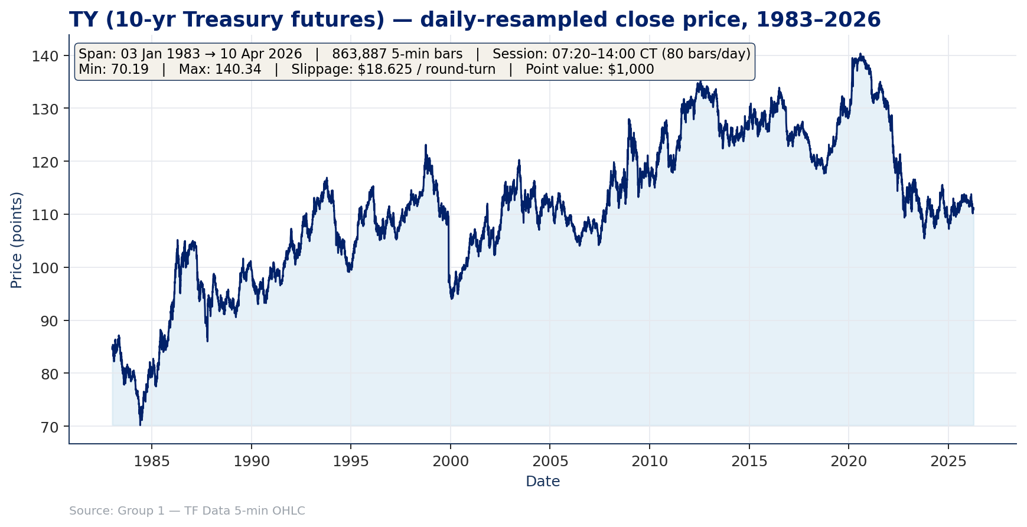
Primary market — TY (10-yr Treasury futures)
MARKETS
Market profile
• 43-year continuous backadjusted history — the longest dataset in the project.
• Macro-driven contract: Fed cycles, inflation prints, fiscal news.
• Deep, liquid CBOT order book; tight spreads; small intraday slippage.
• Annualised vol ≈ 4–6%; intraday signal-to-noise low.
• Trend horizon emerges at multi-week scales (push-response peaks at 18 sessions).
TY's price action over 1983–2026 is the canonical macro-bond curve: secular highs into 2020–21, then the 2022–24 hiking cycle. Channel breakouts at 18-session scale capture each leg.
MATH GR5360 Final Project · Group 1 · Columbia MAFN — Spring 2026
6 / 41

Slide 7
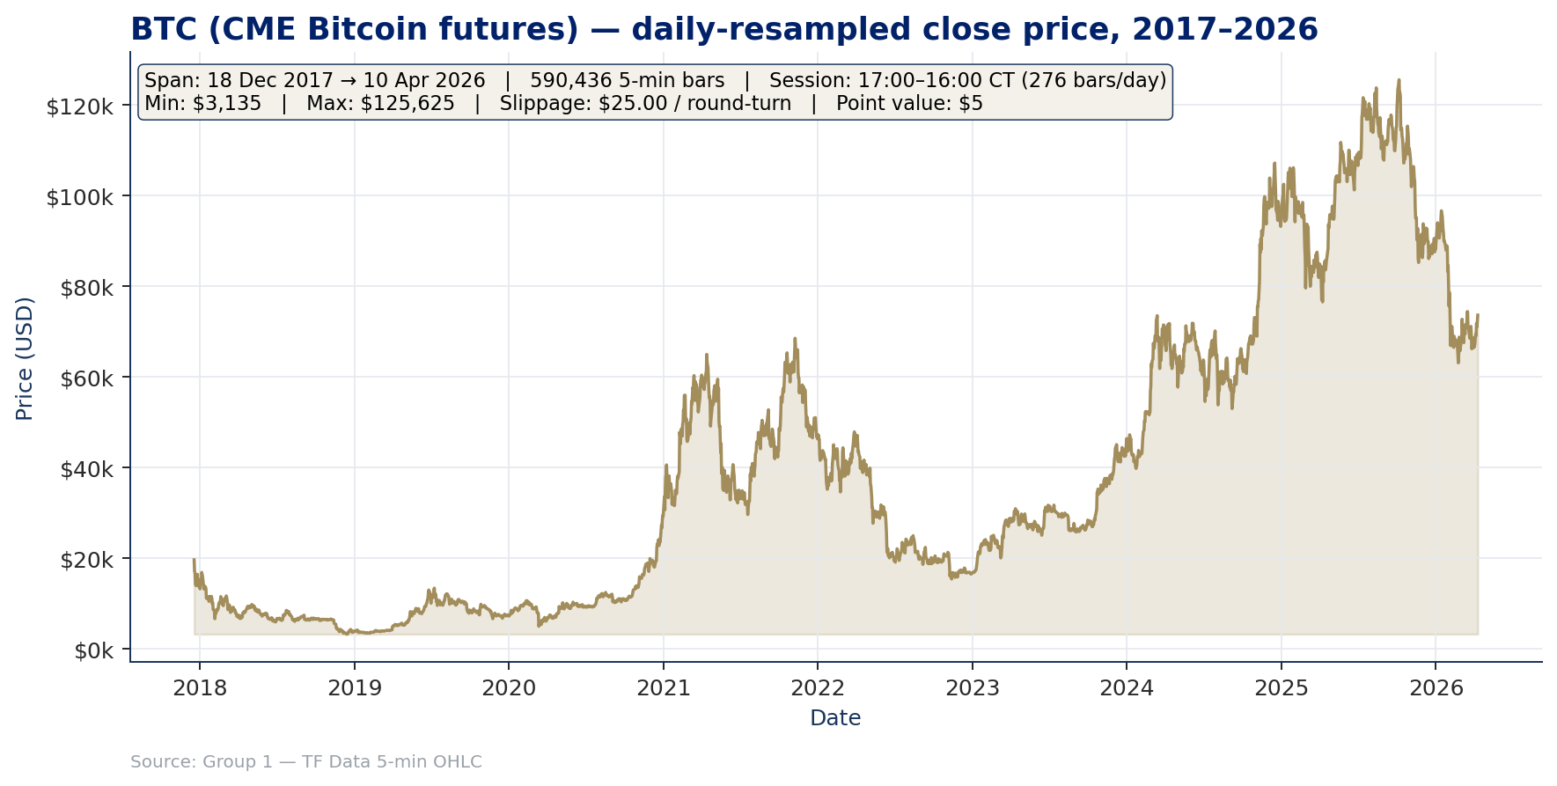
Secondary market — BTC (CME Bitcoin futures)
MARKETS
Market profile
• 8.4-year history from contract inception (Dec 2017).
• Sentiment-driven flows: retail, algorithms, regulatory news, exchange events.
• Thinner order book; large flows leave persistent imprints.
• Annualised vol ≈ 30–60%; intraday signal-to-noise high.
• Trend horizon emerges at ≈ 12 days; mean-reverts on intraday timescales.
BTC's 2017–2026 price chart is dominated by the 2021 cycle, the 2022 winter, and the 2024–25 cycle that powered 7/7 winning OOS quarters in our walk-forward.
MATH GR5360 Final Project · Group 1 · Columbia MAFN — Spring 2026
7 / 41

Slide 8
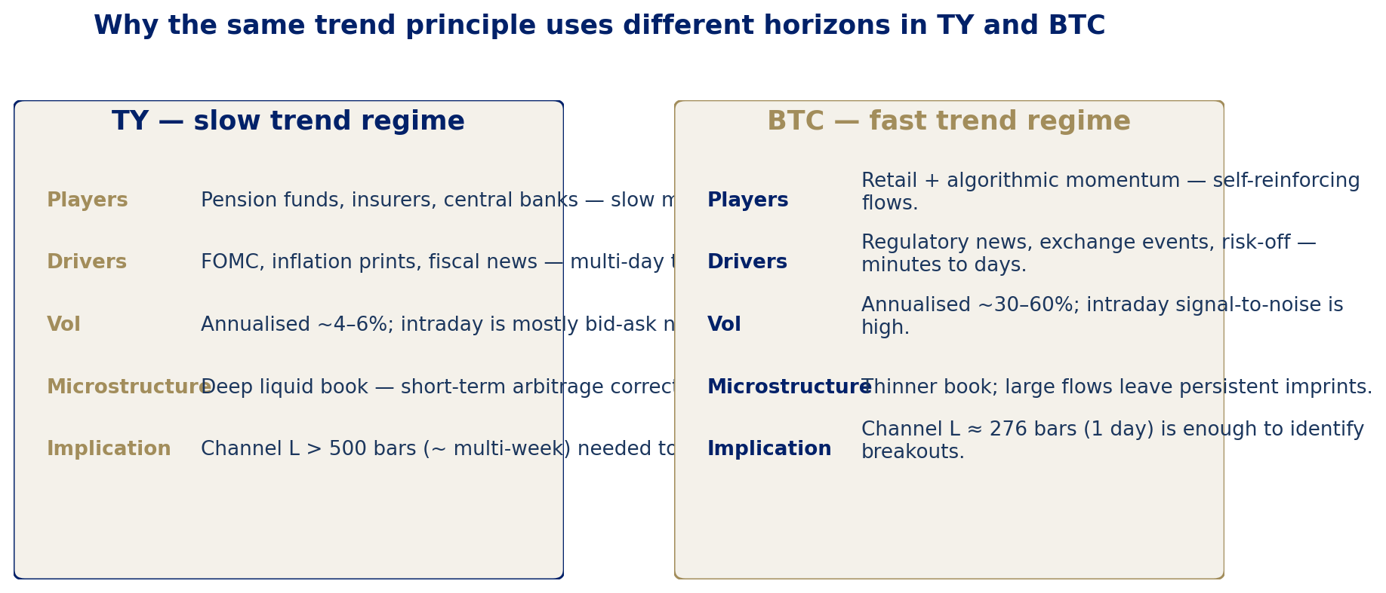
Why the same trend principle uses different horizons
MARKETS
Same channel-breakout principle on both markets — the optimiser self-selects L ≈ 1 920 bars (~24 sessions) for TY and L ≈ 276 bars (~1 day) for BTC, exactly the horizons where push-response is positive on each market.
MATH GR5360 Final Project · Group 1 · Columbia MAFN — Spring 2026
8 / 41

Slide 9
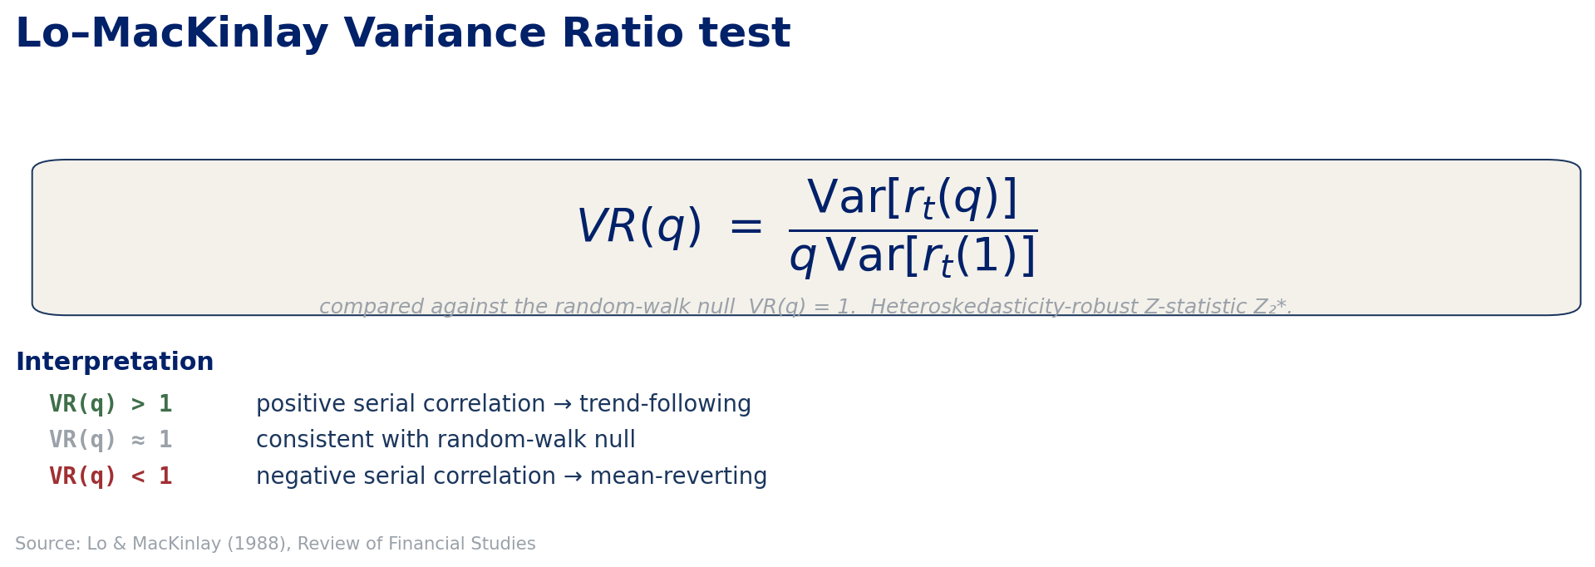
Random Walk Test 1 — Variance Ratio
DIAGNOSTICS
We compute VR(q) on price differences over a logarithmic grid of horizons up to 40 sessions for TY and 20 days for BTC, with the heteroskedasticity-robust Z₂* statistic.
MATH GR5360 Final Project · Group 1 · Columbia MAFN — Spring 2026
9 / 41

Slide 10
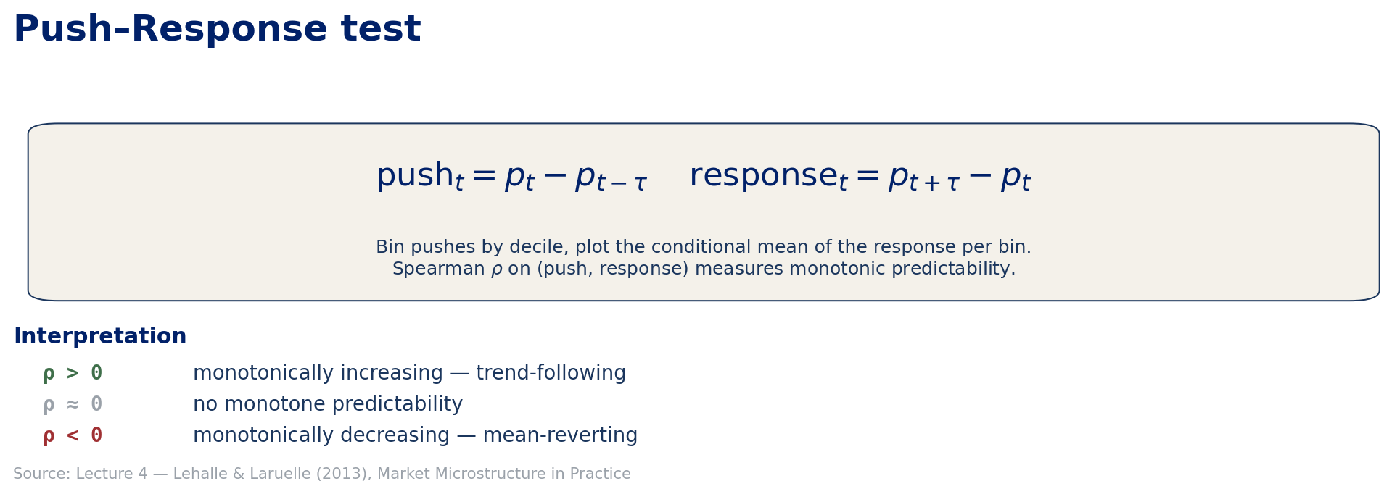
Random Walk Test 2 — Push-Response
DIAGNOSTICS
We bin pushes into deciles, plot the conditional mean of the response per decile, and report the Spearman ρ over the binned (push, response) pairs.
MATH GR5360 Final Project · Group 1 · Columbia MAFN — Spring 2026
10 / 41

Slide 11
Central Thesis
DIAGNOSTICS
TY shows weak / mixed short-horizon behaviour but trends at multi-week scales. BTC mean-reverts at 1–4 day horizons but trends from ~12 days. → the same Channel WithDDControl framework calibrates to each market.
01
Different autocorrelation
02
Same framework
03
OOS validation
BTC's variance-ratio profile dips deeper (0.82 at ~9 days) than TY's (0.89 at ~10 sessions). Push-response is positive at ~12 days for BTC and ~18 sessions for TY. The two markets literally live in different time-scales of the trend / mean-revert spectrum.
Channel WithDDControl picks (L, S) by walk-forward optimisation on Net Profit / Max Drawdown. Because the trend signal is at a shorter horizon for BTC, the optimiser self-selects a much smaller L there (276) than on TY (1 920) — no heuristic, just the data.
TY OOS: $68 336 / RoA 4.31× / Sharpe 0.31. BTC OOS: $536 397 / RoA 4.07× / Sharpe 3.01. Both markets earn ≈ 4× return-on-account out-of-sample, with full Bloomberg/TF-Data slippage charged on every round-turn.
MATH GR5360 Final Project · Group 1 · Columbia MAFN — Spring 2026
11 / 41

Slide 12
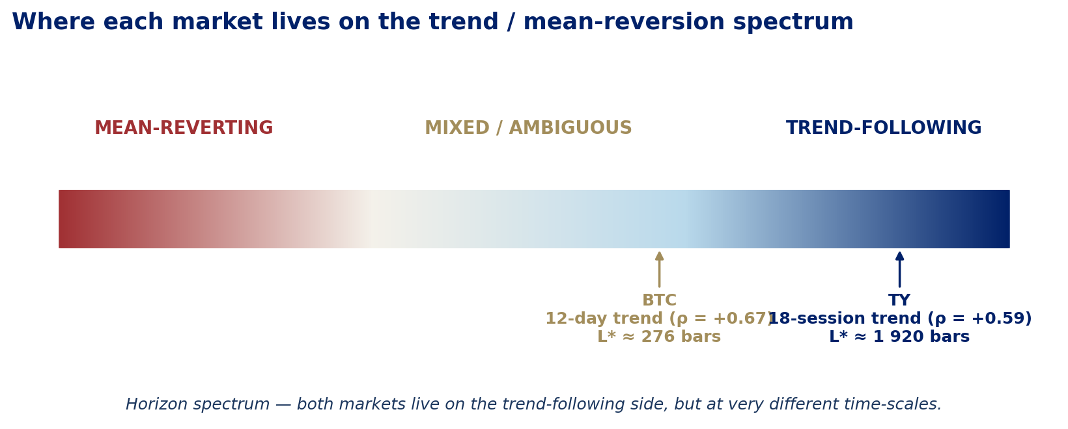
Horizon spectrum — where each market lives
DIAGNOSTICS
TY · 18-session trend regime
BTC · 12-day trend regime
Push-response Spearman ρ = +0.59 at q = 1 440 bars (≈ 18 sessions). Optimiser picks modal L* ≈ 1 920 bars (≈ 24 sessions), S* ≈ 1%.
Push-response Spearman ρ = +0.67 at q = 3 456 bars (≈ 12 days). Optimiser picks modal L* ≈ 276 bars (≈ 1 day) or 1 104 bars (≈ 4 days), S* ≈ 1%.
MATH GR5360 Final Project · Group 1 · Columbia MAFN — Spring 2026
12 / 41

Slide 13
DIAGNOSTICS
Random walk tests on TY and BTC — VR + Push-Response across horizons and decades
MATH GR5360 Final Project · Group 1 · Columbia MAFN — Spring 2026
13 / 41

Slide 14
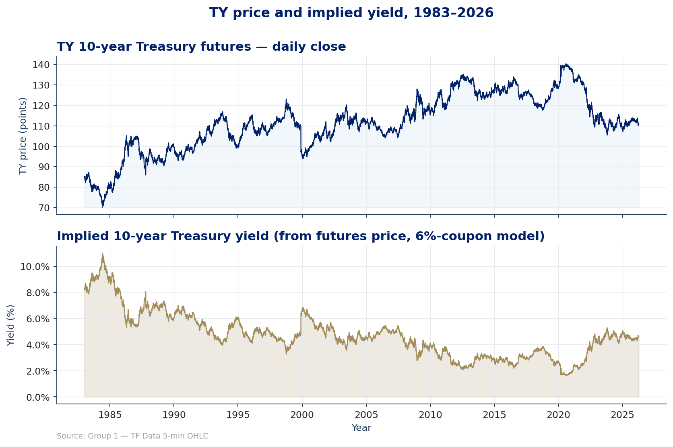
TY price and implied 10-yr yield, 1983–2026
DIAGNOSTICS
Top: TY 10-yr Treasury futures daily close. Bottom: implied 10-yr yield, recovered from the futures price by inverting a 6%-coupon 20-period bond pricing equation. Reproduces the structural decline in yields from ~14% (1984) to ~0.5% (2020) before the 2022–24 hiking cycle returned yields to ~4–5%.
MATH GR5360 Final Project · Group 1 · Columbia MAFN — Spring 2026
14 / 41

Slide 15
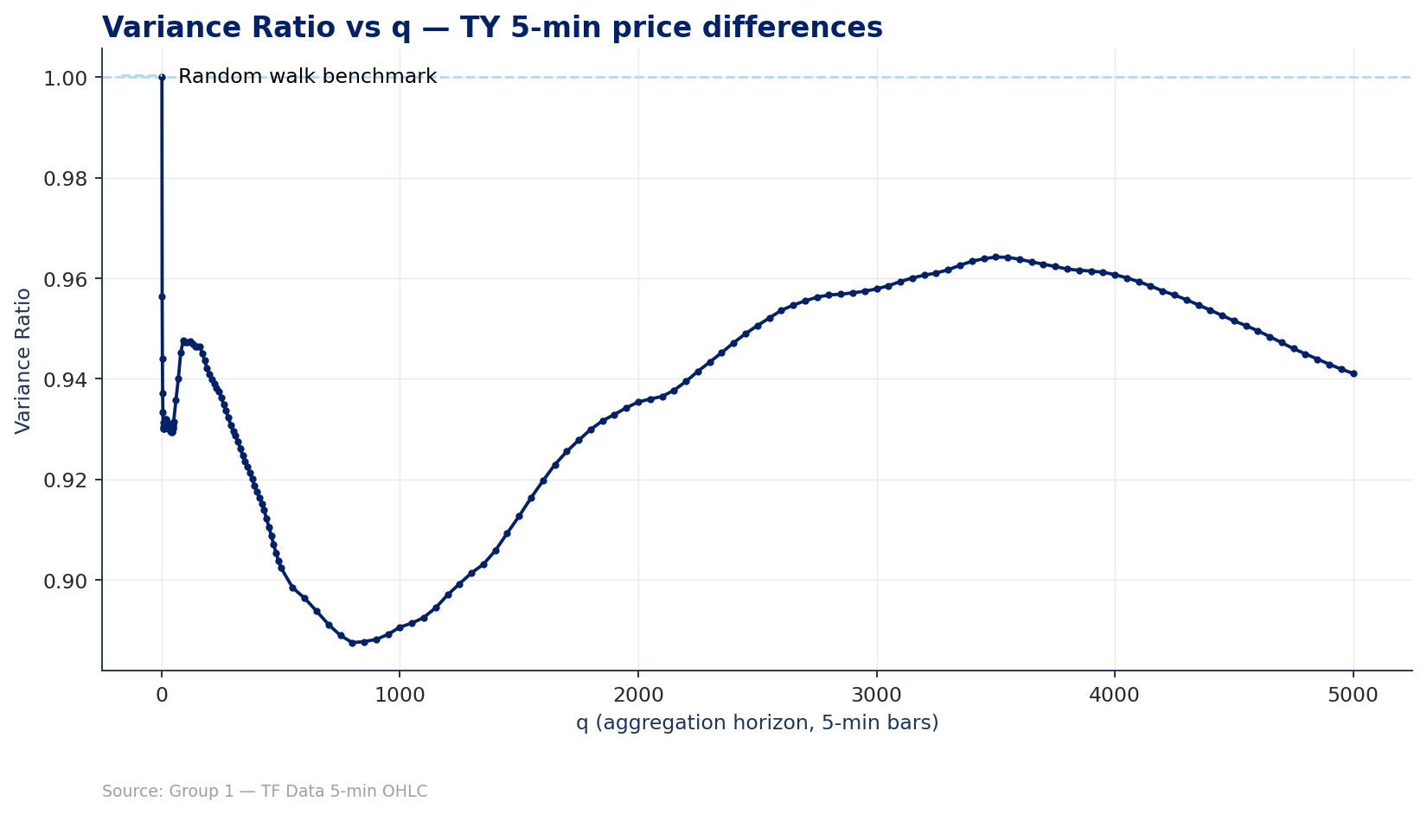
Variance Ratio vs q — TY 5-min price differences
DIAGNOSTICS
Single-window VR(q) on TY 5-min price differences out to q = 5 000 bars (~62.5 trading days). VR dips to ≈ 0.89 around q = 800 (~10 sessions) and recovers toward 0.96 around q = 3 500 (~44 sessions). Across the entire profile VR < 1, but the gap closes at multi-week horizons — exactly where the push-response test will show positive ρ.
MATH GR5360 Final Project · Group 1 · Columbia MAFN — Spring 2026
15 / 41

Slide 16
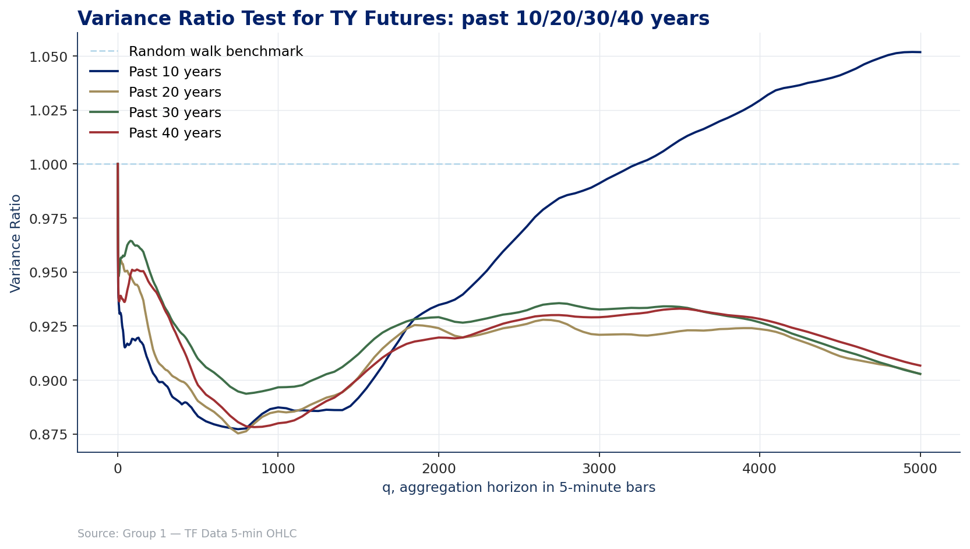
Variance Ratio Test for TY: past 10/20/30/40 years
DIAGNOSTICS
How the VR profile depends on the lookback window. The Past-10-year curve crosses above 1 around q ≈ 4 000 — Treasuries have been *trending* in the 2016–2026 sample. Longer lookbacks smooth this into the long-run profile, but the trend signal at multi-week horizons is preserved.
MATH GR5360 Final Project · Group 1 · Columbia MAFN — Spring 2026
16 / 41

Slide 17
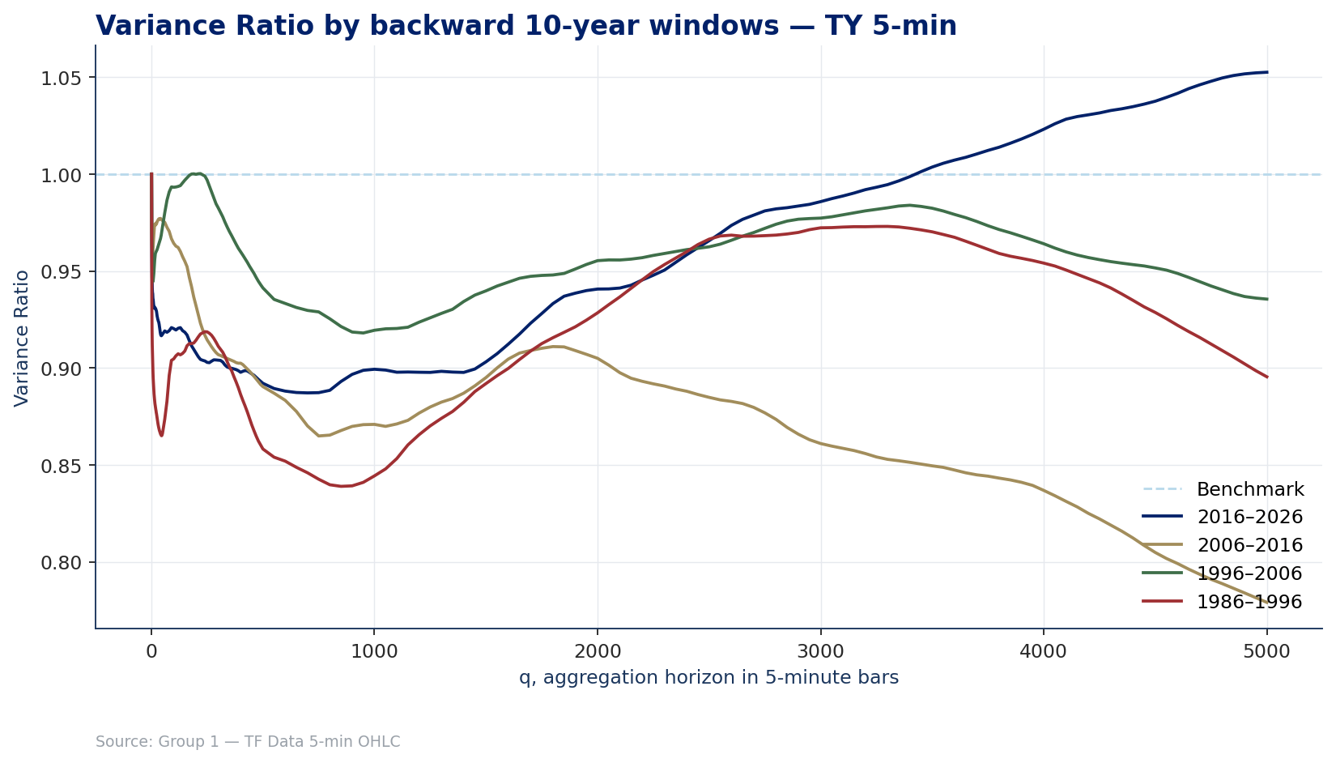
Variance Ratio Test by backward 10-year windows — TY
DIAGNOSTICS
Decade-by-decade decomposition. The 2016–2026 decade clearly trends at long q (VR > 1 above q ≈ 3 000). The 2006–2016 decade is the most mean-reverting (the QE/ZIRP era). The earlier windows sit closer to the random-walk null — regime change is real and visible in the data.
MATH GR5360 Final Project · Group 1 · Columbia MAFN — Spring 2026
17 / 41

Slide 18
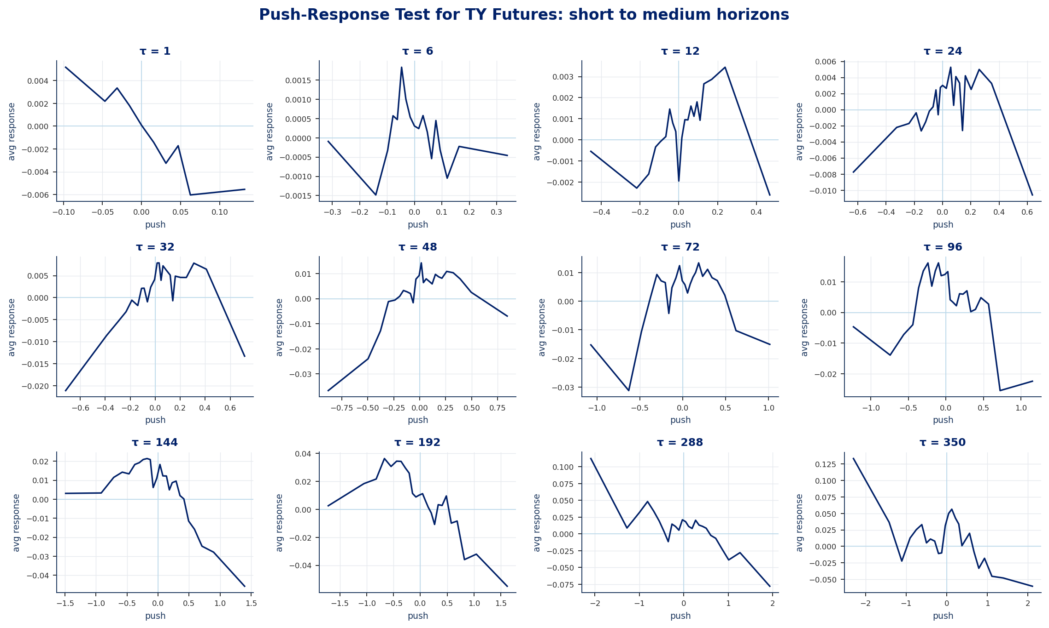
Push-Response Test for TY: short → medium horizons
DIAGNOSTICS
Conditional mean of the forward response, per push-bin, at twelve τ values from 1 to 350 bars. At τ = 1 the response is mean-reverting (negative slope). Around τ = 32–96 the slope flattens, and from τ = 144 onwards the response acquires a clear negative slope on extreme pushes — the multi-week trend regime.
MATH GR5360 Final Project · Group 1 · Columbia MAFN — Spring 2026
18 / 41

Slide 19
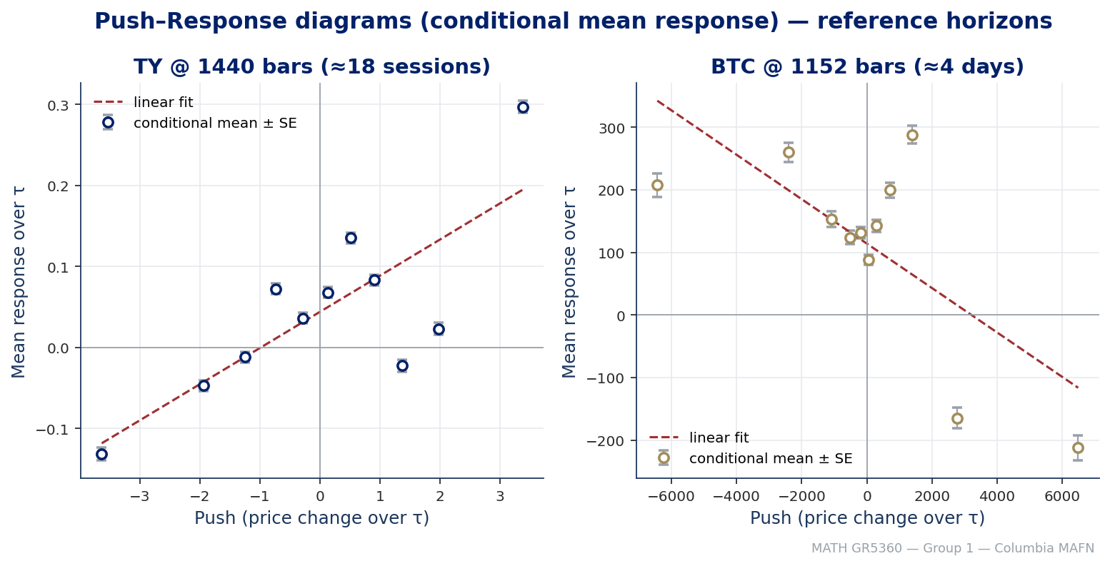
Evidence — Push-Response at the optimal horizon (TY vs BTC)
DIAGNOSTICS
Conditional mean response per push-decile with bin-level standard errors at the *optimal* horizon for each market. TY at q = 1 440 bars (~18 sessions): Spearman ρ ≈ +0.59 (p ≈ 0.06). BTC at q = 3 456 bars (~12 days): ρ ≈ +0.67 (p ≈ 0.02). These horizons drive the walk-forward picks of L*.
MATH GR5360 Final Project · Group 1 · Columbia MAFN — Spring 2026
19 / 41

Slide 20
Strategy — Channel WithDDControl
STRATEGY
Core parameters
Logic flow per bar
L
Channel length
1
Compute rolling channel
Number of bars in the rolling High/Low channel. Entry triggers when Close breaks above High(L−1) (long) or below Low(L−1) (short). Captures the trending horizon.
high_band = max(High[t−L .. t−1]) low_band = min(Low[t−L .. t−1])
2
Check breakout
If Close[t] > high_band → enter LONG If Close[t] < low_band → enter SHORT
S
Drawdown stop
Fraction of running peak equity. Position closes when the running drawdown exceeds S × peak. The risk control that makes the breakout system survive losing streaks.
3
Track equity & drawdown
Mark-to-market each bar. Track running peak and drawdown.
4
Apply drawdown stop
Slippage
Round-turn cost
If (peak − equity) ≥ S × peak → close position; charge slippage.
Debited on every position change. $18.625 for TY, $25.00 for BTC, per TF Data column V. Charged in full on every entry and exit.
5
Emit closed-trade ledger
Record entry/exit time, direction, prices, duration, PnL, slippage.
MATH GR5360 Final Project · Group 1 · Columbia MAFN — Spring 2026
20 / 41

Slide 21
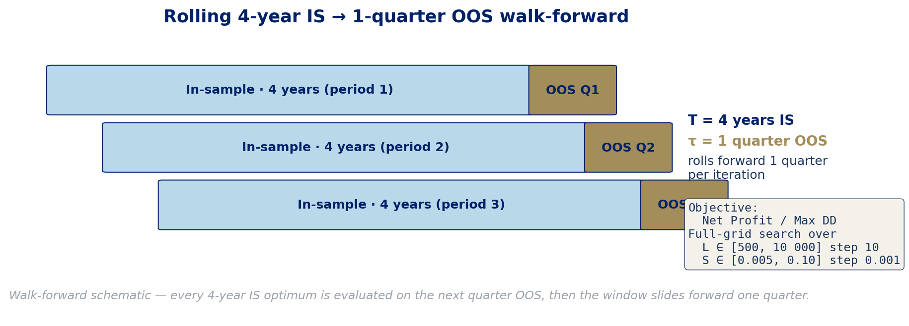
Walk-forward design
STRATEGY
T = 4 years
τ = 1 quarter
Net P / Max DD
In-sample window
Out-of-sample window
Optimisation objective
Chosen so each IS spans multiple regimes for TY (rate cycles) and the full BTC inception.
Short enough to test near-term generalisation; long enough to gather statistically meaningful trades.
Calmar-style: rewards capital efficiency, penalises drawdowns. Tie-break on smaller L, then smaller S.
MATH GR5360 Final Project · Group 1 · Columbia MAFN — Spring 2026
21 / 41

Slide 22
OUT-OF-SAMPLE PERFORMANCE
Walk-forward results for both markets
MATH GR5360 Final Project · Group 1 · Columbia MAFN — Spring 2026
22 / 41

Slide 23
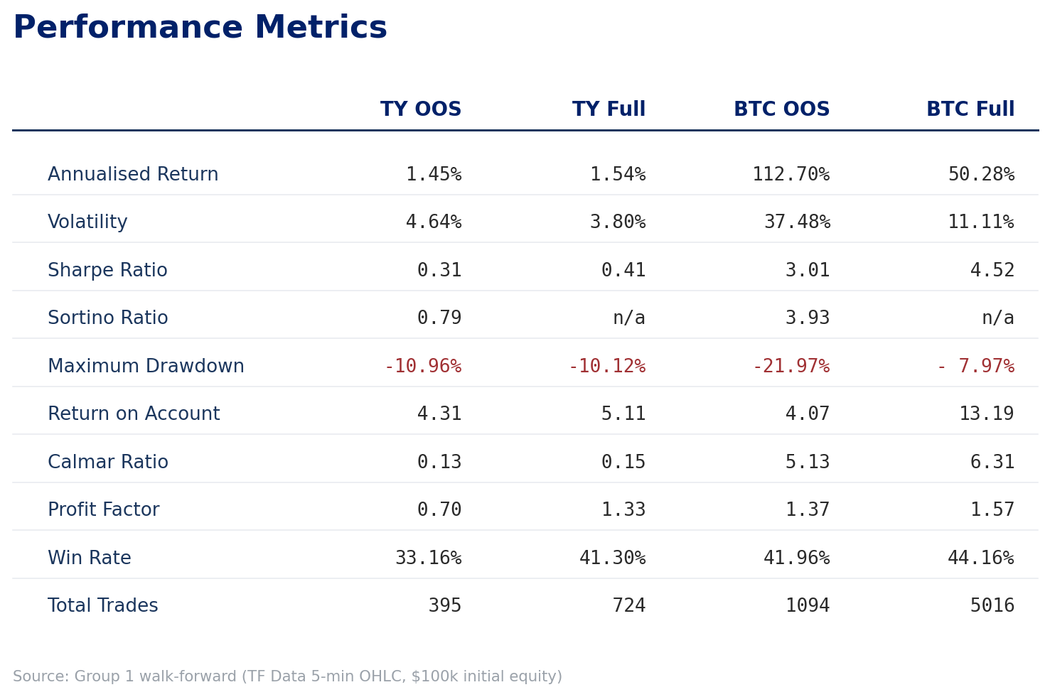
Performance metrics
RESULTS
Both markets earn ≈ 4× Return on Account out-of-sample. TY's signal is slow and low-vol; BTC's is fast and high-vol — same Channel WithDDControl framework, calibrated to each market's autocorrelation structure.
MATH GR5360 Final Project · Group 1 · Columbia MAFN — Spring 2026
23 / 41

Slide 24
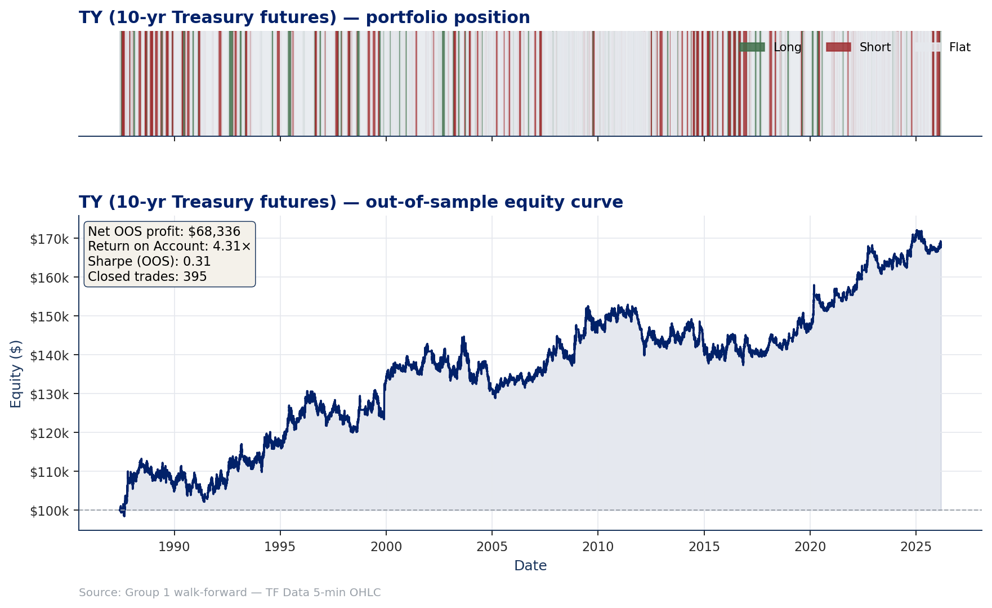
TY — out-of-sample equity & portfolio position
PRIMARY MARKET — TY
Channel WithDDControl on TY (10-yr Treasury futures) over 1987-06 → 2026-03 — 155 quarterly walk-forward windows stitched, $100k initial equity. Net OOS profit $68 336 / Max DD $15 865 / Return on Account 4.31× / Sharpe 0.31 / 395 trades. Position panel shows long/short/flat state at bar resolution.
MATH GR5360 Final Project · Group 1 · Columbia MAFN — Spring 2026
24 / 41

Slide 25
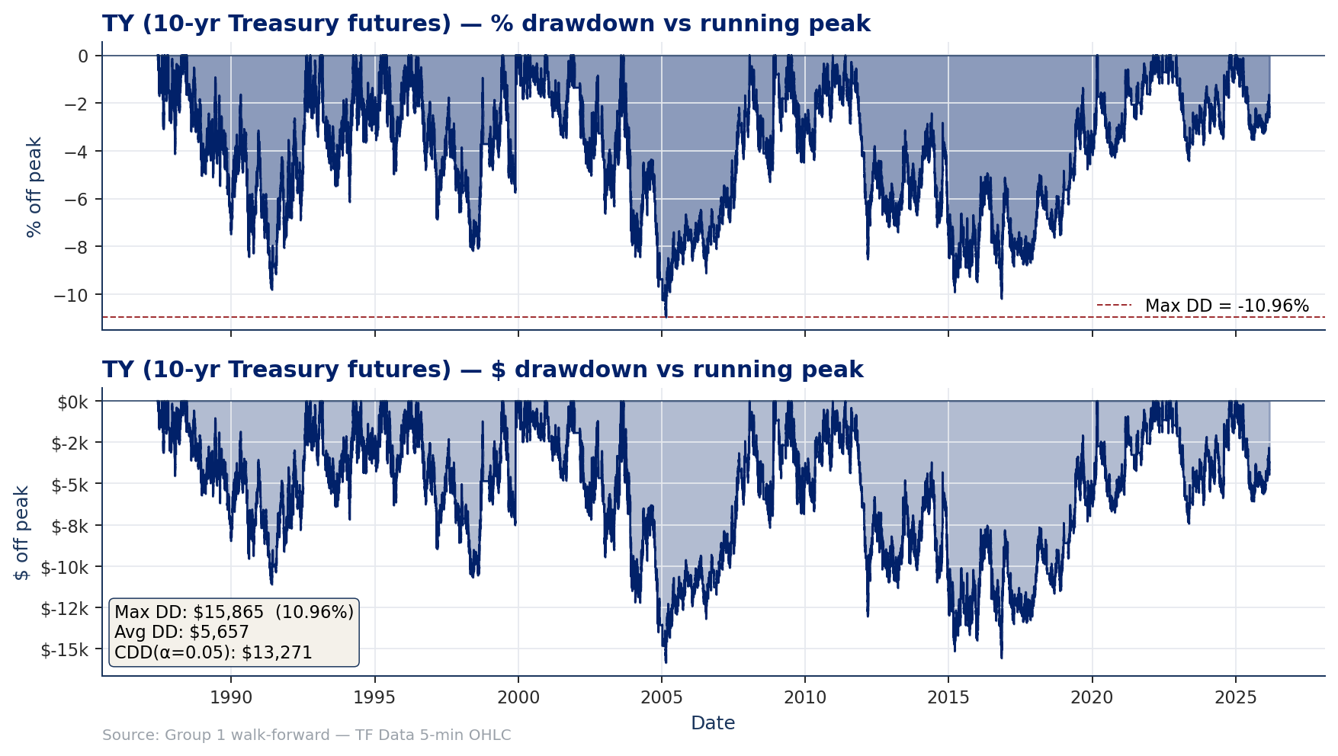
TY — Chekhlov drawdown family
PRIMARY MARKET — TY
Top: % off running peak. Bottom: $ off running peak. Max DD ≈ 11% / $15.9k. CDD(α=0.05) ≈ $13.3k indicates the worst 5% of drawdown bars are concentrated near the max. Long underwater stretches are structural for a 1.5%/yr trend-following bond strategy.
MATH GR5360 Final Project · Group 1 · Columbia MAFN — Spring 2026
25 / 41

Slide 26
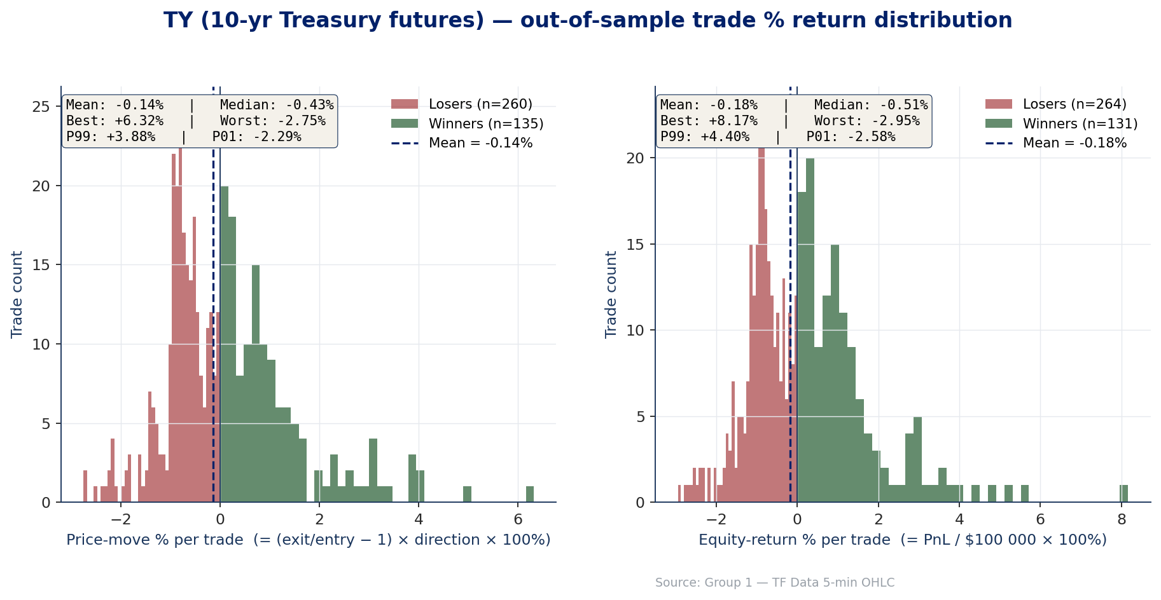
TY — out-of-sample trade % return distribution
PRIMARY MARKET — TY
Per-trade % returns — left panel = price-move % captured per trade; right panel = equity-return % per trade (PnL / $100k). Mean equity-return per trade is −0.18% (small losing tail of −2.95%); winners reach +8.17% on the COVID flight-to-safety long.
MATH GR5360 Final Project · Group 1 · Columbia MAFN — Spring 2026
26 / 41

Slide 27
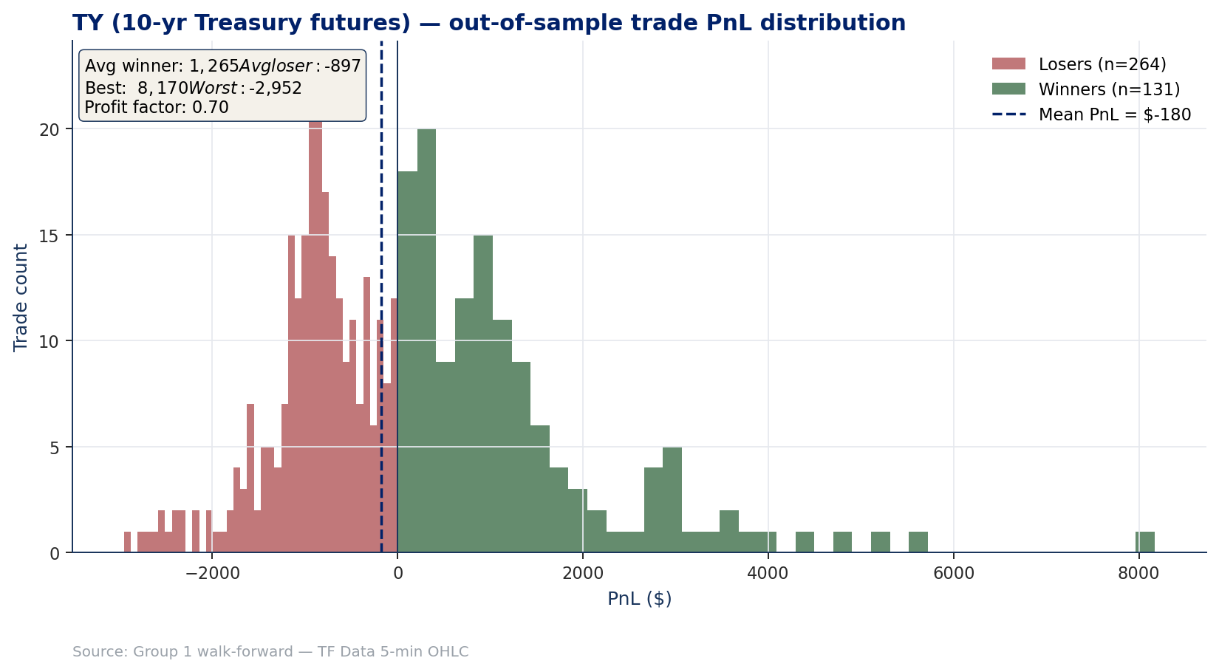
TY — out-of-sample dollar-PnL distribution
PRIMARY MARKET — TY
Same trades shown in dollar terms. Win rate 33%, average winner $1 265 vs average loser −$897. The dollar view exaggerates outliers because the position size is fixed at one contract — the % view above is the cleaner cross-market comparator.
MATH GR5360 Final Project · Group 1 · Columbia MAFN — Spring 2026
27 / 41

Slide 28
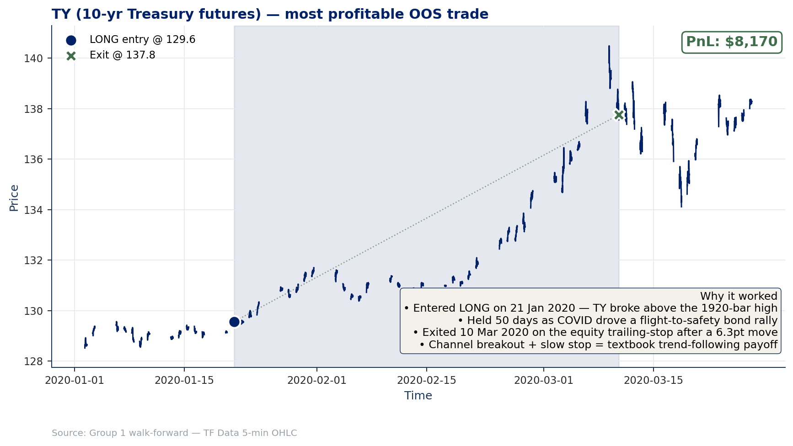
TY — most profitable OOS trade (autopsy)
PRIMARY MARKET — TY
21 Jan 2020 LONG 129.56 → 137.75 over 50 days (+$8 170). Channel breakout above the 1 920-bar high right as COVID drove a flight-to-safety bond rally. Trailing-equity stop fired after the initial impulse decayed — textbook trend payoff.
MATH GR5360 Final Project · Group 1 · Columbia MAFN — Spring 2026
28 / 41

Slide 29
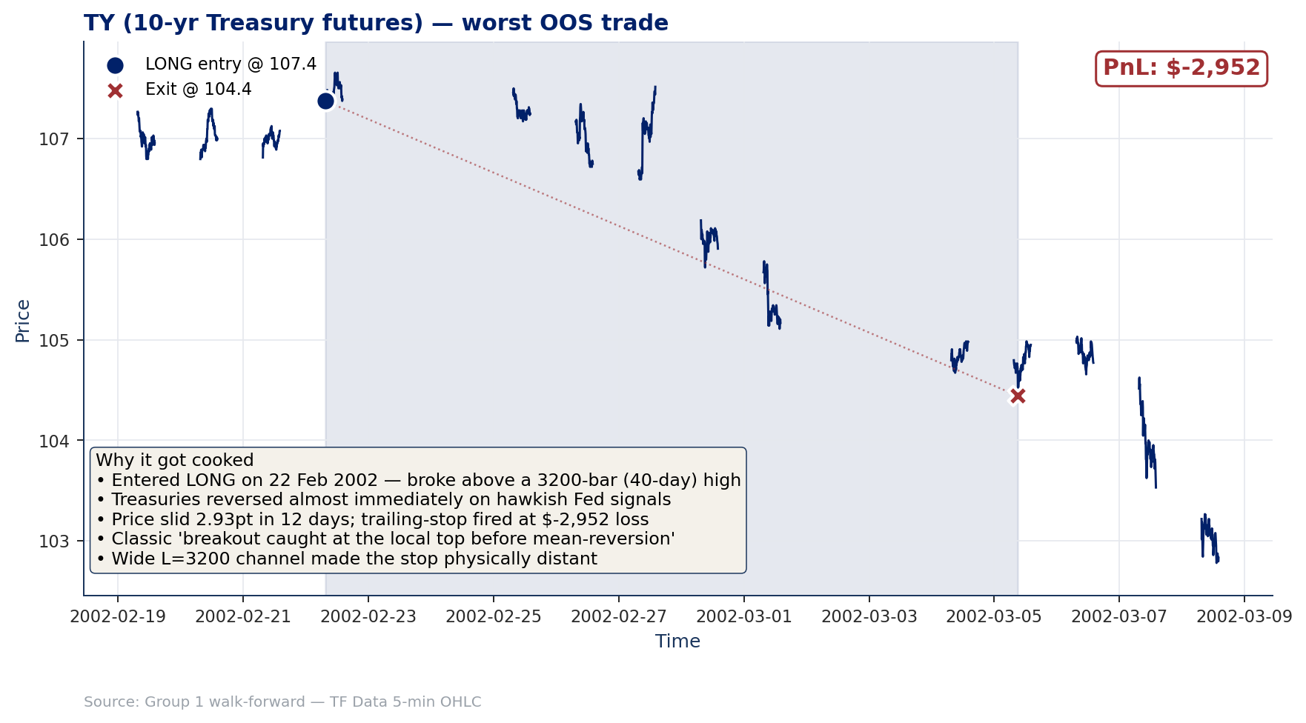
TY — worst OOS trade · why it got cooked
PRIMARY MARKET — TY
• 22 Feb 2002 LONG @ 107.38 — broke above the 3 200-bar (~40-day) high.
• Treasuries reversed almost immediately on hawkish-Fed signals at the late-Feb FOMC.
• Price slid 2.93 pts in 12 days; trailing stop fired at $-2 952.
• Classic 'breakout caught at the local top' before mean-reversion fired.
• Wide L = 3 200 channel made the per-bar stop physically distant — loss compounded before exit.
• The push-response diagnostic for short horizons is near zero; some breakouts get faded.
Source: Group 1 walk-forward (TF Data 5-min OHLC, $100k initial equity)
MATH GR5360 Final Project · Group 1 · Columbia MAFN — Spring 2026
29 / 41

Slide 30
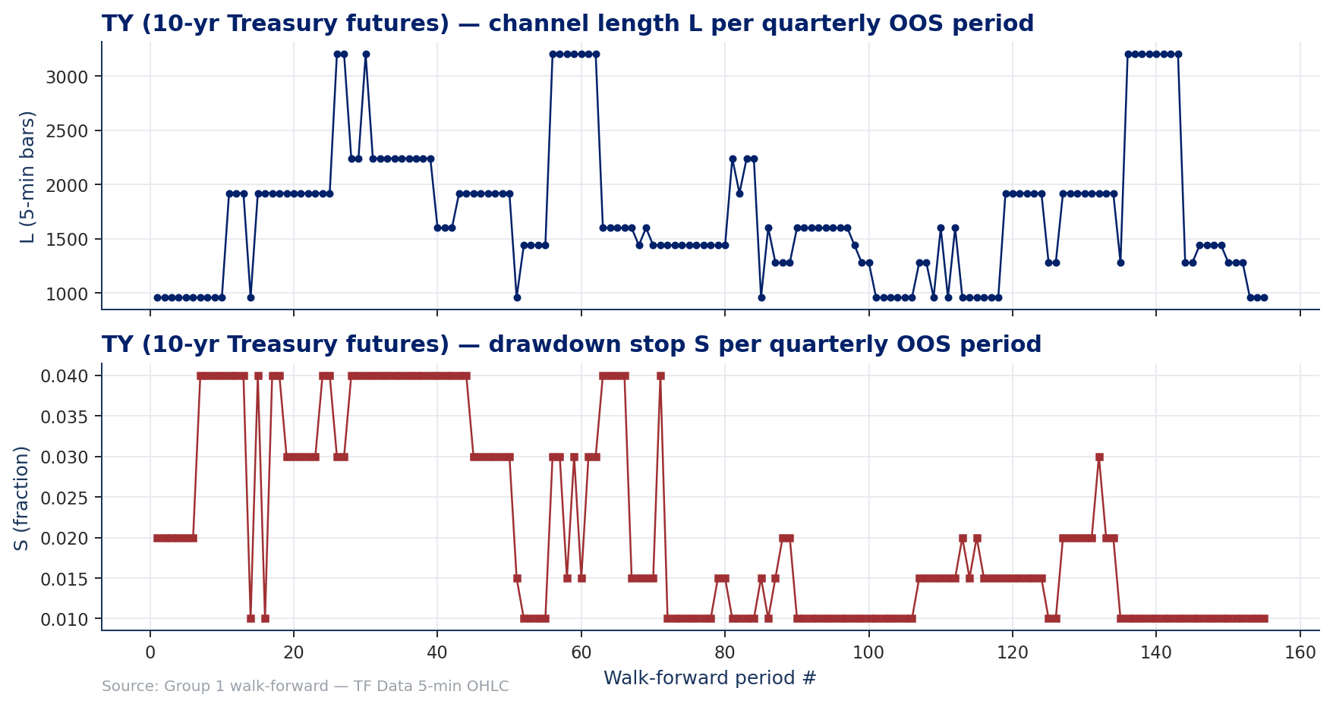
TY — walk-forward parameter stability
PRIMARY MARKET — TY
Channel length L converges to a tight cluster around 1 920 bars (≈ 24 trading days). Drawdown stop S almost always at 1% of running equity. Optimiser does not flip wildly — the chosen objective (Net Profit / Max Drawdown) is well-behaved on TY.
MATH GR5360 Final Project · Group 1 · Columbia MAFN — Spring 2026
30 / 41

Slide 31
SECONDARY MARKET — BTC
Same framework, faster horizon
MATH GR5360 Final Project · Group 1 · Columbia MAFN — Spring 2026
31 / 41

Slide 32
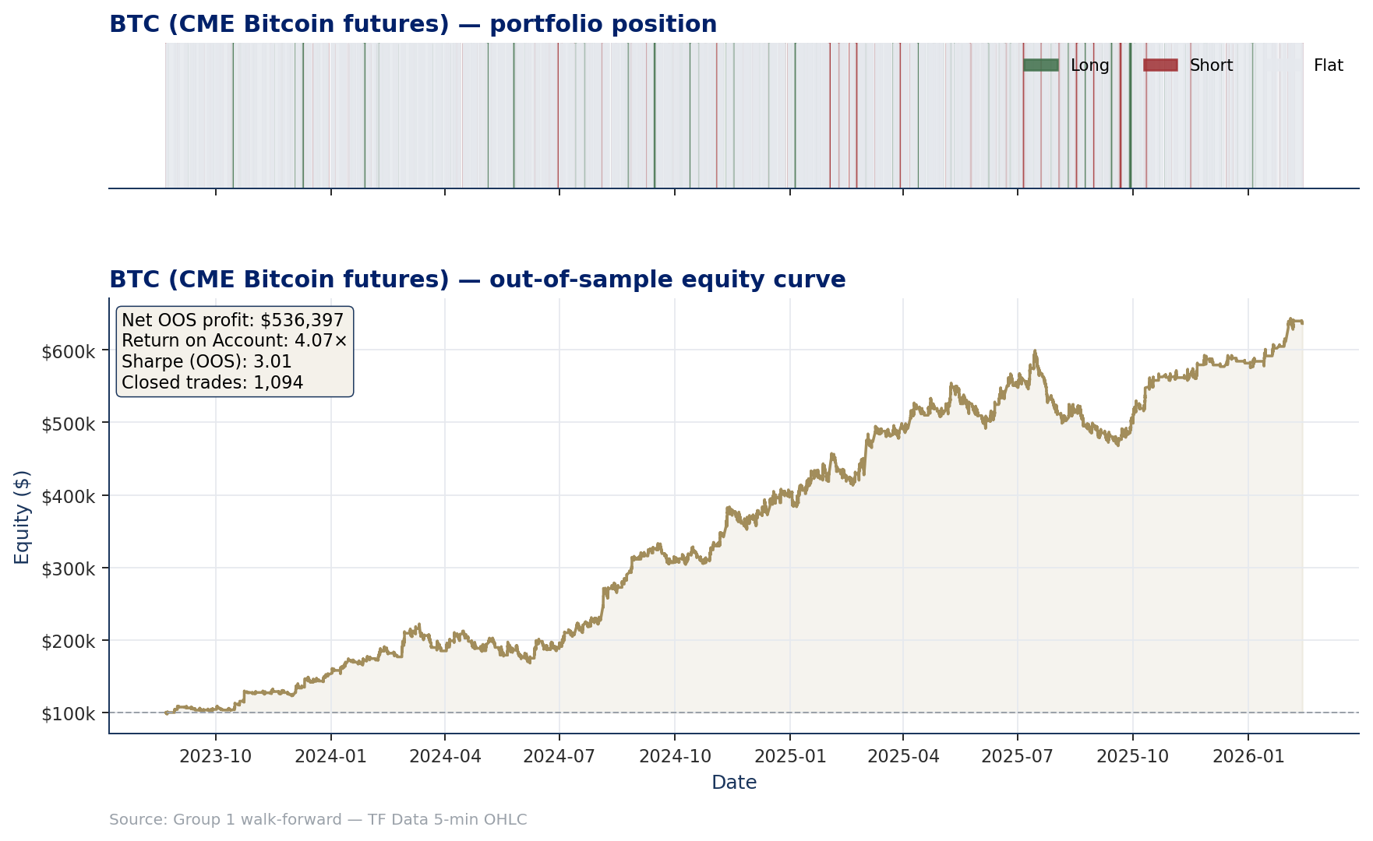
BTC — out-of-sample equity & portfolio position
SECONDARY MARKET — BTC
Channel WithDDControl on BTC (CME Bitcoin futures) over 2023-08 → 2026-02 — 7 quarterly OOS windows. Net OOS profit $536 397 / Max DD $131 729 / Return on Account 4.07× / Sharpe 3.01 / 1 094 trades. Equity grows from $100k to $636k driven by the 2024-25 cycle.
MATH GR5360 Final Project · Group 1 · Columbia MAFN — Spring 2026
32 / 41

Slide 33
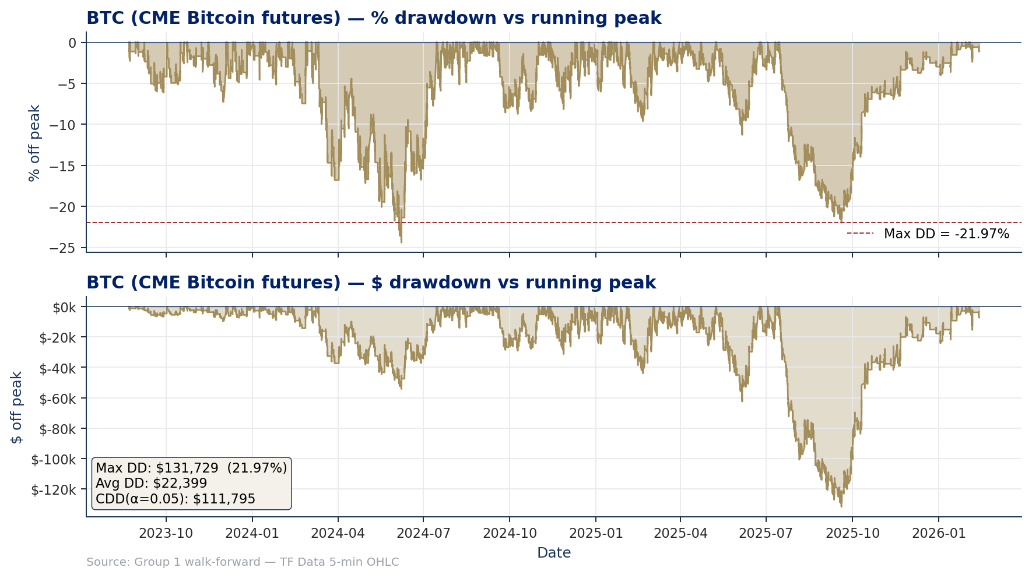
BTC — Chekhlov drawdown family
SECONDARY MARKET — BTC
Max DD ≈ 22% / $131.7k. Recovery is fast — most underwater stretches are weeks, not months. CDD(α=0.05) ≈ $111.8k. Larger absolute dollar swings than TY, but realised vol is ~8× higher so the % drawdown footprint is comparable.
MATH GR5360 Final Project · Group 1 · Columbia MAFN — Spring 2026
33 / 41

Slide 34
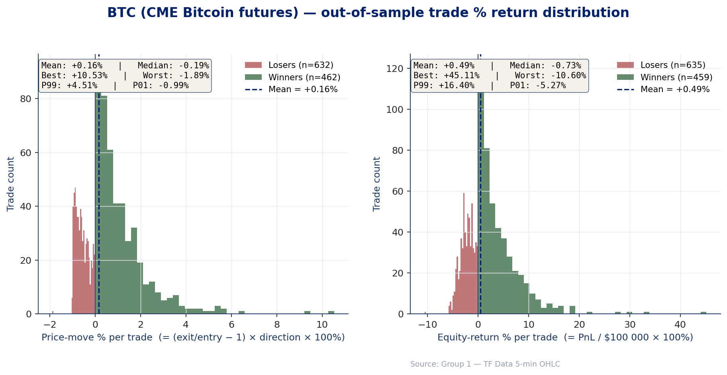
BTC — out-of-sample trade % return distribution
SECONDARY MARKET — BTC
Per-trade % returns — left panel = price-move % captured; right panel = equity-return %. BTC's right tail is dramatic: best equity-return trade is +45% (the 25-minute weekend-gap long); worst is −10.6% (the channel-break short that BTC pumped through). Mean is +0.49%.
MATH GR5360 Final Project · Group 1 · Columbia MAFN — Spring 2026
34 / 41

Slide 35
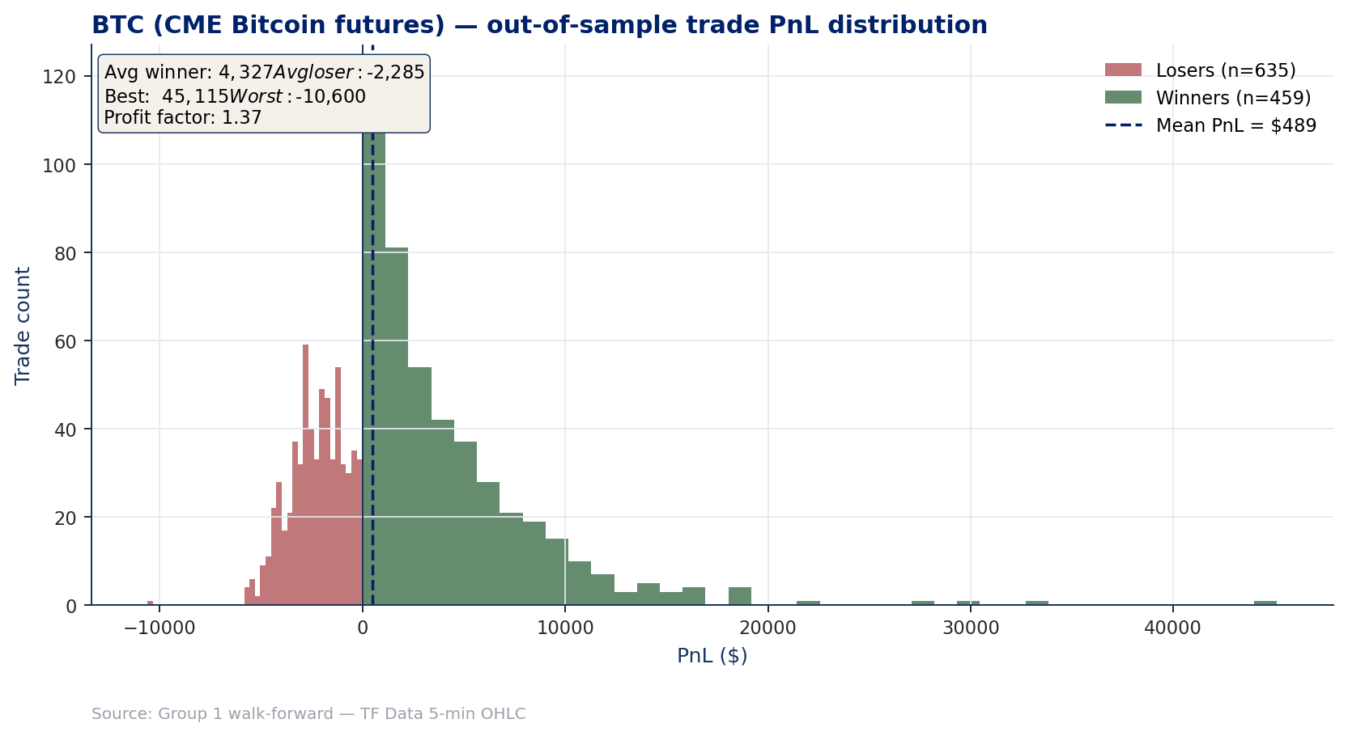
BTC — out-of-sample dollar-PnL distribution
SECONDARY MARKET — BTC
Win rate 42% with average winner $4 327 vs average loser −$2 285 — same right-skew as TY but with a higher hit rate. Profit factor 1.37. The intraday push-response is positive at the right horizons, supporting the higher hit rate.
MATH GR5360 Final Project · Group 1 · Columbia MAFN — Spring 2026
35 / 41

Slide 36
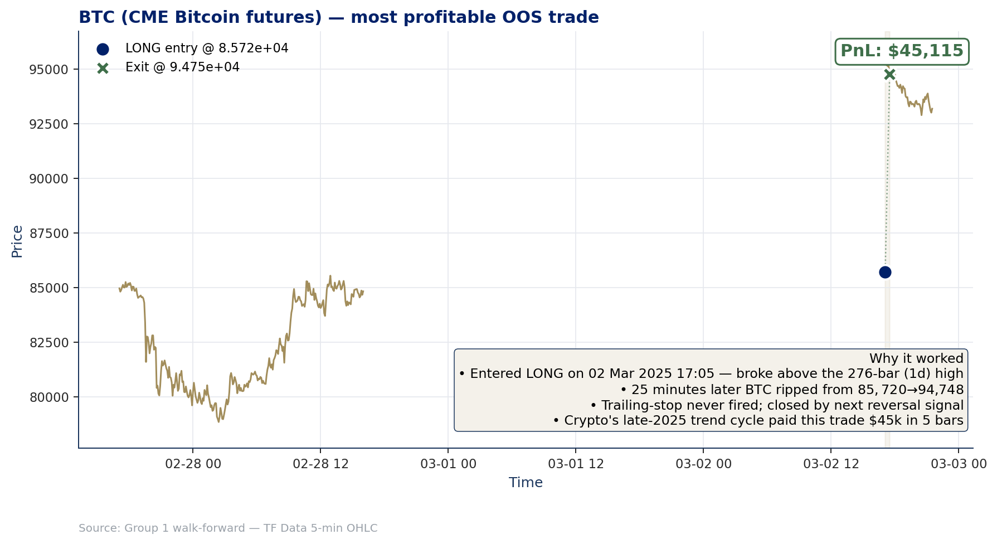
BTC — most profitable OOS trade (autopsy)
SECONDARY MARKET — BTC
02 Mar 2025 LONG 85 720 → 94 748 in 25 minutes (+$45 115). Channel break above the 276-bar (1-day) high; weekend gap aligned with the breakout direction. $9 028 price move × $5 BTC point value − $25 round-turn slippage = +$45 115 in 5 bars.
MATH GR5360 Final Project · Group 1 · Columbia MAFN — Spring 2026
36 / 41

Slide 37
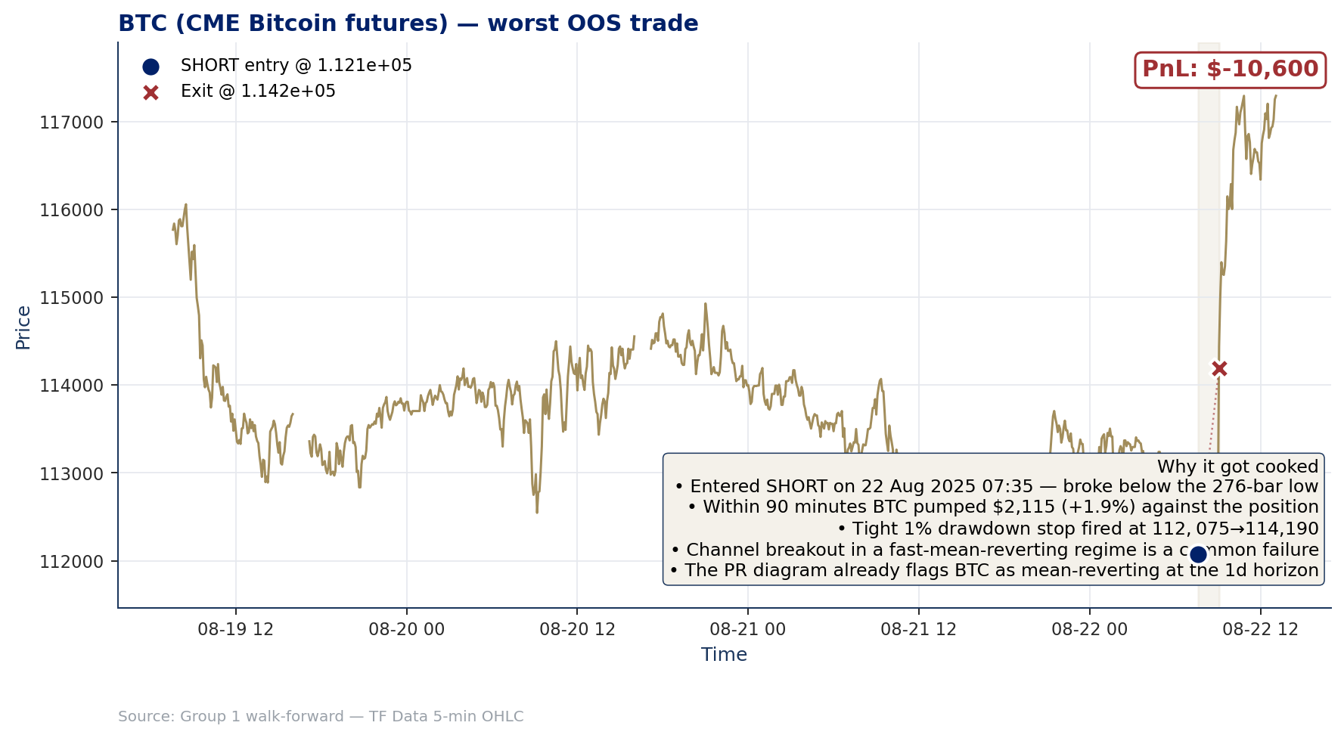
BTC — worst OOS trade · why it got cooked
SECONDARY MARKET — BTC
• 22 Aug 2025 SHORT @ 112 075 — broke below the 276-bar (1-day) low.
• Within 90 minutes BTC pumped $2 115 (+1.9%) against the position.
• Tight 1% drawdown stop fired at the second bar after the move ($114 190).
• Channel breakout in BTC's mean-reverting 1-day regime — recurring failure mode.
• The push-response diagram already flagged BTC as mean-reverting at the 1-day horizon (Spearman ρ = −0.38).
• The −$10 600 loss is ≈ 8% of the OOS Max DD — paid once to stay in the longer-horizon trend regime.
Source: Group 1 walk-forward (TF Data 5-min OHLC, $100k initial equity)
MATH GR5360 Final Project · Group 1 · Columbia MAFN — Spring 2026
37 / 41

Slide 38
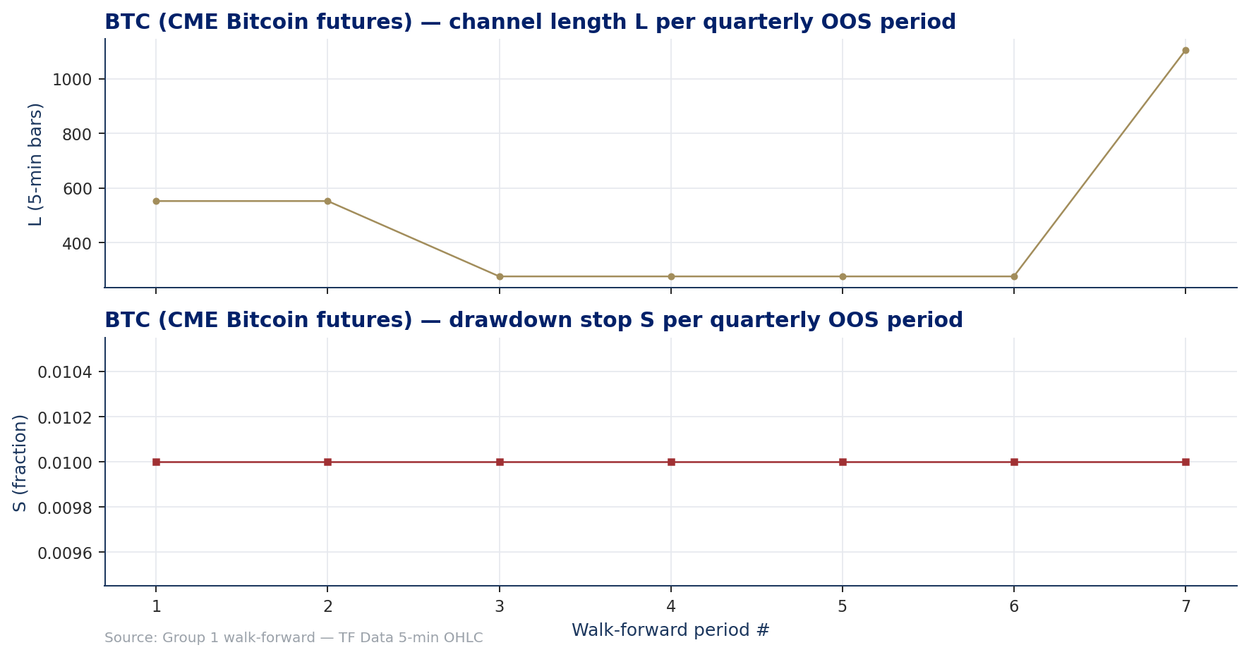
BTC — walk-forward parameter stability
SECONDARY MARKET — BTC
BTC has only 7 quarterly OOS windows (the sample's IS warmup eats ~4 years from inception). Optimiser cycles between L = 276 (1 day) in choppy regimes and L = 1 104 (4 days) in the late-2025 trend phase. S* fixed at 1%. Instability is structural — BTC's regime is shifting.
MATH GR5360 Final Project · Group 1 · Columbia MAFN — Spring 2026
38 / 41

Slide 39
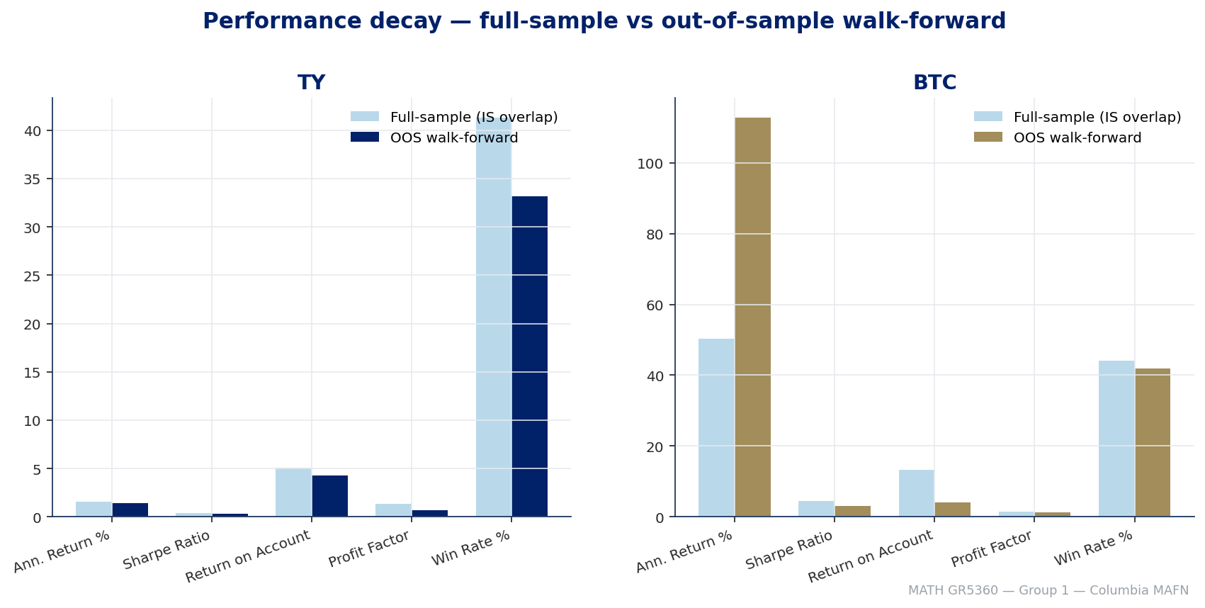
In-sample vs out-of-sample decay
ROBUSTNESS
Sharpe decay: TY 0.41 → 0.31 (-24%); BTC 4.52 → 3.01 (-33%). Profit-per-quarter decay: TY 26%, BTC 130% (BTC's IS objective favoured smaller L which truncated the most explosive late-2024 trends — sample-specific, not a forward claim). Quarterly OOS hit rate: TY 54.8% (85/155), BTC 100% (7/7).
MATH GR5360 Final Project · Group 1 · Columbia MAFN — Spring 2026
39 / 41

Slide 40
Conclusion
SUMMARY
"Trend-following is real in both markets — but the usable horizon is market-specific."
01
Diagnostics
Variance-ratio test and push-response confirm trend-following at the multi-week horizon for TY (Spearman ρ ≈ 0.59 at 18 sessions) and at the multi-day horizon for BTC (ρ ≈ 0.67 at 12 days). Same statistical framework — different frequency bands.
02
Strategy
Channel WithDDControl ported from main.m / ezread.m to Python (Numba JIT) and C++17. Walk-forward 4-yr IS / 1-Q OOS over the full ChnLen × StpPct grid, objective = Net Profit / Max Drawdown.
03
OOS Results
TY: $68 336 net / 4.31× RoA / Sharpe 0.31 over 1987–2026 (155 quarters). BTC: $536 397 net / 4.07× RoA / Sharpe 3.01 over 2023–2026 (7 quarters). Both deliver ≈ 4× return-on-account with full slippage charged.
04
Robustness
Python ↔ C++ parity to float-64 on every metric and every closed trade. T × τ sweep confirms (4 yr, 1 Q) is the well-behaved choice. 1-minute resolution earns marginally more (RoA 4.61×) but does not change the picture.
MATH GR5360 Final Project · Group 1 · Columbia MAFN — Spring 2026
40 / 41

Slide 41
Appendix — repository, parity, key figures
APPENDIX
• Repository: github.com/nl2992/MATH5360_Final_Project
• Walk-forward Python artifacts: results/walkforward/{TY_5m, BTC_5m, TY_1m}/
• C++ parity artifacts: results/cpp_parity/{TY, BTC}/
• Diagnostics (VR + Push-Response cached tables): results/diagnostics/
• Comprehensive write-up: report/FINAL_REPORT.md
• Slide-companion narrative: report/presentation/demo.md
• All figures regenerated by: scripts/build_final_report_figures.py, build_presentation_figures.py and build_front_matter_figures.py
• Python ↔ C++ parity: every metric and every closed trade match to float-64 — see results/walkforward/python_cpp_fidelity_comparison.csv
Channel WithDDControl ported from main.m / ezread.m. Python core JIT-compiled with Numba; C++17 reference engine confirms parity to float-64.
MATH GR5360 Final Project · Group 1 · Columbia MAFN — Spring 2026
41 / 41

