Slide 1

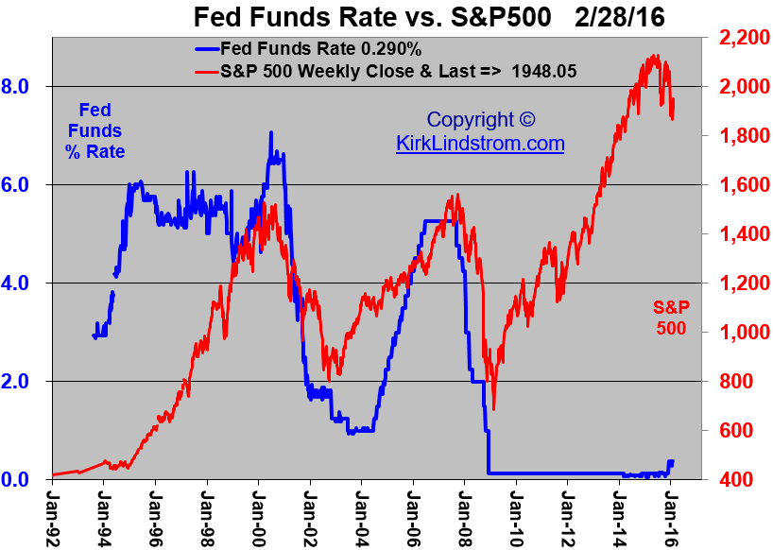

COMP9444: FOMC Sentiment Analysis
Ying Bi (z5444398)
Wing Pui (Nigel) Li (z5320405)
Zhenhua Liu (z5433153)
Tong Zhang (z5542524)

Slide 2
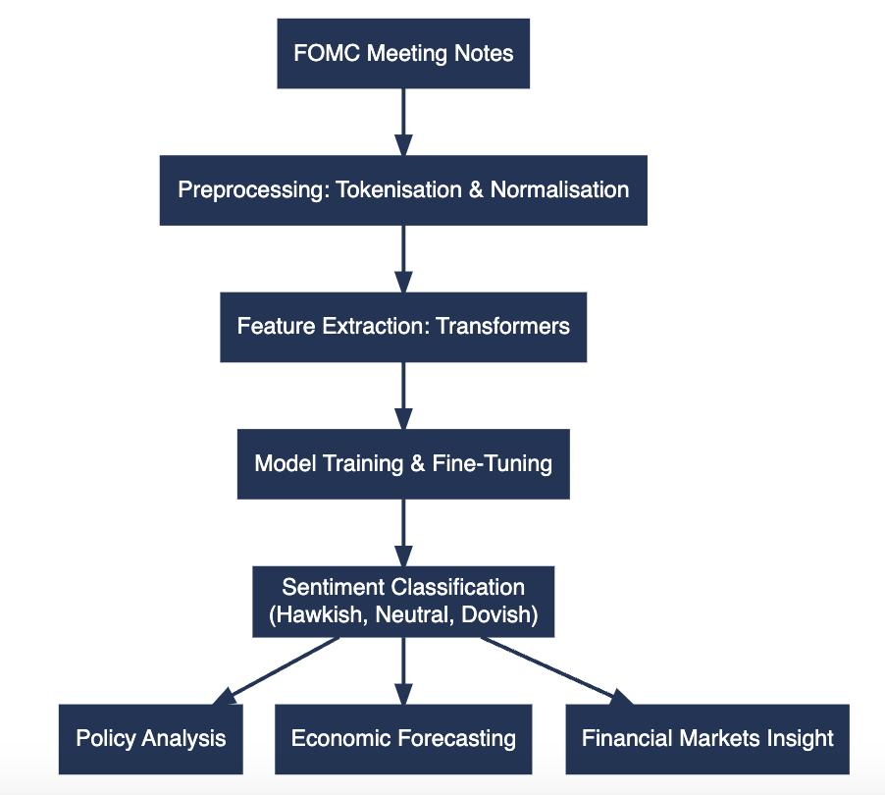




Motivation
One of the core tasks in Natural Language Processing (NLP) is to extract meaningful stances from complex texts. Our project focuses on extracting policy stances from Federal Open Market Committee (FOMC) meeting notes to classify their positions into categories such as Neutral, Hawkish, or Dovish (or {0, 1, 2}). The FOMC’s policy stance is a crucial economic indicator that reflects the Federal Reserve's perspective on interest rates, economic growth, and inflation.
Applications of FOMC Sentiment Classification
Broad array of applications
Correa et al. (2020) found that sentiment in central banks' financial stability reports serves as a useful predictor of banking crises, with a 1 percentage point increase in sentiment followed by a 29 percentage point increase in the probability of a crisis
Hilscher et al. (2024) demonstrated that central bank sentiment predicts policy interest rates and the Taylor rule several quarters into the future, indicating a strong correlation between sentiment and Federal Funds Rate movements
Deng et al. (2024) found that a one-unit increase in the sentiment score of Federal Reserve communications is associated with an increase of approximately 500 basis points in the price of the S&P 500 Exchange-Traded Fund, highlighting the significant impact on stock market returns
Correa et al. (2020) developed a financial stability sentiment index using central bank communications from 30 countries, demonstrating that such methodologies can be applied to emerging markets to assess financial vulnerabilities and predict crises
Presenter: Nigel Li (z5320405)
Method/s
Results
Conclusion
Motivation
Problem Statement
Literature
Data Exploration

Slide 3

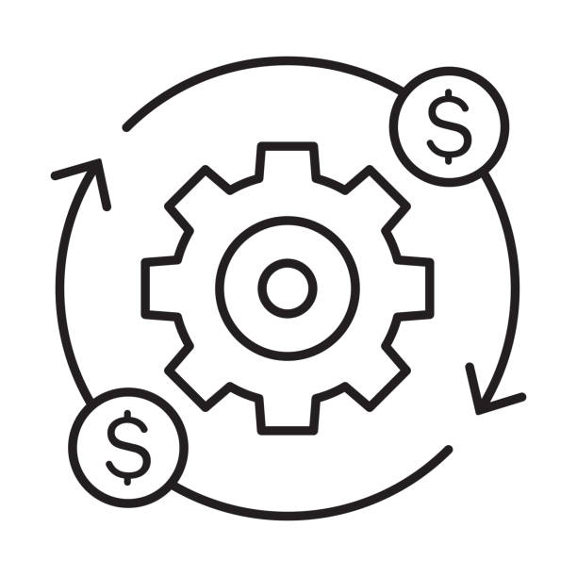
Problem Statement
The Federal Open Market Committee (FOMC) meeting notes contain critical policy perspectives that shape market expectations and economic forecasting. However, extracting sentiment such as "Hawkish," "Neutral," or "Dovish" from these documents requires sophisticated natural language processing techniques. Traditional approaches often fail to fully capture the nuance and complexity inherent in these notes.
There is a need for a robust system to analyse FOMC communications and accurately classify policy stances. Traditional models like LSTM often fail to capture the nuance and complexity of such texts, leading to unreliable analysis
Key Challenges
The intricate and subtle language used in central bank statements often contains implicit policy stances that are difficult for generic models to interpret effectively (Niţoi et al., 2023). This requires advanced transformer architectures and sophisticated contextual learning, as explored by Han (2023) and Yang et al. (2022).
This project aims to thoroughly evaluate multiple Natural Language Processing (NLP) models for the sentiment classification of FOMC communications and develop an optimised solution leveraging advanced neural architectures and fine-tuning methodologies.
Striving for a model that achieves high accuracy while maintaining computational efficiency is an ongoing challenge. Studies such as those by Devlin et al. (2019) and Hutter, Kotthoff, & Vanschoren (2019) have highlighted the trade-offs in achieving superior performance without overwhelming computational resources, emphasising the need for parameter optimisation and lightweight fine-tuning
Our objective is to develop a "best practice" NLP model that effectively balances reliability (accuracy, F1 Precision), interpretability, and computational efficiency for market analysis, in line with guidelines provided by research into best practices for NLP model development (Hirschberg & Manning 2015)
Sources: Hirschberg & Manning (2015); Niţoi, Stanciu & Borlea (2023); Han (2023); Devlin et al. (2019); Hutter, Kotthoff & Vanschoren (2019)
Presenter: Zhenhua Liu (z5433153)
Method/s
Results
Conclusion
Motivation
Problem Statement
Literature
Data Exploration

Slide 4
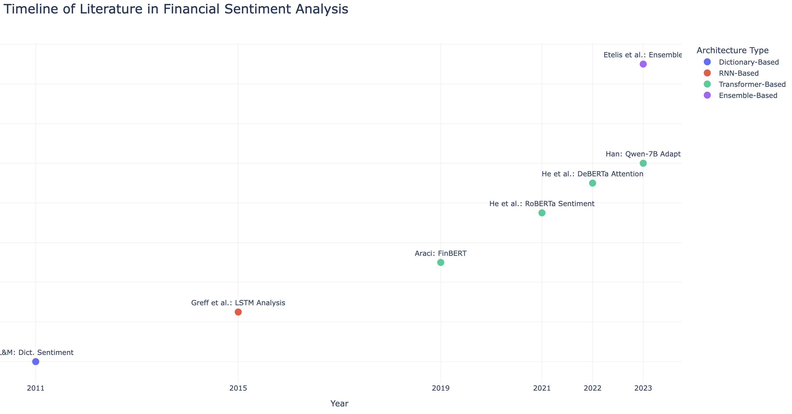
Literature Review: Overall
The literature review is presented through a chronological exploration of key advancements in financial sentiment analysis, highlighting the progression from early dictionary-based approaches to modern transformer-based and ensembling methods, showcasing the evolution of NLP techniques in capturing financial text nuance
Presenter: Nigel Li (z5320405)
Method/s
Results
Conclusion
Motivation
Problem Statement
Literature
Data Exploration

Slide 5
Literature Review
Loughran and McDonald (2011) developed a dictionary-based sentiment analysis for financial texts, which effectively addressed domain-specific sentiment but lacked contextual understanding and flexibility.
Did: Created dictionary-based financial sentiment analysis.
Limitation: Lacked context-awareness; struggled with nuances.
Presenter: Nigel Li (z5320405)
Method/s
Results
Conclusion
Motivation
Problem Statement
Literature
Data Exploration

Slide 6
Literature Review
Greff et al. (2015) introduces LSTMs to capture sequential dependencies in financial text, significantly improving upon traditional models, though computational complexity and long training times were key limitations.
Did: Utilised LSTMs to effectively model sequential dependencies in financial text.
Limitation: High computational complexity and long training times due to LSTM architecture.
Presenter: Nigel Li (z5320405)
Method/s
Results
Conclusion
Motivation
Problem Statement
Literature
Data Exploration

Slide 7
Literature Review
Transformer-based models, like BERT and its variants, have revolutionized financial sentiment analysis by significantly enhancing contextual understanding and capturing language nuances, but face challenges with computational demands and specialized domain adaptation
Did: Adapted transformer architectures, with better comprehension & overall accuracy.
Limitation: Demanding in computational power, making it resource-heavy for financial analysis.
For example, for 10 combinations of hyperparam searching, it took 25 hours to run on a 3080RTX (for deberta)!
Presenter: Nigel Li (z5320405)
Method/s
Results
Conclusion
Motivation
Problem Statement
Literature
Data Exploration

Slide 8
Literature Review
Etelis et al. (2023) demonstrated that ensemble stacking, incorporating diverse NLP model types, improves sentiment analysis performance beyond individual transformer models.
Did: Used a Hierarchical Ensemble Construction (HEC) algorithm with diverse NLP models, achieving a mean accuracy of 90% + across eight sentiment analysis datasets. → Establish benefit of potential stacking
Limitation: Increased complexity and computational demands compared to using a single transformer model, requiring up to 75 base-learners in evaluation.
Presenter: Nigel Li (z5320405)
Method/s
Results
Conclusion
Motivation
Problem Statement
Literature
Data Exploration

Slide 9
Literature Review
Etelis et al. (2023) demonstrated that ensemble stacking, incorporating diverse NLP model types, improves sentiment analysis performance beyond individual transformer models.
Note that the HEC algorithm is more for models with a hierarchical model structure with each model learning an element from the data, and outputs fed as inputs to higher-level models
Did: Used a Hierarchical Ensemble Construction (HEC) algorithm with diverse NLP models, achieving a mean accuracy of 90% + across eight sentiment analysis datasets. → Establish benefit of potential stacking
Limitation: Increased complexity and computational demands compared to using a single transformer model, requiring up to 75 base-learners in evaluation.
Presenter: Nigel Li (z5320405)
Method/s
Results
Conclusion
Motivation
Problem Statement
Literature
Data Exploration

Slide 10
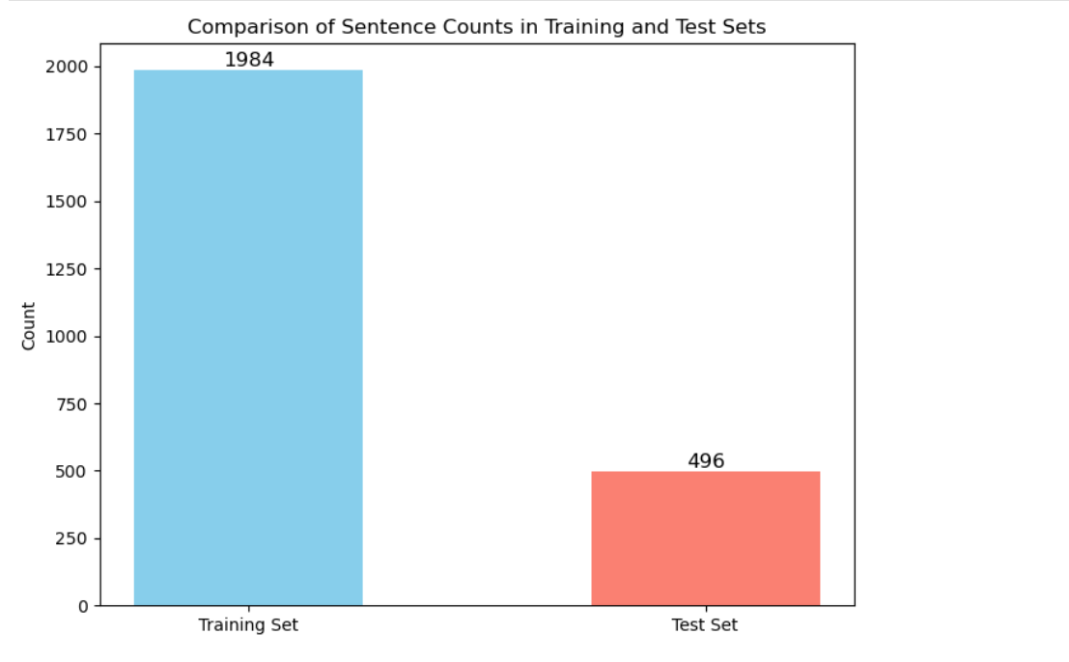
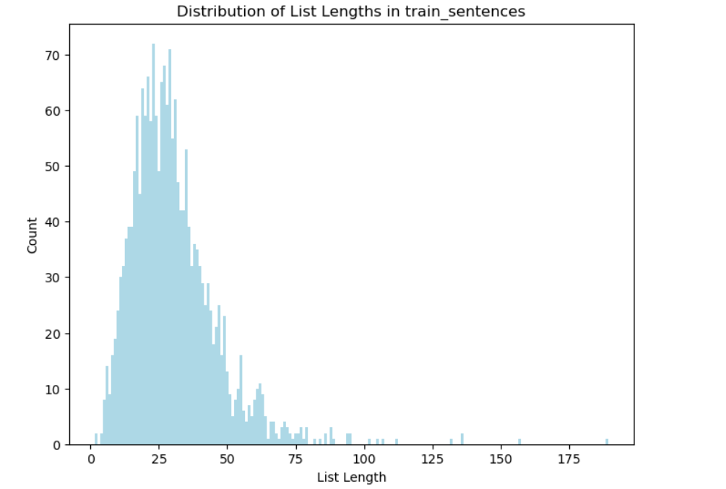
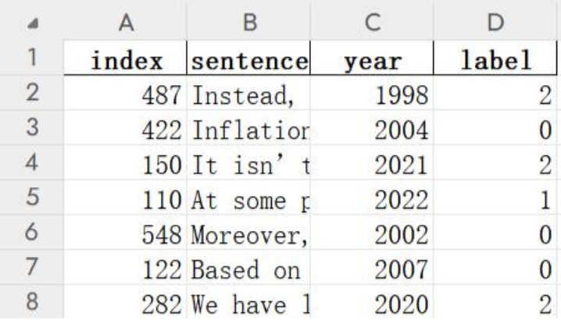
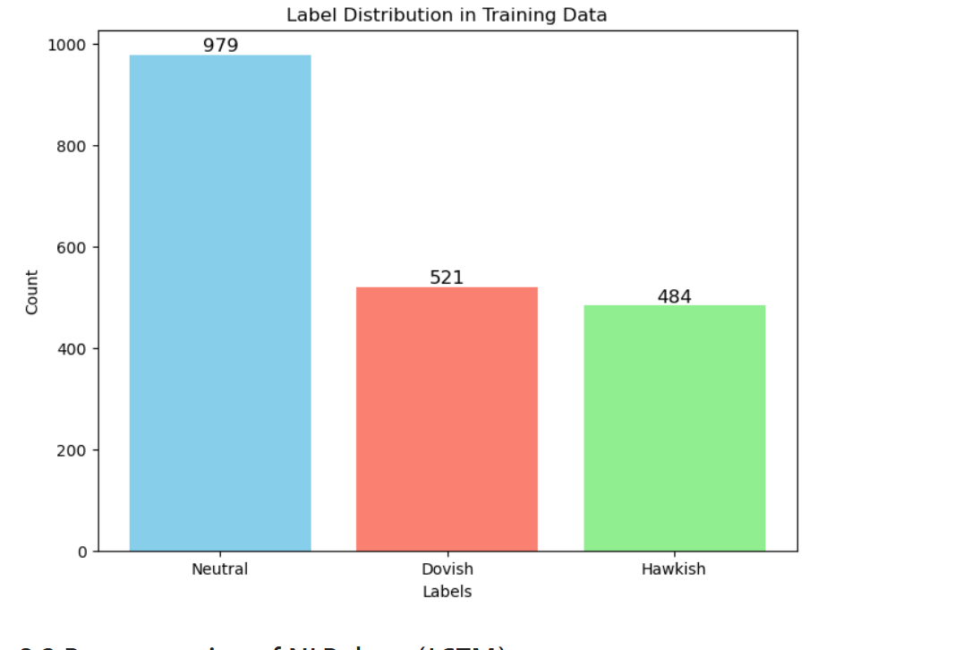
Dataset & Data Exploration
Dataset from the Financial Services Innovation Lab of Georgia Tech, specifically the FOMC dataset titled 'Trillion Dollar Words: A New Financial Dataset, Task & Market Analysis,' presented at ACL 2023. The team decided to use the "78516" dataset split due to its balance between representativeness and computational feasibility.
Data Split
80/20 Split:
The dataset was split into 80% for training (1,984 samples) and 20% for testing (496 samples), ensuring a standard division for robust training and generalisable model evaluation.
Nature of Data
Label Distribution:
Neutral: 979 samples
Dovish: 521 samples
Hawkish: 484 samples
The distribution of list lengths in the training set shows that most lists have fewer than 50 tokens, with a peak around 20-30 tokens. This information is critical for the model to understand the average sentence length, which helps in configuring the appropriate model architecture and parameter settings
Presenter: Ying Bi (z5444398)
Method/s
Results
Conclusion
Motivation
Problem Statement
Literature
Data Exploration
Notes:
Data split - we can cut; just mention 80/20 split for our training

Slide 11
Data Pre-processing
Text Data
Word2Vec (LSTM)
Tokenization (BERT)
E.g. Our mandate, sorry, is price inflation.
E.g. Our mandate, sorry, is price inflation.
Sentences to word lists
Remove case, punctuation
Pretrained tokenizer
Input ID
['our', 'mandate', 'sorry', 'is', 'price', 'inflation']
[ 101, 2256, 11405, 1010, 3374, 1010, 2003, 3976, 14200, 1012, 102, …… , 0]
Convert word to vector
vector size = 100
'Inflation'
[ 0.05 0.01 ….. -0.58 0.32 0.68 1.29 -0.27 ]
Maximum length of sentence
Dimension of vector: 100
Convert sentence to list
Set the maximum number of characters to fill the empty field with a vector of zero.
Padding
[CLS]
comma
[SEP]
Our mandate, sorry, is price inflation.
…
…
…
…
…
0 [[0.07637715, 0.00684211, -0.3023...
1 [[0.04294358, -0.0225435, -0.1720...
2 [[0.07670072, -0.027039701, -0.38...
3 [[0.018912664, -0.010538941, -0.14...
4 [[0.07670072, -0.027039701,, -0.38...
‘our’
Presenter: Ying Bi (z5444398)
Method/s
Results
Conclusion
Motivation
Problem Statement
Literature
Data Exploration

Slide 12
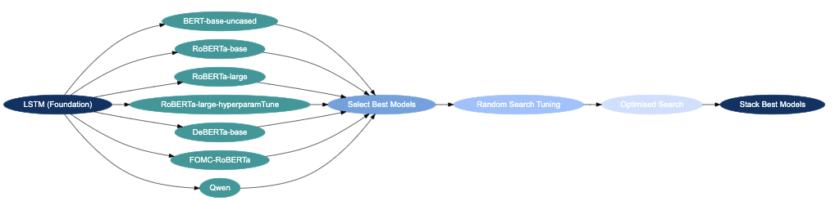
Method(s)
Used LSTM (Long Short-Term Memory) model as the foundational model to establish a baseline for sentiment analysis
Exploration of various Transformer-based models to build upon the baseline
Selection of best models by metrics of {F1, Precision, Accuracy}
1. Random Search Tuning
Stacking Phase
Chosen due to its proven effectiveness in handling sequential data, particularly for natural language processing tasks & bc. Learnt in course
2. Optimised Search
Presenter:
Ying Bi (z5444398)
Tong Zhang (z5542524)
Zhenhua Liu (z5433153)
Motivation
Problem Statement
Literature
Data Exploration
Method/s
Results
Conclusion

Slide 13
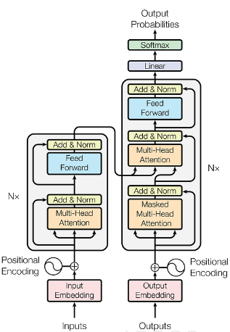
Method(s)
Pre-trained BERTs
Cat | 80%
Man | 2%
Toy | 30%
I
have
a
____
Pre-trained Bert models
BERT
BERT
RoBERTa
DeBERTa
I
have
a
cat[mask]
Dovish | 20%
Hawkish | 80%
Neutral | 50%
Hawkish
Fine-Tuning for FOMC Sentiment
Pre-trained BERT
[CLS] our mandate sorry is price inflation
Presenter: Ying Bi (z5444398)
Method/s
Results
Conclusion
Motivation
Problem Statement
Literature
Data Exploration

Slide 14
Method(s)
Used LSTM (Long Short-Term Memory) model as the foundational model to establish a baseline for sentiment analysis
Exploration of various Transformer-based models to build upon the baseline
Selection of best models by metrics of {F1, Precision, Accuracy}
1. Random Search Tuning
Stacking Phase
Chosen due to its proven effectiveness in handling sequential data, particularly for natural language processing tasks & bc. Learnt in course
2. Optimised Search
Presenter:
Zhenhua Liu (z5433153)
Method/s
Results
Conclusion
Motivation
Problem Statement
Literature
Data Exploration

Slide 15
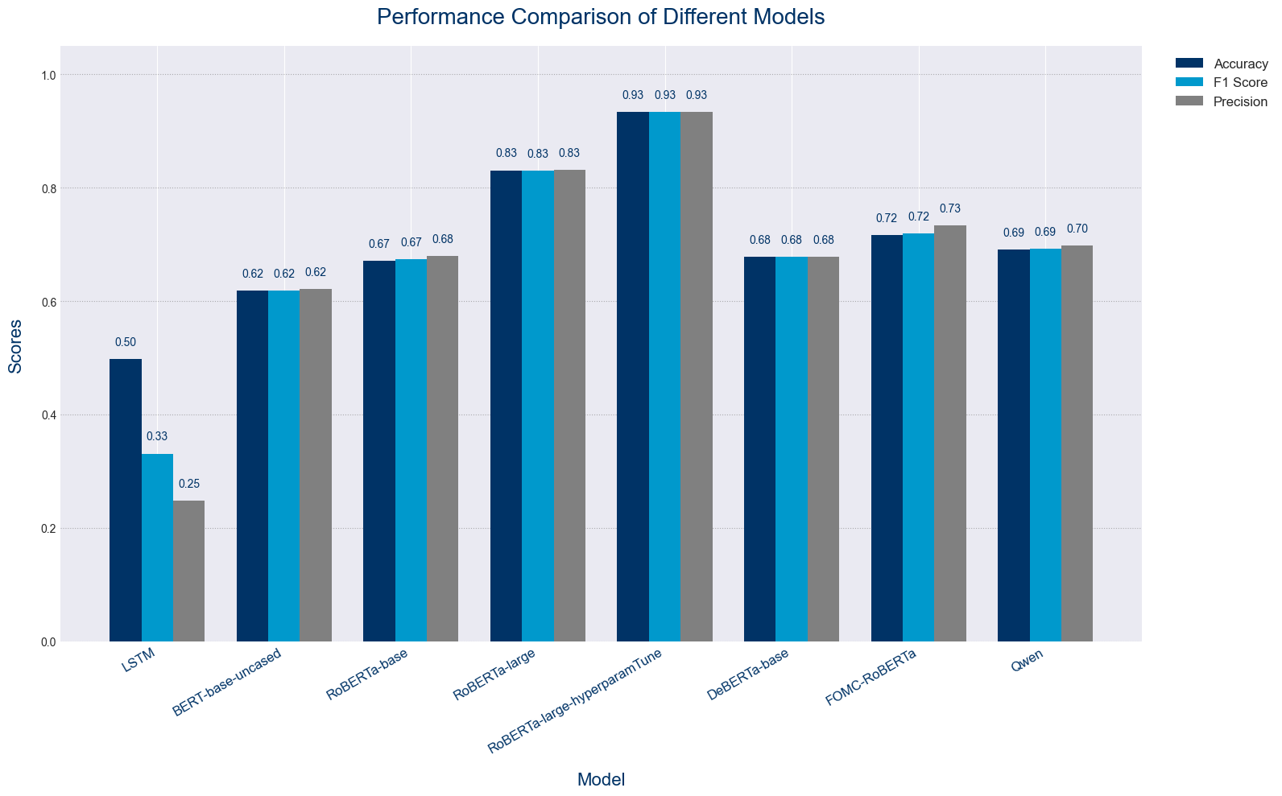
Results
Explainability of Performance
Performance Comparison of Models
Model | Architecture | Features
LSTM | Recurrent Neural Network | Handles sequential data but limited in capturing complex, long-range dependencies. Struggled with long-term dependencies and nuances information.
BERT-base-uncased | Transformer Encoder | Pre-trained model with bidirectional attention; useful for understanding context but limited in comparison to larger models. Struggled evidently, as it had fewer parameters and limited feature extraction capabilities
RoBERTa-base | Transformer Encoder | Improved training over BERT; optimized with larger batch sizes and dynamic masking.
RoBERTa-large | Transformer Encoder | Larger version of RoBERTa-base, he added layers and complexity allow RoBERTa-large to extract deeper features from the input text, giving it an edge in classification tasks where nuanced understanding is essential.
RoBERTa-large-hyperparamTune | Transformer Encoder | Fine-tuned version of RoBERTa-large with optimised hyperparameters, resulting in significantly enhanced performance.
DeBERTa-base | Transformer Encoder with Disentangled Attention | Enhanced handling of dependency between words; handles positional and content-based relationships separately.
FOMC-RoBERTa | Transformer Encoder (Domain-Specific) | Fine-tuned on FOMC-related texts, adapted for specific financial data context. Evidently had limited generalisation ability, and was likely overfit to its existing training data.
Qwen | Transformer Encoder | Performance was limited compared to larger, optimised models due to fewer parameters and general-purpose training.
Presenter: Zhenhua Liu z5433153
Method/s
Results
Conclusion
Motivation
Problem Statement
Literature
Data Exploration

Slide 16
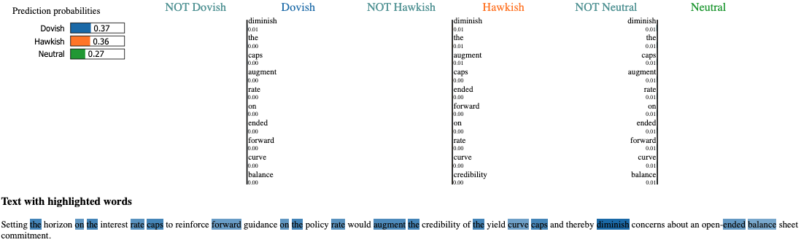

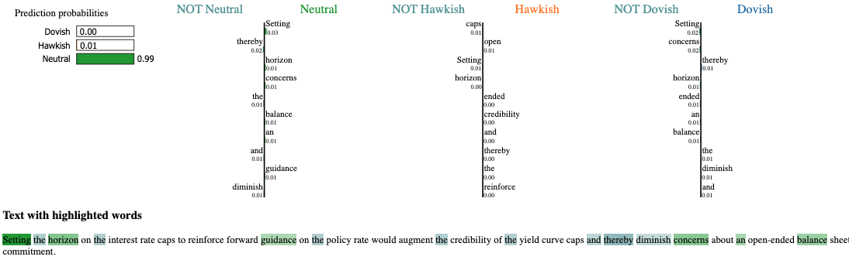


Results – Local Interpretable Model-agnostic Explanations
The fine-tuned RoBERTa-large outperforms LSTM due to its advanced contextual understanding and precision in capturing financial language nuances, highlighting key differences in prediction accuracy and interpretability
Explainability of Performance
RoBERTa-large-hyperparamTune shows high confidence in its classification (100% neutral), whereas LSTM exhibits uncertainty by spreading probabilities across different labels (neutral, dovish, hawkish).
The LSTM model highlights overlapping keywords across multiple labels, indicating weaker feature differentiation. In contrast, RoBERTa-large-hyperparamTune highlights specific words with minimal overlap, suggesting better feature extraction and contextual understanding.
RoBERTa-large-hyperparamTune demonstrates stronger contextual understanding, leading to more decisive classifications, whereas LSTM relies more on individual word-level importance, resulting in less precise predictions
Presenter: Nigel Li (z5320405)
Motivation
Problem Statement
Literature
Data Exploration
Method/s
Results
Conclusion

Slide 17
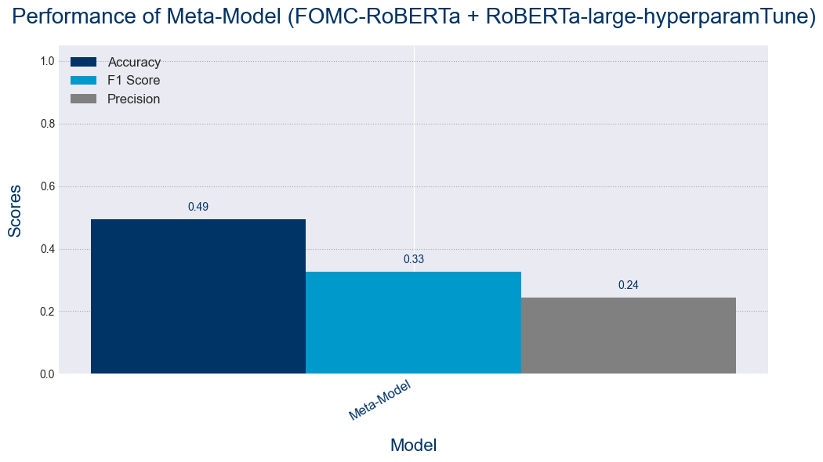
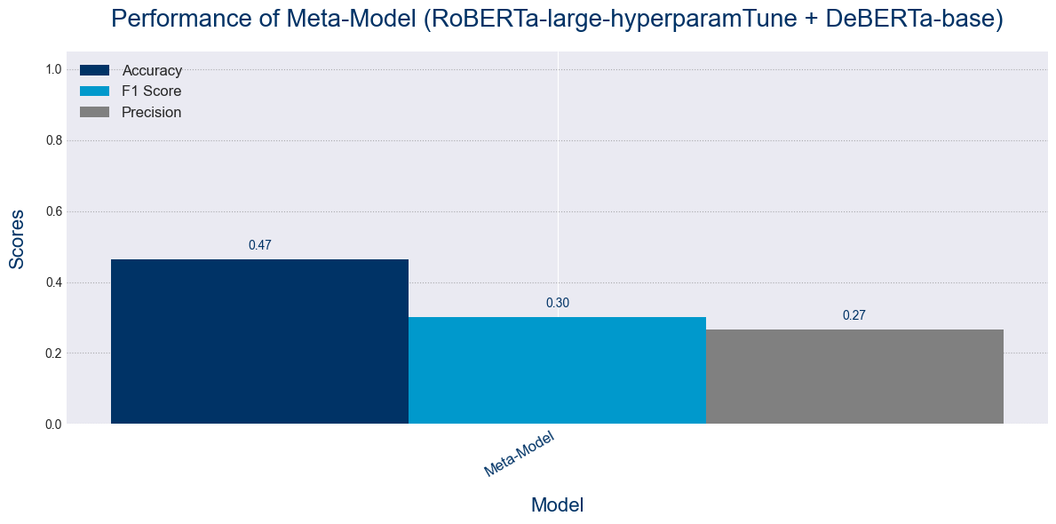
Results – Stacking Result
Etelis et al. (2023) demonstrated that ensemble stacking, incorporating diverse NLP model types, improves sentiment analysis performance beyond individual transformer models. Results did not appear to promising...
Stacking of FOMC-ROBERTa & ROBERTa-large-hyperaparamTune
Stacking of ROBERTa-large-hyperparamTune & DeBERTa
Why?
Advanced transformer techniques with a general large model, combined with disentangled attention & field expertise
Potentially Complementary
Strong individual performance, with DeBERTa with the ability to generalise, while RoBERTa’s larger pre-training give it the ability to understand large constructs. Likewise, with FOMC-RoBERTa
The stacking of FOMC-RoBERTa with RoBERTa-large, as well as DeBERTa with RoBERTa-large, has not yielded strong results primarily due to limited complementary strengths between the models, where overfitting in domain-specific fine-tuned models (like FOMC-RoBERTa) and insufficient differentiation in feature extraction from similar Transformer structures reduce the diversity and generalisation advantages typically sought in stacked models.
Presenter: Tong Zhang
Motivation
Problem Statement
Literature
Data Exploration
Method/s
Results
Conclusion

Slide 18

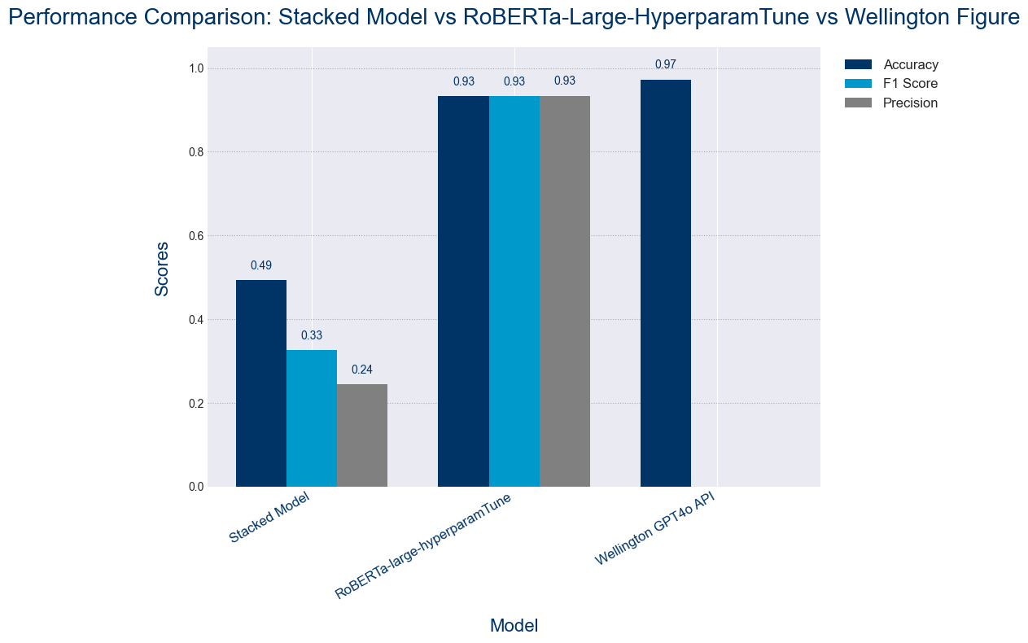


Discussion
A wide range of transformer-based models were evaluated with LSTM as the base model, including BERT, RoBERTa, DeBERTa and others, to assess their ability to classify sentiment in FOMC texts. A gradual iterative process did lead us to eventually reach almost-industry levels of accuracy….
Key Challenges
Fine Tuning Difficulties
Varied effectiveness for domain-specific texts (e.g., FOMC).
Hyperparameter selection was challenging; risk of overfitting (e.g., FOMC-RoBERTa).
Comparison with Industry
Computational Expensiveness
Training RoBERTa-large (25 hours on 3070 RTX GPU for hyperparam tuning of 10 combinations).
High resource demand limits scalability.
So is gradually reaching industry standards
Performance Trade-offs with Stacking Models
Limited gains from stacking (RoBERTa-large + FOMC-RoBERTa).
Increased model variance; high sensitivity to training data.
Computationally intensive without consistent performance benefits.
Source: Wellington Management Quantitative Investment Group (Julia Klevak, Research Scientist)
Presenter: Nigel Li (z5320405)
Method/s
Results
Conclusion
Motivation
Problem Statement
Literature
Data Exploration

Slide 19



Conclusion
Consolidation of Insights: Evaluating Model Efficiency, Optimal Approaches, and Future-Ready Solutions for Sentiment Analysis…
Stacking Performance
Best Practice Identified
Future Applications
Stacking transformer models did not outperform individual fine-tuned models.
Individual model (RoBERTa-large-hyperparamTune) showed better consistency.
Single, well-tuned model (RoBERTa-large-hyperparamTune) proved optimal for this certain case. Although industry trends does appear to currently utilise GPT-4o, which is another transformer architecture
Ensemble techniques added complexity without consistent gains.
Exploring larger and more sophisticated models like GPT-4-tuned versions or experimenting with transformer models that have demonstrated high success rates across other domains could help surpass the current 93% accuracy threshold
Incorporating additional financial and economic datasets, including sentiment data, textual context, and structured numerical information, might enhance model precision beyond current limitations
Presenter: Nigel Li (z5320405)
Method/s
Results
Conclusion
Motivation
Problem Statement
Literature
Data Exploration

Slide 20

Appendices

Slide 21
Appendix Network
Introduction | 1
Set-up
Motivation | 2
Problem Statement | 3
Literature Review
Overall | 4
Literature Review: Dictionaries | 5
Literature Review: LSTM | 6
Literature Review: Transformers | 7
Literature Review: Ensemble | 8
Dataset & Exploration | 9
Methods | 11
Results
Overview | 12
Results - LIME | 13
Results - Stacking | 14
Discussion | 15
Conclusion | 16
CBA Sustainability in the News | 32
Appendix Overview | 17
Literature Review – Datasets used | 18
LSTM Architecture | 19
RoBERTa Architecture | 20
DeBERTa Architecture | 21
Qwen Architecture | 22
Training with RTX3080 | 23
Hyperparameter Tuning Rationale | 24
Fine-Tuning process for RoBERTa-Large | 25
Fine-Tuning process for DeBERTa-Large | 26
Stacking Considerations | 27
Bibliography | 28
Presentation
Presentation
Appendix
21

Slide 22
Literature Review – Datasets Used
Etelis et al. (2023) demonstrated that ensemble stacking, incorporating diverse NLP model types, improves sentiment analysis performance beyond individual transformer models.
The study by Etelis et al. used the following eight canonical sentiment analysis datasets:
Yelp Dataset (YLP): Business reviews.
IMDB Dataset: Movie reviews.
Stanford Sentiment Treebank (SST2): Movie reviews.
Tweet Sentiment Extraction (TSE): Social media posts.
Twitter US Airline Sentiment (TUF): Social media posts related to airlines.
SemEval-2016 TweetEval (TE): Tweets classified for sentiment analysis.
Rotten Tomato (RTM): Movie reviews.
Customer Reviews (CR): Product reviews
Did: Used a Hierarchical Ensemble Construction (HEC) algorithm with diverse NLP models, achieving a mean accuracy of 90% + across eight sentiment analysis datasets.
Bad: Increased complexity and computational demands compared to using a single transformer model, requiring up to 75 base-learners in evaluation.
Motivation
Problem Statement
Literature
Data Exploration
Method/s
Results
Conclusion

Slide 23
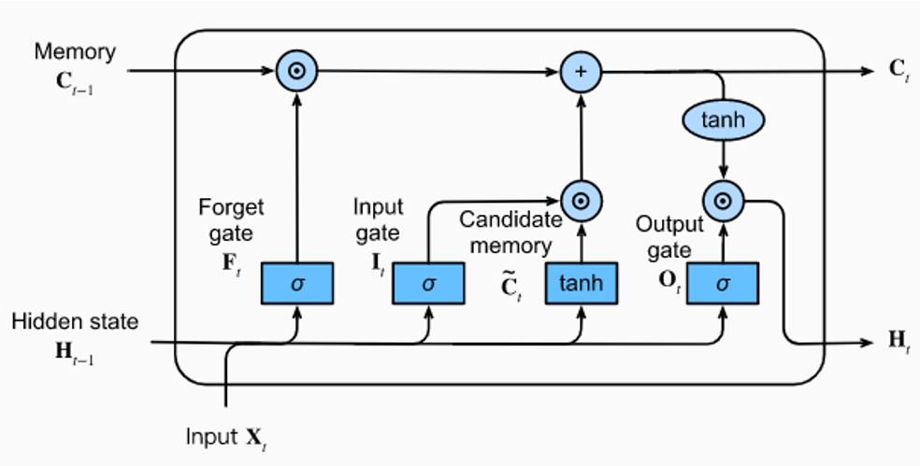
LSTM Architecture
LSTM was utilised as a baseline model for our NLP analysis

Slide 24
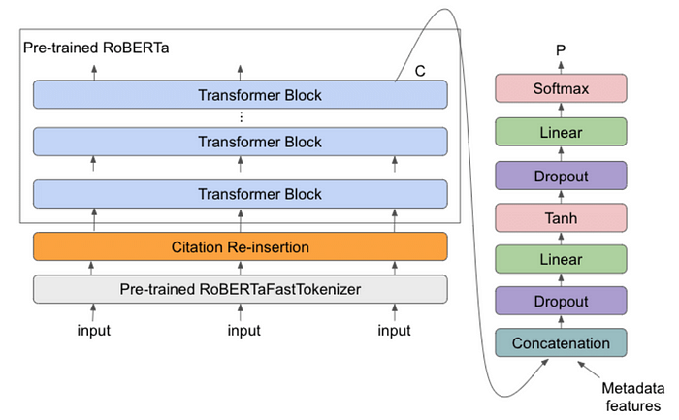
RoBERTa Architecture
RoBERTa proved to be the most optimal model

Slide 25
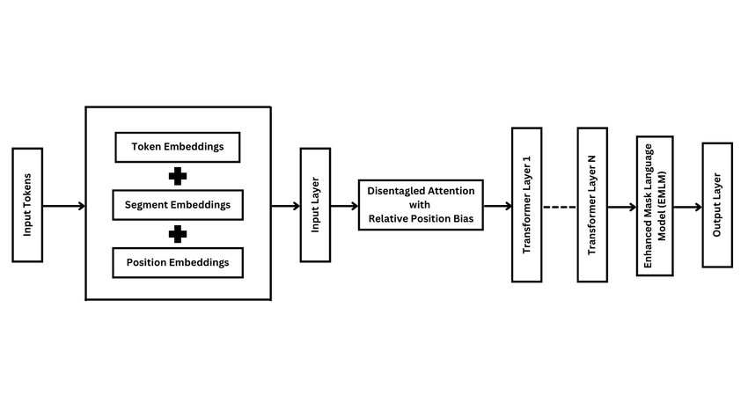
DeBERTa Architecture
DeBERTa was initially promising, but did appear to have its issues…
Disentangled Attention: DeBERTa separates (or “disentangles”) the content of words from their positions. It does this by encoding each word's content and its positional information independently, allowing the model to pay attention to both aspects more effectively. This improves the model's ability to comprehend relationships between words in context.
Relative Position Embedding: DeBERTa’s attention mechanism includes relative position embeddings rather than absolute ones, which allows it to capture long-range dependencies more effectively than traditional transformers.
Improved Masked Language Model: DeBERTa enhances the masked language modeling process, learning better contextual representations that help with nuanced understanding, considering {relative position, content} in its embeddings

Slide 26
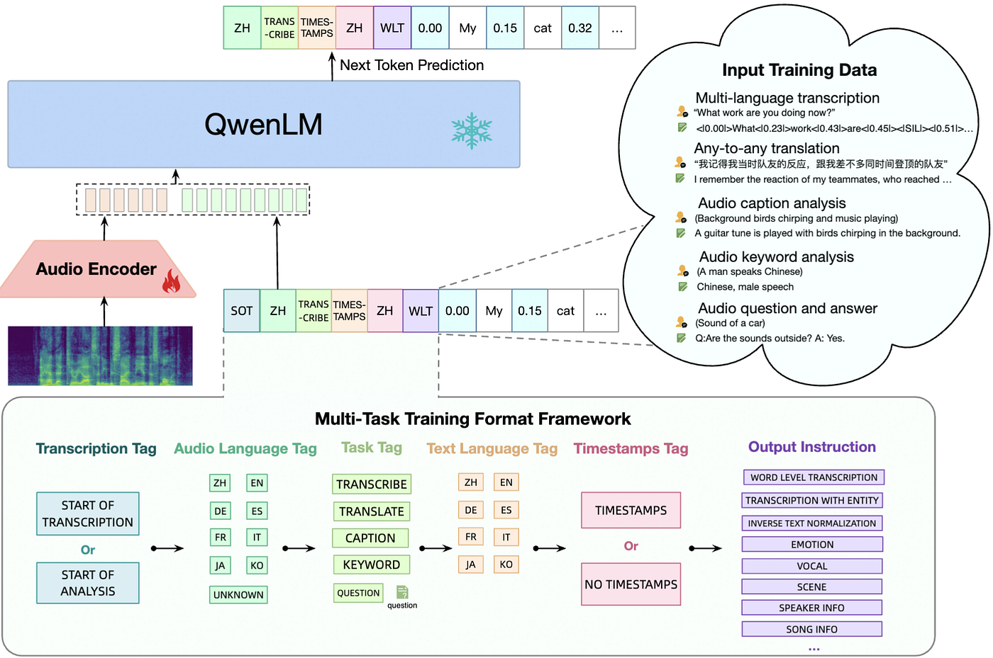
Qwen Architecture
Qwen was evaluated as one of the potential architectures

Slide 27
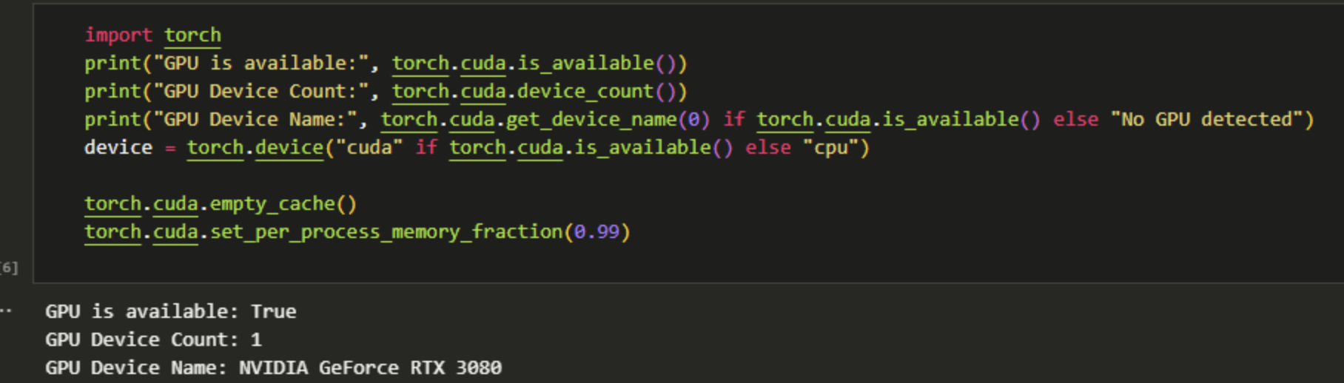
Training with RTX 3080 w. CUDA
Demonstrating computational expensiveness

Slide 28
Hyperparameter Tuning Rationale
The process of fine-tuning involved random search, then optimised search with more optimised parameters …
Hyperparameter | Description | Impact on Model
Learning Rate | Controls how much to change the model in response to the estimated error each time model weights are updated. | A higher learning rate can speed up training but risks overshooting the optimal solution. A lower rate provides stable training but can be very slow.
Batch Size | Number of training examples utilized in one iteration. | Larger batch sizes offer more stable gradients but require more memory. Smaller batches may lead to better generalization but noisier training.
Epochs | Number of times the entire dataset is passed forward and backward through the model. | More epochs allow the model to learn better, but too many can cause overfitting.
Max Length | Maximum number of tokens considered from the input text. | A larger maximum length allows for longer context, which improves understanding but increases computation and memory usage.
Hidden Dropout | Dropout applied to fully connected layers during training to prevent overfitting. | Higher dropout values reduce overfitting risk but can slow down convergence. Too low a value might lead to overfitting.
Attention Dropout | Dropout applied to the attention mechanism to regularize and prevent overfitting. | Helps the model to not rely too heavily on particular attention weights, promoting robustness. However, too much dropout can hamper learning.

Slide 29
Fine Tuning Process for RoBERTa-Large
The process of fine-tuning involved random search, then optimised search with more optimised parameters …
Random Search
Bayesian Optimisation (structured like a greedy-epsilon policy)
Builds an iteratively probabilistic model that maps hyperparameters, after the random search we set ranges
More efficient as it explored promising hyperparameter values
Less computationally expensive than grid search
Trial | Learning Rate | Batch Size | Epochs | Max Length | Hidden Dropout | Attention Dropout | Train Accuracy | Test Accuracy | Train F1 Score | Test F1 Score
1 | 0.00001 | 16 | 10 | 50 | 0.1 | 0.1 | 0.997479839 | 0.699596774 | 0.997481661 | 0.709971699
2 | 0.00001 | 16 | 10 | 75 | 0.1 | 0.1 | 0.991935484 | 0.703629032 | 0.991946733 | 0.725743208
3 | 0.00002 | 16 | 10 | 50 | 0.1 | 0.1 | 0.993951613 | 0.701612903 | 0.993949791 | 0.721192025
4 | 0.00002 | 16 | 10 | 75 | 0.1 | 0.1 | 0.996975806 | 0.697580645 | 0.996976208 | 0.724541632
5 | 0.00003 | 16 | 10 | 50 | 0.1 | 0.1 | 0.996975806 | 0.70766129 | 0.996978383 | 0.708563043
6 | 0.00003 | 16 | 10 | 75 | 0.1 | 0.1 | 0.996975806 | 0.693548387 | 0.996977713 | 0.70122742
7 | 0.00001 | 16 | 10 | 50 | 0.3 | 0.1 | 0.993447581 | 0.693548387 | 0.993445341 | 0.709621421
8 | 0.00001 | 16 | 10 | 75 | 0.3 | 0.1 | 0.996471774 | 0.717741935 | 0.996471601 | 0.720427922
9 | 0.00002 | 16 | 10 | 50 | 0.3 | 0.1 | 0.994959677 | 0.675403226 | 0.994954989 | 0.683569682
10 | 0.00002 | 16 | 10 | 75 | 0.3 | 0.1 | 0.997479839 | 0.721774194 | 0.997481601 | 0.720499973
11 | 0.00003 | 16 | 10 | 50 | 0.3 | 0.1 | 0.992943548 | 0.66733871 | 0.992946063 | 0.693947225
12 | 0.00003 | 16 | 10 | 75 | 0.3 | 0.1 | 0.982358871 | 0.697580645 | 0.982331028 | 0.705469479
13 | 0.00001 | 16 | 15 | 50 | 0.1 | 0.1 | 0.996471774 | 0.697580645 | 0.996469958 | 0.713963077
14 | 0.00001 | 16 | 15 | 75 | 0.1 | 0.1 | 0.997479839 | 0.695564516 | 0.997480755 | 0.709306904
15 | 0.00002 | 16 | 15 | 50 | 0.1 | 0.1 | 0.987903226 | 0.695564516 | 0.987921546 | 0.715365944
16 | 0.00002 | 16 | 15 | 75 | 0.1 | 0.1 | 0.996975806 | 0.701612903 | 0.996976571 | 0.710024361
17 | 0.00003 | 16 | 15 | 50 | 0.1 | 0.1 | 0.98891129 | 0.685483871 | 0.988961532 | 0.712546618
18 | 0.00003 | 16 | 15 | 75 | 0.1 | 0.1 | 0.997479839 | 0.675403226 | 0.997480693 | 0.694066736
19 | 0.00001 | 16 | 15 | 50 | 0.3 | 0.1 | 0.996975806 | 0.70766129 | 0.996978197 | 0.712880709
20 | 0.00001 | 16 | 15 | 75 | 0.3 | 0.1 | 0.995967742 | 0.695564516 | 0.995969855 | 0.704778857
21 | 0.00002 | 16 | 15 | 50 | 0.3 | 0.1 | 0.997479839 | 0.717741935 | 0.997478847 | 0.721955313
22 | 0.00002 | 16 | 15 | 75 | 0.3 | 0.1 | 0.501008065 | 0.463709677 | 0.334454007 | 0.311728884
23 | 0.00003 | 16 | 15 | 50 | 0.3 | 0.1 | 0.996975806 | 0.689516129 | 0.996973986 | 0.704353893
24 | 0.00003 | 16 | 15 | 75 | 0.3 | 0.1 | 0.968245968 | 0.66733871 | 0.967989039 | 0.702222273
25 | 0.00001 | 16 | 10 | 50 | 0.1 | 0.3 | 0.99546371 | 0.699596774 | 0.995462115 | 0.707102133
26 | 0.00001 | 16 | 10 | 75 | 0.1 | 0.3 | 0.99546371 | 0.691532258 | 0.995464162 | 0.700391886
27 | 0.00002 | 16 | 10 | 50 | 0.1 | 0.3 | 0.996975806 | 0.701612903 | 0.996978647 | 0.704910236
28 | 0.00002 | 16 | 10 | 75 | 0.1 | 0.3 | 0.996975806 | 0.72983871 | 0.996976998 | 0.732300639
29 | 0.00003 | 16 | 10 | 50 | 0.1 | 0.3 | 0.992439516 | 0.695564516 | 0.992447592 | 0.712676856
30 | 0.00003 | 16 | 10 | 75 | 0.1 | 0.3 | 0.997479839 | 0.713709677 | 0.997478847 | 0.722853904
31 | 0.00001 | 16 | 10 | 50 | 0.3 | 0.3 | 0.501008065 | 0.463709677 | 0.334454007 | 0.342103438
32 | 0.00001 | 16 | 10 | 75 | 0.3 | 0.3 | 0.993447581 | 0.719758065 | 0.993441503 | 0.724020517
33 | 0.00002 | 16 | 10 | 50 | 0.3 | 0.3 | 0.997479839 | 0.721774194 | 0.997481661 | 0.721724738
34 | 0.00002 | 16 | 10 | 75 | 0.3 | 0.3 | 0.994959677 | 0.697580645 | 0.994957114 | 0.713229674
35 | 0.00003 | 16 | 10 | 50 | 0.3 | 0.3 | 0.501008065 | 0.463709677 | 0.334454007 | 0.602764763
36 | 0.00003 | 16 | 10 | 75 | 0.3 | 0.3 | 0.995967742 | 0.691532258 | 0.995969207 | 0.698922677
37 | 0.00001 | 16 | 15 | 50 | 0.1 | 0.3 | 0.997479839 | 0.695564516 | 0.997478913 | 0.704080766
38 | 0.00001 | 16 | 15 | 75 | 0.1 | 0.3 | 0.996975806 | 0.699596774 | 0.996976805 | 0.717319432
39 | 0.00002 | 16 | 15 | 50 | 0.1 | 0.3 | 0.990927419 | 0.709677419 | 0.99091089 | 0.737857247
40 | 0.00002 | 16 | 15 | 75 | 0.1 | 0.3 | 0.997479839 | 0.697580645 | 0.997481661 | 0.714125863
41 | 0.00003 | 16 | 15 | 50 | 0.1 | 0.3 | 0.995967742 | 0.691532258 | 0.995966852 | 0.713327285
42 | 0.00003 | 16 | 15 | 75 | 0.1 | 0.3 | 0.995967742 | 0.715725806 | 0.995968769 | 0.726517103
43 | 0.00001 | 16 | 15 | 50 | 0.3 | 0.3 | 0.995967742 | 0.675403226 | 0.995969674 | 0.691591328
44 | 0.00001 | 16 | 15 | 75 | 0.3 | 0.3 | 0.996975806 | 0.737903226 | 0.996976208 | 0.743978736
45 | 0.00002 | 16 | 15 | 50 | 0.3 | 0.3 | 0.995967742 | 0.677419355 | 0.995966403 | 0.714873911
46 | 0.00002 | 16 | 15 | 75 | 0.3 | 0.3 | 0.996471774 | 0.693548387 | 0.996475524 | 0.733600156
47 | 0.00003 | 16 | 15 | 50 | 0.3 | 0.3 | 0.983366935 | 0.66733871 | 0.983324658 | 0.711026424
48 | 0.00003 | 16 | 15 | 75 | 0.3 | 0.3 | 0.501008065 | 0.463709677 | 0.334454007 | 0.293810539
Note, this random search process took 25 hours…

Slide 30
Fine Tuning Process for DeBERTa-Large
The process of fine-tuning involved random search, then optimised search with more optimised parameters …
Random Search
Post Bayesian Optimisation
Trial | Learning Rate | Batch Size | Epochs | Max Length | Hidden Dropout | Attention Dropout | Test Accuracy | Test F1 Score
1 | 1.00E-05 | 8 | 3 | 128 | 0.1 | 0.1 | 0.514112903 | 0.475532808
2 | 3.00E-05 | 8 | 5 | 128 | 0.2 | 0.2 | 0.737903226 | 0.738384111
3 | 2.00E-05 | 8 | 5 | 256 | 0.2 | 0.1 | 0.747983871 | 0.748117281
4 | 1.00E-05 | 8 | 3 | 128 | 0.2 | 0.1 | 0.752016129 | 0.750811226
5 | 1.00E-05 | 8 | 5 | 256 | 0.2 | 0.1 | 0.737903226 | 0.737606474
6 | 1.00E-05 | 16 | 3 | 256 | 0.2 | 0.1 | 0.731854839 | 0.732716836
7 | 1.00E-05 | 16 | 3 | 128 | 0.1 | 0.2 | 0.719758065 | 0.718901159
8 | 3.00E-05 | 8 | 3 | 256 | 0.1 | 0.2 | 0.745967742 | 0.745317183
9 | 1.00E-05 | 8 | 3 | 256 | 0.1 | 0.1 | 0.741935484 | 0.741859184
10 | 2.00E-05 | 8 | 3 | 256 | 0.1 | 0.1 | 0.733870968 | 0.734802007
Failed to generalise to other test sets
Note, this random search process took 26 hours…

Slide 31
Stacking Considerations
The process of stacking was initially proposed to help enhance and further the current outcomes…
Stacking Consideration | Description | Supporting Study | Application to Model Combinations
Model Complementarity | Combining models that capture different linguistic features enhances performance. | "Natural Language Inference with Transformer Ensembles and Explainability Techniques" | RoBERTa-large and DeBERTa have distinct architectures; stacking them can harness their unique strengths. Similarly, FOMC-RoBERTa (domain-specific) combined with RoBERTa-large (general-purpose) balances domain adaptation with general language understanding.
 |  | ArXiv
Stacking Architecture | The meta-learner should effectively integrate base model outputs. Logistic regression or shallow neural networks are commonly used. | "Optimizing Multi-Class Text Classification: A Diverse Stacking Ensemble Framework" | Utilizing a logistic regression meta-learner can effectively combine outputs from RoBERTa-large and DeBERTa, as well as FOMC-RoBERTa and RoBERTa-large, ensuring balanced integration of their predictions.
 |  | ArXiv
Avoiding Overfitting | Ensuring base models generalize well and their errors are uncorrelated is crucial. Cross-validation during stacking helps mitigate overfitting. | "Improving Academic Skills Assessment with NLP and Ensemble Learning" | Implementing cross-validation in stacking RoBERTa-large with DeBERTa, and FOMC-RoBERTa with RoBERTa-large, can reduce overfitting risks by ensuring the meta-learner is robust.
 |  | ArXiv

Slide 32
Bibliography
Araci, D., 2019. FinBERT: A Pretrained Language Model for Financial Communications. arXiv preprint arXiv:1908.10063. Available at: https://arxiv.org/abs/1908.10063.
Han, X., 2023. Qwen-7B: A 7-Billion-Parameter Transformer Model for Financial Sentiment Analysis. arXiv preprint arXiv:2308.10063. Available at: https://arxiv.org/abs/2308.10063.
He, P., Liu, X., Gao, J. and Chen, W., 2021. DeBERTa: Decoding-enhanced BERT with Disentangled Attention. arXiv preprint arXiv:2006.03654. Available at: https://arxiv.org/abs/2006.03654.
Howard, J. and Ruder, S., 2018. Universal Language Model Fine-Tuning for Text Classification. Proceedings of the 56th Annual Meeting of the Association for Computational Linguistics (Volume 1: Long Papers), pp.328-339. Available at: https://aclanthology.org/P18-1031/.
Krishnan, A., 2023. Optimizing Multi-Class Text Classification: A Diverse Stacking Ensemble Framework Utilizing Transformers. Big Data Mining and Analytics. Available at: https://arxiv.org/abs/2308.11519.
Liu, Y., Ott, M., Goyal, N., Du, J., Joshi, M., Chen, D., Levy, O., Lewis, M., Zettlemoyer, L. and Stoyanov, V., 2019. RoBERTa: A Robustly Optimized BERT Pretraining Approach. arXiv preprint arXiv:1907.11692. Available at: https://arxiv.org/abs/1907.11692.
Loughran, T. and McDonald, B., 2011. When is a Liability not a Liability? Textual Analysis, Dictionaries, and 10-Ks. The Journal of Finance, 66(1), pp.35-65. Available at: https://www.jstor.org/stable/29789771.
Luo, H. and Specia, L., 2024. From Understanding to Utilization: A Survey on Explainability for Large Language Models. arXiv preprint arXiv:2401.12874v2. Available at: https://arxiv.org/abs/2401.12874v2.
Perikos, I. and Souli, S., 2024. Natural Language Inference with Transformer Ensembles and Explainability Techniques. Electronics, 13(19), p.3876. Available at: https://www.mdpi.com/2079-9292/13/19/3876.
Peters, M.E., Neumann, M., Iyyer, M., Gardner, M., Clark, C., Lee, K. and Zettlemoyer, L., 2018. Deep Contextualized Word Representations. Proceedings of the 2018 Conference of the North American Chapter of the Association for Computational Linguistics: Human Language Technologies, Volume 1 (Long Papers), pp.2227-2237. Available at: https://aclanthology.org/N18-1202/.
Yang, X., Zhang, Y., Chen, D., Zhang, Y., Zhang, Y. and Wang, B., 2022. FinBERT: A Pretrained Language Model for Financial Text Mining. IEEE Access, 8, pp.171683-171698. Available at: https://ieeexplore.ieee.org/document/9206570.

