Slide 1
Probing dynamics of activation and repression

Slide 2
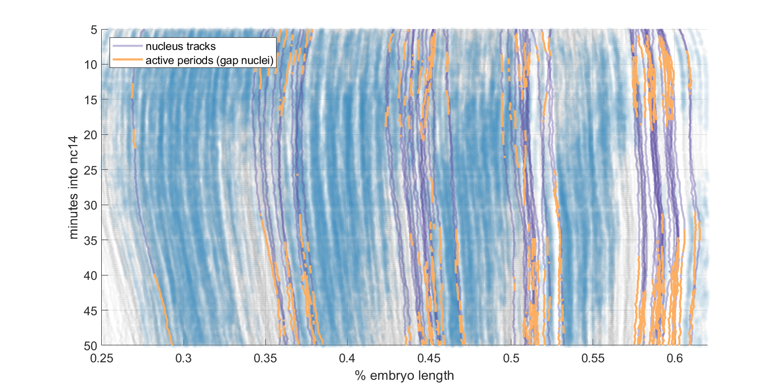
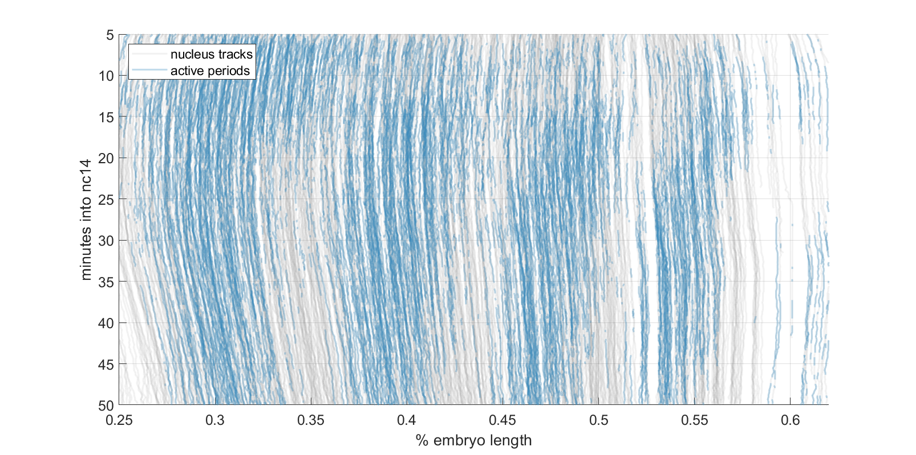
Repression in stripe flanks is reversible

Slide 3
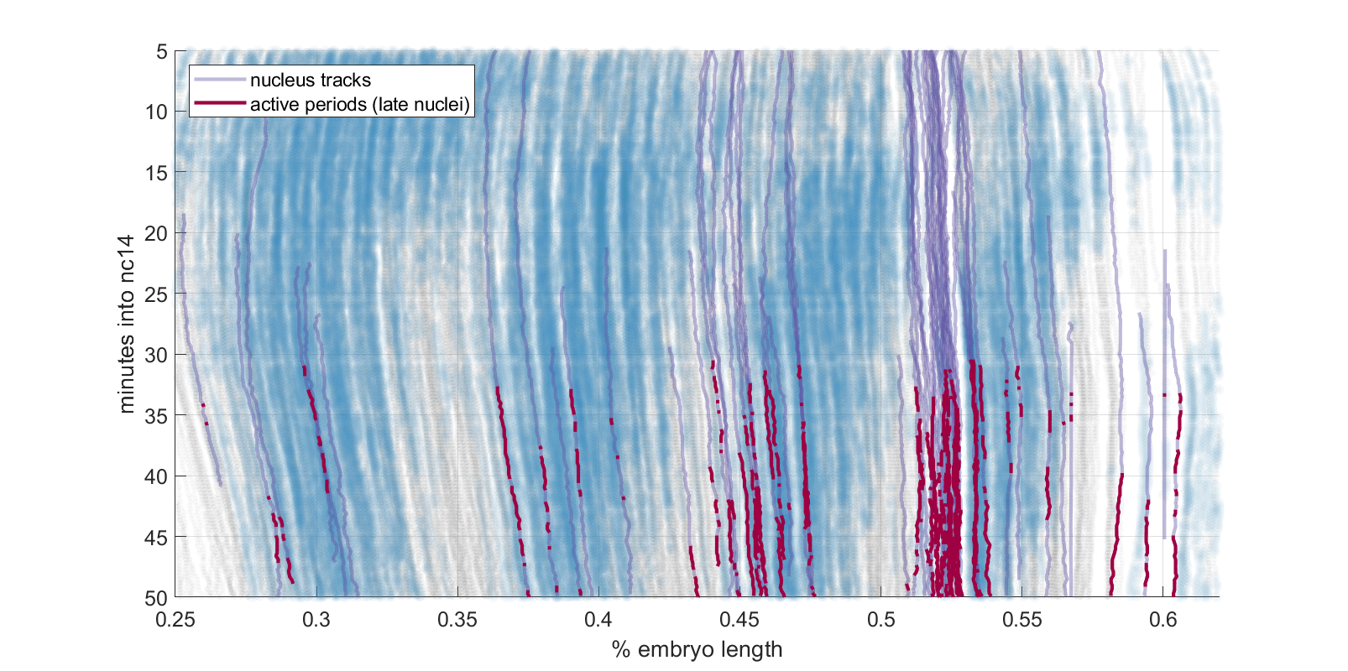
There is no fixed “activation window”

Slide 4
2 spot analyses

Slide 5
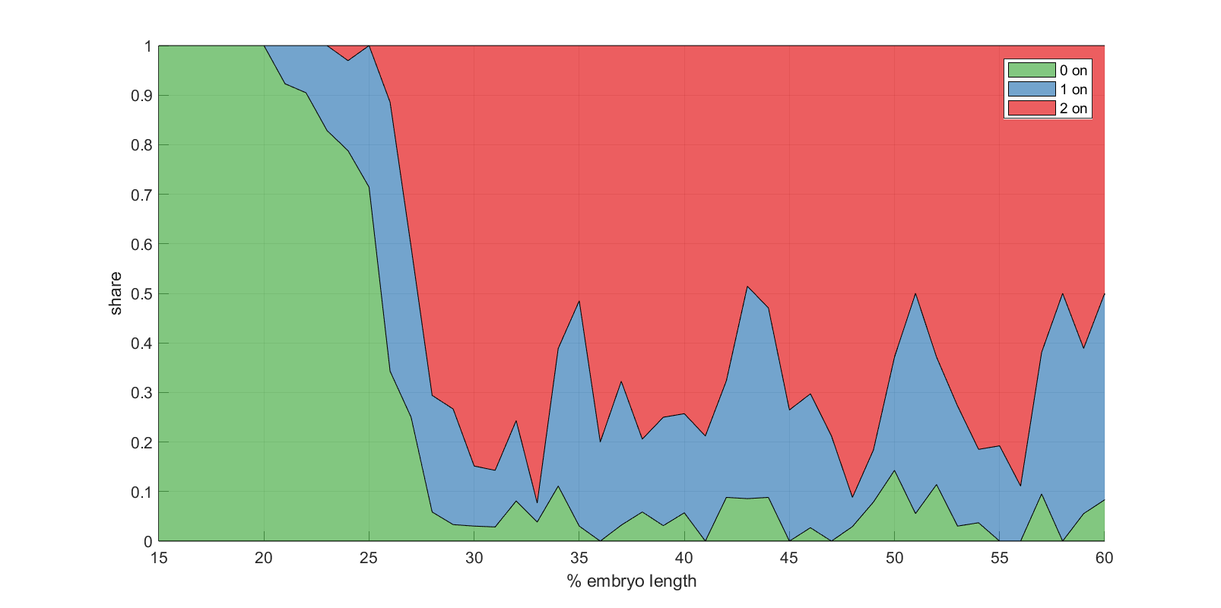
Number of active loci tracks with stripe location

Slide 6
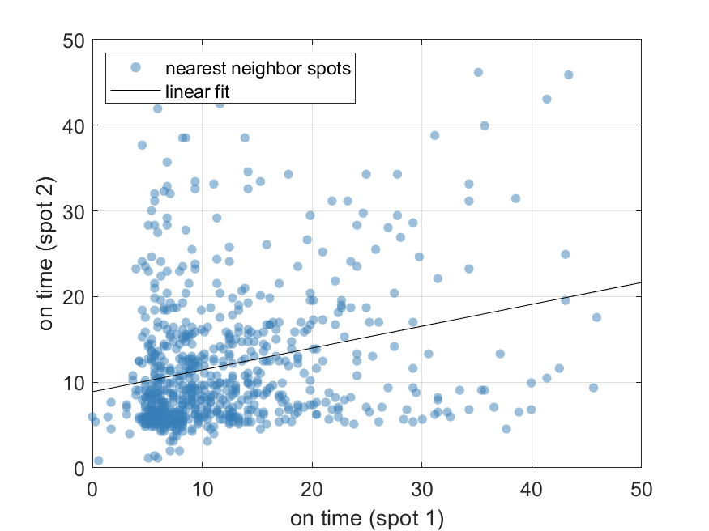
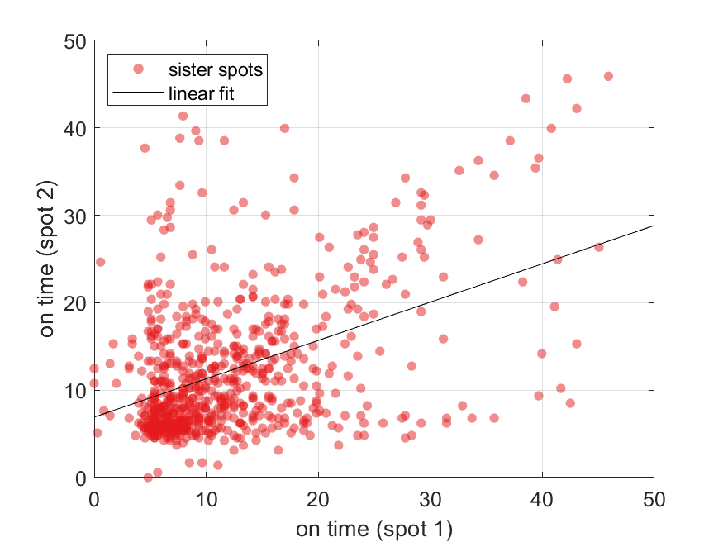
Activation times uncorrelated for both sister spots and nearest neighbor spots
Nearest neighbor spots
Sister spots

Slide 7
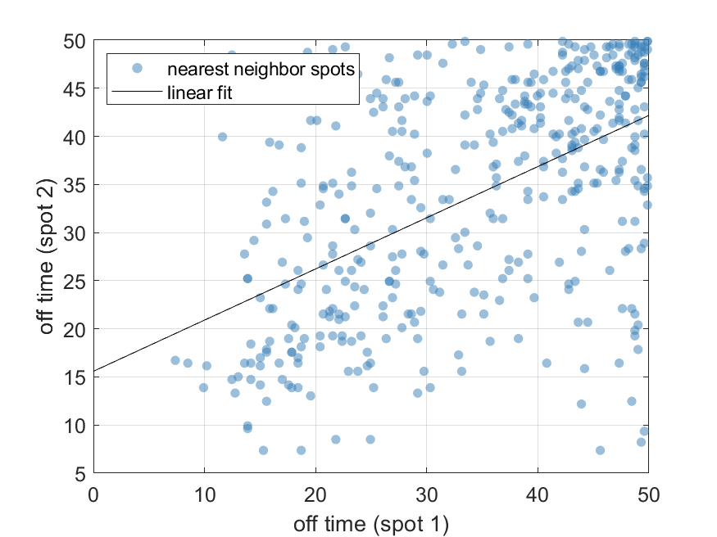
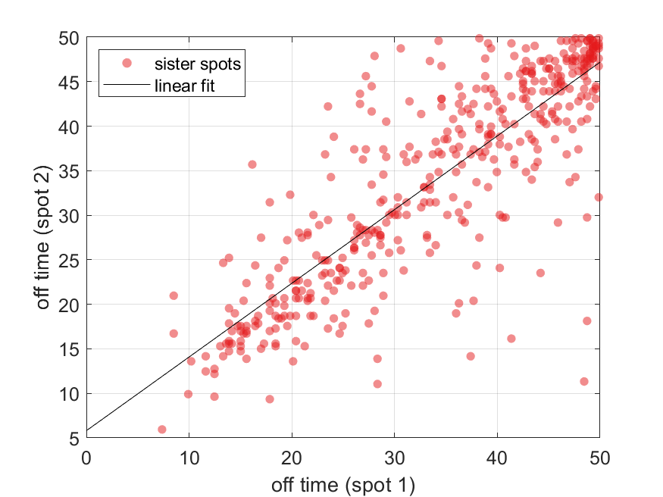
Deactivation times correlated in sister loci
Nearest neighbor spots
Sister spots

