Slide 1
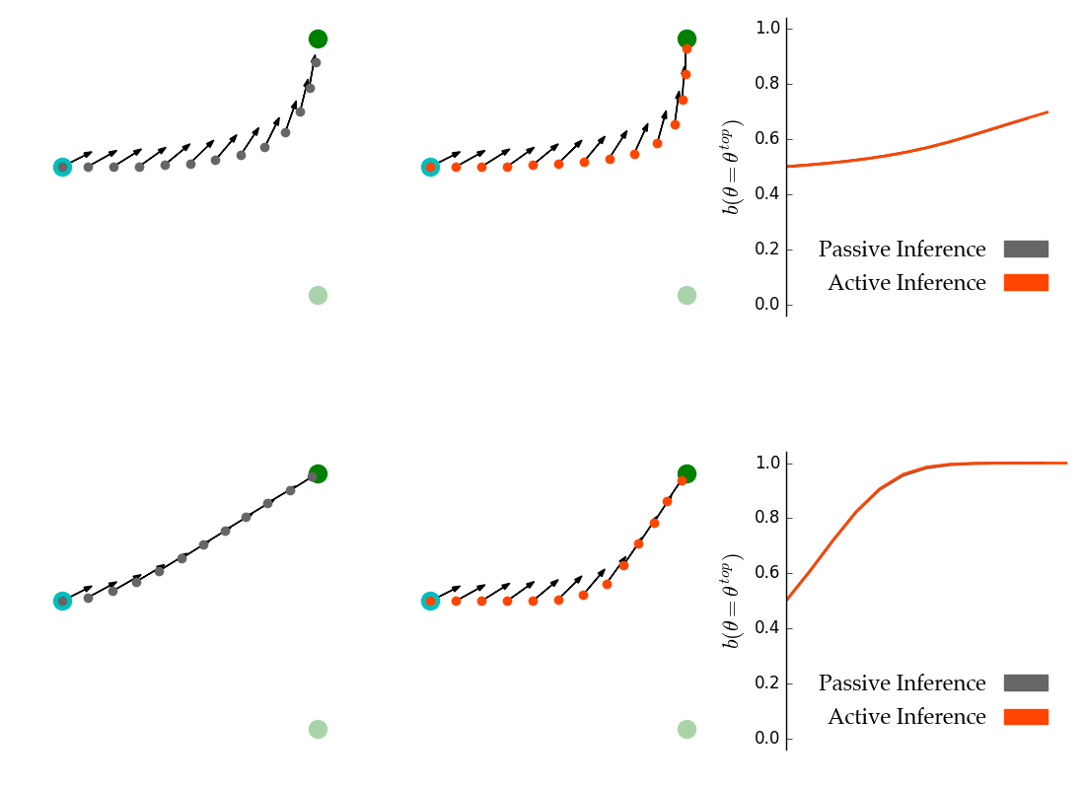
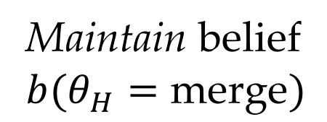
(a) Passive trajectory, active trajectory and beliefs for 𝛽 = 0.5
(b) Passive trajectory, active trajectory and beliefs for 𝛽 = 10.0
Maintain belief
$$b(θ_{H}=\text{merge})$$

Slide 2
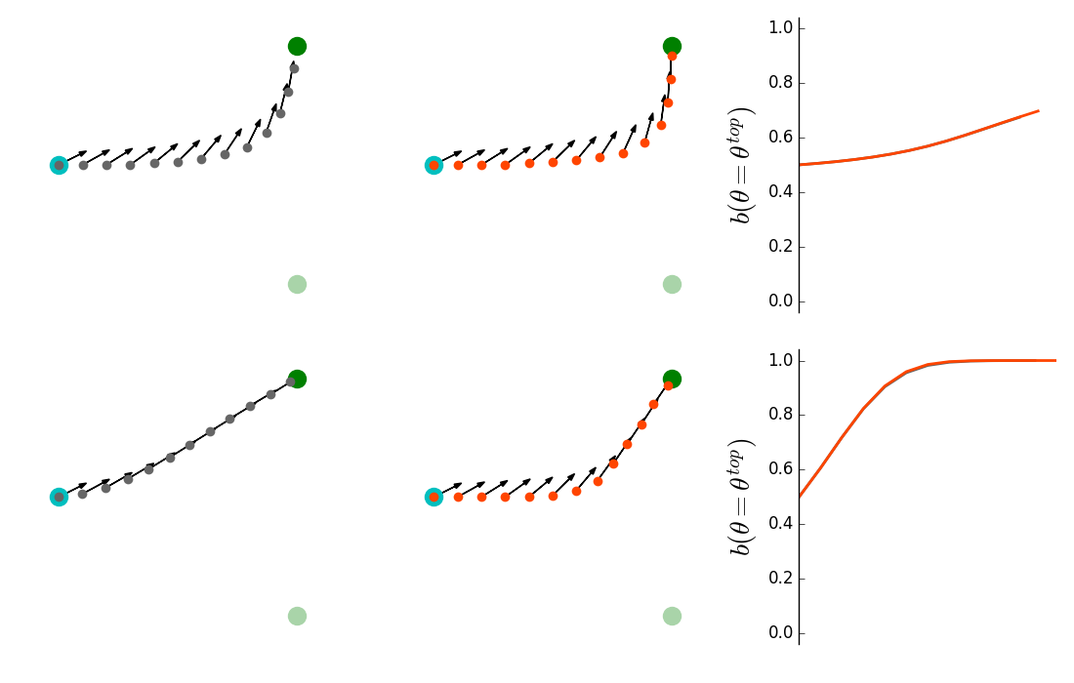
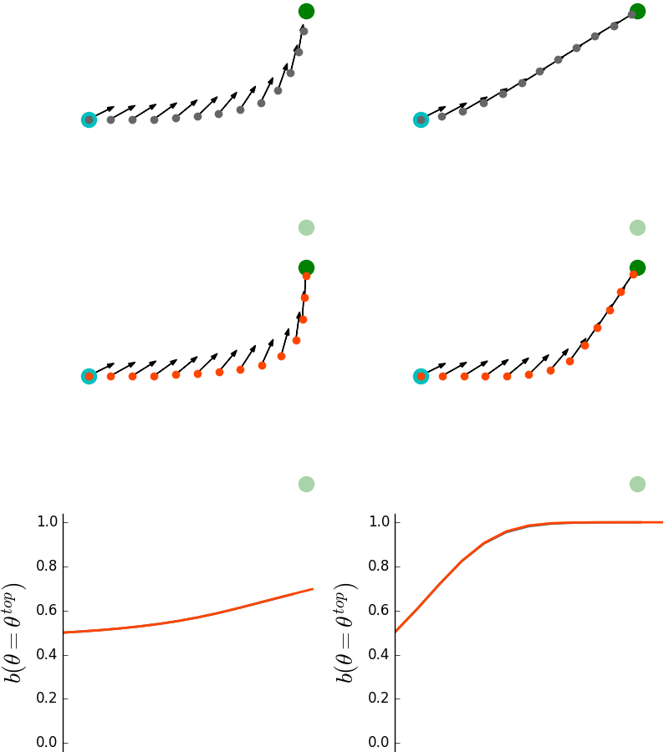
(a)
(b)
Maintain belief
$$b(θ_{H}=\text{merge})$$

