Slide 1
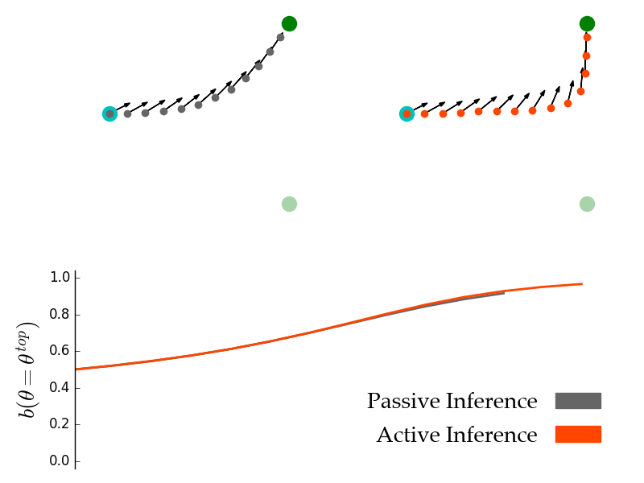
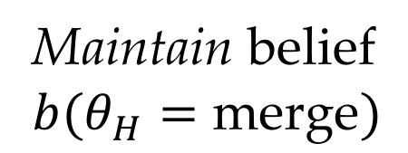
(a) Passive Inference
(b) Active Inference
(c) Beliefs in true goal
Maintain belief
$$b(θ_{H}=\text{merge})$$

Slide 2
(a)
(b)
(c)
Maintain belief
$$b(θ_{H}=\text{merge})$$

Slide 3
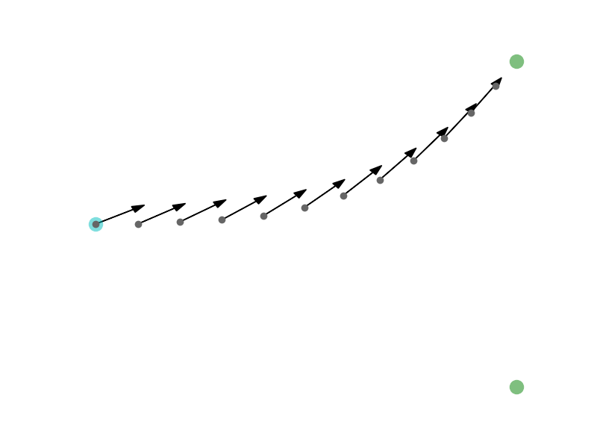
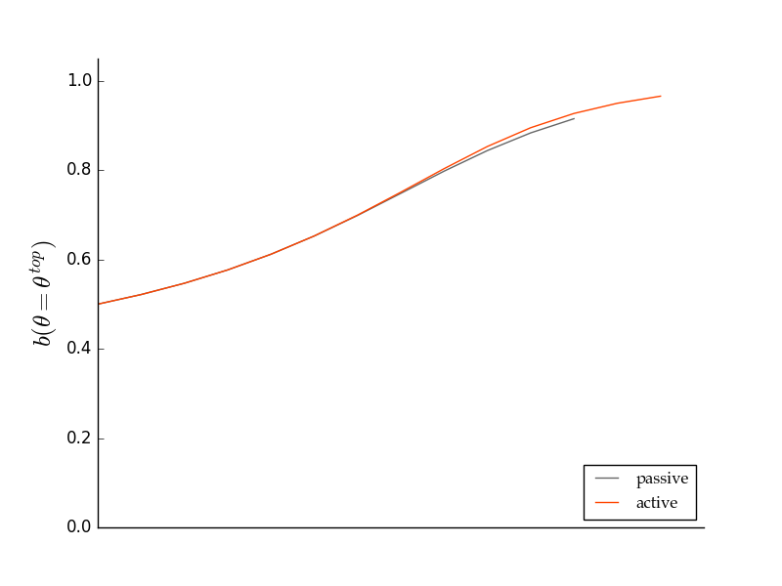
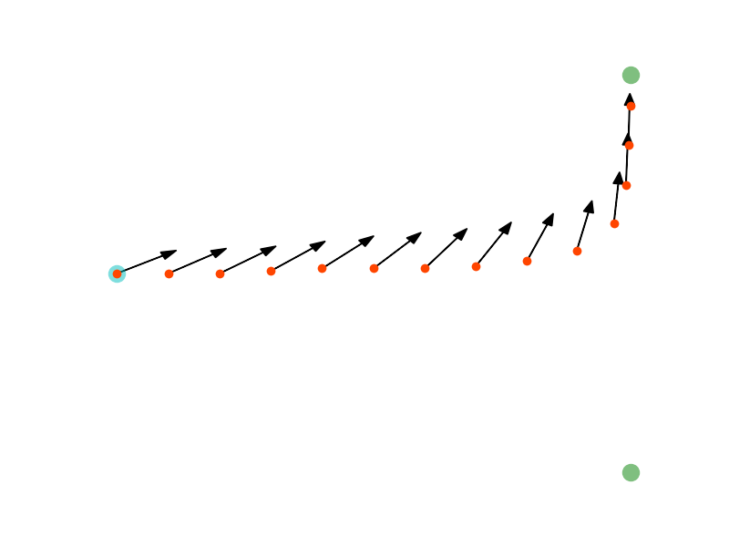
(a)
(b)
(c)
Maintain belief
$$b(θ_{H}=\text{merge})$$

