Slide 1
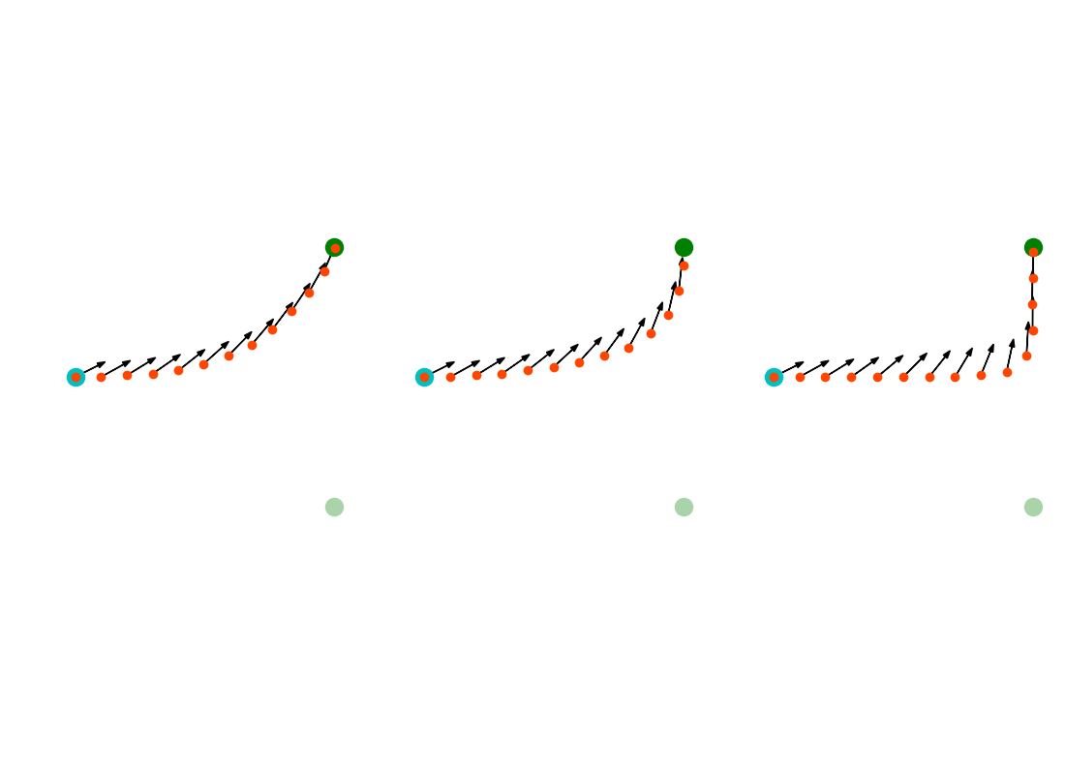
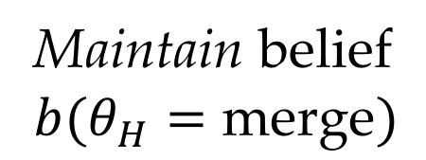
(a) 𝜆 = 1
(b) 𝜆 = 10
(c) 𝜆 = 100
Maintain belief
$$b(θ_{H}=\text{merge})$$

