Slide 1
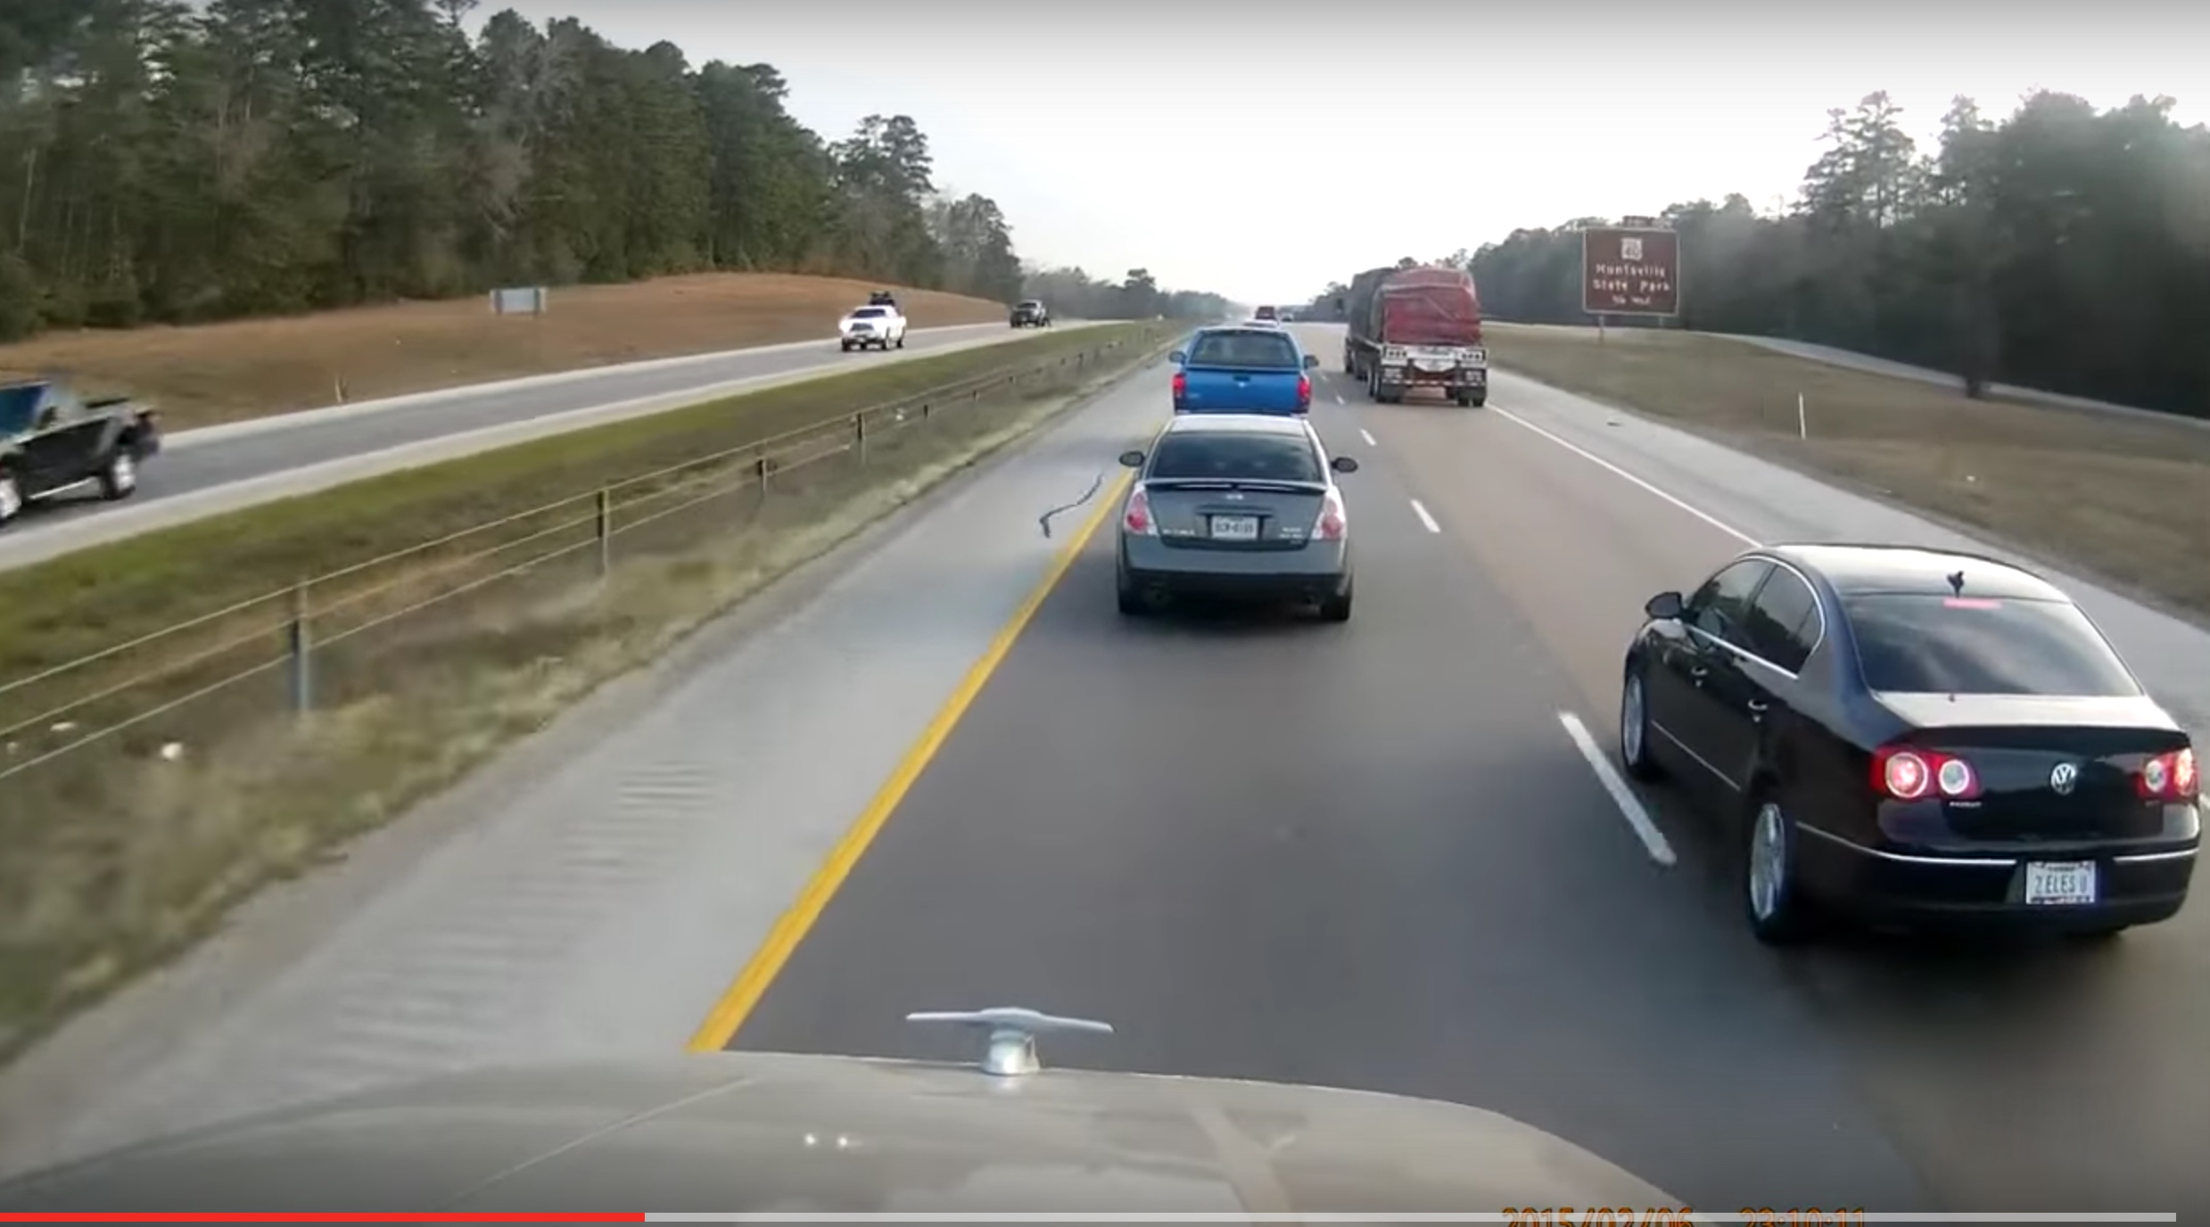



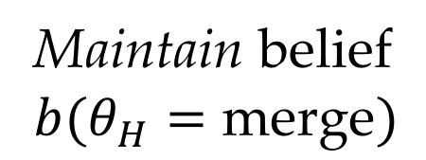
1
2
(a) Merge Example
(b) Simulation
Maintain belief
$$b(θ_{H}=\text{merge})$$

Slide 2
1
2
(a)
(b)
Maintain belief
$$b(θ_{H}=\text{merge})$$

