Slide 1
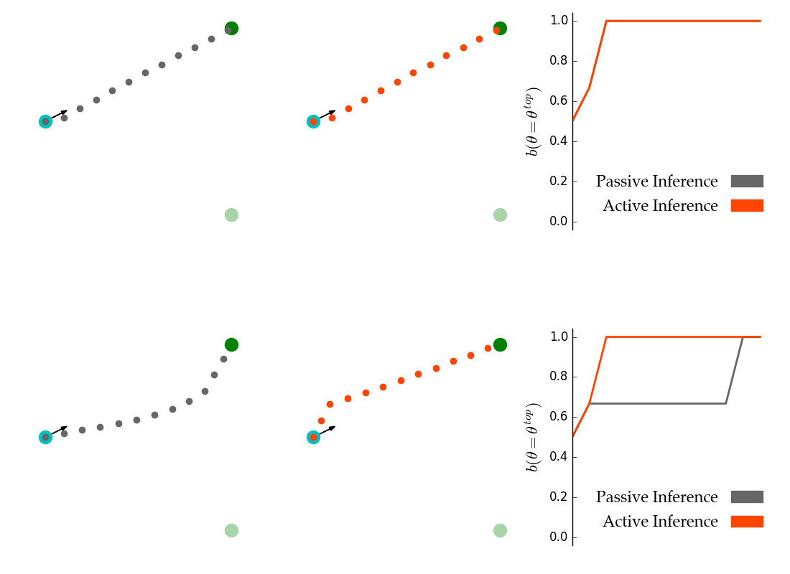
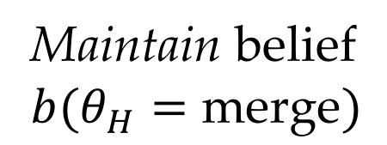
(a) Passive trajectory, active trajectory and beliefs for low 𝛿
(b) Passive trajectory, active trajectory and beliefs for high 𝛿
(a)
(b)
Maintain belief
$$b(θ_{H}=\text{merge})$$

Slide 2
(a) Passive trajectory, active trajectory and beliefs for 𝛿 = 𝜋/8
(b) Passive trajectory, active trajectory and beliefs for 𝛿 = 𝜋/2
(a)
(b)
Maintain belief
$$b(θ_{H}=\text{merge})$$

Slide 3
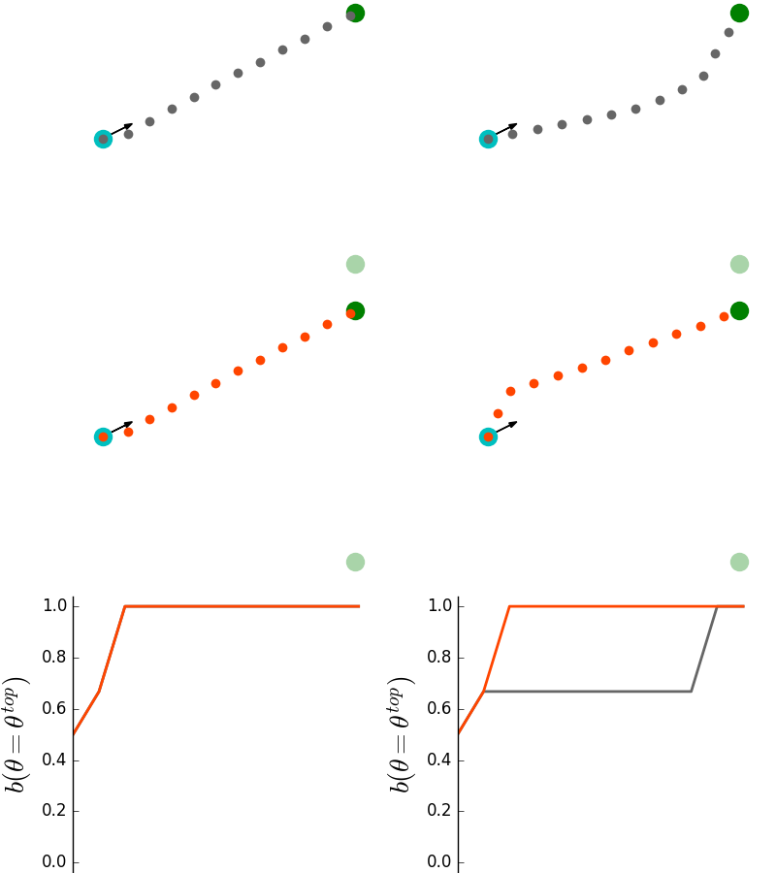
(a)
(b)
Maintain belief
$$b(θ_{H}=\text{merge})$$

