Slide 1
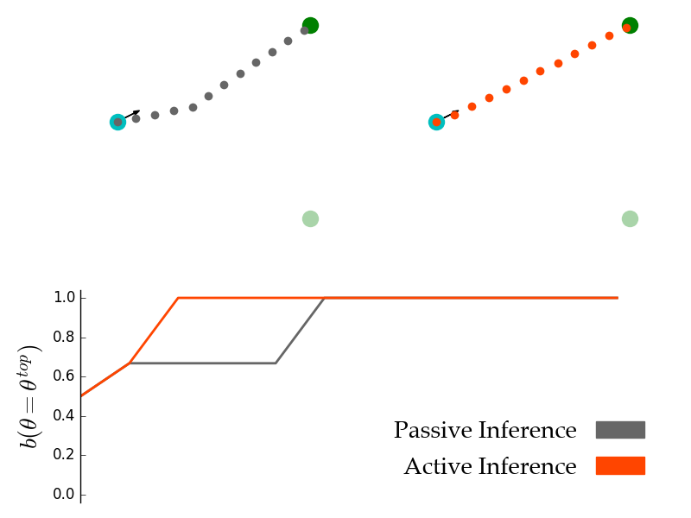
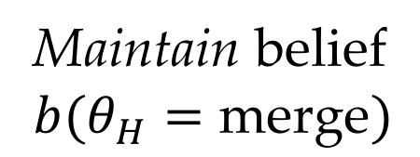
(a) Passive Inference
(b) Active Inference
(c) Beliefs in true goal
Maintain belief
$$b(θ_{H}=\text{merge})$$

