Slide 1
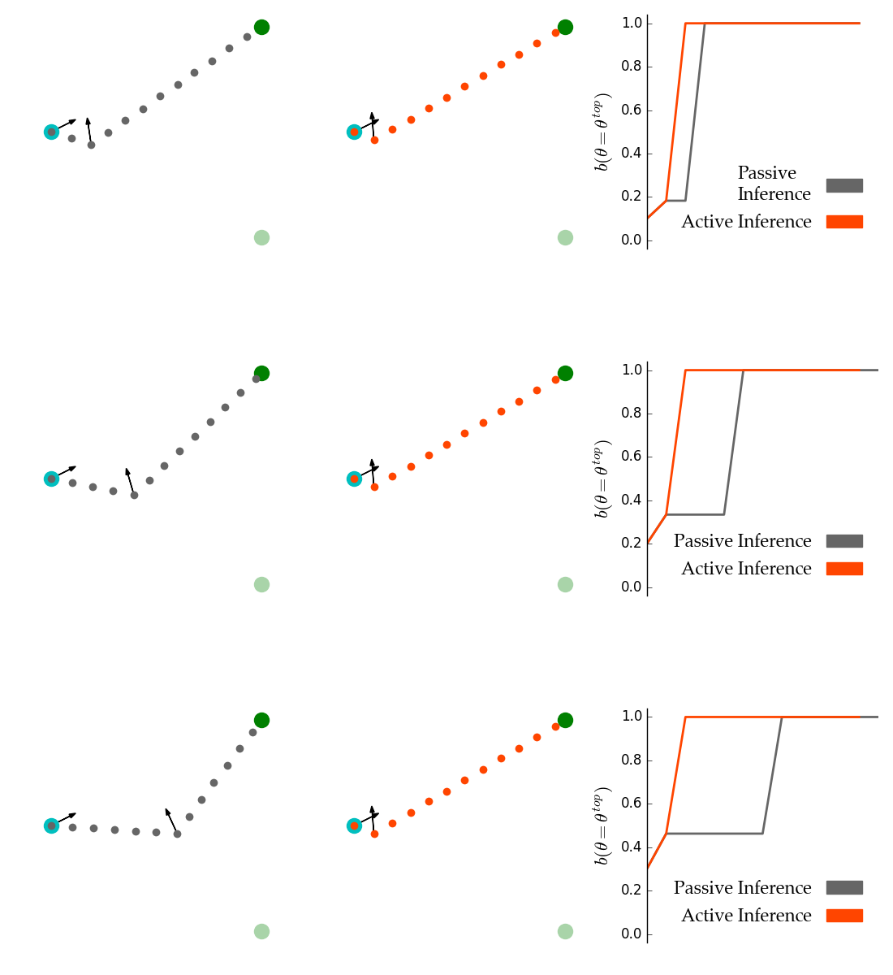
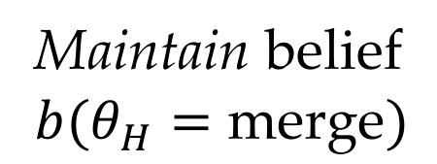
(a) Passive, active trajectory and beliefs for $b^{0}\left(θ\right)=(0.1, 0.9)$
(b) Passive, active trajectory and beliefs for $b^{0}\left(θ\right)=(0.2, 0.8)$
(c) Passive, active trajectory and beliefs for $b^{0}\left(θ\right)=(0.3, 0.7)$
Maintain belief
$$b(θ_{H}=\text{merge})$$

Slide 2
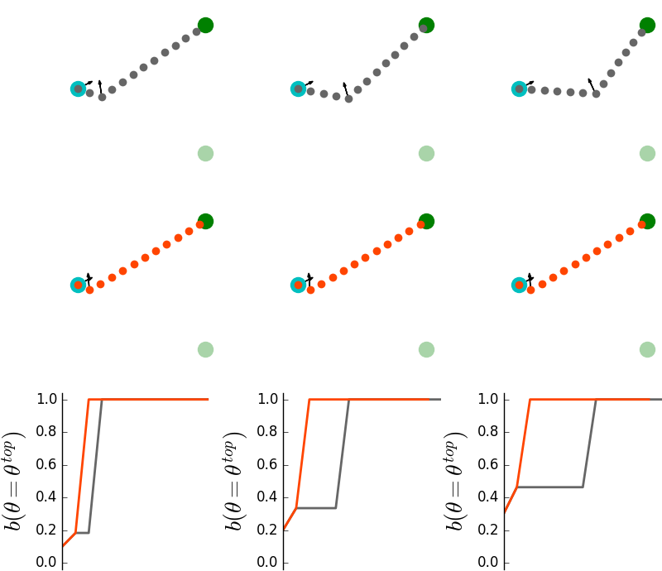
(a)
(b)
(c)
Maintain belief
$$b(θ_{H}=\text{merge})$$

