Slide 1
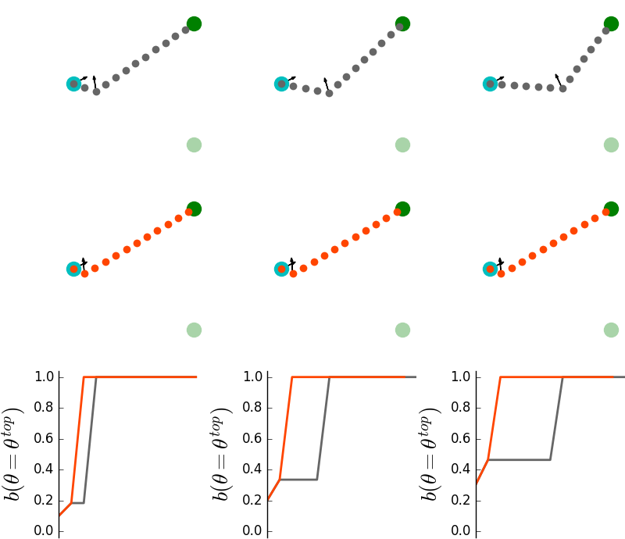
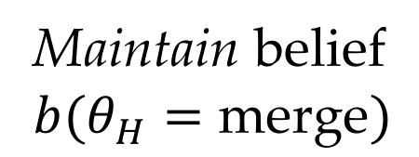
(a)
(b)
(c)
Maintain belief
$$b(θ_{H}=\text{merge})$$

