Slide 1
IoT Reference Framework
IoT Alliance Australia
Enabler Workstream #3 Cybersecurity & Network Resilience
Version 1.3
August 2022
eWS#3 Workstream Chair: Matt Tett
eWS#3 Workstream Author: Nam Nguyen

Slide 2
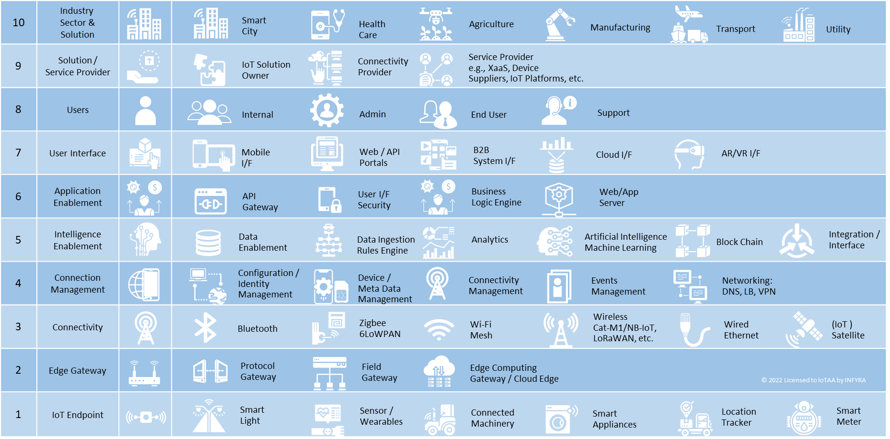
IoT Reference Framework
The IoT Reference Framework
is a generic and vendor-neutral reference framework for all IoT solutions
shows IoT building blocks
brings in one place the relationship between technical architecture, IoT users, business stakeholders, and industry sectors
Is a communications tool
It’s Purpose
serves as reference building blocks for all IoT applications across multiple industry sectors
provides a ‘Common Language’ to avoid ambiguity amongst stakeholders
Enables organisations to articulate IoT solution requirements clearly by looking through the various business lenses, e.g., business, data, cybersecurity, technology, etc.
Helps demystify IoT

Slide 3
IoT Reference Framework – Overview
Notes:
Further explanation is articulated in the next slide

Slide 4




























































IoT Reference Framework – editable icons
10 | Industry Sector & Solution
9 | Solution / Service Provider
8 | Users
7 | User Interface
6 | Application Enablement
5 | Intelligence Enablement
4 | Connection Management
3 | Connectivity
2 | Edge Gateway
1 | IoT Endpoint
Smart
City
Health
Care
Agriculture
Manufacturing
Transport
Utility
IoT Solution
Owner
Connectivity
Provider
Service Provider
e.g., XaaS, Device
Suppliers, IoT Platforms, etc.
Internal
Admin
End User
Support
Mobile
I/F
Web / API
Portals
B2B
System I/F
Cloud I/F
AR/VR I/F
API
Gateway
User I/F
Security
Business
Logic Engine
Web/App
Server
Data
Enablement
Data Ingestion
Rules Engine
Analytics
Artificial Intelligence
Machine Learning
Block Chain
Integration /
Interface
Configuration /
Identity
Management
Device /
Meta Data
Management
Connectivity
Management
Events
Management
Networking:
DNS, LB, VPN
Zigbee
6LoWPAN
Wi-Fi
Mesh
Wireless
Cat-M1/NB-IoT,
LoRaWAN, etc.
Wired
Ethernet
(IoT )
Satellite
Bluetooth
Protocol
Gateway
Field
Gateway
Edge Computing
Gateway / Cloud Edge
© 2022 Licensed to IoTAA by INFYRA
Smart
Light
Sensor /
Wearables
Connected
Machinery
Smart
Appliances
Location
Tracker
Smart
Meter

Slide 5

IoT Reference Framework – Overview
10 | IoT Industry & Solution |  | The IoT industry & solution layer aims to provide the context for an IoT solution such as the industry segment (industrial, consumer, enterprise) that the IoT solution belongs to, and the potential implications that IoT solution owners/practitioners might have to comply to in terms of regulatory compliance such as cybersecurity, data privacy, critical infrastructure, etc.
9 | Solution / Service Provider |  | The IoT Solution Owner / Service Provider layer intends to bring in the business aspects of the IoT solution into consideration. Understanding the roles of stakeholders in a solution can enable clear understanding of roles, responsibilities as well as missing items such as strategies, processes, people and skills that need to be actioned. Examples of items can include (but not limited to) Governance, Cybersecurity compliance, Strategy, Risks, Data Sharing, etc.
8 | IoT Users |  | The IoT User layer helps businesses identify who the end-users (and/or beneficiary of) the IoT solution. As a suggestion, IoT Users can be categorised as Primary or Secondary. Primary users are those who will act upon / make their (business) decisions based directly on the outcome/information that their IoT solution produced. Secondary users are those who might use the IoT data to derive further value, but not directly affecting the primary users.
7 | IoT User Interface |  | The IoT User Interfaces layer shows the type of interfaces that need to be supported by the Application Enablement layer. Examples include interfaces that are widely used today such as from mobile apps, to the emerging type such as AR/VR devices. User Interface that enable access and or manage of the IoT system and devices. IoT Client devices can be a Desktop, Laptop, Tablet, Smart Phone, Wearables, or purpose-made devices.
6 | Application Enablement |  | The Application Enablement layer refers to a set of functions and foundational services such as the API enabler, Web Portal, Web & Mobile application building and enablement, User Interface Security, Developer services, etc. This layer includes functions that are both business and technical in nature to be accessible to the ‘users’. You might have come cross other sources of information refers to Application Enablement as IoT platform. This layer forms one part of what is commonly referred to as the ‘IoT Platform’. (The functions in this layer could be a PaaS/SaaS solution.)
5 | Intelligence Enablement |  | The Intelligence Enablement layer refers to the use of smart technologies such as Analytics, Artificial Intelligence, Machine Learning, Deep Learning, Block Chain, etc. as part of the IoT solution, in order to generate insightful outcomes and to drive smart actions. The functions in this layer is what really make IoT solutions truly smart and value-adding. This layer forms another part of what is commonly referred to as the ‘IoT Platform’. (The functions in this layer could be a PaaS/SaaS solution or Edge solution.)
4 | Connection Management |  | The Connection Management layer refers to a set of the IoT Core functions, commonly refers to as Connection Management, which includes, but not limited to to the management of networks, protocols, device/gateway management, ID management, User Authentication, etc. This layer forms the final part of what is commonly referred to as the ‘IoT Platform’. (The functions in this layer could be a PaaS/SaaS solution.)
3 | Connectivity |  | The Connectivity layer represents the digital connectivity between end-point/gateway devices (layer 1, 2) and various platforms in layers 4, 5 or 6. Digital connectivity technologies in this layer can be any of the followings, wired or wireless: Bluetooth, WiFi, Ethernet, 6LoPAN, LoRaWAN, Sigfox, Weighless-D, 2G/3G/4G LTE, 5G (Cat-M1, NB-IoT and 5G NR), DECT (Wirepas) as well as any other proprietary radio technologies (e.g., Taggle); This layer can also represent (Internet) Access Network for IoT client devices, which could be fixed or mobile broadband, as well as connectivity to ISP.
2 | IoT Gateway |  | IoT Gateway layer represents 1) the Aggregation Point for a group of sensors and actuators to coordinate the connectivity of these devices to each other and to an external network such as a connectivity network; 2) a Protocol Gateway that performs protocol conversion between devices and the core platform; and/or 3) a Edge Computing Gateway that performs a subset of functions from layer 4, 5 and 6 above, such as data storage, analytics, ML, etc.
1 | IoT EndPoint |  | IoT End Point (EP) layer represents end point devices that can be remotely managed. These endpoints can either be simple, stand-alone device such as wearables, sensors, or embedded devices, etc., or complex products that have multiple endpoints embedded in it, or an appliance (e.g., washing machines, vehicle, industrial machines, etc.) that has embedded sensors.

Slide 6
IoT Reference Framework – Template
10 | Industry Sector & Solution
9 | Solution / Service Provider
8 | Users
7 | User Interface
6 | Application Enablement
5 | Intelligence Enablement
4 | Connection Management
3 | Connectivity
2 | Edge Gateway
1 | IoT Endpoint
© 2022 Licensed to IoTAA by INFYRA

Slide 7
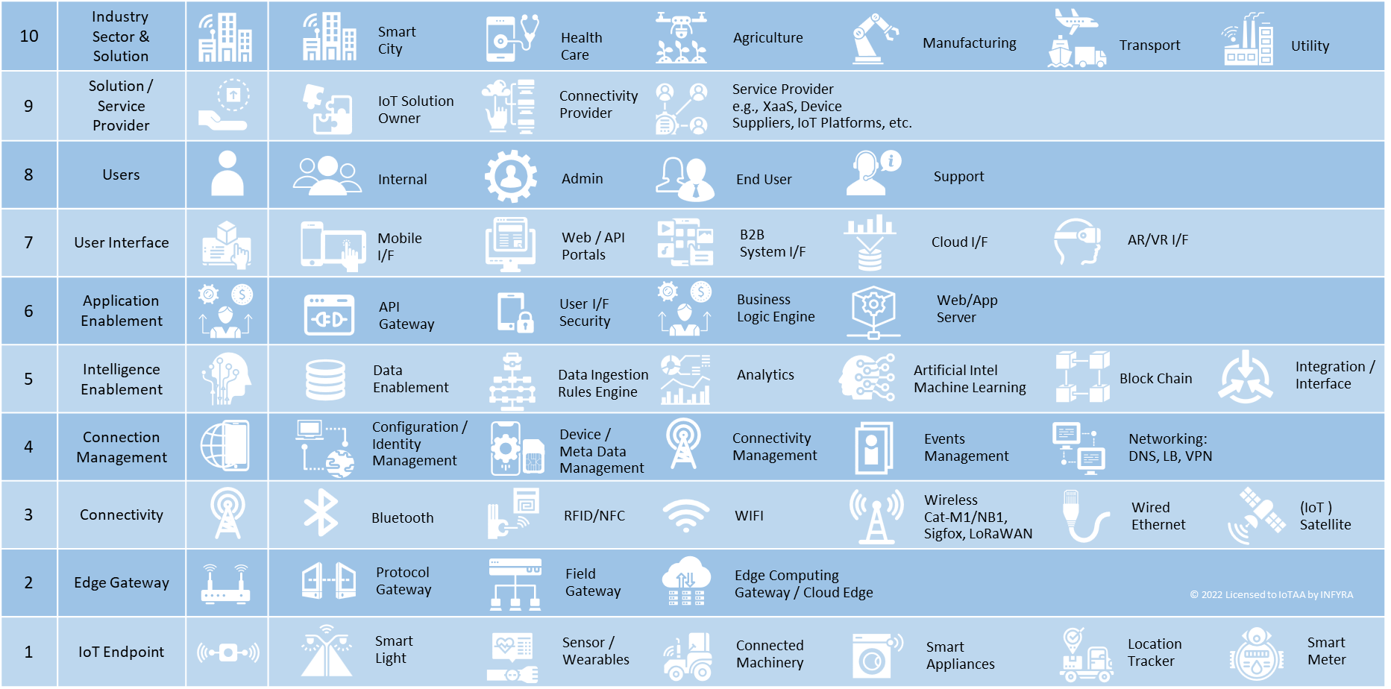
IoT Reference Framework – Views
The IoT Reference Framework shows
Contextual View
Industries, markets, solution, revenue, value-chain
security, risks, regulations, etc.
Business View
Stakeholders, processes, policies, industry and regulatory compliance
User View
Organisations, consumers, governments, communities
Architectural View
Solution, architecture, network, system, sub-system (each layer), component (detailed view)
Contextual View
Business View
User View
Architectural / Implementation View

Slide 8
IoT Reference Framework – Lenses
BUSINESS
SOLUTION
SECURITY
PRIVACY
SAFETY
DATA
INTEGRATION
IoT solution requirements can be viewed through the lenses of:
Business requirements
Technical solution;
Security;
Privacy;
Safety;
Data;
reliability;
Integration;
And more

Slide 9


Acknowledgements
This IoT Reference Framework was developed by
The IoT Reference Framework was further refined with contributors from
Nam Nguyen
Principal Consultant
INFYRA
www.infyra.net
nam@infyra.net
nam.nguyen@iot.org.au
Members of Enabler Workstream 3
Cybersecurity & Network Resilience
IoT ALLIANCE AUSTRALIA
www.iot.org.au

Slide 10

Terms of Use
This work is licensed under a Creative Commons Attribution-NonCommercial-ShareAlike 4.0 International License.
The IoT Reference Framework is available for non-commercial use by organisations and individuals, for purposes of communications, IoT architecture references, documentation, capability assessment, etc.
The use of this IoT Reference Framework for commercial purposes, such as marketing, advisory services, consulting tools, etc. for financial gains are not permitted, and subject to IP licensing.
Please contact INFYRA if you want to use this IoT Reference Framework for commercial purposes.
Copyright © 2022 INFYRA and licenced to IoTAA

Slide 11
Revision History
REVISION | DATE | CHANGE HISTORY
V1.0 | November 2018 | First release
V1.1 | October 2020 | Updated with new icons, and licence agreement
V1.2 | February 2022 | Updated to Layers 4, 5, 6 and 7, to better explain the concept behind those icons
V1.3 | August 2022 | Updated explanations as well as general editing

