Slide 1
Felix
Note from osgi and apache felix 3.0

Slide 2
Chapter 3

Slide 3
Variable and type
Int Felix terminal:
g! var1 = ‘this is a string’ -> type of var1 is string
g! days = [mon tue wev thu] -> type is list
g! sounds = [dog=bark cat=meow] -> map
Object properties and operations:
g! echo $var1
g! $days get 1 -> tue
g! $sounds get dog -> bark

Slide 4
Start Felix with some commands
F:\osgi_felix\felix-framework-4.2.1>java -jar bin\felix.jar
Bundles: command lists the currently installed bendles.
Grep: the same with grep on linux
Execution quotes:
Ex: g! bundles
0|Active | 0|org.apache.felix.framework (4.2.1)
1|Active | 1|org.apache.felix.bundlerepository (1.6.6)
2|Active | 1|org.apache.felix.gogo.command (0.12.0)
3|Active | 1|org.apache.felix.gogo.runtime (0.10.0)
4|Active | 1|org.apache.felix.gogo.shell (0.10.0)
g! (bundle 1) location
file:/F:/osgi_felix/felix-framework-4.2.1/bundle/org.apache.felix.bundlerepository-1.6.6.jar

Slide 5
Some commands
Listing installed bundles: lb
EX: g! lb
START LEVEL 1
ID|State |Level|Name
0|Active | 0|System Bundle (4.2.1)
1|Active | 1|Apache Felix Bundle Repository (1.6.6)
2|Active | 1|Apache Felix Gogo Command (0.12.0)
3|Active | 1|Apache Felix Gogo Runtime (0.10.0)
4|Active | 1|Apache Felix Gogo Shell (0.10.0)
g! lb bundle
START LEVEL 1
ID|State |Level|Name
0|Active | 0|System Bundle (4.2.1)
1|Active | 1|Apache Felix Bundle Repository (1.6.6)

Slide 6
Command and scope
The scope of a command is specified by pre-pending it to the command, separated from the command with a colon (:)
felix:bundlelevel
felix:cd
felix:frameworklevel
felix:headers
felix:help
felix:inspect
felix:install
felix:lb
felix:log
felix:ls
felix:refresh
felix:resolve
felix:start
felix:stop
felix:uninstall
felix:update
felix:which
gogo:cat
gogo:each
gogo:echo
gogo:format
gogo:getopt
gogo:gosh
gogo:grep
gogo:not
gogo:set
gogo:sh
gogo:source
gogo:tac
gogo:telnetd
gogo:type
gogo:until
obr:deploy
obr:info
obr:javadoc
obr:list
obr:repos
obr:source

Slide 7
Variable types
g! var1 = ‘this is a string’ -> type is string
g! days = [mon tue web] -> type is list
g! sounds = [dog=bark cat=meow] -> type map
Object properties and operations:
Echo $var1
$days get 1 -> tue
$sounds get dog -> bark

Slide 8
Command install
The install command is used to instruct Felix to install an external bundle:
EX:g! install http://www.mysite.com/testbundle-1.0.0.jar
Bundle ID: 7
Here, the bundle I've just installed has the ID 7.
g! lb
START LEVEL 1
ID|State |Level|Name
0|Active | 0|System Bundle (3.0.1)
1|Active | 1|Apache Felix Bundle Repository (1.6.2)
2|Active | 1|Apache Felix Gogo Command (0.6.0)
3|Active | 1|Apache Felix Gogo Runtime (0.6.0)
4|Active | 1|Apache Felix Gogo Shell (0.6.0)
7|Installed | 1|Test Bundle (1.0.0)

Slide 9
Some command
Update: update 7 http://www.mysite.com/testbundle-1.0.1.jar
Resolve, stop, start, uninstall, refresh, header, inspect, which, log, cd, ls, frameworklevel, bundlelevel, cat, tac, set,…
Ex: g! headers 1
Apache Felix Bundle Repository (1)
----------------------------------
Bnd-LastModified = 1309866817010
Build-Jdk = 1.6.0_24
Built-By = mcculls
Bundle-Activator = org.apache.felix.bundlerepository.impl.Activator
Bundle-Description = Bundle repository service.
Bundle-DocURL = http://felix.apache.org/site/apache-felix-osgi-bundle-repository
.html
Bundle-License = http://www.apache.org/licenses/LICENSE-2.0.txt
………

Slide 10
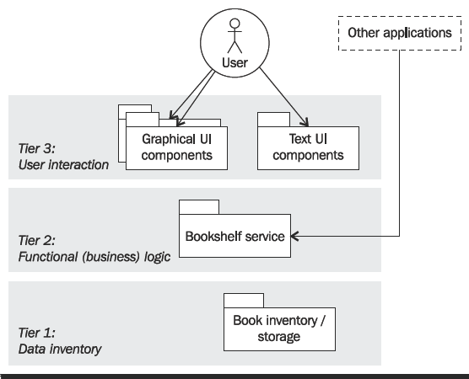
Chapter 4: Let’s get started: The Bookshelf Project
A simple Bookshelf project;

Slide 11
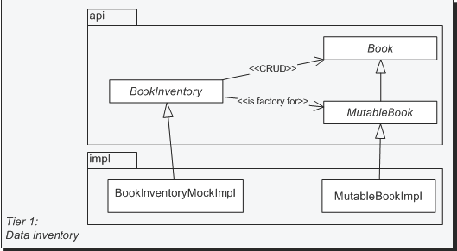
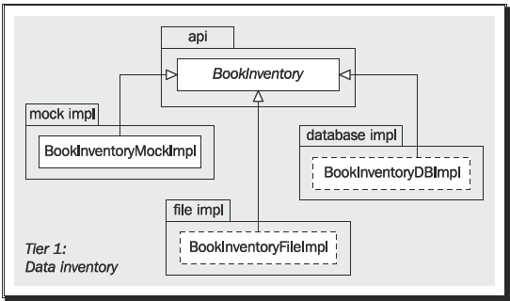
The data inventory tier
The Book interface defines the read-only book bean.
The MutableBook: update the bean attributes.

Slide 12
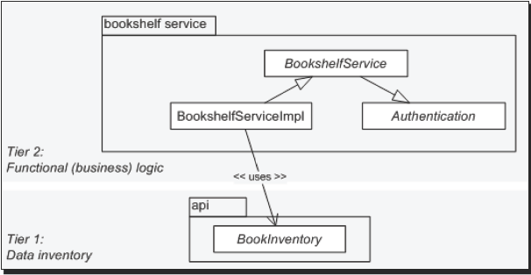
The business logic tier

Slide 13
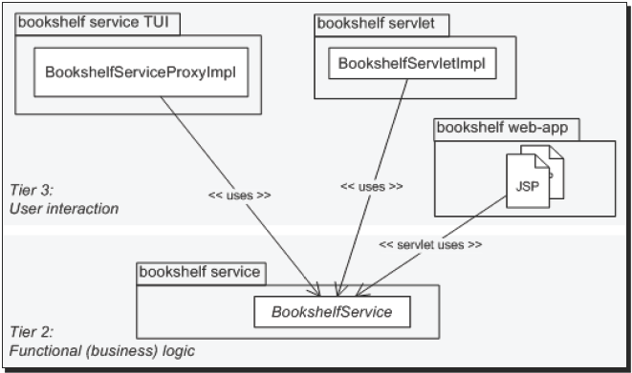
The user interaction tier

Slide 14
Chapter 5: The Book Inventory Bundle
In this chapter, we will defne the Book Inventory API and write a mock implementaton. The mock implementaton will store the Book items in memory. We will also start looking at how bundles are packaged for installaton onto an OSGi framework.
We will:
Create the book inventory API bundle project skeleton
Defne the Book bean
Defne the Book Inventory API
Package and deploy the bundle
Then we will:
Create the book inventory mock implementaton (memory-based)
Package and deploy the new bundle

Slide 15
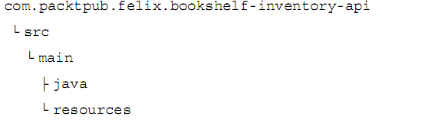
Create directory

Slide 16
Create pom.xml under com.packtpub.felix.bookshelf-inventory-api directory
<?xml version="1.0" encoding="UTF-8"?><project xmlns="http://maven.apache.org/POM/4.0.0" xmlns:xsi="http://www.w3.org/2001/XMLSchema-instance" xsi:schemaLocation="http://maven.apache.org/POM/4.0.0 http://maven.apache.org/maven-v4_0_0.xsd">
<modelVersion>4.0.0</modelVersion>
<groupId>com.packtpub.felix</groupId>
<artifactId>com.packtpub.felix.bookshelf-inventory-api</artifactId>
<version>1.5.0</version>
<packaging>bundle</packaging>
<name>Bookshelf Inventory API</name>
<description>Defines the API for the Bookshelf inventory.</description>
</project>
Notes:
<?xml version="1.0" encoding="UTF-8"?><project xmlns="http://maven.apache.org/POM/4.0.0" xmlns:xsi="http://www.w3.org/2001/XMLSchema-instance" xsi:schemaLocation="http://maven.apache.org/POM/4.0.0 http://maven.apache.org/maven-v4_0_0.xsd"> <modelVersion>4.0.0</modelVersion> <groupId>com.packtpub.felix</groupId> <artifactId>com.packtpub.felix.bookshelf-inventory-api</artifactId> <version>1.5.0</version> <packaging>bundle</packaging> <name>Bookshelf Inventory API</name> <description>Defines the API for the Bookshelf inventory.</description> <build> <plugins> <plugin> <groupId>org.apache.felix</groupId> <artifactId>maven-bundle-plugin</artifactId> <version>2.4.0</version> <extensions>true</extensions> <configuration> <instructions> <Bundle-Category>inventory</Bundle-Category> <Bundle-SymbolicName>${artifactId}</Bundle-SymbolicName> <Export-Package>com.packtpub.felix.bookshelf.inventory.api</Export-Package> </instructions> <remoteOBR>repo-rel</remoteOBR> <prefixUrl>file:///F:/osgi_felix/felixbook/releases</prefixUrl> </configuration> </plugin> <plugin> <artifactId>maven-compiler-plugin</artifactId> <inherited>true</inherited> <configuration> <source>1.5</source> <target>1.5</target> </configuration> </plugin> </plugins> </build> <distributionManagement> <!-- releases repo --> <repository> <id>repo-rel</id> <url>file:///F:/osgi_felix/felixbook/releases</url> </repository> </distributionManagement></project>

Slide 17
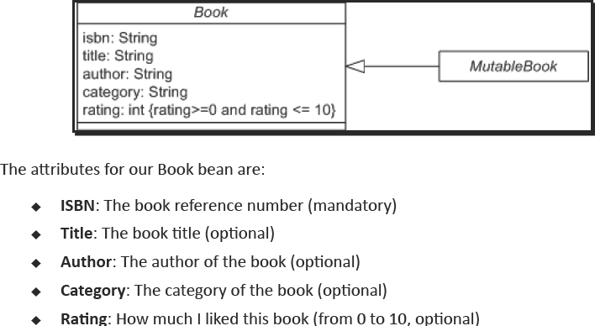
Book bean interface

Slide 18
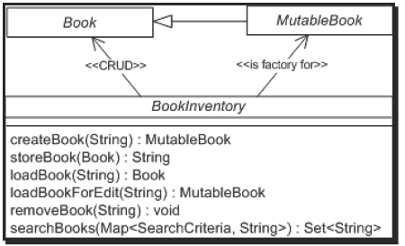
The Book inventory interface

Slide 19
Build and deploy the bundle
Maven clean install
Please refer chapter 5 for more step….

Slide 20
Writing the Bundle Activator
we will implement a small bundle actvator for our inventory implementaton.
It will instantate and register the service on start and then unregister it on stop.
For that, we will create an implementaton of the BundleActivator interface (from the OSGi Core API) and declare it as our bundle actvator in the POM.
<dependency>
<groupId>org.osgi</groupId>
<artifactId>org.osgi.core</artifactId>
<version>5.0.0</version>
</dependency>

Slide 21
BundleActivator
public void start(BundleContext context) throws Exception
public void stop(BundleContext context) throws Exception
The BundleContext object is private to the bundle and can be shared within the bundle.
However, it is not supposed to be shared with other bundles.

Slide 22
BundleContext
The registerService method is used to make a service available for look-up by other bundles on the framework. Its parameters are as follows:
String clazz: The class name that will be used to look up the service
Object service: The service to be registered
Dictionary properties: Optonal dictonary of propertes atached with this service registraton

Slide 23
Chapter 6: Using the OSGi Bundle Repository
By the end of this chapter, you will have:
Learned about the OSGi Bundle Repository concepts and the OBR repository
XML fle format
Inspected the local releases repository
Installed the bundles from Chapter 5 onto Felix
The OSGi Bundle Repository (OBR) is a draf specifcaton from the OSGi alliance for a service that would allow getng access to a set of remote bundle repositories

Slide 24
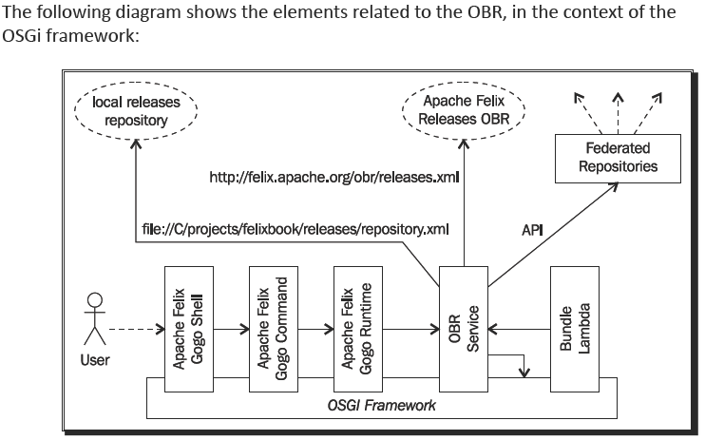

Slide 25
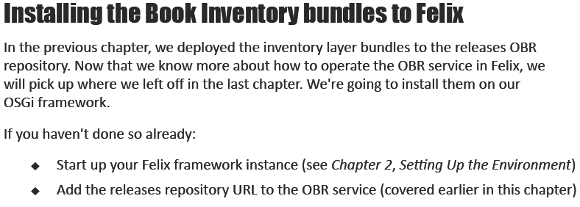
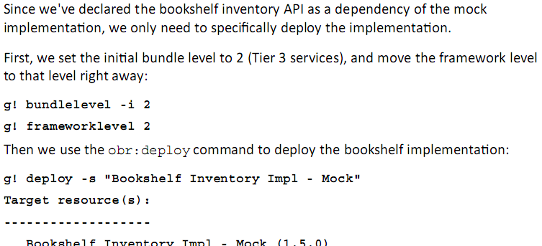

Slide 26
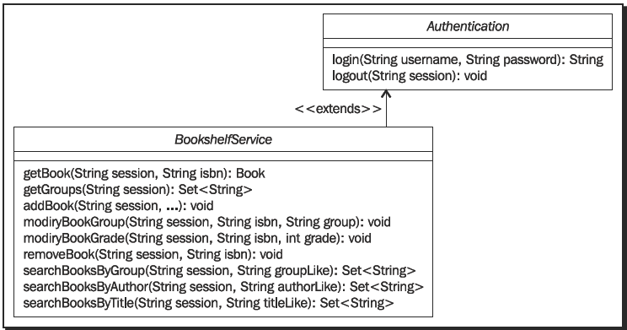
Chapter 7: The Bookshelf: First Stab

Slide 27
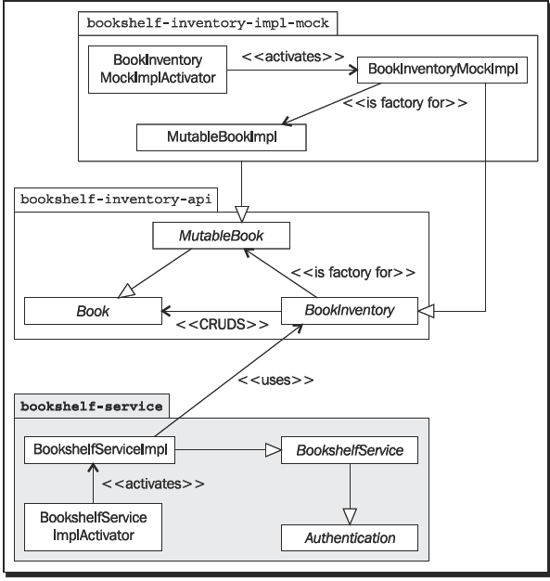
Implementing the service

Slide 28
The service receives a BundleContext through its constructor, handed to it by the actvator (see later). It will keep a reference of it in order to use it for the BookInventory component lookup when it needs the inventory functonality.
public BookshelfServiceImpl(BundleContext context)
{
this.context = context;
}
private BookInventory lookupBookInventory() {
String name = BookInventory.class.getName();
ServiceReference ref =
this.context.getServiceReference(name);
if (ref == null)
{
throw new
BookInventoryNotRegisteredRuntimeException(name);
}
return (BookInventory) this.context.getService(ref);
}

Slide 29
implementing the service activator
public class BookshelfServiceImplActivator implements BundleActivator
{
ServiceRegistration reg = null;
public void start(BundleContext context) throws Exception
{
this.reg = context.registerService(
BookshelfService.class.getName(),
new BookshelfServiceImpl(context), null);
testService(context);
}
public void stop(BundleContext context) throws Exception {
if (this.reg!=null) {
context.ungetService(reg.getReference());
}
}

Slide 30
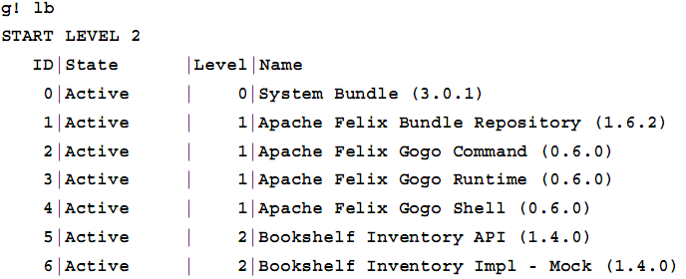
Trying the BookshelfService
building the bundle
installing and testing the service

Slide 31
installing and testing the service
the following repositories registered with the OBR service:
g! repos list
file:/C:/projects/felixbook/releases/repository.xml
http://felix.apache.org/obr/releases.xml
We refresh our releases repository and get the updated list of Bookshelf bundles:
g! repos refresh file:///C:/projects/felixbook/releases/repository.xml
g! list book
Bookshelf Inventory API (1.5.0)
Bookshelf Inventory Impl - Mock (1.5.0)
Bookshelf Service (1.7.0)

Slide 32
installing and testing the service
let's stop the book inventory implementaton.
g! stop 6
Stoping Book Inventory Mock Impl This will make the inventory functonality unavailable when the bookshelf service actvator tries to run the tests.
Now, let's instruct the OBR service to deploy and start the bookshelf service. We're installing the bookshelf service on start level 3 (Tier 2 services):
g! bundlelevel -i 3
g! frameworklevel 3
g! deploy -s "Bookshelf Service"

Slide 33
installing and testing the service
Having checked dependencies, it installs the service and atempts to start it. However, when we start with our test, we atempt to get an instance of the BookInventory service—in lookupBookInventory()—and this bit fails
We'll get to fx this later

Slide 34
fulflling the missing dependency
Looking at the bundle listng, we fnd the newly installed bundle in the Resolved state:
g! lb
START LEVEL 3
ID|State |Level|Name
0|Active | 0|System Bundle (3.0.1)
…..
5|Active | 2|Bookshelf Inventory API (1.4.0)
6|Resolved | 2|Bookshelf Inventory Impl - Mock (1.4.0)
7|Resolved | 3|Bookshelf Service (1.7.0)
Let's start the mock inventory implementaton and make it available again:
g! start 6
Starting Book Inventory Mock Impl
Now that the dependency is satsfed, startng the Bookshelf Service should work as follows:
g! start 7

Slide 35
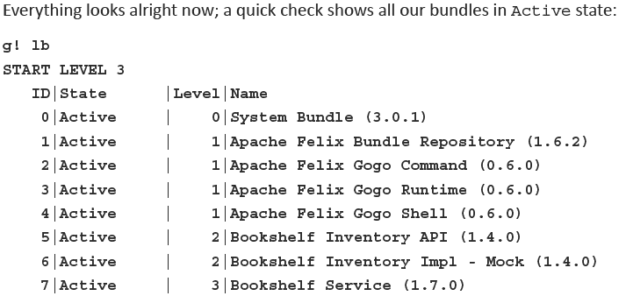

Slide 36
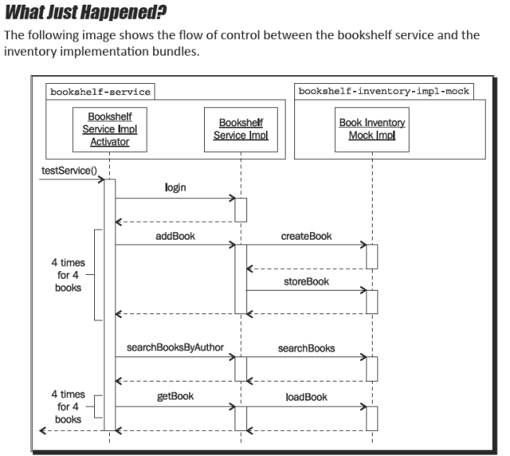

Slide 37
Chapter 8: Adding a Command-Line Interface
In this chapter, you will:
Learn about the Apache Felix Gogo Shell Service
Discover how to extend it with your own commands
We will also improve our Bookshelf case study by:
Implementng the Gogo shell commands, namely, book:search and book:add
Removing the temporary test procedures in the bookshelf-service actvator
We'll also learn how to:
Update a bundle with a newer version
Write a script for automatng frequently repeated tasks

Slide 38
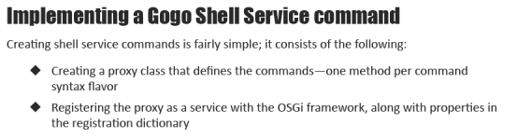
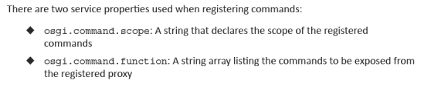

Slide 39
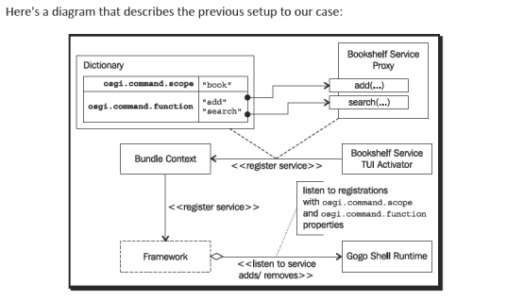

Slide 40
Implementing the book:search command
I've chosen the package com.packtpub.felix.bookshelf.service.tui for the proxy and com.packtpub.felix.bookshelf.service.tui.activator for the bundle actvator
The BookshelfServiceProxy is the main class for the bookshelf command functonality

Slide 41
Implementing the book:search command
public class BookshelfServiceProxy
{
public static final String SCOPE = "book";
public static final String[] FUNCTIONS = new String[] {
"search"
};
private BundleContext context;
public BookshelfServiceProxy(BundleContext context)
{
this.context = context;
}
The proxy constructor also takes a BundleContext, which will be needed to look up the BookshelfService when executng the command operatons

Slide 42
Implementing the book:search command
The search commands that are exposed have two possible syntax signatures:
search <username> <password> <attribute> <filter>: For searches matching books fltering by "author", "ttle" or "category" attribute
search <username> <password> <attribute> <lower> <upper>: For searches matching books with a "ratng" attribute between lower and upper
Each one of these signatures matches a method in the proxy class:
Set<Book> search(String username, String password, String attribute, String filter)
Set<Book> search(String username, String password, String attribute, int lower, int upper)

Slide 43
protected BookshelfService lookupService()
{
ServiceReference reference = context.getServiceReference(
BookshelfService.class.getName());
if (reference == null)
{
throw new RuntimeException(
"BookshelfService not registered, cannot invoke "+
"operation");
}
BookshelfService service =
(BookshelfService) this.context.getService(reference);
if (service == null)
{
throw new RuntimeException(
"BookshelfService not registered, cannot invoke "+
"operation");
}
return service;
}

Slide 44
implementing a bundle activator
Create the class BookshelfTuiActivator and make it register an instance of the BookshelfServiceProxy at start
public class BookshelfTuiActivator implements BundleActivator
{
public void start(BundleContext bc)
{
Hashtable props = new Hashtable();
props.put("osgi.command.scope", BookshelfServiceProxy.SCOPE);
props.put("osgi.command.function", BookshelfServiceProxy.FUNCTIONS);
bc.registerService( BookshelfServiceProxy.class.getName(),
new BookshelfServiceProxy(bc), props);
}
public void stop(BundleContext bc)
{
}
}
You stll need to confgure the bundle plugin in the POM, and you're done

Slide 45
packaging and installing
The shell extension bundles ft on start level 5, as defned in Chapter 1, Quick Intro to Felix and OSGi. Here we set the inital start level for all the newly installed bundles to 5 and change the framework level as well.
g! bundlelevel -i 5
g! frameworklevel 5
Refresh the OBR repository and get the updated list using:
g! repos refresh file:///C:/projects/felixbook/releases/repository.xml

Slide 46
On Converters
The shell can recognize the basic types and convert them for use as parameters when calling the command functon. However, for more complex types, it would require the assistance of a helper class.
The Converter (org.apache.felix.service.command.Converter) is a service that knows how to convert a String to an object of a specifc type and vice-versa. Without going into too much detail, the converter is registered as a service, along with a property (osgi.converter.classes) that lists the classes it supports conversion for.
The service exposes the following two methods:
convert(...) that takes the target class (the desired type) and an input object and is expected to return the converted object
format(...) that takes an object to format, a formatng directve, and a Converter for delegaton of the formatng of sub-parts

Slide 47
Chapter 9: Improve the Bookshelf Service with iPOJO
we will look at how iPOJO can help keep this process simple, while improving the overall performance. You will:
Look at an overview of the inversion of control component-oriented programming paterns and its applicaton in our context, namely, the service locator, dependency injecton, whiteboard, and extender paterns
Introduce iPOJO, the service and Maven plugin, and look at the ways it is used to simplify OSGi integraton, using XML confguraton as well as annotatons
Learn how to use the iPOJO Gogo commands to get a view of registered iPOJO instances and factories

