Slide 1
Differentiating and integrating measured motion
Model-free kinematics from one sensor or two
Nonlinear Dynamics Laboratory · University of Rhode Island
Notes:
[~0.5 min] TIMING. Full deck: 34 content slides plus title, four section dividers and closing, about 46 min. The October 2026 additions are slides marked [NEW] in their notes (about 12 min).
30-minute path: drop the original optional slides (Savitzky-Golay, tuning-rule table, uncertainty band, validation checklist), the tuning-curve figure, the self-tuning cost figure, the integration figure, and the new optional slides (defaults that failed silently, where delay reconstruction helps). Keep the four delay-reconstruction core slides and the causal-filter slide.
Open on the two problems; do not spend time on the title.

Slide 2
Two problems every vibration lab has
THE PROBLEM
The setting: one sensor type, and you need the other kinematic quantities
You measured displacement (laser vibrometer, DIC, encoder) and you need velocity and acceleration.
Restoring-force surfaces, NNM energy balance, damping identification, model updating.
You measured acceleration (the cheap, rugged, ubiquitous sensor) and you need velocity and displacement.
Mode shapes in physical units, drift-free response, base-excitation compensation, fatigue cycles.
Both are routine requests. Both are harder than they look.
The naive answers — finite differences one way, cumulative trapezoid the other — fail, and fail differently.
Notes:
[~1.5 min] Open by asking who in the room has done each of these. Frame the talk: this is not a survey of filters, it is one idea — that both tasks are the same inverse problem — plus the practical consequences. Everything shown is measured on a benchmark with exact ground truth, so every error quoted is a true error, not a comparison between two estimates.

Slide 3
They are the same problem, run in opposite directions
THE PROBLEM
One framing that organises the whole landscape
Write the measurement as y = A u + e, with A the integration operator.
Differentiation: u is the derivative you want, A integrates it back to what you measured.
Integration: u is the displacement, A integrates the acceleration twice.
A is compact. Its inverse is unbounded. This is the definition of an ill-posed inverse problem.
Noise is amplified without limit — by ω per derivative going up, by 1/ω per integration going down.
No amount of cleverness removes this. It is a property of the operator, not of your algorithm.
Every usable method therefore adds a regularity prior. That is the only thing that distinguishes them.
Notes:
[~2 min] This is the conceptual spine of the talk — spend time here. The key move is recognising that differentiating and integrating are not opposites to be treated with different toolkits; they are the same compact operator inverted in two directions. Emphasise the last line: when someone asks 'which filter should I use', the honest reformulation is 'what do you believe about your signal?'

Slide 4
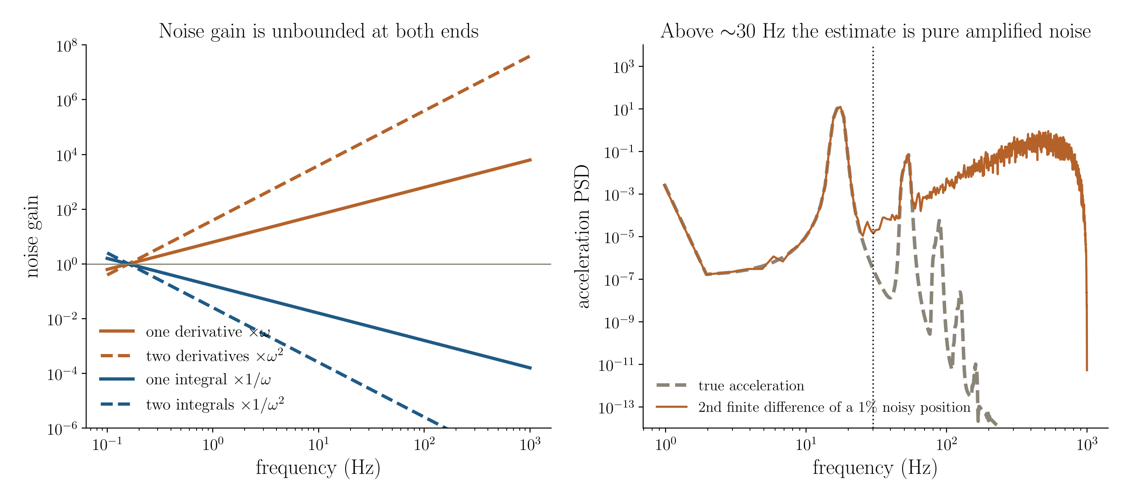
Why it is ill-posed
THE PROBLEM
Left: the amplification factor is unbounded at both ends. Right: the same effect on a real record — a 1% noise floor on position dominates the acceleration estimate above about 30 Hz.
Notes:
[~1.5 min] Left panel is the theory in one picture: differentiation multiplies by ω, integration divides by it, and both diverge. Right panel makes it concrete. The gold curve is the true acceleration spectrum — it rolls off. The red curve is what you get from differentiating a 1% noisy position twice: it RISES with frequency. Where they separate, around 30 Hz, everything to the right is amplified noise. Point out that the only information about the third and fourth modes is already buried.

Slide 5
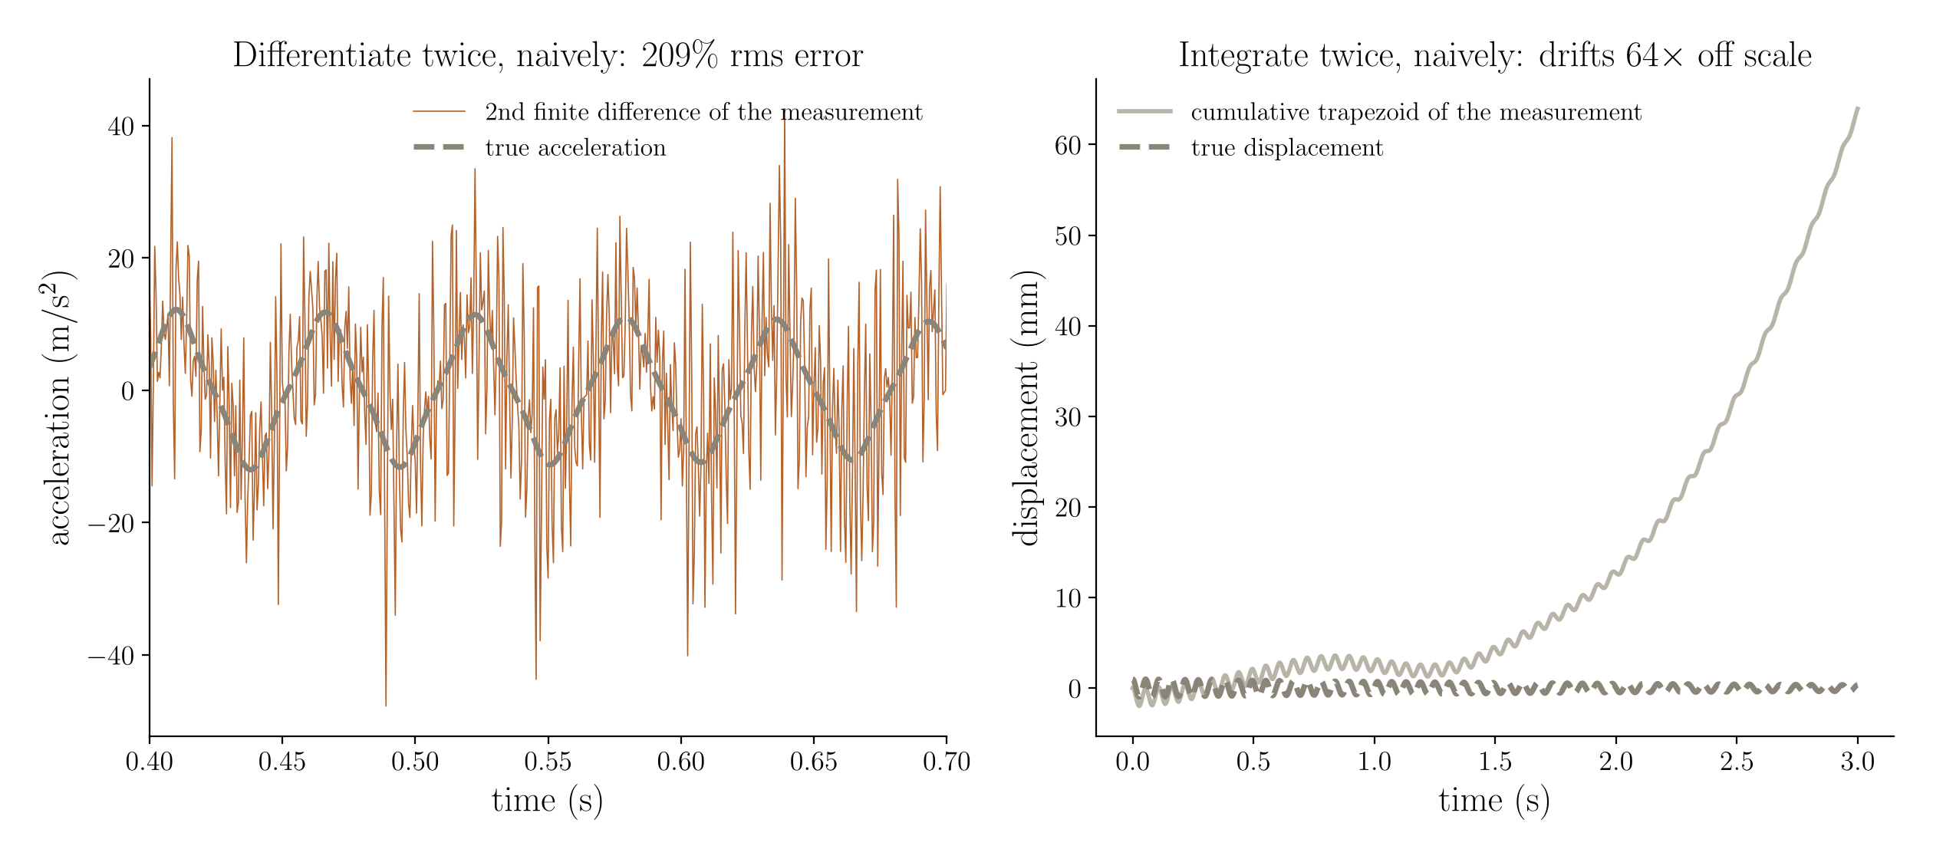
What happens if you ignore it
THE PROBLEM
Left: second central difference of a 1% noisy position — 209% rms error. Right: plain cumulative trapezoid of an accelerometer with a 0.5% offset — 64x off scale in 3 s.
Notes:
[~1.5 min] Two failure modes, deliberately shown side by side because they look nothing alike. Differentiation fails by adding high-frequency noise you can see. Integration fails by adding a low-frequency drift that looks smooth and plausible — which is far more dangerous, because a drifting displacement record can survive review. Note the asymmetry: the differentiated signal is obviously wrong; the integrated one is quietly wrong.

Slide 6
The only cure: state a prior
THE PROBLEM
Methods differ only in which regularity prior they impose — pick the row you actually believe
What you are willing to assume | The method it gives you
The signal is bandlimited and periodic | Spectral / FFT differentiation
It is locally a low-order polynomial | Savitzky–Golay, Lanczos
It lies in a low-rank delay-embedding subspace | Delay SVD (SSA) / SOD — now in the toolbox
Its p-th derivative is small in L2 | Whittaker–Henderson, Tikhonov, smoothing spline
Its derivative is piecewise constant (L1) | Total variation (Chartrand)
It is an integrated Wiener process | Kalman / RTS smoother ≡ Gaussian process
Its third derivative is bounded by a known constant | Levant sliding-mode (causal, online)
Notes:
[~1.5 min] This table is the map for the rest of the talk. Walk down it once. Stress that these are not seven unrelated tricks: they are seven answers to one question. The two most people already know are the first and third rows. Rows 4–7 are the ones that repay attention. Say explicitly: if you cannot state which row you believe, you are not choosing a method, you are accepting a default. [UPDATED] The delay-embedding row is no longer a pointer to elsewhere: section 3 implements it and it wins on quasi-periodic records.

Slide 7
Differentiation methods
01
Notes:
[~0.2 min] Section divider: one family per prior.

Slide 8
Spectral (FFT) differentiation
DIFFERENTIATION
Multiply the spectrum by (iω)ⁿ, roll off above a cutoff, transform back.
STRENGTHS
Exact for a bandlimited periodic signal — no discretisation error at all
Most accurate of any method in the interior of a long record (0.54% velocity error here)
Trivial to implement, O(N log N), and the cutoff has an obvious physical meaning
The natural choice when you already work in the frequency domain
LIMITATIONS
Enforces periodicity — catastrophic at the record ends (next slide)
Needs uniform sampling and a gap-free record
Cutoff must be chosen; too high amplifies noise, too low removes signal
Leakage if the record is not an integer number of periods (taper, then divide it out)
USE IT WHEN The record is long, uniformly sampled, and you only care about the middle of it.
Notes:
[~1.5 min] Most people in a vibrations group already use this. Give it full credit: in the interior it genuinely wins. The point of the next slide is that 'in the interior' is doing a lot of work in that sentence.

Slide 9
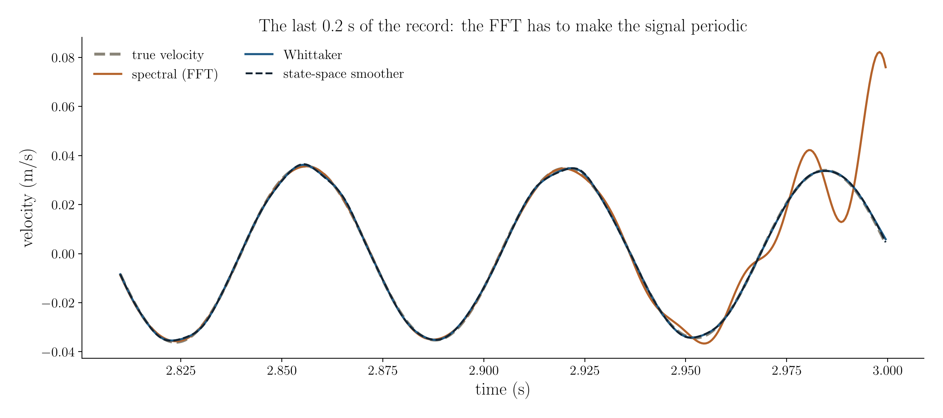
The FFT caveat that costs people real results
DIFFERENTIATION
Velocity over the last 0.2 s of a 3 s free decay. Interior error 0.54%; over the full record, 8.4% — a 15x degradation.
Notes:
[~1.5 min] This is the single most practically important slide for anyone doing free-decay testing. The FFT must make the signal periodic, so it splices the end of the record to the beginning — and a decay has a large amplitude at the start and a small one at the end. The estimate rings to bridge that discontinuity. Say the consequence out loud: in free-decay work the information you want — the high-amplitude, strongly nonlinear cycles — is exactly at the start of the record, in the region the method corrupts. Whittaker and the state-space smoother are flat across the whole record; that is why they are the defaults later in the talk.

Slide 10
Savitzky–Golay
DIFFERENTIATION
Fit a low-order polynomial in a sliding window; differentiate the polynomial analytically.
STRENGTHS
Simple, fast, and available in every toolbox
No periodicity assumption — much better behaved at the ends than the FFT
Preserves peak heights and widths better than a plain moving average
Window length maps to a cutoff via Schafer's rule, so it can be set from physics
LIMITATIONS
Two knobs (window, polynomial order) that interact
Implicitly assumes the signal is polynomial over the window — poor for lightly damped resonance
Noticeably worse than an L2 penalty for second derivatives (2.4% vs 0.9% here)
Edge behaviour depends on the padding convention, which differs between implementations
USE IT WHEN You want something defensible in ten lines with no linear solve, and first derivatives are enough.
Notes:
[OPTIONAL — drop this slide first if running long]
[~1 min] Worth including because it is the most widely used method in experimental practice and it is not a bad one. The honest summary: fine for velocity, mediocre for acceleration. Mention the implementation detail — MATLAB and scipy pad differently at the ends, which is a real reproducibility trap when moving code between them.

Slide 11
Whittaker–Henderson and Tikhonov
DIFFERENTIATION
Penalise the p-th derivative in L2: min ‖s − x‖² + λ‖Dᵖs‖². One banded solve.
STRENGTHS
One sparse banded solve — O(N), no iteration, no convergence to check
Flat accuracy across the whole record, ends included
λ has a closed-form map to a cutoff frequency, so no blind parameter sweep
Same machinery runs the integration direction (Tikhonov) — one implementation, both tasks
LIMITATIONS
Still one knob, and the optimum is sharp for second derivatives
Quadratic penalty rounds off genuine corners — wrong prior for impacting systems
The normal matrix is badly scaled; use a sparse direct solver, not an iterative one
No uncertainty estimate comes out of it
USE IT WHEN This is the sensible default for smooth vibration data. Start here.
Notes:
[~1.5 min] This is the recommendation for most of the audience's work. Emphasise the tuning rule — the response is 1/(1 + λω^2p), so λ = (2πfc)^−2p converts a cutoff in hertz into the penalty weight. That single fact removes most of the folklore around 'choosing the smoothing parameter'. Note that Tikhonov integration is the same equation read right to left.

Slide 12
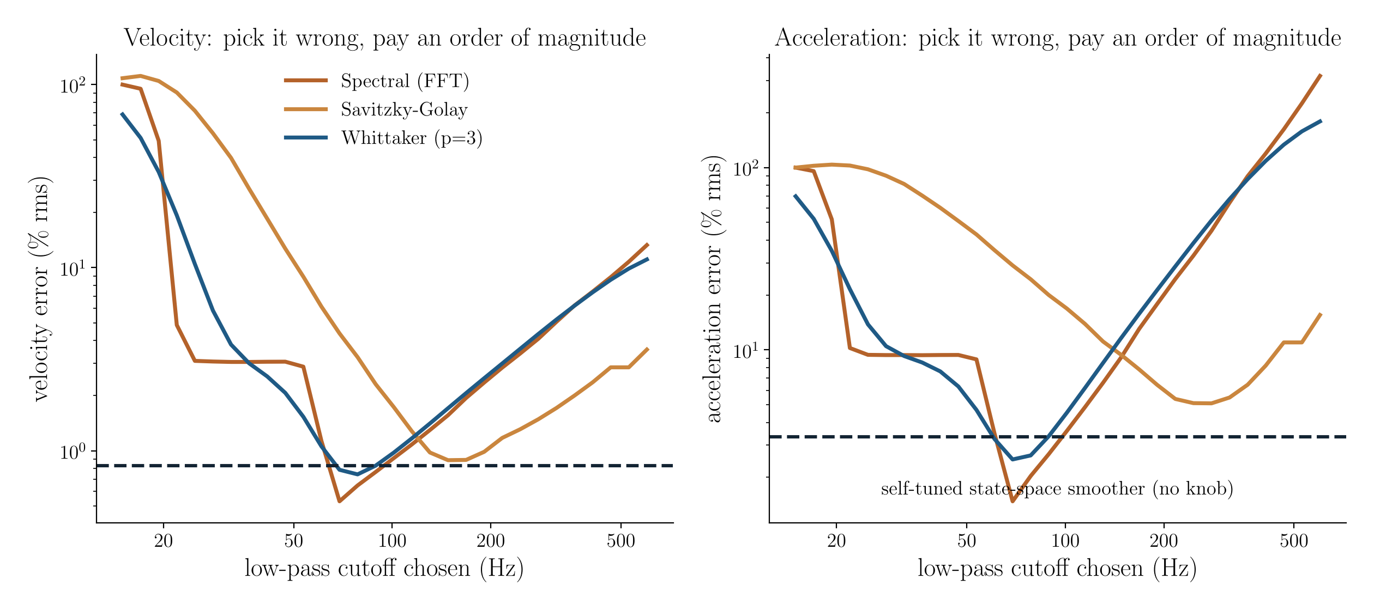
Every method has an optimum you have to find
DIFFERENTIATION
Error against exact ground truth as the cutoff is swept, 1% position noise. The dashed line is the self-tuned state-space smoother, which has no knob at all.
Notes:
[~1.5 min] The U-shape is the bias–variance trade-off made visible: too much smoothing on the left, too much noise on the right. Two things to point out. First, the minima are sharp — a factor of three error in the cutoff costs an order of magnitude in the acceleration estimate. Second, and this is the uncomfortable part, these curves were computed WITH knowledge of the true answer. On a real record you cannot draw them. That is the argument for the method on the dashed line.

Slide 13
Setting the knob from physics, not from a sweep
DIFFERENTIATION
Every L2 method has a closed-form map from a corner frequency in Hz to its penalty weight
Method | Parameter | Rule | Set it from
Whittaker–Henderson (order p) | λ | λ = (2π fᶜ)⁻²ᵖ | Highest mode you care about
Tikhonov integration (order n) | λ | λ = (2π fᶜ)²ⁿ | Lowest frequency you trust
Savitzky–Golay | window 2M+1 | fᶜΔt ≈ (k+1)/(3.2M − 4.6) | Schafer's −3 dB rule
Spectral | cutoff | direct | Where the PSD meets the noise floor
Total variation | α | no closed form | Sweep; scale-sensitive, normalise first
State-space smoother | q | fitted automatically | Marginal likelihood — nothing to set
Notes:
[OPTIONAL — drop this slide first if running long]
[~1 min] Practical slide — tell the audience to photograph it. The message is that 'tune lambda by cross-validation' is usually unnecessary: for the quadratic-penalty family the map from a physically meaningful cutoff to the penalty weight is exact. Start the cutoff at two to three times the highest mode of interest and move it only if the residual shows structure.

Slide 14
Total variation (L1)
DIFFERENTIATION
Penalise ‖Du‖₁ instead of ‖Du‖₂. The L1 norm does not punish a single large jump.
STRENGTHS
The only family that preserves a genuine discontinuity in the derivative
Best method tested at an impact: 16.9% vs 21–25% for every quadratic penalty
Physically the right prior for impacts, stick–slip, backlash, dry friction reversal
Recovers a piecewise-constant derivative exactly in the noise-free limit
LIMITATIONS
Several times worse than an L2 penalty on smooth signals — 5.1% vs 0.5% here
Iterative, no closed form, and the objective is non-smooth
α is tied to absolute signal scale — normalise before, rescale after
The naive solver silently fails to converge (next slide)
USE IT WHEN Your derivative genuinely jumps. Otherwise do not — it is the wrong prior for smooth data.
Notes:
[~1.5 min] Be balanced here. TV is fashionable and it is often applied where it does not belong. The honest position: it wins decisively at a corner and loses decisively on smooth data, and both results are correct because they reflect the prior. For this audience the relevant application is vibro-impact and friction-damped systems.

Slide 15
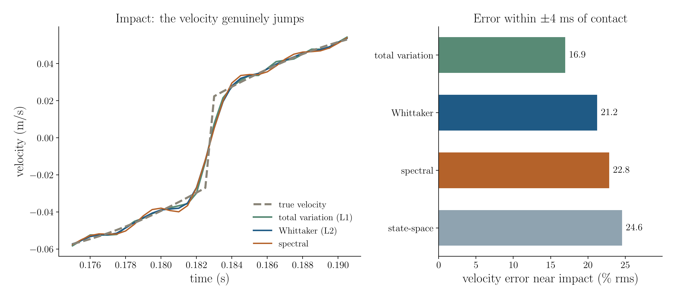
Where the L1 penalty earns its place
DIFFERENTIATION
Vibro-impact oscillator, restitution 0.85. Left: one impact, velocity jumps. Right: velocity error within ±4 ms of contact, best setting per method.
Notes:
[~1.5 min] The left panel shows the mechanism: the quadratic penalties round the corner because a large second difference is expensive under L2; L1 lets one jump through. The right panel quantifies it — a 14% reduction against the best quadratic method. Be honest that this is a real but modest margin, and say why it matters anyway: if you are measuring restitution coefficients, the impact velocity IS the measurement.

Slide 16
A cautionary tale: the solver was the result
DIFFERENTIATION
Reported numbers for an iterative method are claims about the solver as much as the estimator
Chartrand's formulation has a dense, severely ill-conditioned Hessian AᵀA + αL.
Conjugate gradients stalls at any iteration cap. IRLS on the smoothed L1 stalls too — measured rate 0.997 per iteration.
The unconverged iterate acts as extra smoothing and silently changes the answer.
MATLAB's pcg warns. scipy's cg returns the same unconverged vector with no warning at all.
Three successive solvers moved the same benchmark:
smooth signal 3.77% → 4.93% → 5.07% near impacts 17.9% → 16.6% → 19.2%
Under-convergence had been flattering the method in both directions. Only the last pair is the true minimiser.
Fix: substitute w = Au to get L1 trend filtering — the ADMM system is pentadiagonal and constant, so it factors once.
Notes:
[~1.5 min] This slide is here because it generalises far beyond total variation. The specific lesson: whenever you report a result from an iterative method, the convergence status is part of the result. The general lesson: a silent solver is worse than a noisy one — scipy's cg returning an unconverged answer without complaint is how this went unnoticed through several rounds. If the audience takes one methodological point from the talk, make it this one.

Slide 17
Two defaults that failed without a warning
DIFFERENTIATION
Found while porting to MATLAB; both are fixed in both languages
scipy's make_smoothing_spline picks λ by GCV. On the 6000-point decay it returned a flat fit: 100% error.
The exact GCV score, with an O(N) trace, has a clear minimum: 1.18% velocity error. The failure was the implementation, not GCV.
Levant's default bound L used the (n+1)-th derivative. The three-state form needs the third derivative bound for both outputs.
L was about 100× too small: 119% error. With max|jerk| from the state-space smoother: 7.7%, at the swept optimum.
Neither raised an error. Each returned a plausible-looking array.
Same lesson as the solver slide: check a default against a case where you know the answer.
Notes:
[NEW] [OPTIONAL] [~1 min] Two more instances of the solver lesson, both found by cross-checking the MATLAB port against Python. The GCV case matters because the earlier version of this talk blamed GCV itself; the corrected statement is that scipy's selection failed on this record while the exact score works.

Slide 18
State-space: the Kalman / RTS kinematic smoother
DIFFERENTIATION
Model the signal as an integrated random walk; state = [x, v, a, jerk, ...]. Smooth, do not filter.
STRENGTHS
Self-tuning — the single parameter q is fitted by marginal likelihood, no sweep
Handles gaps, non-uniform sampling and multirate channels natively (NaN = missing)
Returns a posterior standard deviation — error bars, not just an estimate
Does differentiation, integration AND sensor fusion with one implementation
O(N), and equivalent to a Gaussian process without the O(N³)
LIMITATIONS
Costs something against a perfectly tuned method on very clean data (up to 3.7x)
The prior is smoothness — it rounds corners just as the L2 penalties do
More code than a banded solve; the likelihood optimisation needs a sane bracket
Bias states are weakly identified over short records — a drift absorber, not a calibration
USE IT WHEN You want one tool that covers every case, or you have two sensors, or you need uncertainty.
Notes:
[~1.5 min] This is the recommendation to end on. Explain the equivalence chain briefly: an integrated-Wiener state-space model IS a smoothing spline IS a Gaussian process with a particular kernel — but the recursive form is linear time instead of cubic. The self-tuning is the practical selling point: the marginal likelihood of the data under the model is a function of q alone, so you maximise it and you are done. No held-out set, no L-curve, no eyeballing.

Slide 19
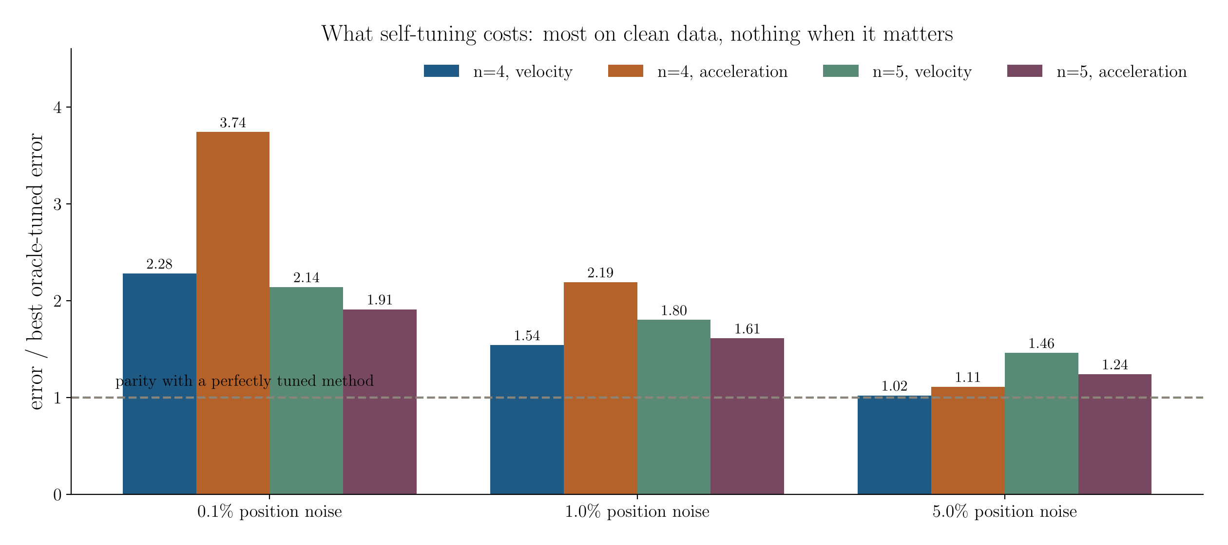
What does self-tuning actually cost?
DIFFERENTIATION
Ratio of the self-tuned error to the best error achieved by ANY method in this study with its knob tuned against ground truth.
Notes:
[~1 min] An honest accounting, and the shape is favourable. On very clean data the self-tuned smoother pays up to 3.7x — but there the absolute errors are a fraction of a percent and the choice does not matter. At 5% noise, where tuning actually decides the answer, it reaches parity. Practical note: raise the state dimension from 4 to 5 for clean records if you want acceleration — it roughly halves the low-noise penalty. Remember the comparison is against an oracle you do not have on real data.

Slide 20
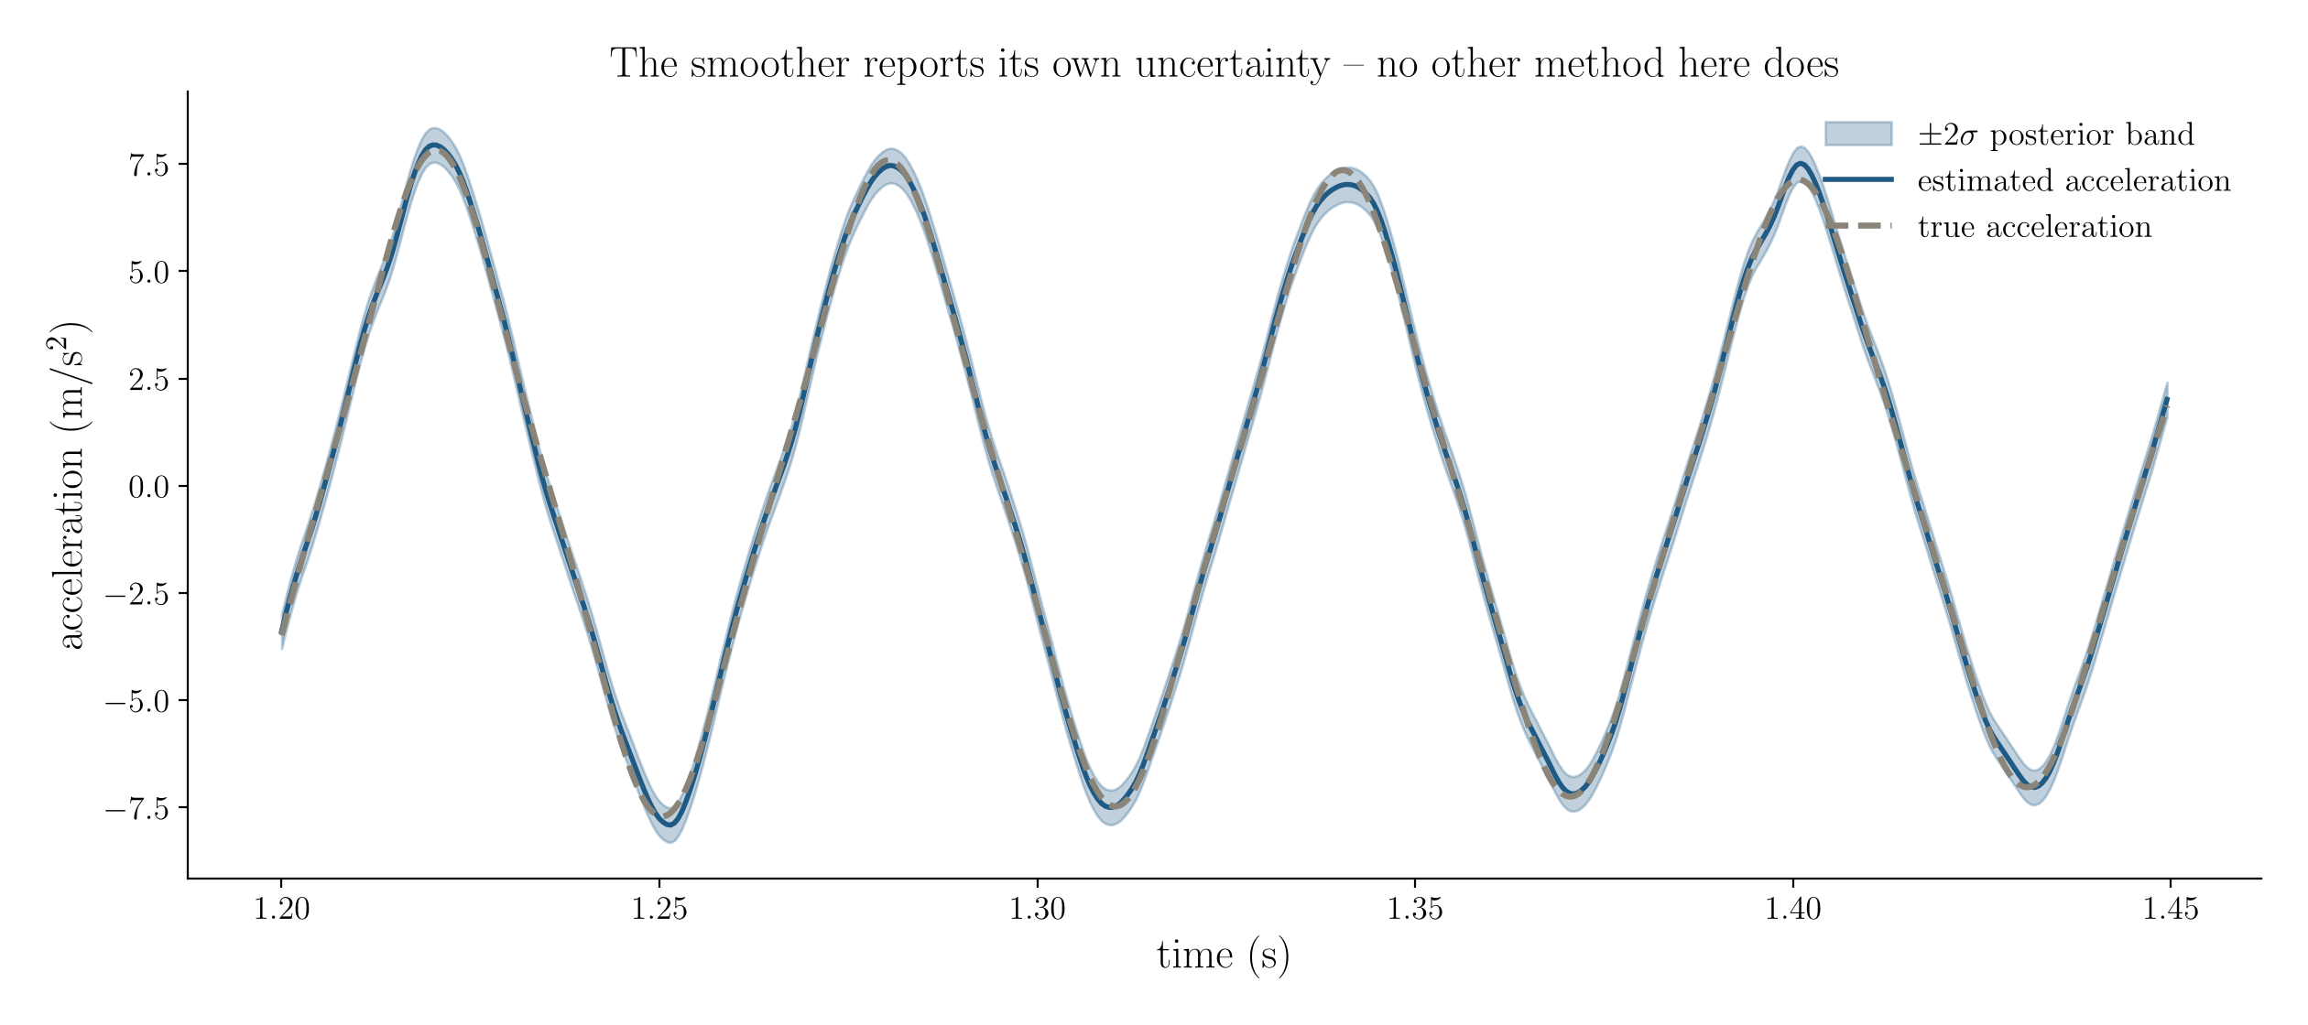
It tells you how much to trust it
DIFFERENTIATION
Acceleration from a noisy position record with its ±2σ posterior band. No other method in this comparison produces one.
Notes:
[OPTIONAL — drop this slide first if running long]
[~1 min] Short slide but an important one. Every other method returns a curve; this one returns a distribution. The practical rule: if the feature you are about to interpret is narrower than the band, it is not there. Mention that the band widens automatically over gaps and at the record ends, which is exactly the behaviour you want and exactly what the FFT does not do.

Slide 21
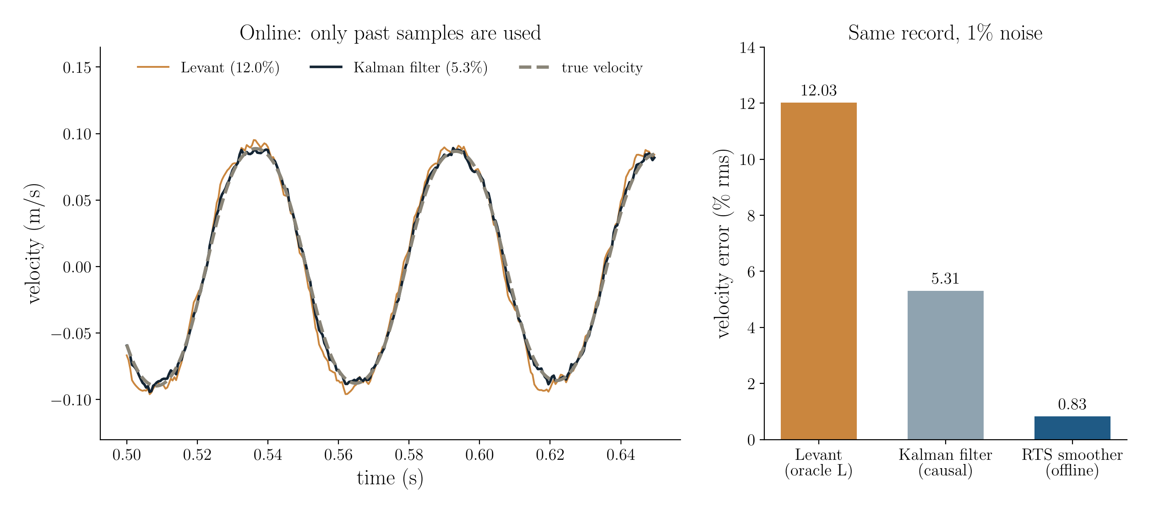
Online, the Kalman filter halves Levant's error
DIFFERENTIATION
Forward pass of the same state-space model, self-tuned: 5.3% velocity error against 12.0% for Levant at its best bound. Offline, the RTS smoother reaches 0.83%.
Notes:
[NEW] [~1.5 min] The causal filter is the forward half of the smoother we already have, so it costs nothing to add. It uses only past samples, so it can run in a control loop. Fit q once on a calibration record for genuine online use. Levant keeps one advantage: finite-time exactness under a known bound.

Slide 22
Delay reconstruction
02
Notes:
[NEW] [~0.2 min] Section divider: the delay-embedding prior, now implemented.

Slide 23
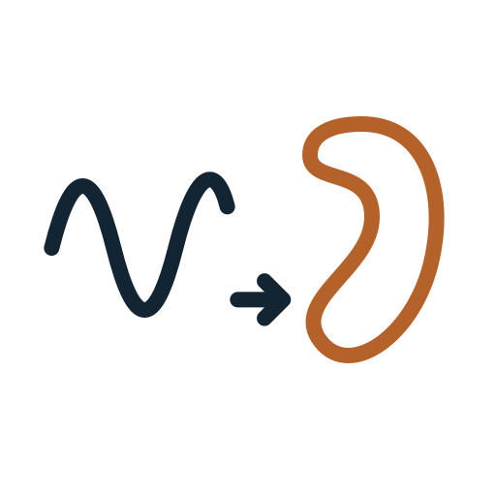
Differentiate in the delay space, not on the raw record
DELAY RECONSTRUCTION
Prior: the signal lies in a low-dimensional subspace of its delay reconstruction
Embed: rows of a Hankel matrix are delay vectors [xₖ, xₖ₊₁, …, xₖ₊ₗ₋₁], window L = N/3.
Decompose: SVD of that matrix; keep directions above the Gavish–Donoho hard threshold.
Guard: drop any kept direction whose mean frequency lies above the band where the PSD clears the noise floor.
Reconstruct: project, then average along anti-diagonals. Several sensors embed side by side.
Differentiate the reconstruction with a fourth-order stencil. It is band-limited, so the stencil error is negligible.
No knob: L from the record length, dimension from the threshold, guard from the spectrum.
Notes:
[NEW] [~1.5 min] This is singular spectrum analysis used as a differentiator. Broomhead and King showed that for short windows the principal axes look like Legendre polynomials, so the method reduces to a local polynomial fit; with long windows the axes become data-adaptive band-pass filters. The guard matters: at long windows one noise direction at 637 Hz passed the threshold and cost 90% in acceleration until the guard removed it.

Slide 24
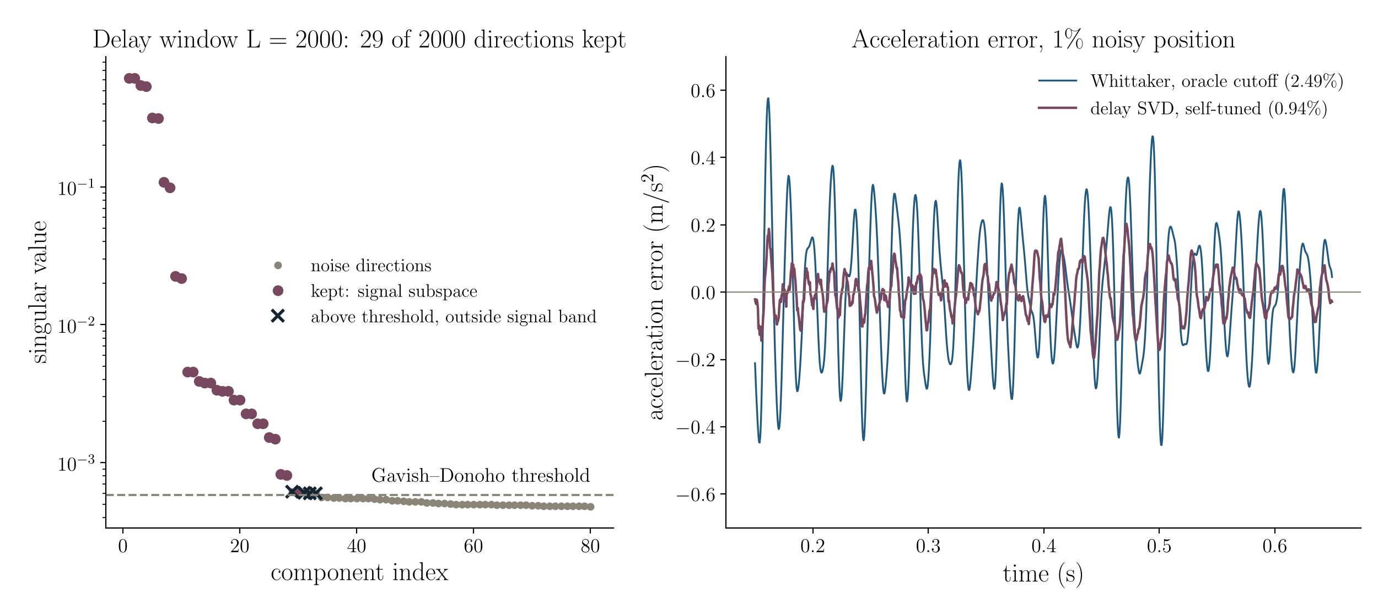
29 of 2000 delay directions carry the decay
DELAY RECONSTRUCTION
Left: singular spectrum of the trajectory matrix, 1% position noise. Right: acceleration error of the self-tuned delay estimate against Whittaker at its oracle cutoff.
Notes:
[NEW] [~1.5 min] Left: the decay occupies a few pairs of directions per harmonic; everything below the dashed threshold is noise. The orange crosses passed the threshold but sit outside the signal band, so the guard drops them. Right: the delay estimate's error is a third of the best-tuned quadratic penalty's.

Slide 25
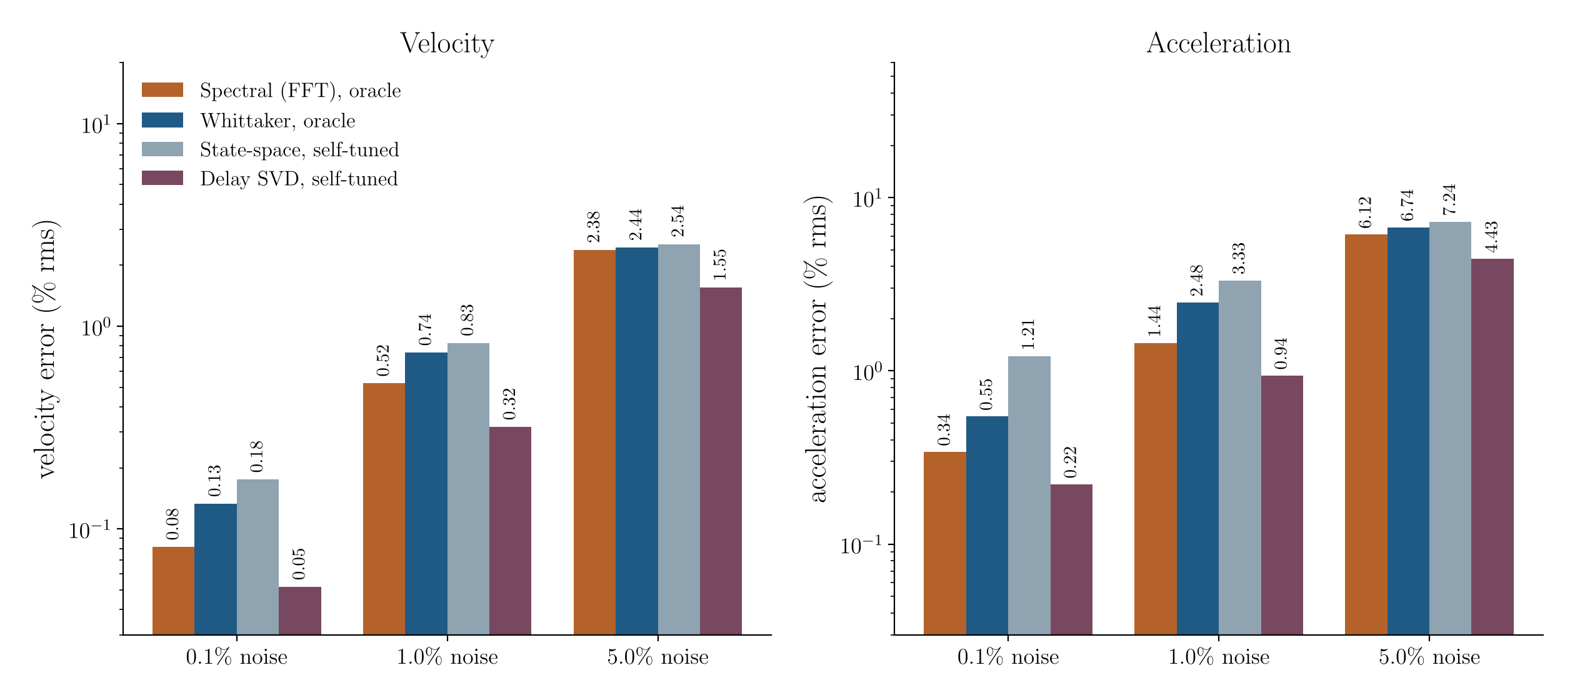
Self-tuned delay SVD beats every oracle-tuned method
DELAY RECONSTRUCTION
Duffing free decay, same noise realisations as the main benchmark. Oracle = cutoff swept against the exact answer. The delay method sees no truth.
Notes:
[NEW] [~1.5 min] At 1% noise: 0.32% velocity and 0.94% acceleration, against 0.52% and 1.44% for the spectral method with a perfect cutoff. The reason is the prior, not cleverness: a lightly damped decay really is low-rank in delay coordinates. The next two slides say where that stops being true.

Slide 26
Delay reconstruction (SSA)
DELAY RECONSTRUCTION
Project onto the signal subspace of the trajectory matrix; differentiate or integrate the reconstruction.
STRENGTHS
No knob: window from record length, dimension from the hard threshold
Best accuracy of any method tested on decays, by 1.4–1.6× at every noise level
Several sensors share one subspace (multichannel SSA)
Full-record accuracy: no FFT-style edge damage
LIMITATIONS
The prior is quasi-periodicity: no gain at impacts (23% vs 17% for TV)
Cost grows as L²N: about 1 s for N = 6000, L = 2000
Needs uniform sampling and a gap-free record
No error bars, and integration still needs a corner
USE IT WHEN The record is a free decay, a ringdown or a steady forced response.
Notes:
[NEW] [~1.5 min] Be clear about the scope: the win comes from a prior that lightly damped structures satisfy. On the vibro-impact record it is no better than the quadratic penalties, and total variation still wins there.

Slide 27
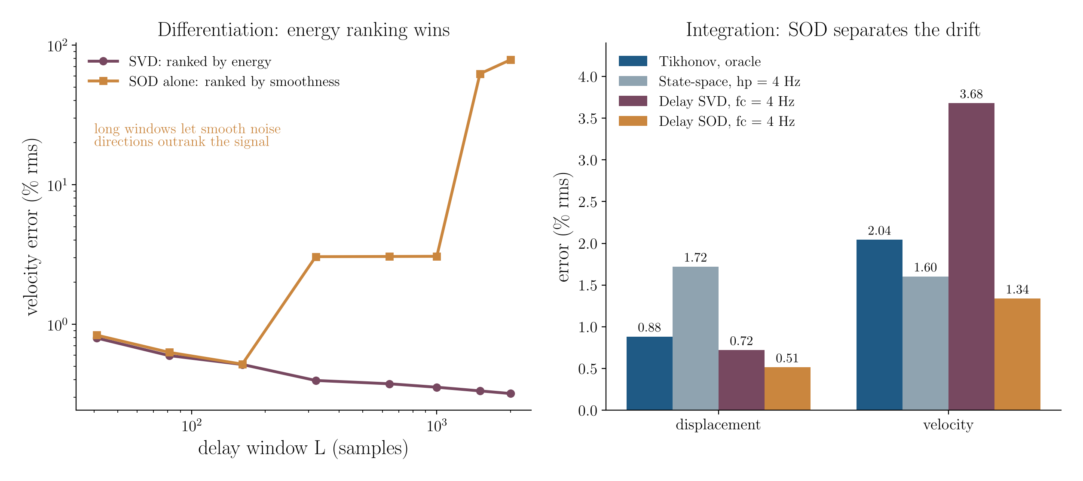
SVD for differentiation, SOD for integration
DELAY RECONSTRUCTION
Left: SOD alone ranks directions by smoothness, so long windows admit smooth noise. Right: SOD inside the SVD subspace orders it by frequency and isolates the drift.
Notes:
[NEW] [~1.5 min] We compared the two bases. Smooth orthogonal decomposition ranks by smoothness and ignores energy; with long windows there are noise directions smoother than the signal, and they win (left, purple). Used inside the SVD signal subspace instead, SOD reorders that subspace by frequency, which is exactly what drift removal needs: 0.51% displacement error against 0.72% with SVD ordering.

Slide 28
Where delay reconstruction helps, and where it does not
DELAY RECONSTRUCTION
Velocity / acceleration error, % rms; integration rows give displacement / velocity
Record | Best competitor | Delay method | Verdict
Duffing decay, 1% noise | 0.52 / 1.44 spectral, oracle | 0.32 / 0.94 SVD | helps
3-DOF chain, mass 3 | 0.95 / 2.21 Whittaker, oracle | 0.38 / 0.64 SVD | helps
3-DOF chain, 3 sensors jointly | 0.95 / 2.21 Whittaker, oracle | 0.26 / 0.63 MSSA | small extra gain
Vibro-impact, near impacts | 17.0 total variation | 23.1 SVD | does not help
Drifting accelerometer | 0.88 / 2.04 Tikhonov, oracle | 0.51 / 1.34 SOD | helps
Drifting accelerometer | 0.50 / 0.25 spectral, oracle | 0.51 / 1.34 SOD | spectral wins here
Notes:
[NEW] [OPTIONAL] [~1 min] The honest map. Joint processing of the three chain sensors helps the weaker channels and slightly hurts the strongest one, so it is a small extra gain, not a second win. On this narrowband record the oracle spectral integrator is still best for velocity; with a mode near the drift band that ranking changes.

Slide 29
Integration and fusion
03
Notes:
[~0.2 min] Section divider: the reverse direction and the two-sensor case.

Slide 30
Integration has an extra problem: the constants
INTEGRATION
Two integration constants are unobservable — every method makes an assumption, so make yours explicit
Acceleration determines displacement only up to x₀ + v₀t. Those two constants are not in the data.
A DC offset of 0.5% integrates twice into a parabola that swamps the signal within seconds.
Every working method therefore imposes a high-pass — the question is whether it admits to it.
Detrend + high-pass filter: fast, but the corner is chosen by eye and distorts the low modes.
Tikhonov: the corner appears explicitly as λ = (2πfᶜ)²ⁿ. One banded solve.
State-space with a bias state: the corner becomes a prior on the unobservable directions.
Choose the corner below your lowest mode of interest and above the drift band — and say what you chose.
If you also have a displacement channel, you do not need the corner at all. That is the next slide.
Notes:
[~1.5 min] The conceptual point: this is not a numerical difficulty, it is a genuine identifiability gap. No algorithm can recover what the sensor did not measure. What distinguishes good practice from bad is whether the assumption is stated. A detrend-and-filter pipeline makes exactly the same assumption as the Tikhonov solve, but hides it in a filter design step. Encourage the audience to report their high-pass corner in papers the way they report a sampling rate.

Slide 31
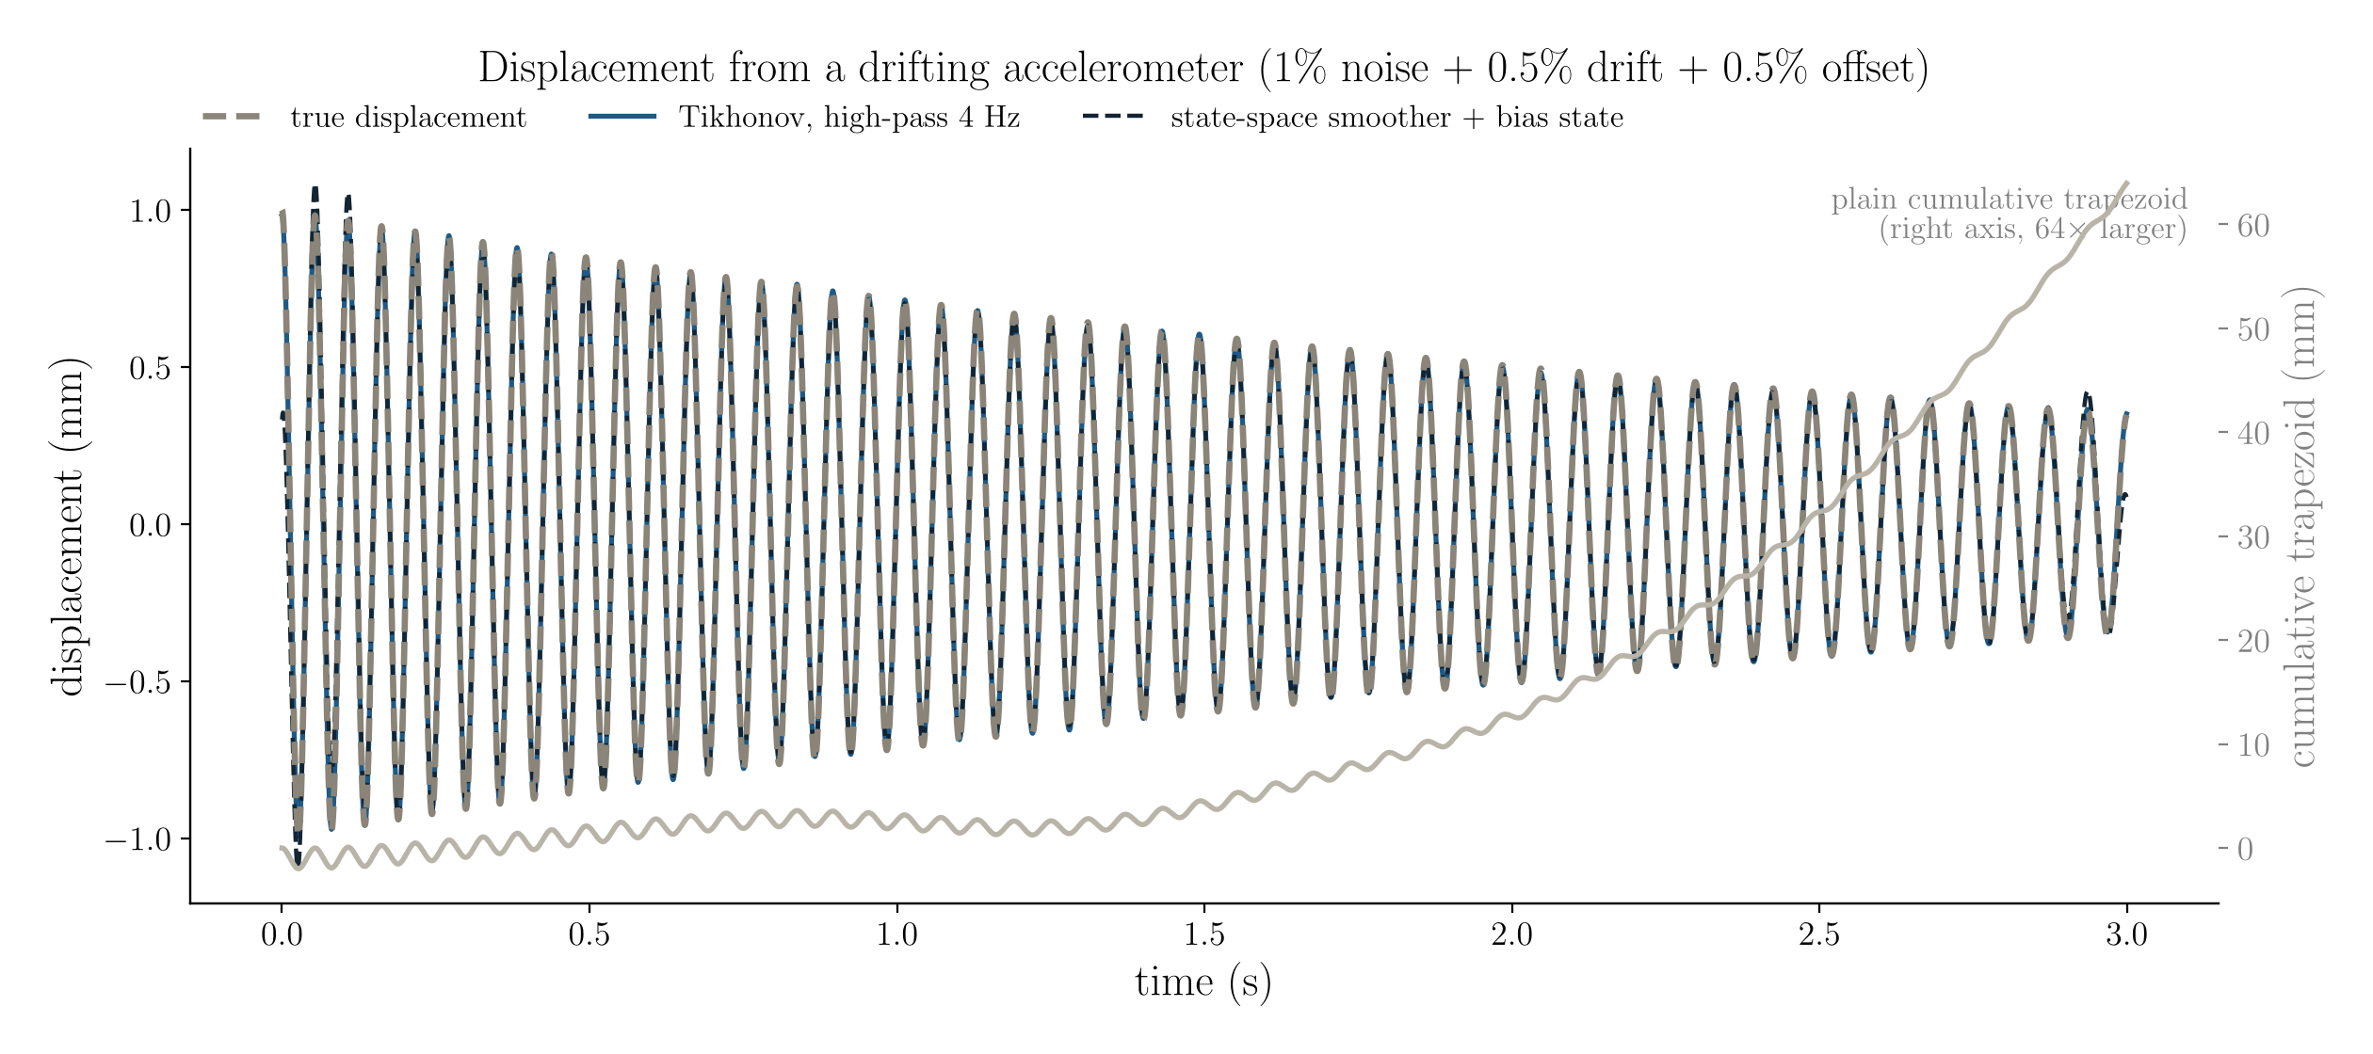
Integration done three ways
INTEGRATION
Displacement recovered from an accelerometer with 1% noise, 0.5% drift and a 0.5% offset. Regularised methods overlay the truth; the plain trapezoid needs its own axis.
Notes:
[~1 min] Quick slide. The two regularised curves are indistinguishable from truth at this scale — 0.9% and 1.7% rms. The grey curve is on a separate axis because it is 64 times larger. Point at the grey curve and note that it is smooth and monotone: it looks like a physical drift, not like an error, which is what makes it dangerous.

Slide 32
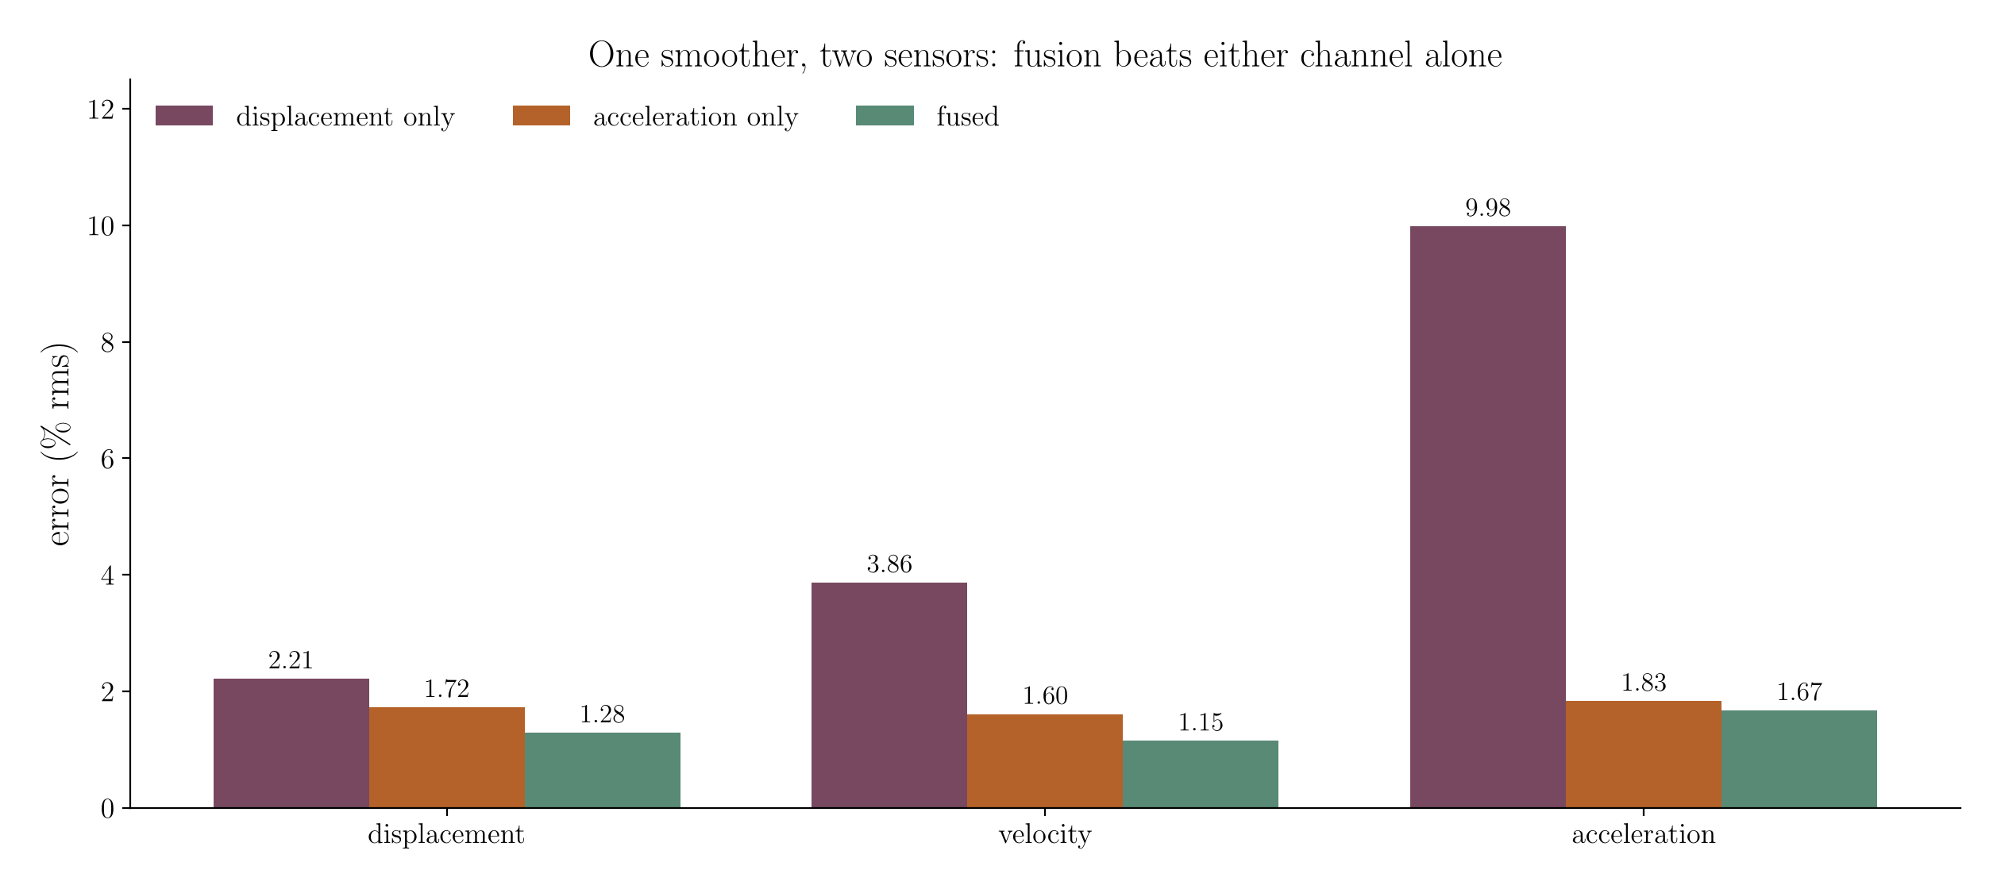
If you have both sensors, use both at once
INTEGRATION
One state-space smoother, 200 Hz displacement at 3% noise fused with 2 kHz acceleration at 1% noise plus drift.
Notes:
[~1.5 min] The strongest practical result in the talk. Fusion beats either channel alone on all three kinematics, and the reason is structural, not numerical: displacement observes the low frequencies where the accelerometer has nothing, and acceleration observes the high frequencies where the displacement sensor is noise-limited. Critically, fusing removes the high-pass corner entirely — the displacement channel makes the two integration constants identifiable, so there is no longer an arbitrary choice to defend. Note the sampling rates differ by 10x and the smoother does not care.

Slide 33
In practice
04
Notes:
[~0.2 min] Section divider: what to do on Monday.

Slide 34
The comparison on one slide
IN PRACTICE
Knobs = free parameters you must choose; three methods now set their own
Method | Prior | Knobs | Ends | Gaps | Error bars | Best at
Spectral (FFT) | bandlimited | 1 | poor | no | no | long uniform records
Savitzky–Golay | local polynomial | 2 | fair | no | no | quick first derivatives
Whittaker / Tikhonov | small p-th deriv. | 1 | good | no | no | smooth data, both directions
Smoothing spline | small p-th deriv. | 1 | good | yes | no | non-uniform sampling
Total variation | piecewise-const. | 1 | good | no | no | impacts, stick–slip
State-space smoother | integrated Wiener | 0 | good | yes | yes | everything else, and fusion
Delay SVD / SOD (new) | low-rank delay space | 0 | good | no | no | free decays, ringdowns
Kalman filter, causal (new) | integrated Wiener | 0 | n/a | yes | yes | online / control loops
Levant sliding mode | bounded 3rd deriv. | 1 | n/a | no | no | finite-time exactness
Notes:
[~1.5 min] The summary slide — leave it up while you talk. Read down the 'knobs' column: that is the column that determines how reproducible somebody else's result will be. Read down 'error bars': only one method gives you any. Invite questions here if you are running to time; the remaining slides are practical advice. [UPDATED] Two new zero-knob rows: delay reconstruction (dimension from the Gavish-Donoho threshold) and the causal Kalman filter, which displaces Levant as the online recommendation.

Slide 35
What to actually do
IN PRACTICE
A decision list, in the order the questions actually arise
Smooth data, one sensor, want it simple → Whittaker–Henderson, cutoff from physics.
Smooth data, want no knob or need uncertainty → state-space smoother, nstate = 4 (5 if very clean).
Quasi-periodic record (free decay, ringdown, steady forced response) → delay SVD, no knob.
Two sensors → always fuse them in one smoother. Never process them separately and reconcile after.
Impacts, backlash, stick–slip → total variation, and check that the solver converged.
Integrating acceleration alone → Tikhonov or a bias-state smoother; report the high-pass corner.
Online or in a control loop → the causal Kalman filter; Levant only when you need finite-time exactness with a known bound.
Never: a bare finite difference, or a bare cumulative trapezoid.
Notes:
[~1.5 min] The takeaway slide. Read it as a sequence of questions rather than a ranking. The third line is the one most often violated in practice — people process displacement and acceleration separately, get two different answers, and then argue about which to trust. Fusing them is not an advanced technique; it is one function call. [UPDATED] Two changes: the delay line, and the online line now points to the causal Kalman filter, which halves Levant's error on the benchmark.

Slide 36
Validating on a record with no ground truth
IN PRACTICE
Four checks that cost minutes and one habit that costs nothing
Everything shown here was measured against an exact solution. On your data you have none — so:
Cross-check. Differentiate the estimated displacement twice; compare with the measured acceleration in the band you trust.
Read the posterior band. If the feature you are interpreting is narrower than ±2σ, it is not there.
Move the knob. Change the cutoff by a factor of two either way; if the answer moves more than the band, report that.
Hold out a channel. With two sensors, fit on one and predict the other — the honest test.
State your choices. Method, cutoff or high-pass corner, and solver convergence, alongside the sampling rate.
Notes:
[OPTIONAL — drop this slide first if running long]
[~1 min] Close the methods content here. The last bullet is a plea: these choices are as consequential as the sampling rate and are almost never reported. If a result depends on the cutoff, that dependence belongs in the paper.

Slide 37
Summary
IN PRACTICE
Differentiating displacement and integrating acceleration are one ill-posed problem, not two.
Noise amplification is a property of the operator. Every method you can choose adds a prior instead.
So the real question is never 'which filter' — it is 'what do I believe about this signal?'
For smooth vibration data: a quadratic penalty, tuned from a cutoff in hertz.
For a quasi-periodic record: project onto its delay-space subspace first. Self-tuned, it beat every oracle-tuned method here.
For a genuine corner: an L1 penalty, with the solver's convergence checked.
For anything else — gaps, two sensors, no time to tune, or a need for error bars: the state-space smoother.
And if you have displacement and acceleration, fuse them. It is strictly better and it removes a knob.
Notes:
[~1 min] Close on the third bullet — it is the reframing that makes the rest follow. Then offer the code. Total elapsed should be about 30 minutes with a little room for questions during the comparison table.

Slide 38
Implementation
IN PRACTICE
Python and MATLAB implementations of every method here, with matching names.
kin_diff_whittaker, kin_diff_spectral, kin_diff_savgol, kin_diff_tvreg, kin_diff_spline, kin_diff_gp, kin_diff_levant
kin_int_tikhonov, kin_int_spectral, kin_int_trapz_detrend
kin_delay_project, kin_diff_delay, kin_int_delay — delay reconstruction, SVD or SOD
kin_smooth — differentiation, integration, fusion; causal option for online use
Cross-validated between the two languages: 38 of 38 checks pass, agreement 1e-16 to 1e-4.
Notes:
[~0.5 min] Hand off the code. Offer to run any of these on somebody's record after the talk. [UPDATED] The MATLAB port is now complete (it previously lacked the spline, GP, Levant and trapezoid methods) and the delay-reconstruction references are added.

Slide 39
References
IN PRACTICE
Primary sources for each family, not a full bibliography
Chartrand (2011), Numerical differentiation of noisy, nonsmooth data — ISRN Appl. Math.
Eilers (2003), A perfect smoother — Anal. Chem. 75:3631
Särkkä & Solin, Applied Stochastic Differential Equations, CUP 2019
Kim, Koh, Boyd & Gorinevsky (2009), l1 trend filtering — SIAM Review 51(2):339
Levant (1998), Robust exact differentiation via sliding mode technique — Automatica 34:379
Broomhead & King (1986), Extracting qualitative dynamics from experimental data — Physica D 20
Golyandina, Nekrutkin & Zhigljavsky (2001), Analysis of Time Series Structure: SSA — CRC
Gavish & Donoho (2014), The optimal hard threshold for singular values is 4/√3 — IEEE Trans. Inf. Theory
Chelidze & Zhou (2006), Smooth orthogonal decomposition-based vibration mode identification — J. Sound Vib.
Notes:
[~0.2 min] Primary sources. The last four support the delay-reconstruction section.

Slide 40
Questions
web.uri.edu/nld · chelidze@uri.edu
Notes:
[~0.2 min] Leave this up for questions.

