Slide 1

Notes:
NCVD toolbox, version 1.0. Python package and MATLAB package with identical APIs, a manual, and these slides. The animations in this deck run live in the browser from data computed with the toolbox.

Slide 2
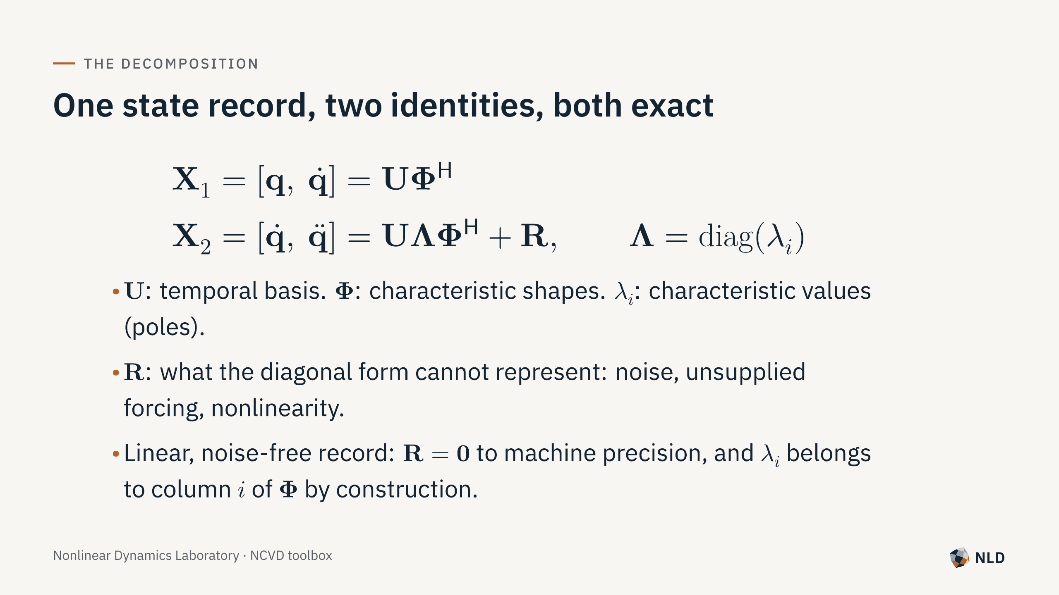
Notes:
Rows are time instants. For a linear system X2 = X1 A^T. The first identity is always exact; the second is exact for clean linear data and is the least-squares remainder otherwise.

Slide 3
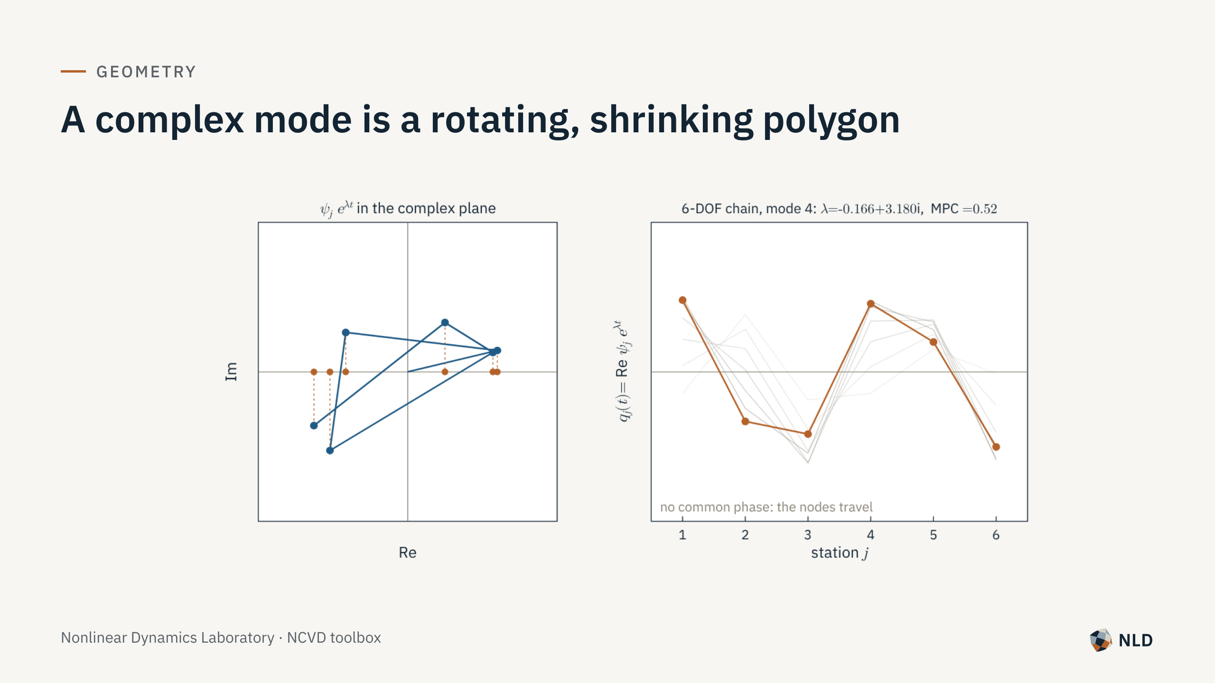
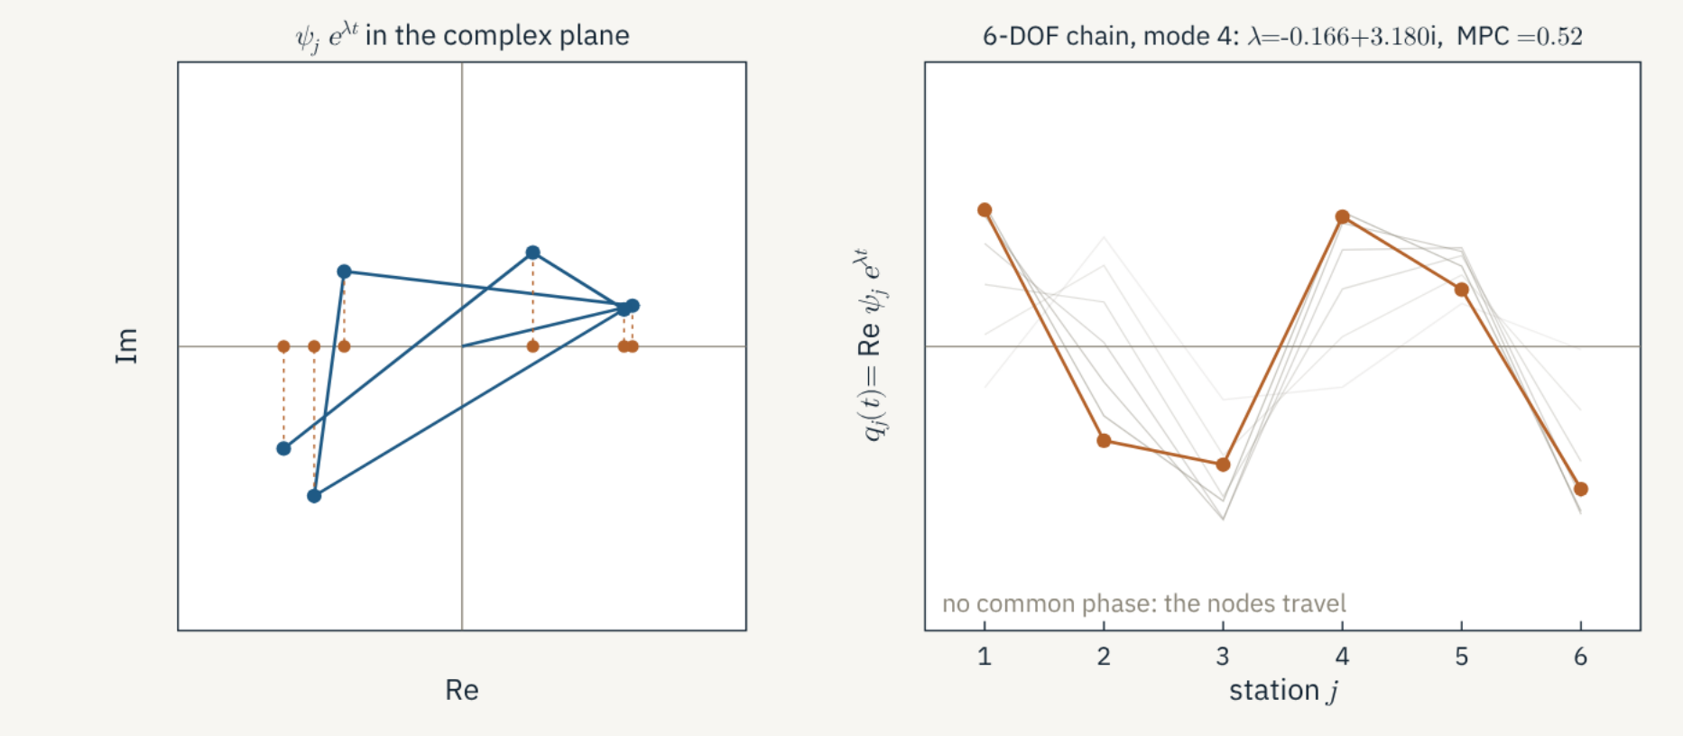
Notes:
Each station contributes a phasor psi_j exp(lambda t). With non-proportional damping the phases differ, so the polygon rotates at Im lambda and shrinks at Re lambda; the motion is its real part and the nodes travel. MPC measures how close the polygon is to a line (0.52 here). 6-DOF chain with dampers at masses 1 and 2. Live animation computed from the toolbox's true modes.

Slide 4
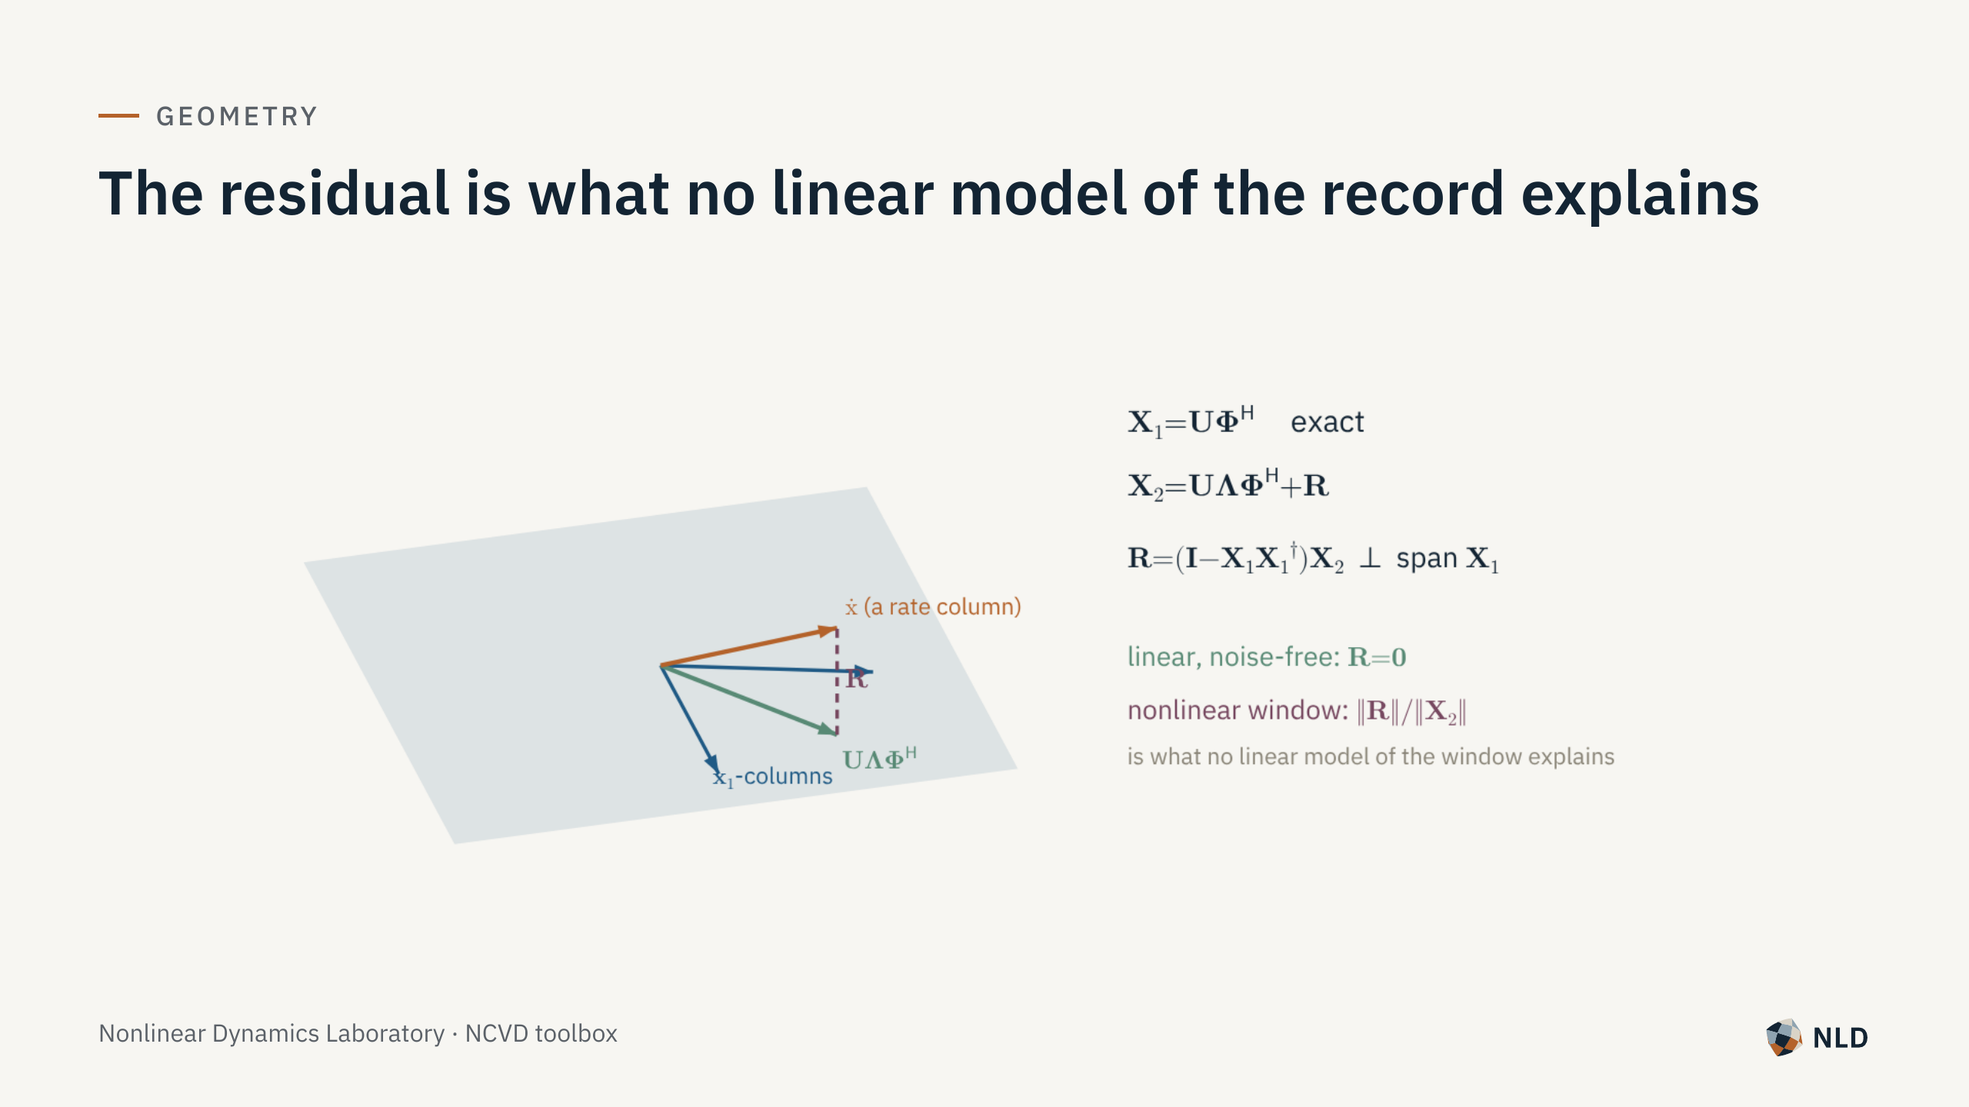
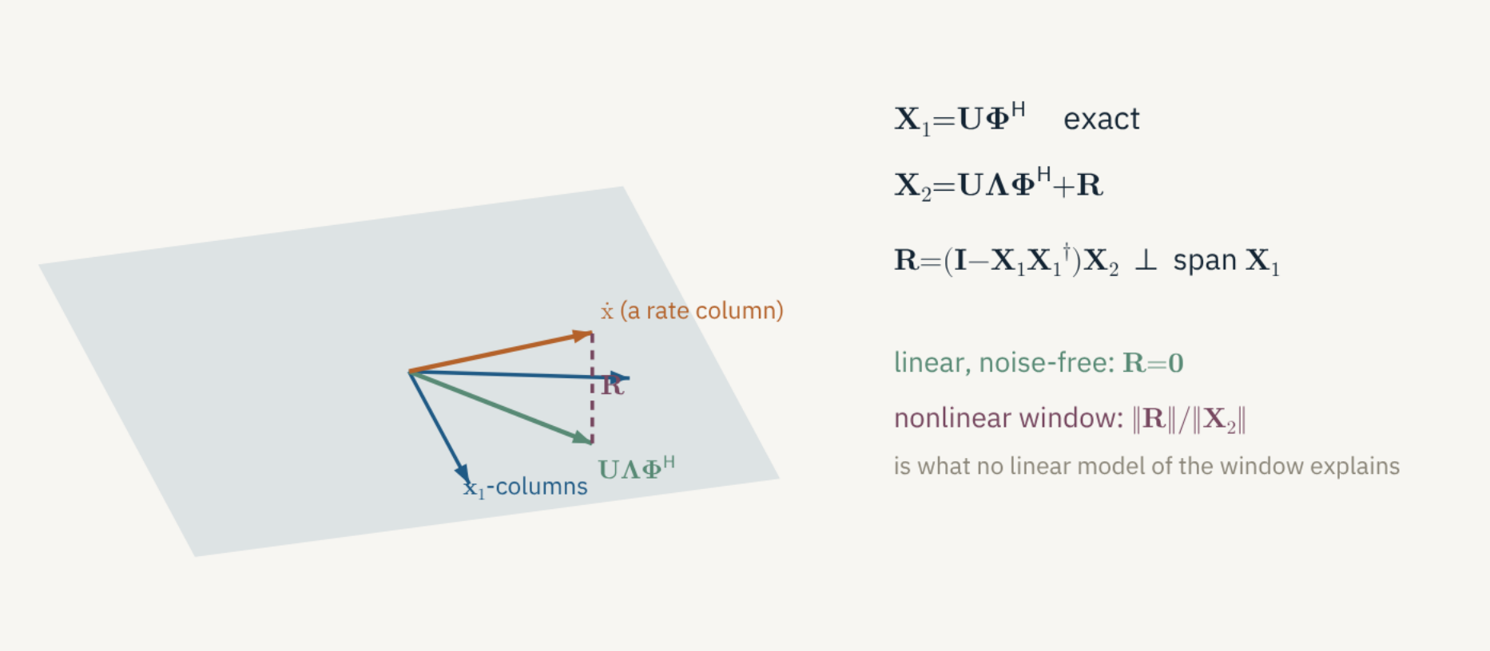
Notes:
Each rate column splits into its projection on span X1, reproduced exactly by U Lam Phi^H, and a remainder orthogonal to it. For a window of a nonlinear decay ||R||/||X2|| indicates how strongly the window engages the nonlinearity.

Slide 5

Notes:
Why reading poles from the diagonal of the coupling matrix is exact only in special cases, and what replaces it.

Slide 6
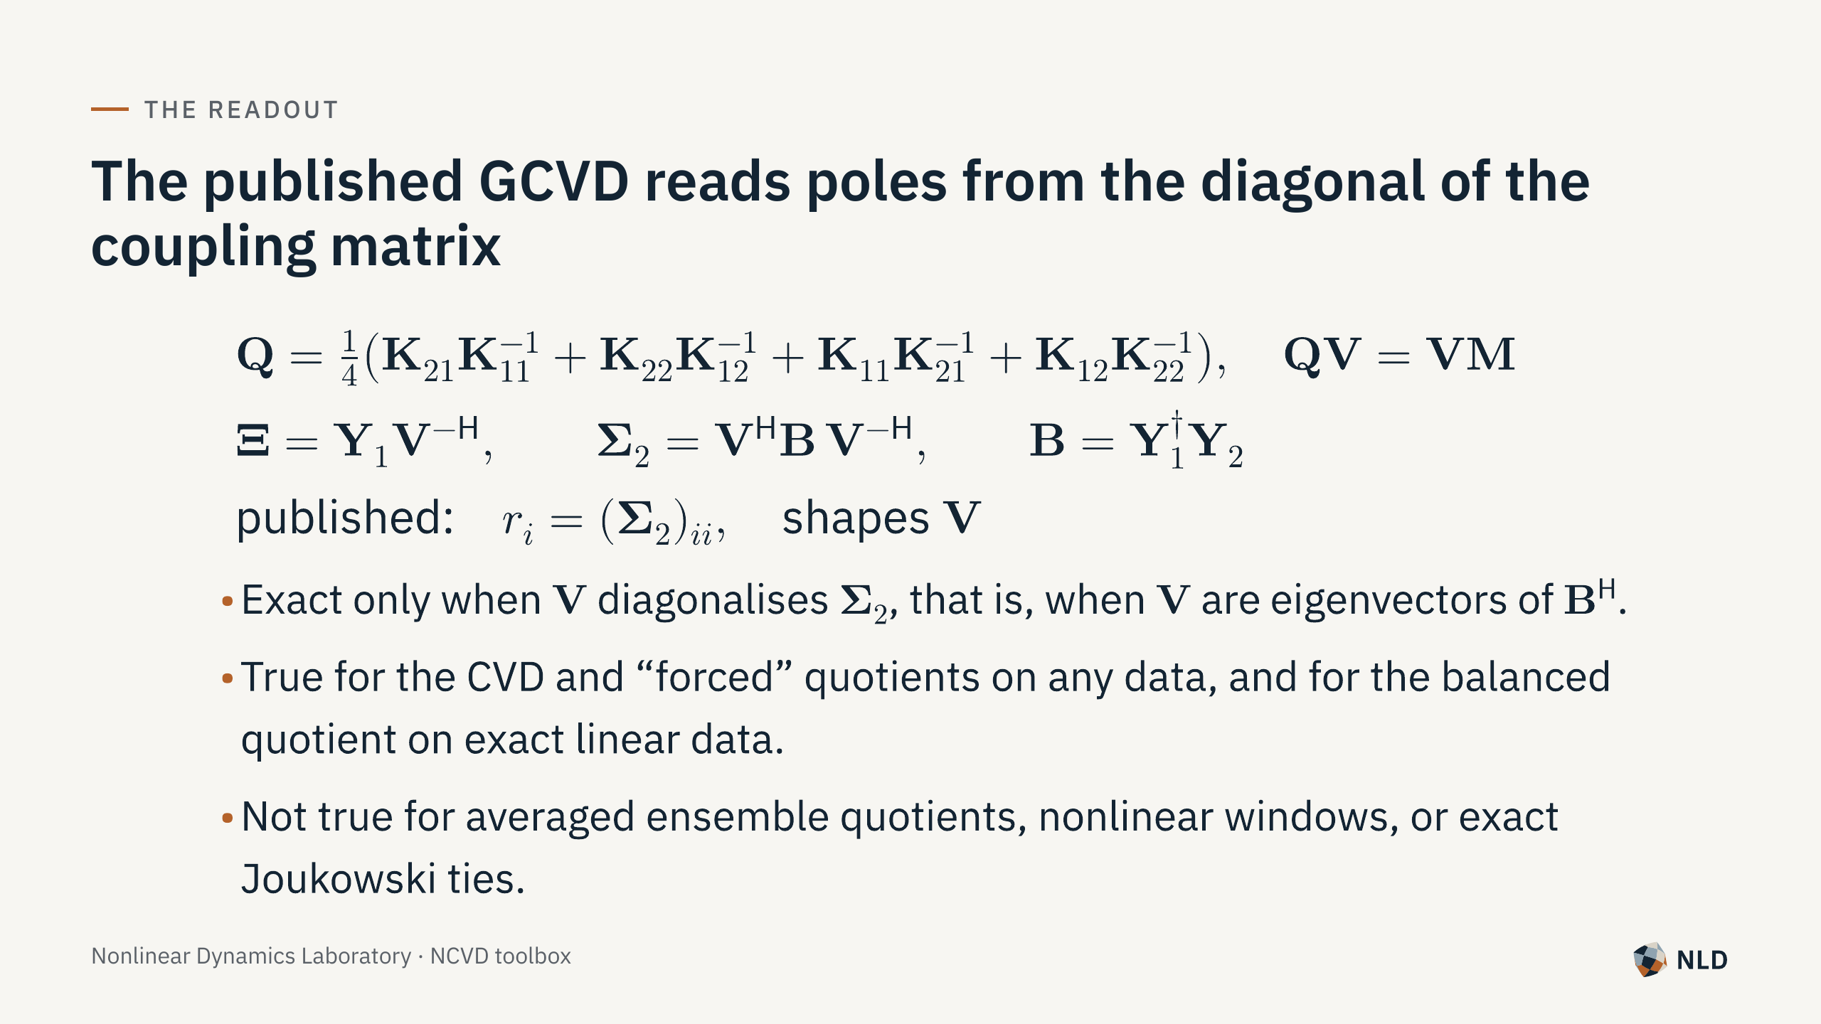
Notes:
Li, Stein and Chelidze, MSSP 222 (2025) 111769, Algorithm 1 and Eqs. 13-14.

Slide 7
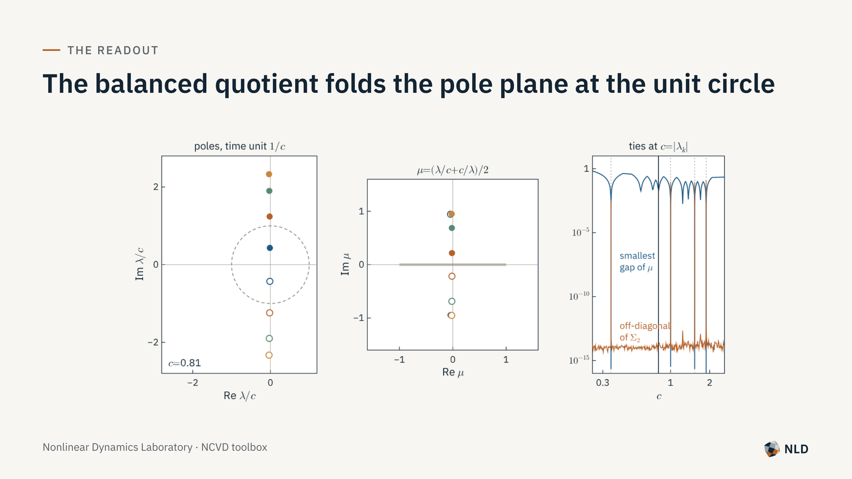
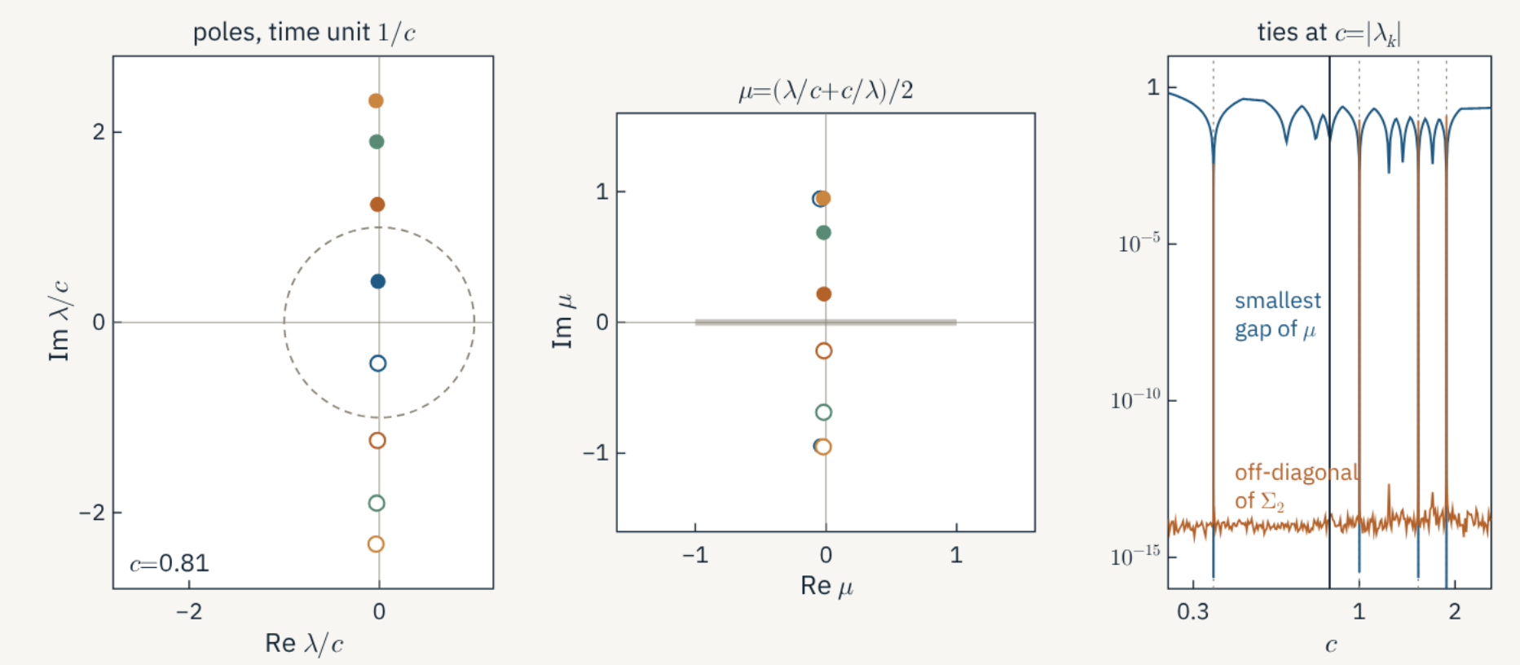
Notes:
For exact linear data Q = (A + A^-1)/2, so mu = (lambda + 1/lambda)/2: a Joukowski map, one-to-one only on one side of the unit circle. Rescaling time by c moves the poles; when a pole crosses |lambda/c| = 1 it meets its conjugate and V is undetermined. The off-diagonal of Sigma_2 spikes exactly at c = |lambda_k|. time_scale=auto places all poles at modulus >= 2.

Slide 8
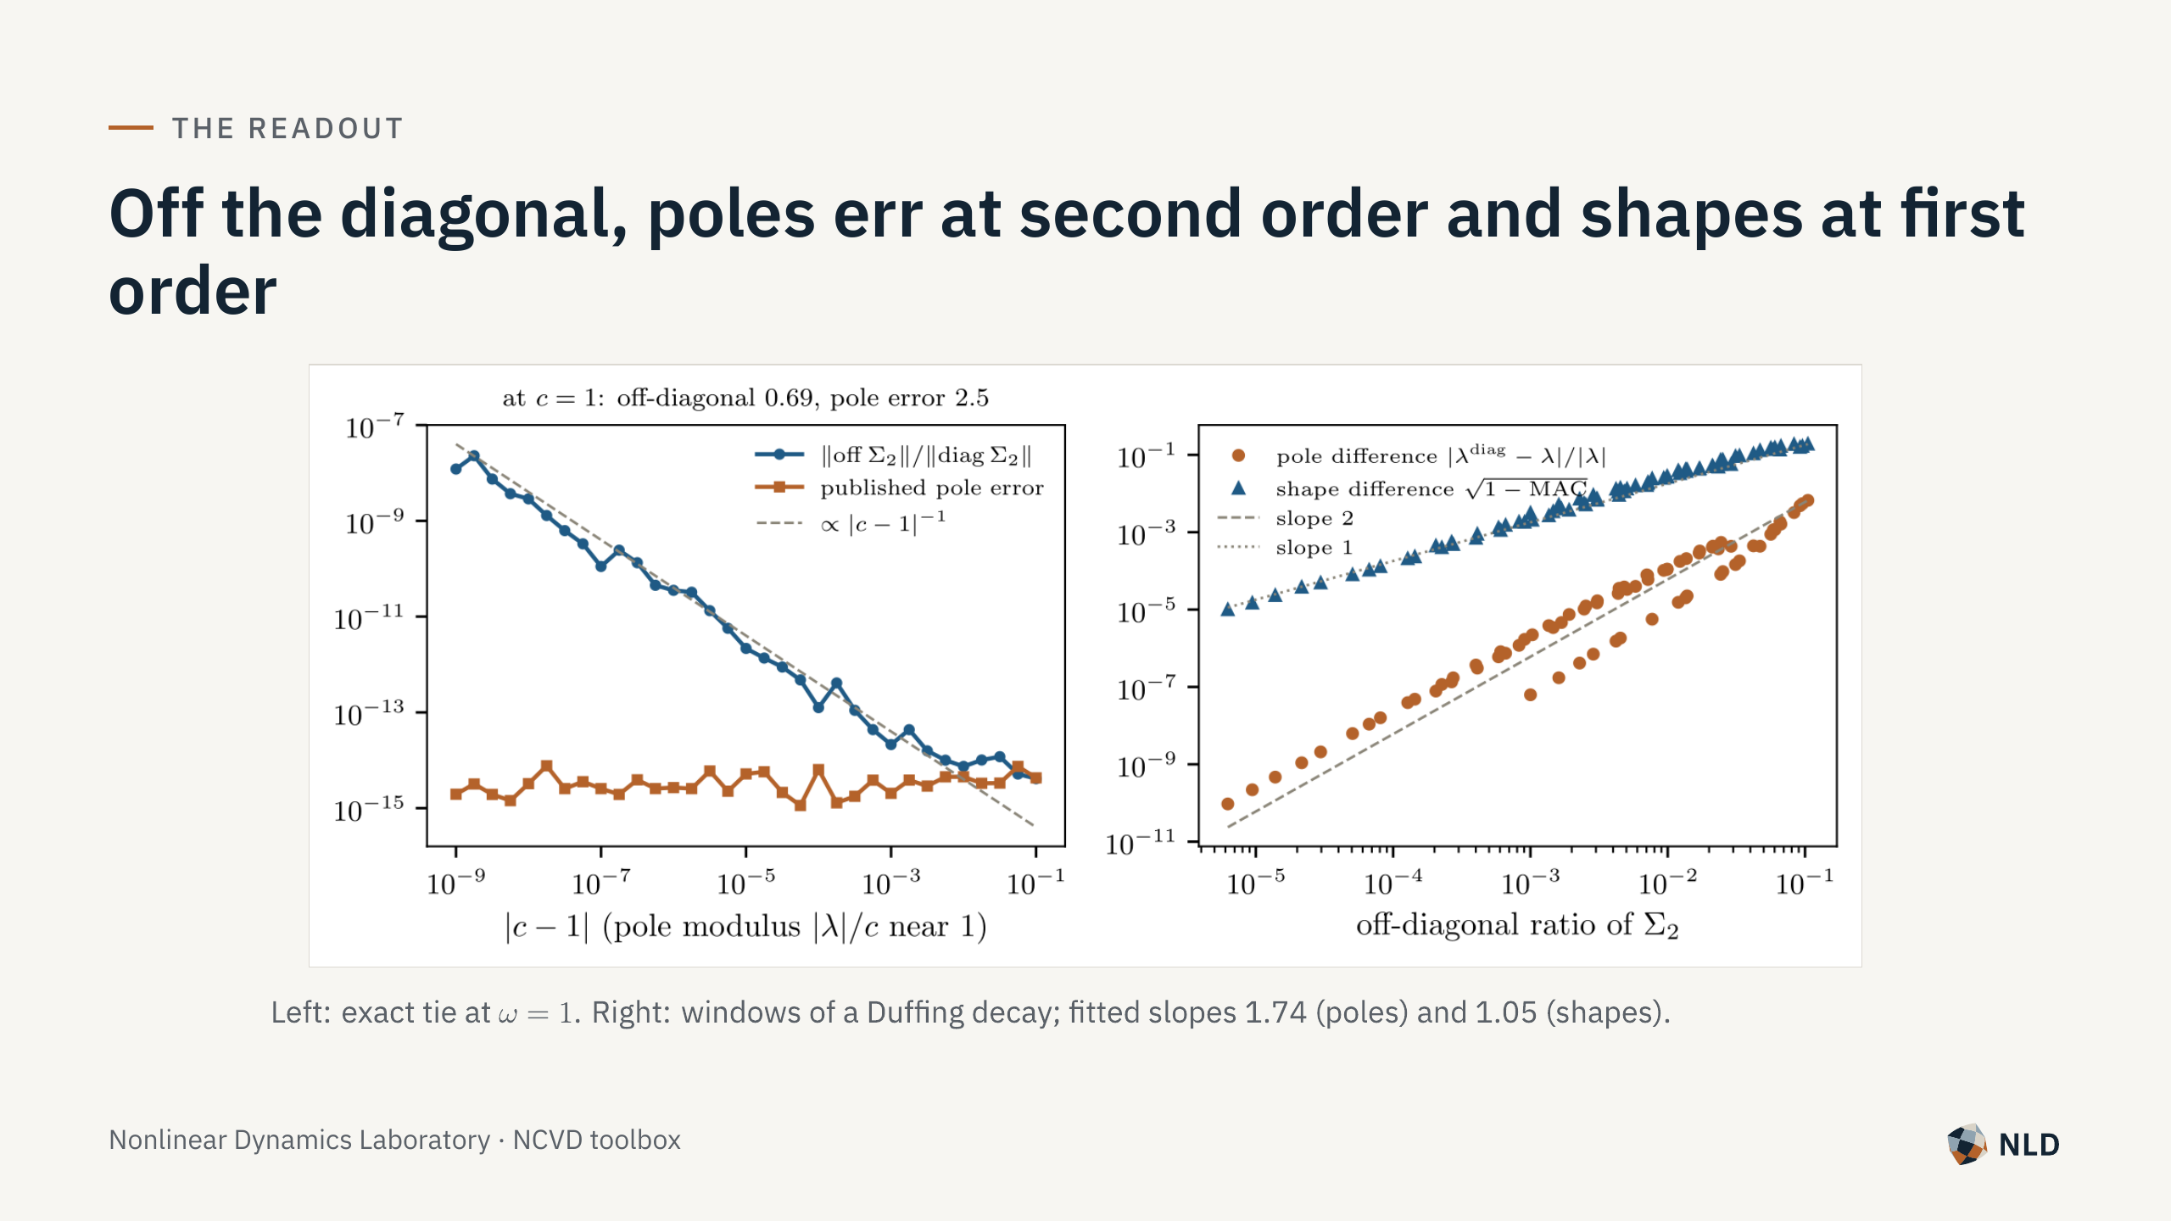
Notes:
Left: exact tie, omega = 1, published pole error 2.5 at c = 1, machine precision at |c-1| = 1e-4. Right: windows of a Duffing decay; fitted slopes 1.74 (poles) and 1.05 (shapes). Shape-derived ROM quantities inherit the first-order change.

Slide 9
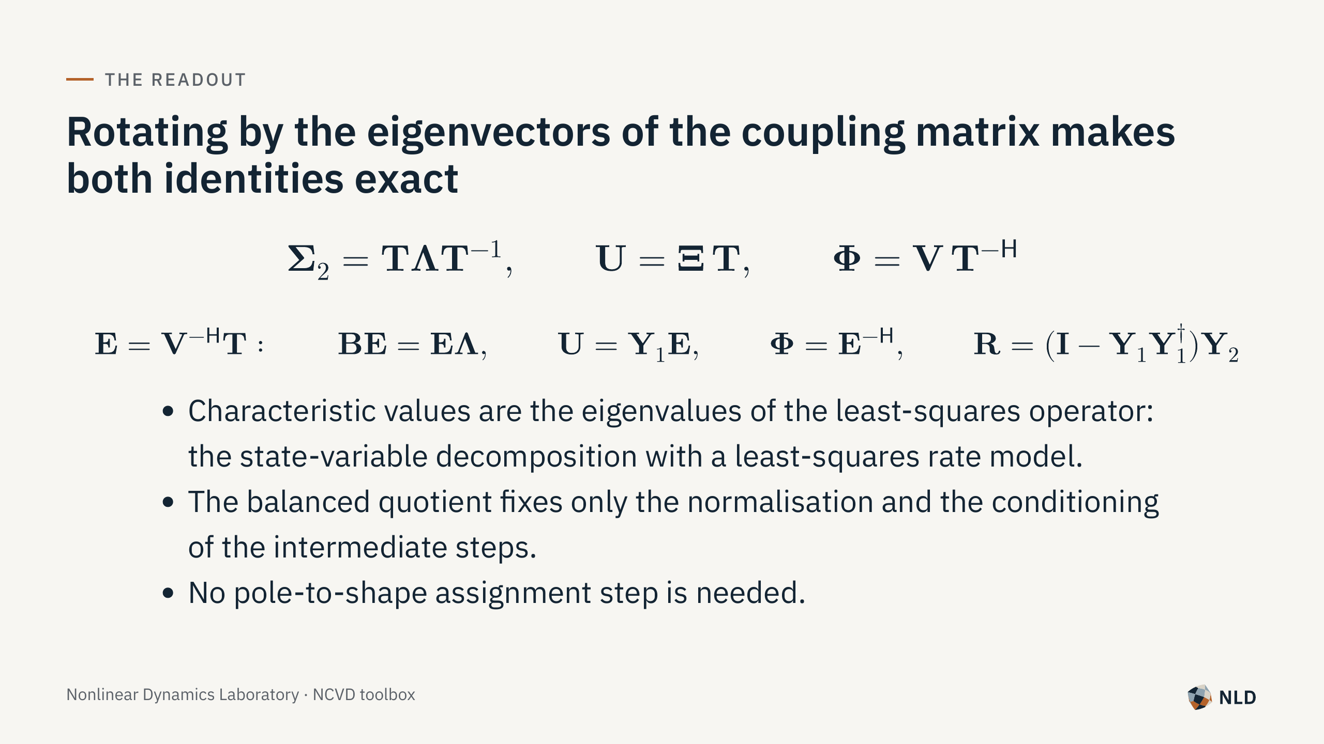
Notes:
Proposition 1 of the manual. With the default LS operator the canonical poles are least-squares poles; the contribution is the exactness analysis and the toolset around it.

Slide 10

Notes:
Derivative stencils, sensor noise, measured forcing and ensembles of records.

Slide 11
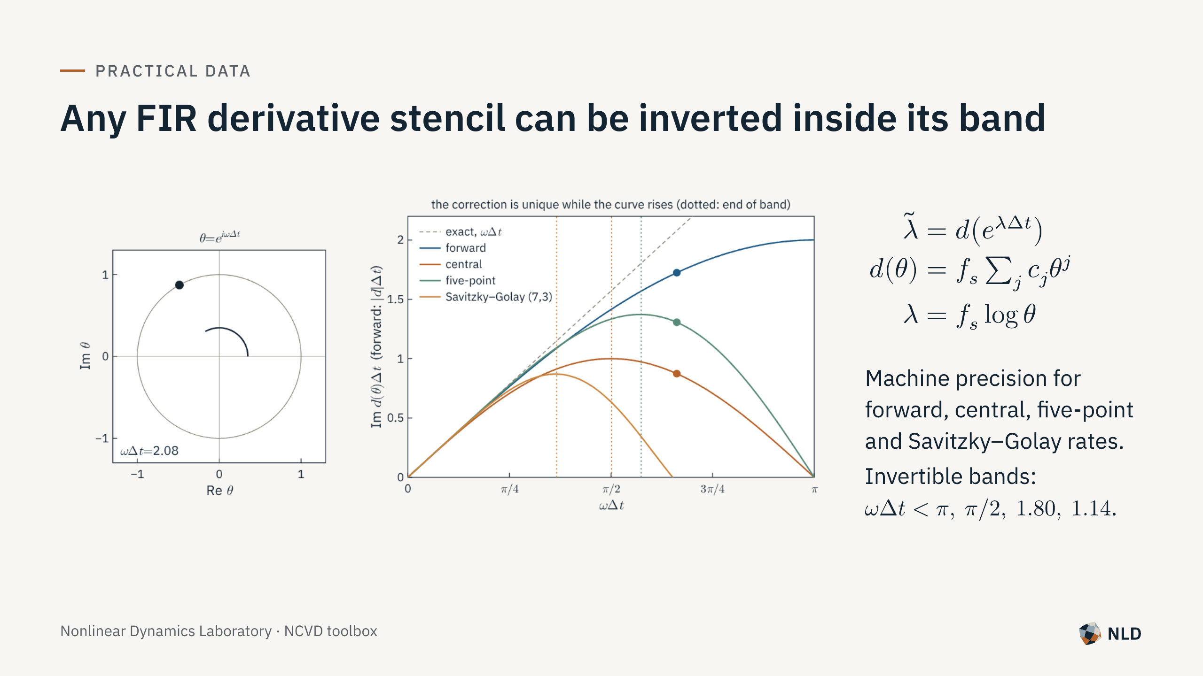
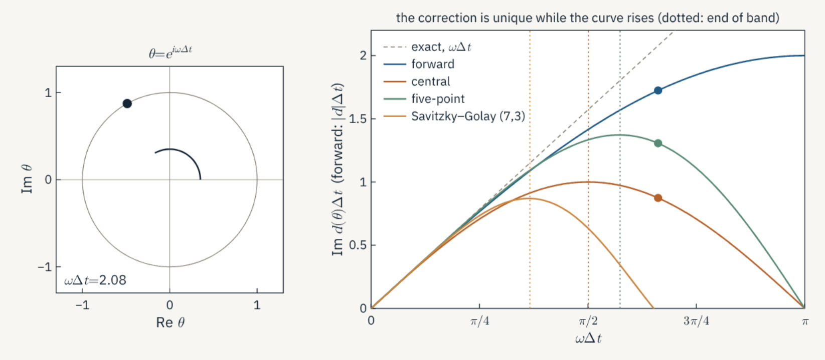
Notes:
With X1 = [q, Dq], X2 = [Dq, DDq] and one stencil D, a linear record satisfies X2 = X1 A~^T exactly with eigenvalues d(theta). correct_poles solves d(theta) = lambda~ and keeps the lowest-frequency root. Forward difference reproduces Eq. 48 of the paper. Central-type stencils turn over, so the inversion is unique only inside the band.

Slide 12
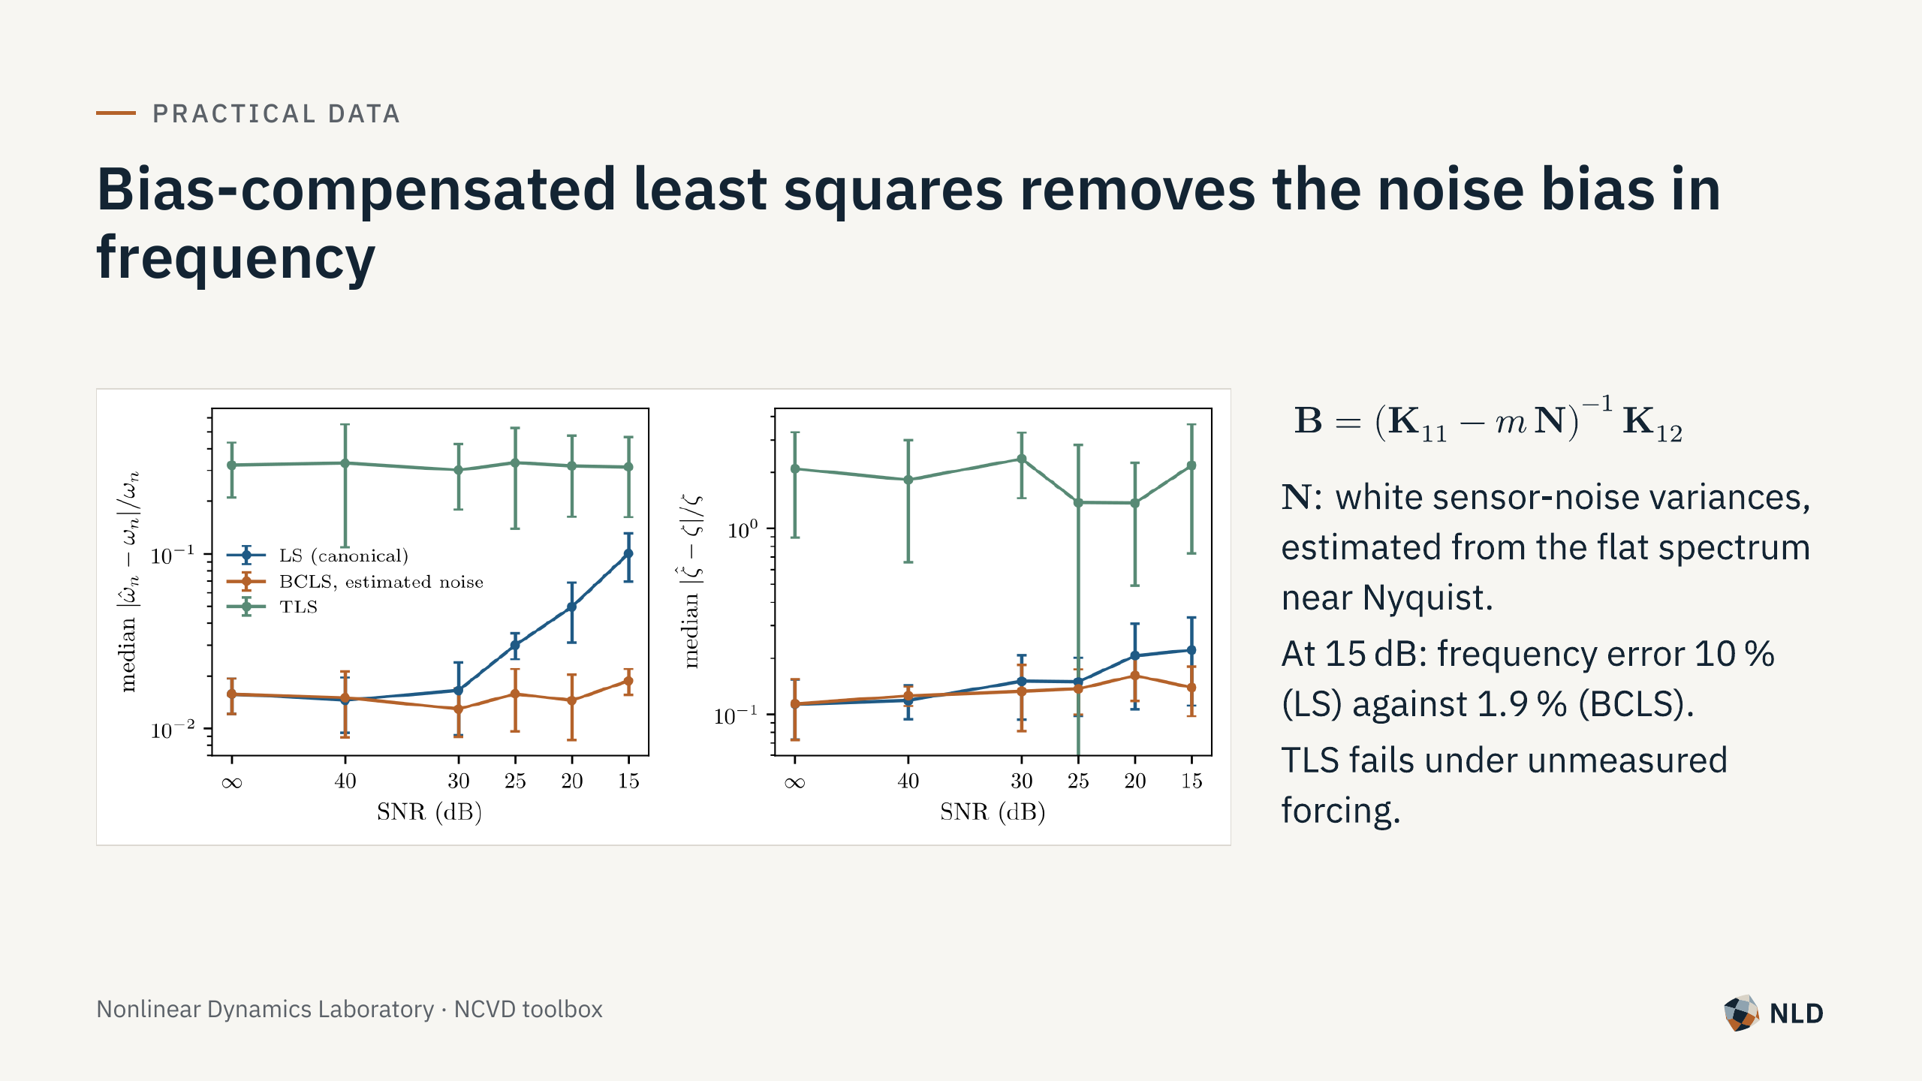
Notes:
10-DOF chain of the paper under white forcing at every mass, 200 Hz, 150 s, independent noise on every channel, 10 records per SNR. Remaining damping error (11-16 %) is the statistical error of a finite record under random forcing.

Slide 13
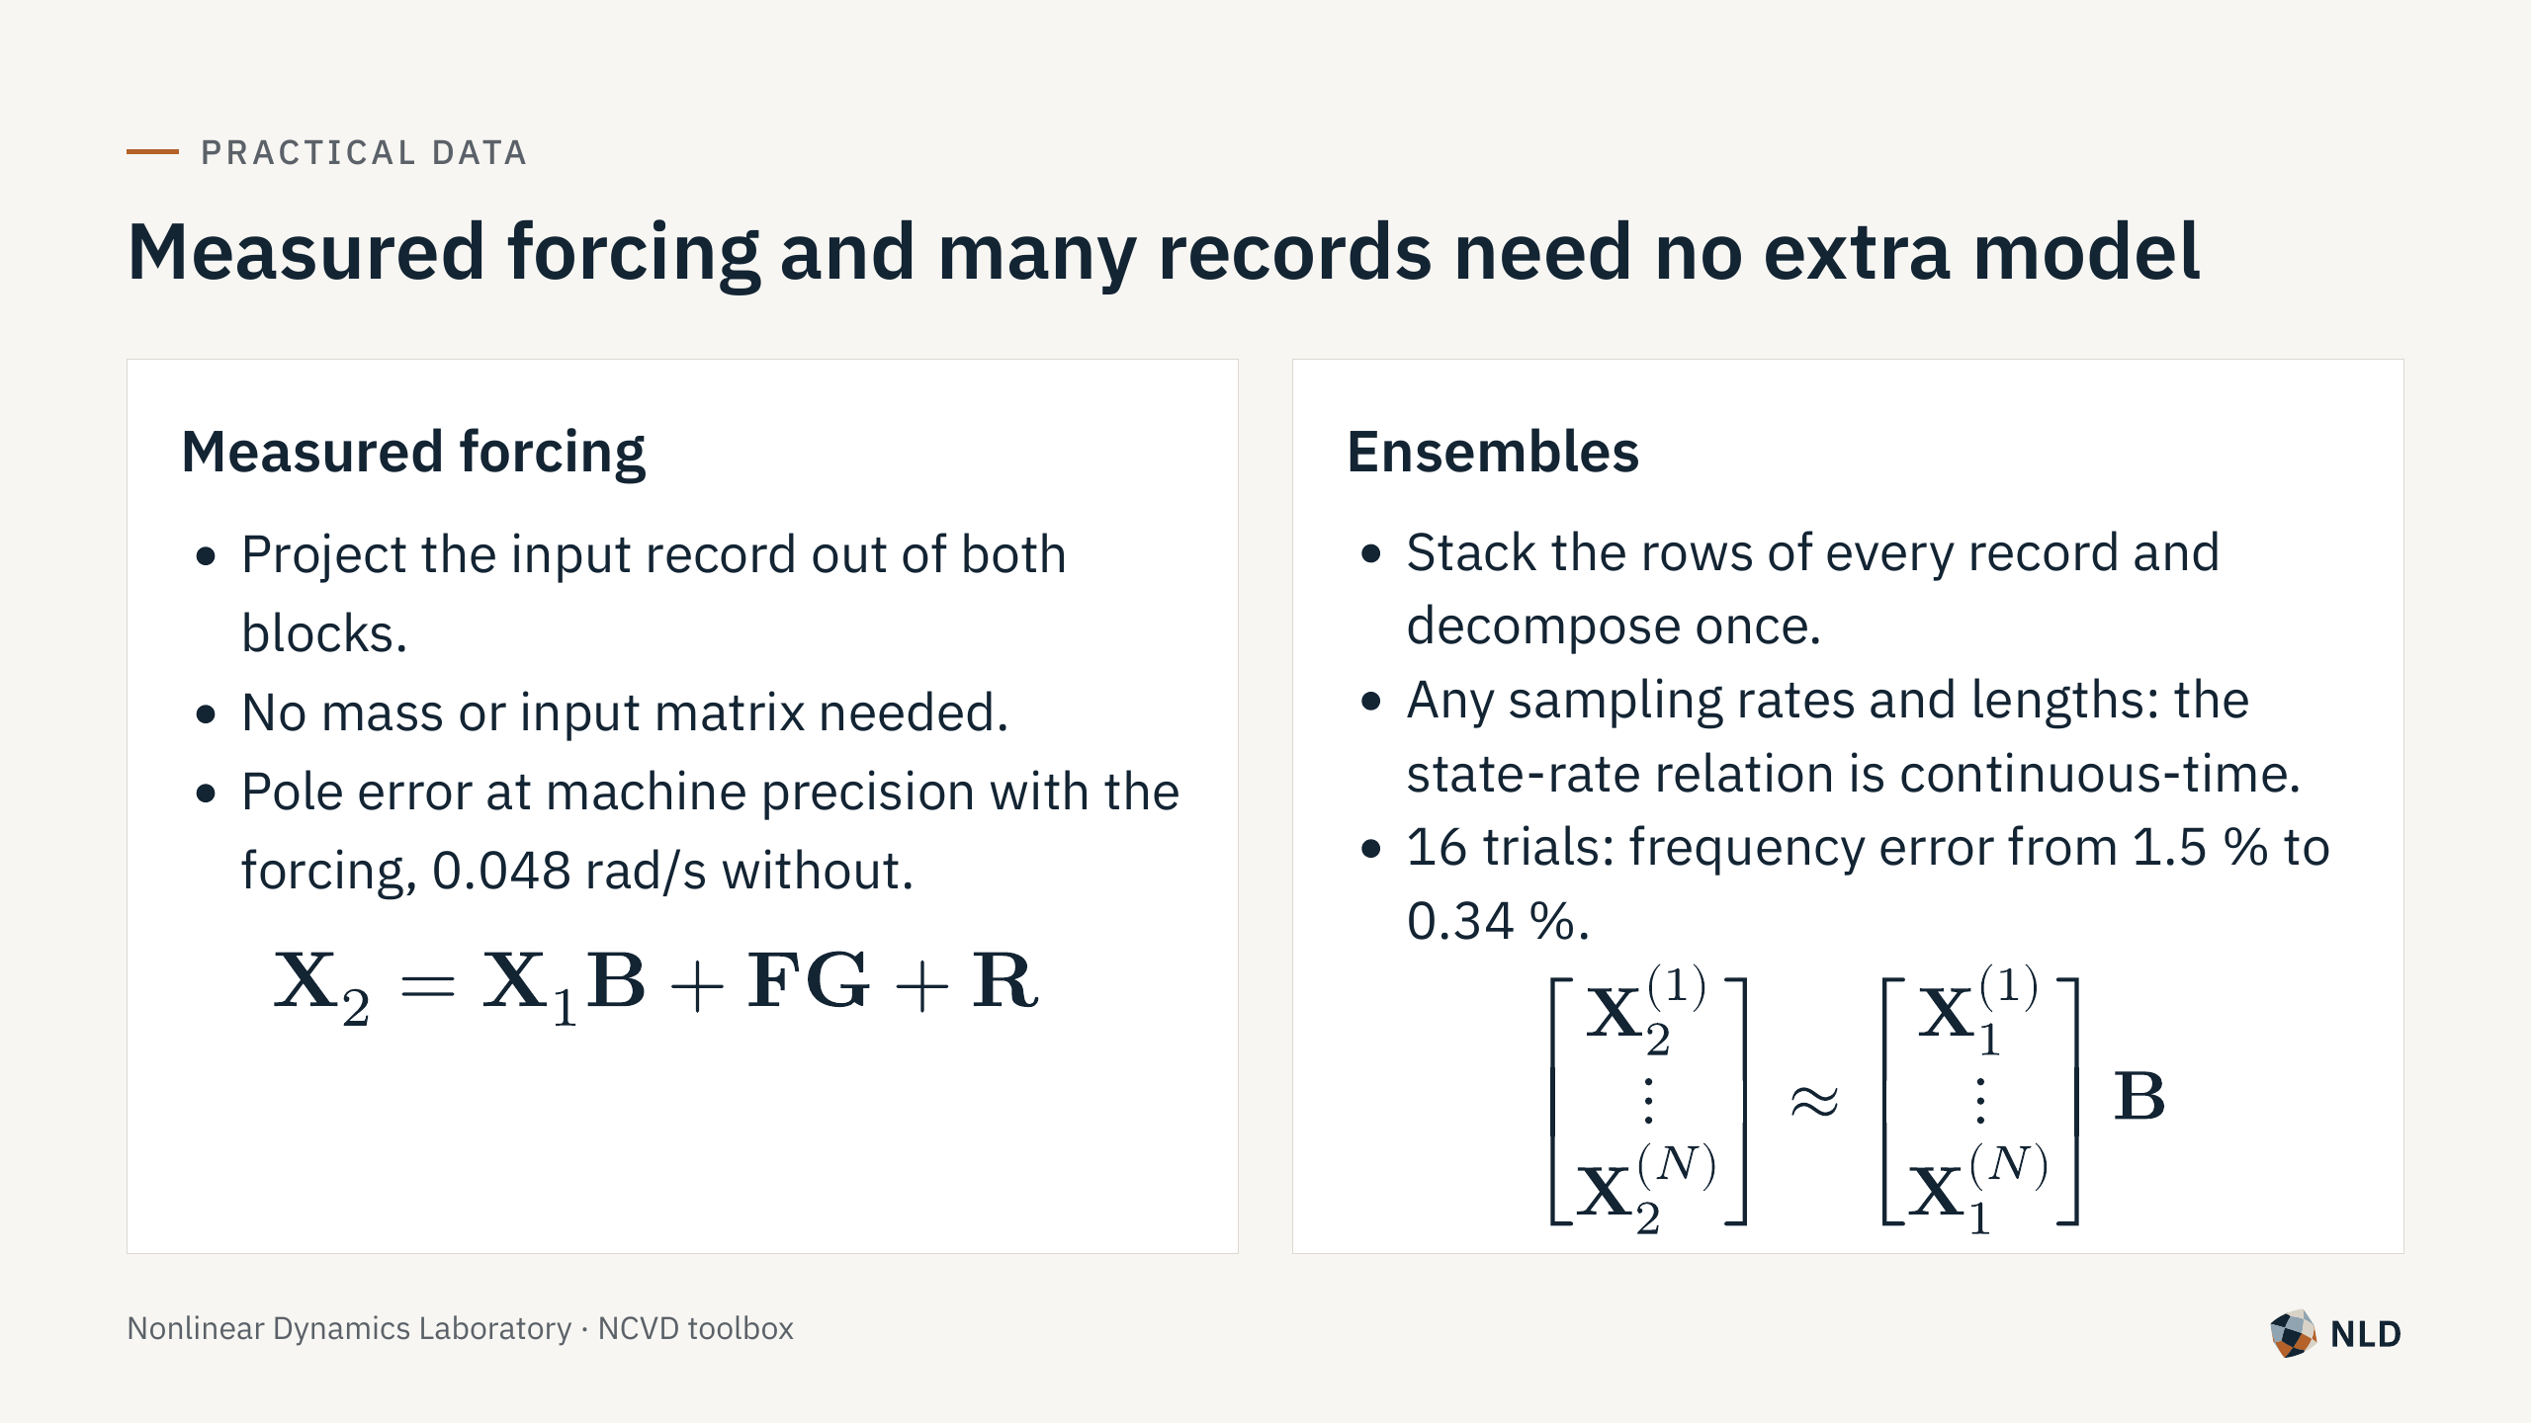
Notes:
Forcing: Frisch-Waugh projection, then the operator; gains returned as G. Ensemble: least-squares fusion replaces the quotient averaging of Eq. 59 and is exact for clean data. Weights: equal per record (default), per sample, or by SNR.

Slide 14

Notes:
Sliding windows along a nonlinear free decay, and what each window can and cannot tell you.

Slide 15
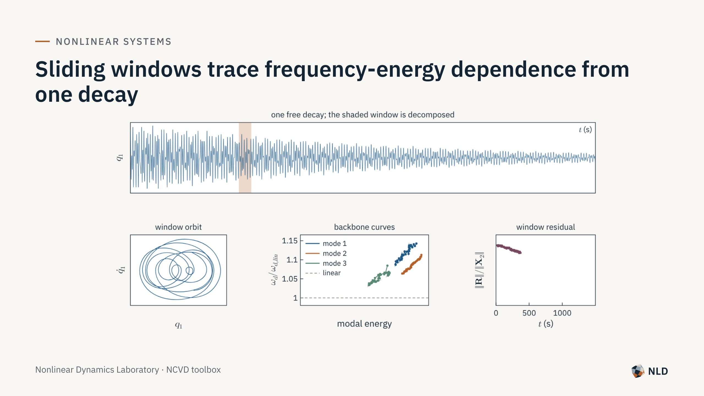
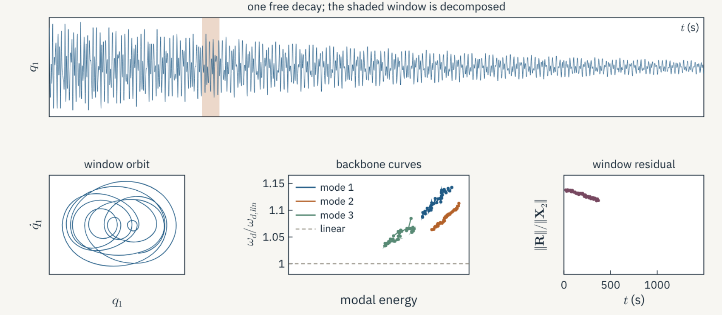
Notes:
Duffing chain, cubic spring grounding mass 1, damping 0.003 M, 1500 s decay, 40 s windows every 10 s. All three backbones converge to the linear frequencies (0.770/0.765, 1.419/1.414, 1.850/1.848). Mode-1 poles agree with the measured response frequency to 1.5 %. The window residual falls with energy. The orbit panel is drawn from a 2.9 Hz copy of the record.

Slide 16
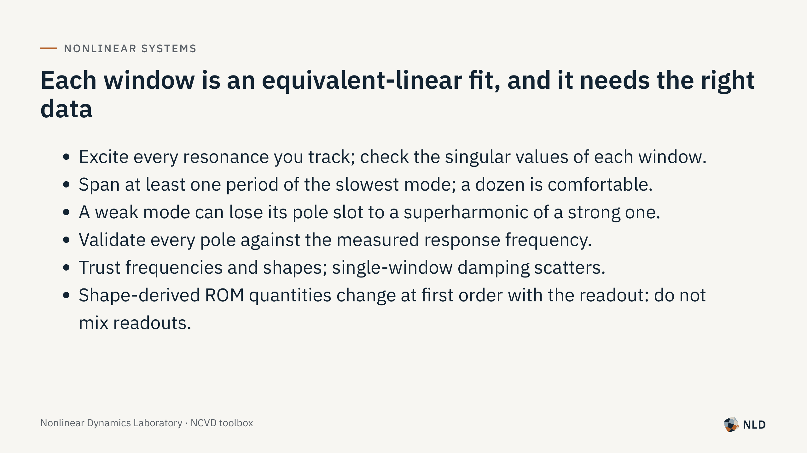
Notes:
See Section 4.2 of the manual.

Slide 17
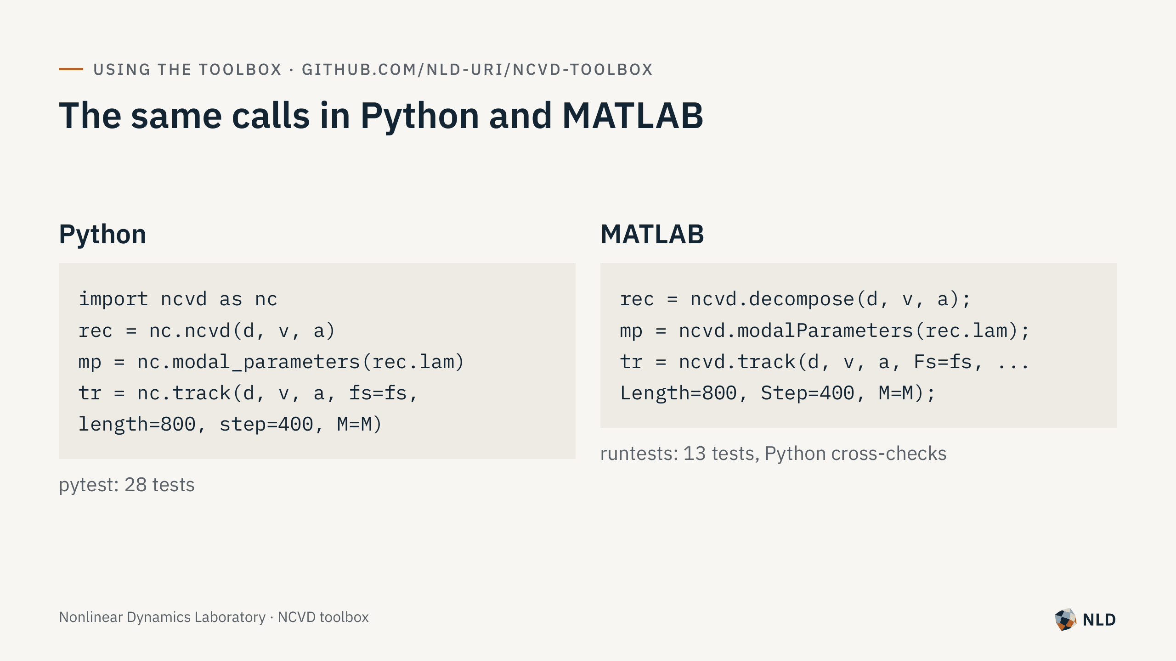
Notes:
Options: rank, center, operator (ls, tls, bcls), forcing, time_scale, weights, readout (eig or diag for benchmarking). Manual: docs/manual/NCVD_manual.pdf.

Slide 18

Notes:
Code, manual and these slides: github.com/nld-uri/ncvd-toolbox. Project page: web.uri.edu/nld/ncvd-toolbox.

