Slide 1
Why vibrations matter for mechanical engineers
David Chelidze · University of Rhode Island

Slide 2
Linear modal analysis fails when frequency depends on amplitude
BACKGROUND
Natural frequencies shift with vibration energy
Mode shapes bend along invariant manifolds
Superposition no longer holds

Slide 3
Nonlinear normal modes
02

Slide 4
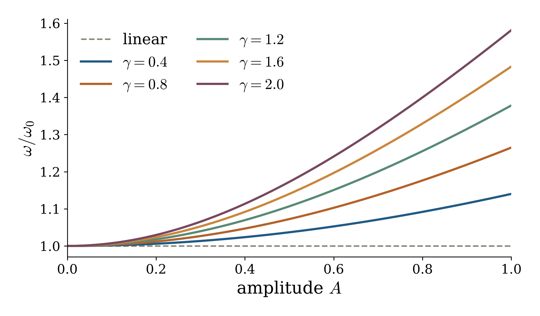
Stiffening shifts the backbone curve upward
RESULTS
Larger γ, stronger hardening. The dashed line is the linear natural frequency. Illustrative Duffing curves, not measured data.

Slide 5
Native charts pick up the figure palette from the theme
NATIVE CHART
Illustrative curves, not data.

Slide 6
Experiment and model answer different questions
METHODS
Experiment
Phase resonance testing traces the backbone curve directly
Free decay gives frequency-energy dependence
Model
Continuation computes nonlinear normal modes
Reduced-order models predict forced response

Slide 7
Questions
web.uri.edu/nld · chelidze@uri.edu

