Slide 1






Slide 2





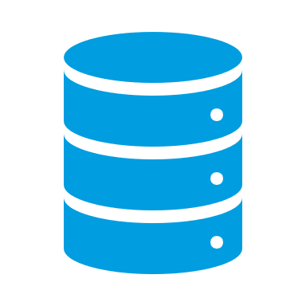

local PC
Rstudio
GWDG cloud server Rstudio server
GWDG HPC
R console
Submit jobs via future/clustermq
store to disk
data exchange via network drives (inputs, model, outputs)

Slide 3
local PC
Rstudio
GWDG cloud server Rstudio server
GWDG HPC
R console
git repo
Submit jobs via future/clustermq
store to disk
data exchange via SSH (inputs, model, outputs)

Slide 4
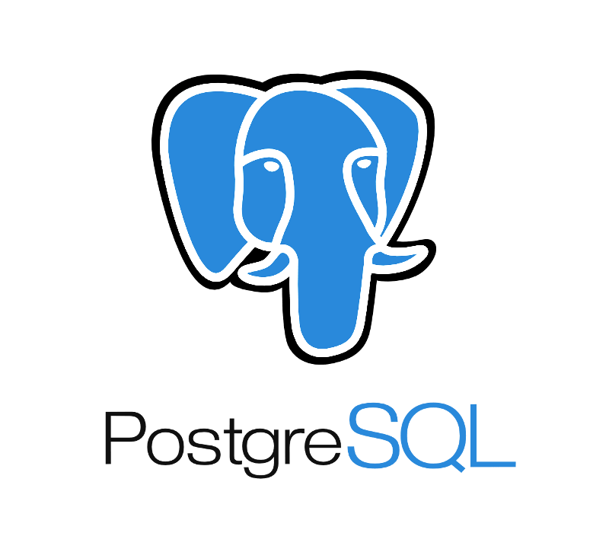
local PC
Rstudio
GWDG cloud server Rstudio server
GWDG HPC
R console
git repo
Submit jobs via future/clustermq
data exchange via SSH (inputs, model)

