Slide 1
PROJECT HANDOFF
The Programming Workstation
What it does, how it's built, and where to pick up.
Nate Lehnhof · August 4, 2026

Slide 2
PART 1 OF 4
What It Does
The problem, the fix, and what an operator sees.
2

Slide 3
THE PROBLEM
Every gate router used to be set up by hand
Airport jet bridges each have a small router that controls the gate equipment. Before one can be installed, someone must load the right firmware onto it, give it the right network address for that specific gate, test that it works, and print a label — and there are hundreds of gates.
~30 min
per router, done manually
Hundreds
of gates across every airport deployment
Manual, repetitive, and easy to get wrong — a mistyped IP or a skipped step doesn't show up until the gate is live.
Programming Workstation — Handoff
3

Slide 4
THE SOLUTION
This app does it in about 7 minutes
The same way, every time — and it writes down what happened.
BEFORE
AFTER
Manual setup
Programming Workstation
~30 minutes of manual steps per router
Column position in Excel decides what gets read/written
No consistent record of what happened, or why a run failed
~7 minutes, guided, same steps every run
Spreadsheet columns resolved by header name — reordering can't misdirect a write
Every run stamps the sheet: black timestamp on success, red on failure, with a linked crash log
Programming Workstation — Handoff
4

Slide 5
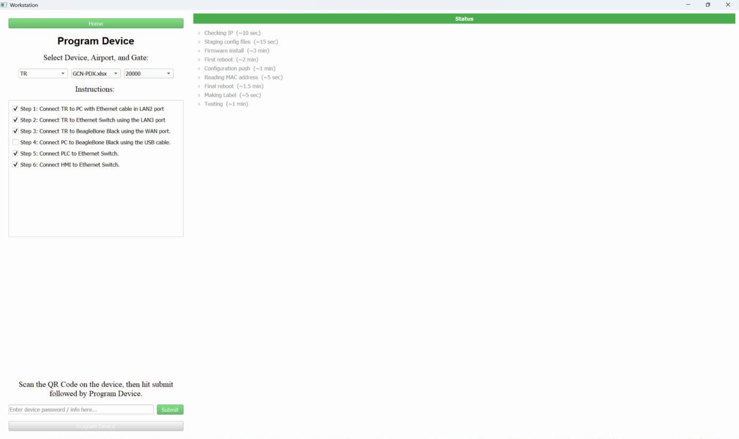
THE OPERATOR'S VIEW
Four steps, then the app takes over
1
2
3
4
→
→
→
Plug in the router
Pick the gate
Scan the QR code
Press “Program Device”
Per the wiring diagram or by following the instructions dialog
From a dropdown, sourced from the airport's spreadsheet (also selected)
On the router — extracts its temporary password
And watch the live checklist
Then a live checklist ticks itself off — green PASS, red FAIL — while the background thread does the work:
Programming Workstation — Handoff
5

Slide 6
TWO DEVICE TYPES, TODAY
Two routers, same job, one shared codebase
Digi IX20
Teltonika RUTX08
Folder
devices/digiIX20/
devices/TR/
Live checklist
Yes — 9 steps
Yes — 9 steps
Resumes after failure
Yes — picks up where it left off
No — needs a factory reset
Built on shared toolbox
Fully
Fully
The only real remaining difference is recovery. Everything else — spreadsheet access, SSH, waits, reporting — is one shared layer.
Programming Workstation — Handoff
6

Slide 7
THE SYSTEM OF RECORD
The spreadsheet is the record
One row per gate. The app reads the left side to know what to do and writes the right side to record what it did.
APP READS
APP WRITES
Gate number (PBB SN)
Gate IP, netmask, gateway
Serial number, part number
MAC address
Programmed-on timestamp — black = success, red = failure
Label + Crash Report hyperlinks
PRG # / Test # attempt counters
Columns are found by their header text, not by counting across — a column inserted anywhere no longer misdirects a read or write.
Programming Workstation — Handoff
7

Slide 8
PART 2 OF 4
Under the Hood
How the app is built, one layer at a time.
8

Slide 9
ARCHITECTURE, IN PLAIN LANGUAGE
Four layers, each talking only to the one below it
The screens
What the operator sees and clicks — four pages in a QStackedWidget.
A
pages/
The device folder
Everything specific to one router — its settings, software, spreadsheets, instructions.
B
devices/TR/, devices/digiIX20/
The toolbox
The shared, tested layer every device needs: spreadsheets, SSH, waits, reporting.
C
resources/utilities/
The registry
The short list of which devices this workstation knows about.
D
core/
Programming Workstation — Handoff
9

Slide 10
THE MOST IMPORTANT IDEA IN THE WHOLE APP
“A device is a folder,
not a piece of code.”
To teach the workstation a new router, you don't write a new program — you drop in a folder containing that router's software and settings, and register it. There is no base class to subclass; devices/ is the whole extension mechanism, and it works even in the packaged .exe.
10

Slide 11
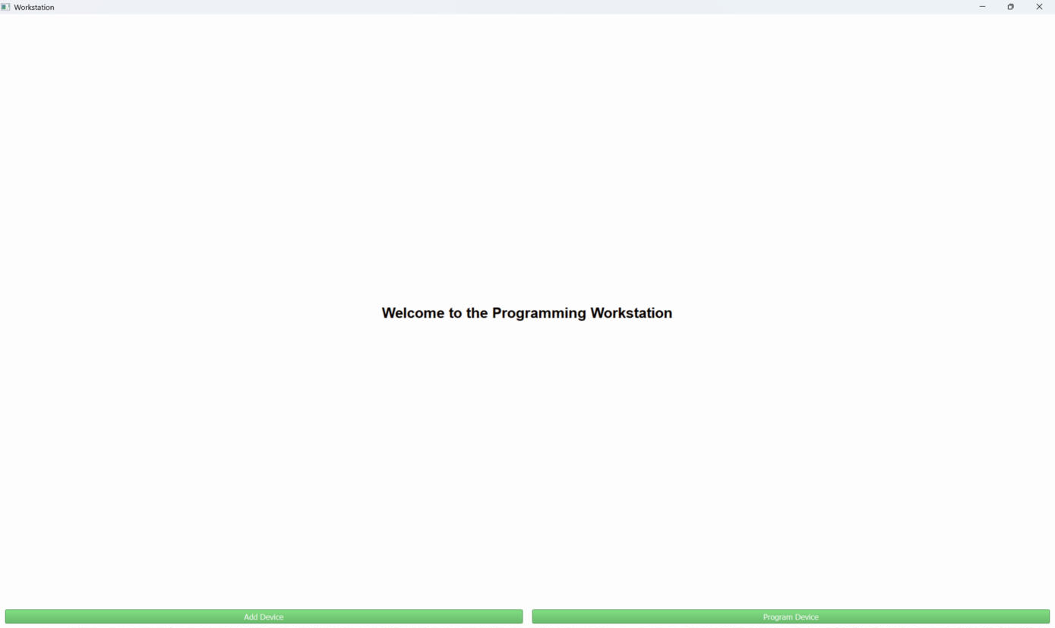
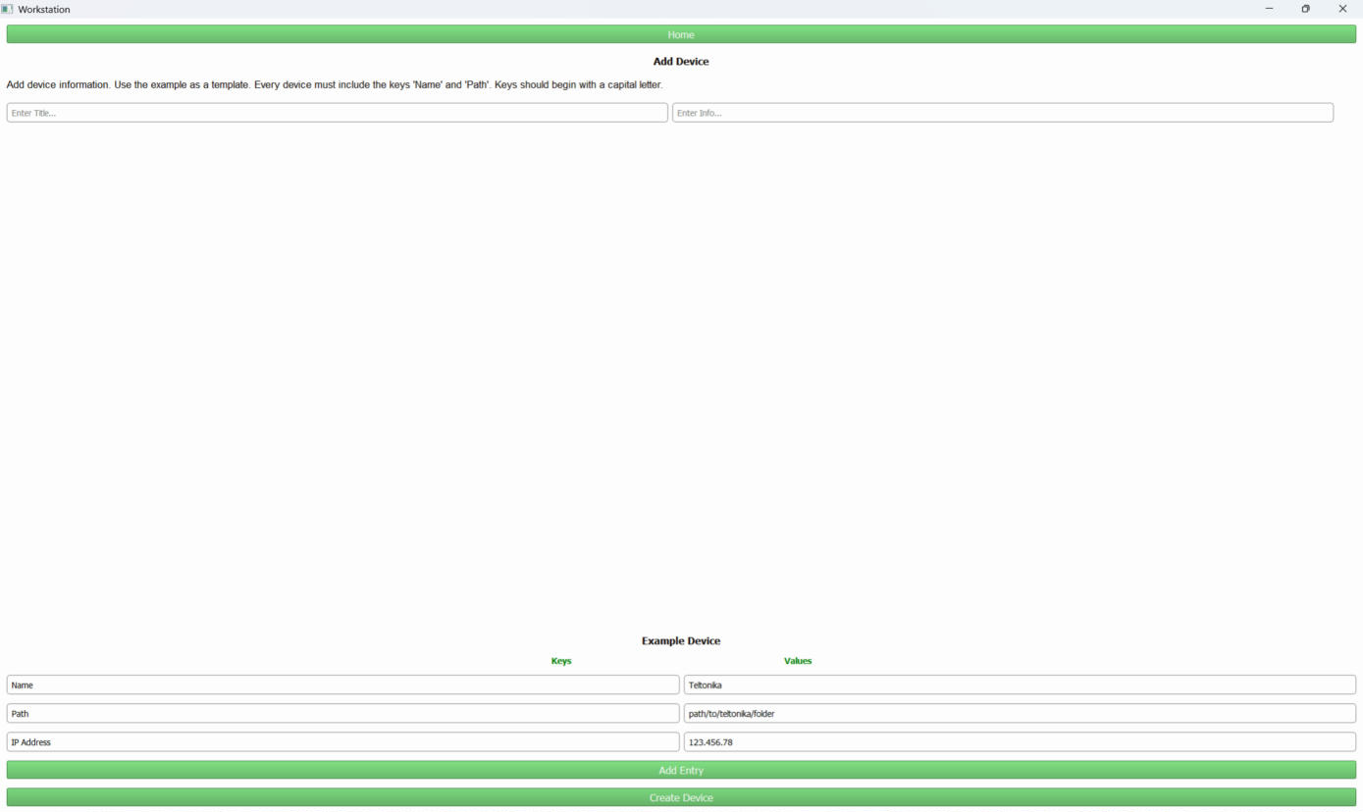

A QUICK TOUR
Home → Add Device → Program Device
Home
Add Device
Program Device
One QStackedWidget holds all four pages at fixed indices; navigation is just switching which one is visible — there's no router or history stack.
Note: “Program Device” stays disabled until every cabling checkbox from that device's instructions.txt is ticked — the pre-flight gate.
Programming Workstation — Handoff
11

Slide 12
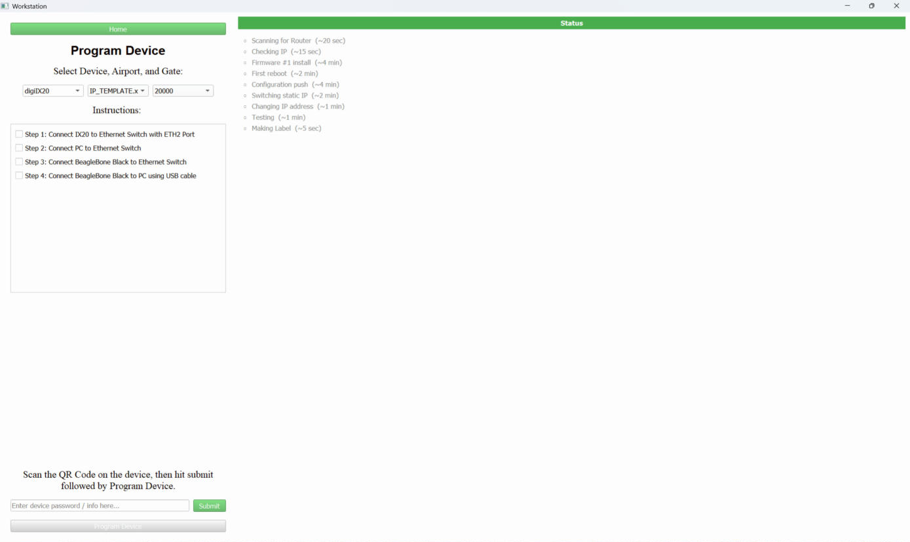
SIDE BY SIDE
Same shared layer, two different checklists
Teltonika RUTX08 — 9 milestones (Checking IP → Testing)
Digi IX20 — 9 milestones (Scanning → Making Label)
Row labels come from each device's own checklist.json — a device without one simply gets an empty panel.
Programming Workstation — Handoff
12

Slide 13
THE CORE FLOW
What happens when you press the button
1
Look up the gate
TWO RULES, DELIBERATE
Read the spreadsheet for the gate's network address. If it's wrong or missing, stop here — before touching any hardware.
A failed run gets a red timestamp — and no label.
Run the router's setup script
A printable label for a router that didn't program is worse than none — someone could stick it on a broken unit.
2
Firmware → config push → reboot → change address → test. Reports back after each step — this is what drives the live checklist.
A failed run still gets written down.
Write down what happened
The red timestamp and crash-log link are how a failure gets noticed later — nothing fails silently.
3
Stamp the spreadsheet row, save a label on success, save a crash log on failure.
Programming Workstation — Handoff
13

Slide 14
PART 3 OF 4
Developer Deep Dive
Where the code lives, and how it's stitched together.
14

Slide 15
FOR THE INCOMING ENGINEER
Architecture map
pages/
core/
devices/{NAME}/
PyQt5 UI — QStackedWidget, ProgramWorker (QThread), status_panel, global error handler
DeviceManager — the module-level device registry, backed by core/devices.json
prog_dev.py (orchestration) + hardware script + config/checklist JSON — a folder, not a class
↓
↓
↓
resources/utilities/
excel_utils · status · reporting · ssh_session · wait_utils · templating · device_config · mac_utils · app_paths — the shared, tested layer both devices build on
Devices are folders discovered lazily through manager.names() / app_paths.registered_devices() — nothing is scanned or cached at import time.
Programming Workstation — Handoff
15

Slide 16
THE PART THAT SURPRISES PEOPLE
prog_dev.py is never imported — it's exec()'d
pages/program_page.py reads devices/{device}/prog_dev.py as text and runs exec(code, namespace) on a background QThread, then calls run_main_script(airport, gate, temp_pass, device) from that namespace.
1
No reliable __file__
Resolve every path from app_paths.device_dir(device) or app_root() — a relative path resolves against the app's working directory, not the device folder.
2
Module-level code runs on press
Before run_main_script is even called. Keep the top of the file to imports and constants only.
3
progress_callback is injected, not passed
Reach it with globals().get("progress_callback") and wrap it in status.forwarder(...), which tolerates its absence.
4
sys.exit() is treated as success
ProgramWorker.run catches SystemExit and emits finished_ok. Signal failure by raising — the worker turns any other exception into the failed signal, the log, and a dialog.
Programming Workstation — Handoff · pages/program_page.py
16

Slide 17
RESOURCES/UTILITIES/
The shared layer — covered by 83 tests
excel_utils.py
status.py
reporting.py
ssh_session.py
Header-name column resolution. lookup_excel() raises rather than returning blanks.
The ##STATUS## protocol, both ends — emitting and the watch_process() single-pass reader.
Crash log, spreadsheet stamp, label file. Red-on-failure, no label on failure — enforced here.
Pooled, lazy-connect SSHSession + ManagedShell context manager.
wait_utils.py
templating.py
device_config.json
app_paths.py
Completion-driven waits — port down/up, prompt-return — never a fixed sleep.
og_* → working-copy staging. Verifies by counting replacements, not by presence.
DEFAULTS → device_config.json → {PREFIX}_* env vars, three-tier precedence.
Where things are, from source or a packaged .exe. script_command() matters here.
Programming Workstation — Handoff
17

Slide 18
RECENT HISTORY WORTH KNOWING
The migration that got both devices here
943 → 364
353 → 104
44 / 6 / 2 → 83
lines in TR's prog_dev.py
lines in Digi's prog_dev.py
tests passing / failing / broken → all passing
What moved into the shared layer:
Three real bugs shipped with it: a double-read of stdout that made every TR run look like a success, a functional test that ran even after a failed program, and a leaked shell channel per call.
device_types/ was deleted outright — four files of working code that nothing ever instantiated. Devices are folders; that was always the real extension mechanism.
Programming Workstation — Handoff · commit e96074a
18

Slide 19
THE LARGEST REMAINING GAP
TR vs. Digi: the one real difference left
Digi IX20 — resumes
Teltonika RUTX08 — doesn't
digix20.py works out where the router currently is (resume_index()) and restarts at the right milestone. A failed attempt doesn't need a factory reset before the next try.
teltonika.py only has a coarse check_ip / AlreadyProgrammed check — “this gate is already done, skip everything.” A failure part-way through still means a factory reset before the next attempt.
Listed as a future action in INSTRUCTIONS.md — a good first project.
Programming Workstation — Handoff
19

Slide 20
PART 4 OF 4
Handoff
What's known, what's left, and where to look next.
20

Slide 21
OBSERVED IN CODE, NOT ASPIRATIONAL
Known limitations
Credentials are plaintext
JKC-SLC.xlsx is corrupt
core/devices.json and every device_config.json. Documented, deliberate — not an oversight.
devices/TR/JKC-SLC.xlsx isn't a valid .xlsx. Skipped gracefully; still needs replacing from a good copy.
TR can't resume a failed run
Trash-icon path is wrong
Coarse “already programmed” check only — see previous slide.
pages/add_device_page.py references utilities\\trash.jpg, which doesn't exist — the delete-row icon renders blank.
ConnectionPage is unreachable
subprocess.run is monkey-patched
Exists at index 3, but nothing navigates there — per-device cabling checkboxes do the hardware-verification job instead. OK for now. May not even use it.
error_log_page forces capture_output=True, check=True process-wide — including call sites that never asked for it.
Programming Workstation — Handoff · documentation/INSTRUCTIONS.md
21

Slide 22
EXTENDING THE APP
Adding a new device type — the contract
Nothing is enforced by an interface. Get one of these wrong and the failure is usually silent or misleading.
1
File is named exactly prog_dev.py
directly inside devices/{NAME}/
REFERENCE
devices/digiIX20/prog_dev.py
2
Defines run_main_script(airport, gate, temp_pass, device)
four positional params, in that order
104 lines. Copy this, not TR's — it's the thin, current example of orchestration on the shared layer.
3
instructions.txt has ≥ 1 non-blank line
no lines → no checkboxes → Program button never enables
4
Airport sheets are .xlsx with the standard header row
or the dropdown just comes back empty
Programming Workstation — Handoff · documentation/INSTRUCTIONS.md
22

Slide 23
DOCUMENTATION MAP
Where to look, depending on the question
Not a programmer, want the gist?
documentation/CHEAT_SHEET.md
Setting up a machine that's never run this?
documentation/SETUP.md
Using the app day to day?
documentation/INSTRUCTIONS.md
How the files fit together?
documentation/WORKFLOW.md
What a specific function does?
documentation/CODE_EXPLAIN.md
Working on the Teltonika specifically?
devices/TR/documentation/
Weird TR failure, seen it before?
devices/TR/debugging.md
Programming Workstation — Handoff
23

Slide 24
DAY ONE COMMANDS
Getting started
Run the app
./venv/Scripts/python.exe main.py
Windows will show a UAC prompt — the Digi flow needs admin rights to reconfigure this PC's network adapter.
Run the test suite
./venv/Scripts/python.exe -m pytest tests/
From the repo root, as a module — there's no conftest.py adding it to sys.path. All 83 tests should pass; a failure is a real regression.
Where things live
No linter/formatter config exists in this repo — don't invent style-check commands. venv/ is Python 3.13 with PyQt5, paramiko, openpyxl, ping3, pytest, pyinstaller.
Programming Workstation — Handoff · documentation/SETUP.md
24

Slide 25
HANDOFF COMPLETE
Over to you.
Both devices are fully migrated onto the shared layer, 83 tests pass, and the documentation set is current as of this commit. Start with the Cheat Sheet, keep the shared layer shared, and ping me with questions before Friday.
Nate Lehnhof · n.lehnhof01@gmail.com
25

